Slide 1
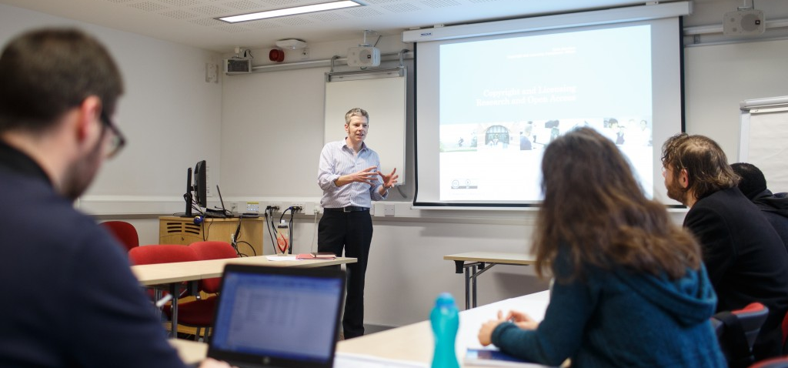
Chris Morrison: Copyright, Software Licensing and IS Policy Manager
The UK Scholarly Communications Licence
What it is, progress to date and what it means in practice
Notes:
CM to include slide(s). 1 or 2 at the absolute most.

Slide 2








Chris Morrison - Introduction
copyrightliteracy.org

Slide 3

the challenge
Many funder policies:
  Different compliance requirements
  Differently funded (or not)
Many different publisher policies
  Some publishers have different policies depending on who funds the researcher
HEFCE policy in particular, differs substantially from other policies and applies to all UK academics
Many publisher policies are not in line with HEFCE policy
Difficult to know what to do to comply both with Funder and HEFCE policies

Slide 4















Private
Public
Policy
Policy
UK Government
Researchers
Funding bodies
Commercial Publishers
Research Excellence
Universities

Slide 5
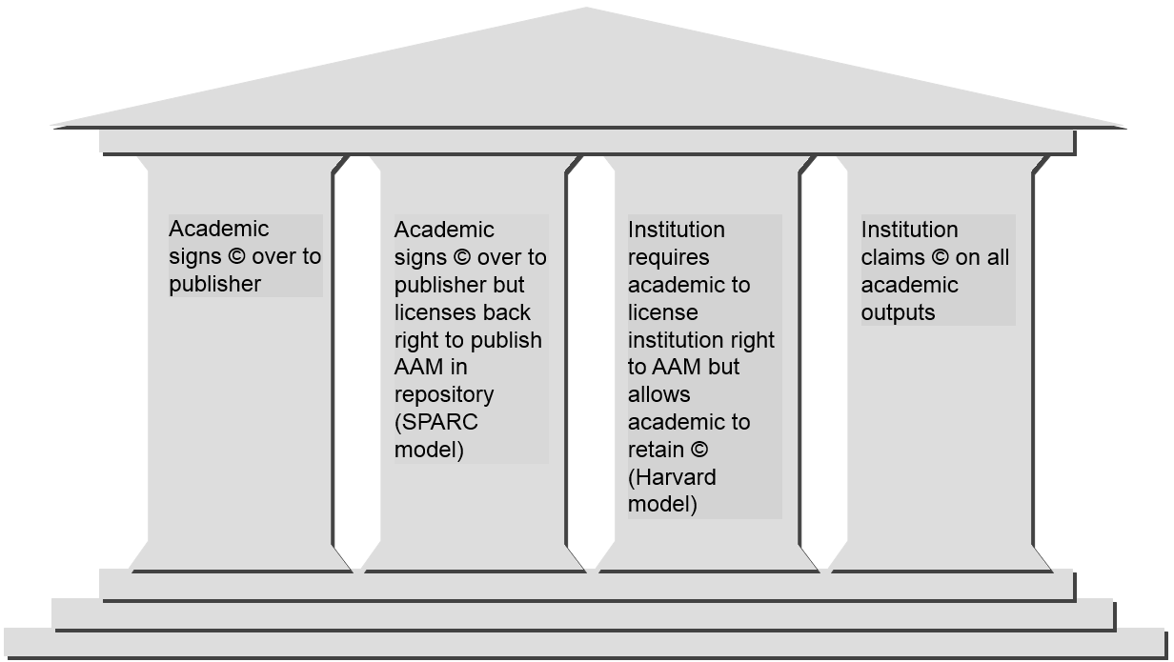
The options

Slide 6
The UK-SCL policy
Make accepted manuscripts of scholarly articles of its staff available online
  on or shortly after the date of first publication, be it online or in any other medium
  with a Creative Commons licence that allows non-commercial reuse as long as the authors are fully credited (CC BY NC 4.0)
Allow authors and publishers to request a temporary waiver for applying this right for up to 12 months for AHSS and 6 months for STEM (aligned to REF panels).

Slide 7
The UK-SCL policy
Where a paper is co-authored with external co-authors, the institution will:
  Automatically sub-license this right to all co-authors credited on the paper and to their host institutions.
  Not apply the licence if a co-author (who is not based at an institution with a UK-SCL-based model policy) objects.
  Honour waiver requests granted by other institutions which have adopted the UK-SCL model policy.
Where an output is available immediately on publication with a CC-BY licence, the accepted manuscript will remain on closed deposit.

Slide 8
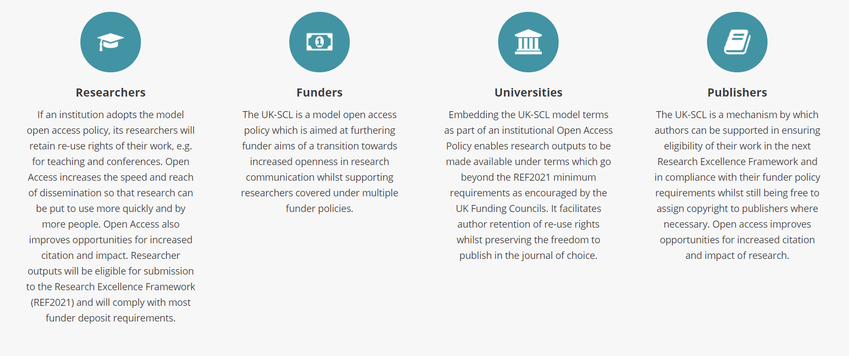
implications
http://ukscl.ac.uk/

Slide 9
Latest news
Website launched October 2017
A number of Russell Group institutions are ready to implement
Academic consultation underway within institutions
  Understanding sources of resistance
  Addressing misconceptions
Continued dialogue with publisher groups
Technical/Procedural aspects still under development
  Waiver now available at a publisher level – maximum 12 months
  Different options for co-authored papers

