Slide 1
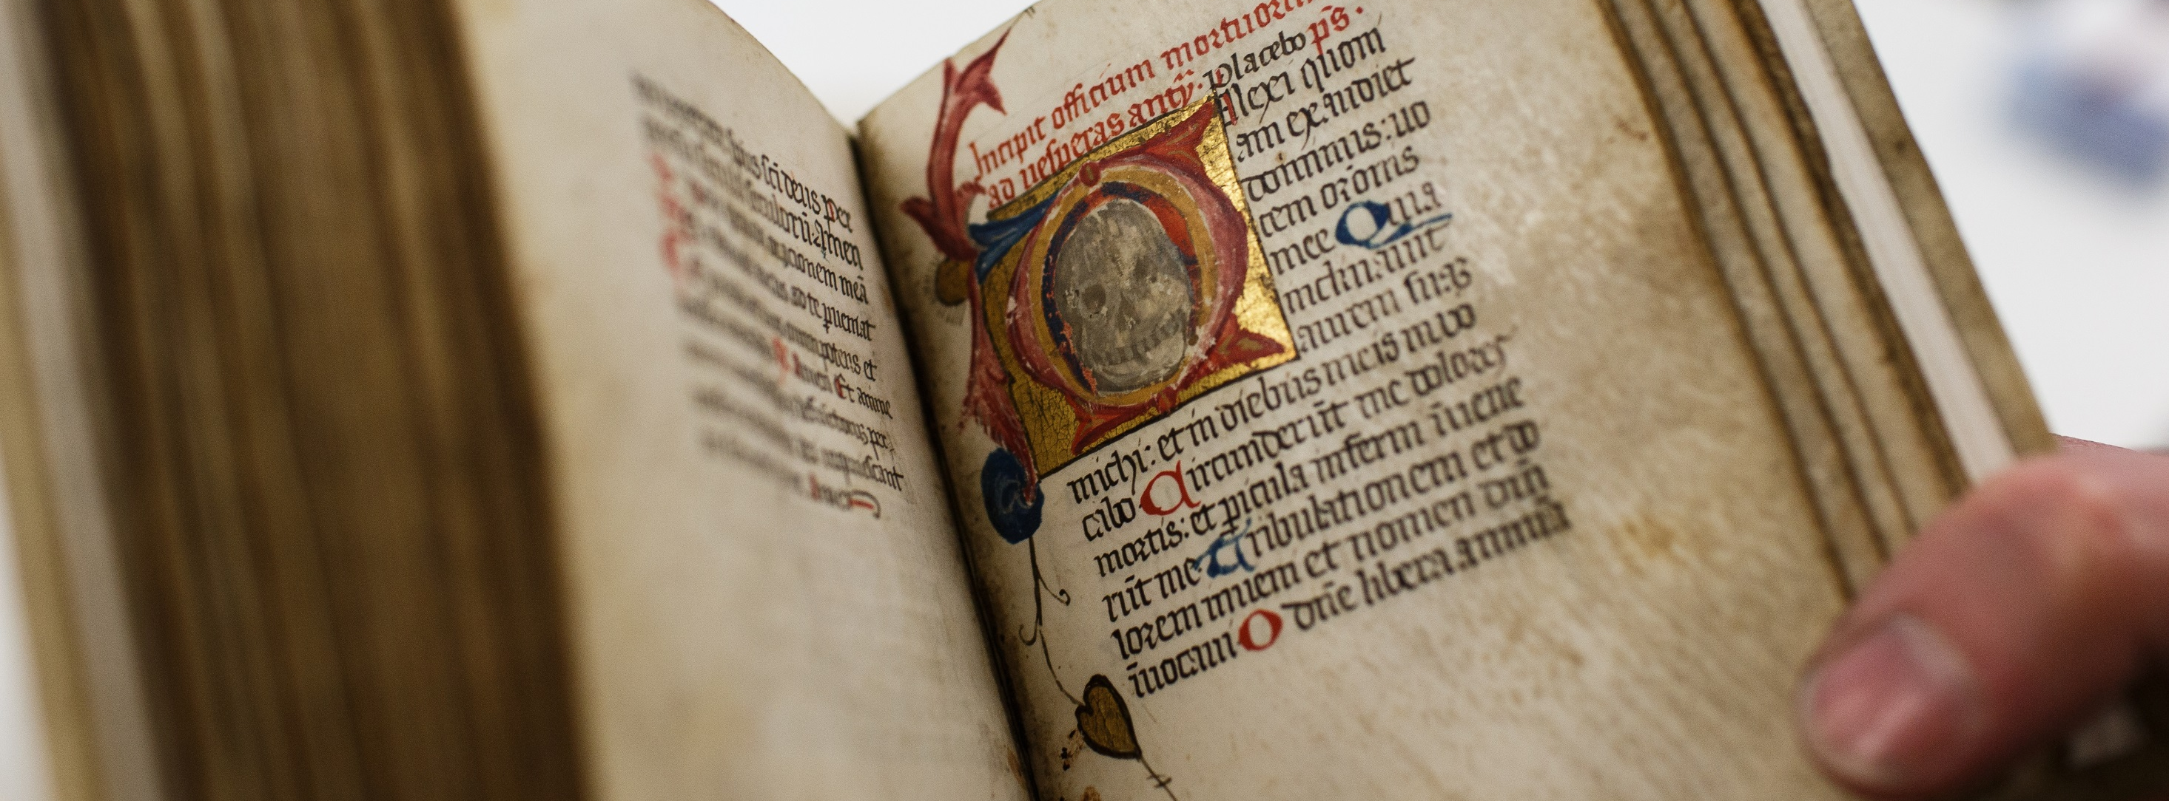
University of Kent and Rochester Cathedral:
Cataloguing and Collaboration
Josie Caplehorne
j.caplehorne@kent.ac.uk

Slide 2
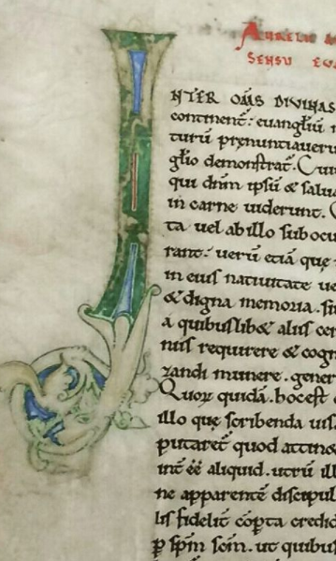
Project Background
Project Planning
Cataloguing Standards
Post Project Review
Achievements
Communication Strategy

Slide 3
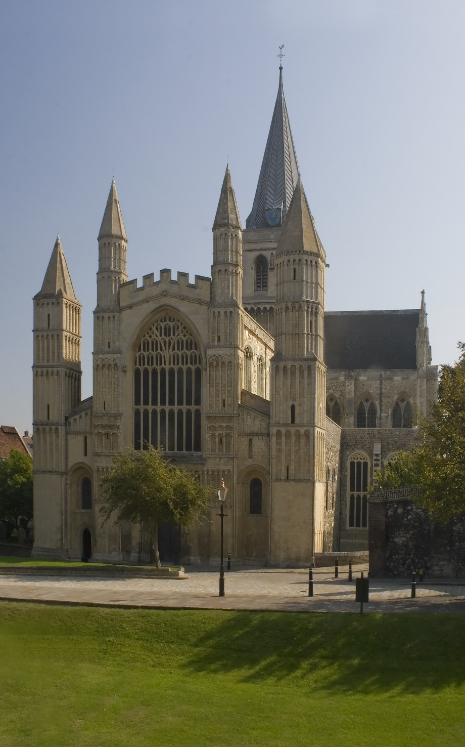

“Hidden Treasures, Fresh Expressions”
£5 million of Heritage Lottery Funding
Over £1 million of additional fundraising
Improve accessibility of collections to all – physically & intellectually
Renovation of Library and Crypt
Creation of an exhibition space
Catalogue the Library’s printed volumes
Project Background
© All rights reserved
Notes:
The project cost about £7 million in total, with around £5 million coming from HLF. Over £1 million was raised through grants from other sources such as Colyer-Fergusson, Friends of Rochester Cathedral, Rochester Bridge Trust, Garfield Weston Foundation, Wolfson Foundation, The Headley Trust and the Esmée Fairbairn Foundation.

Slide 4



Collaboration
Rochester Cathedral
Heritage Lottery Fund
University of Kent
Kent History Centre
Canterbury Cathedral
Drill Hall Library
Professional staff
Academics/students
Public

Slide 5
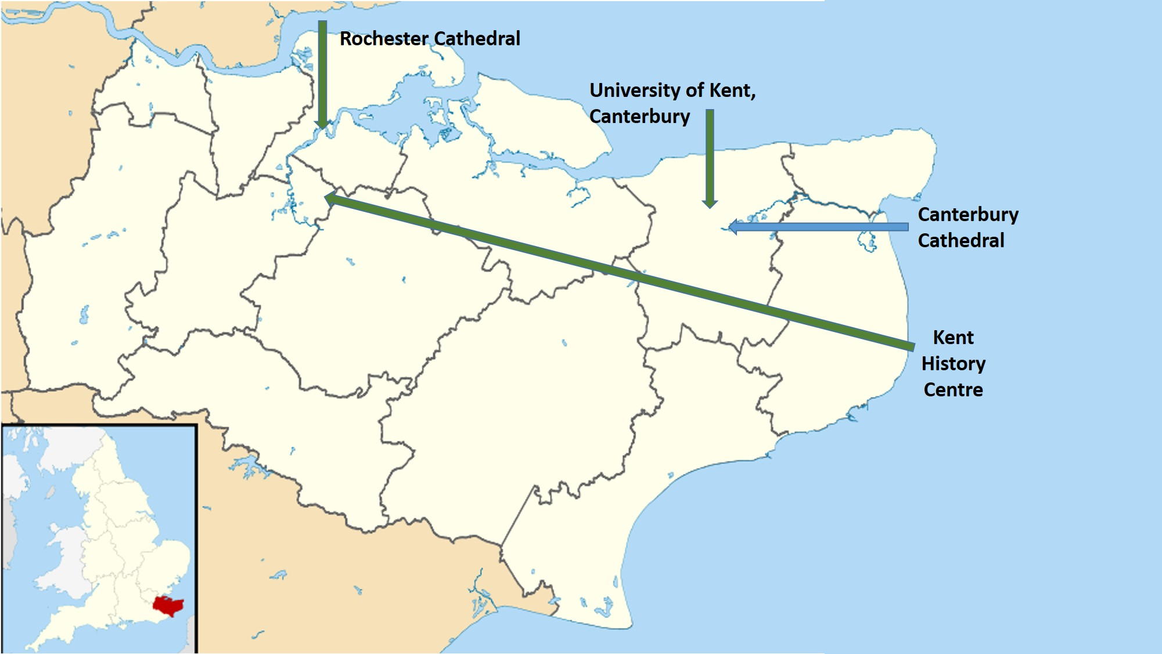

Slide 6
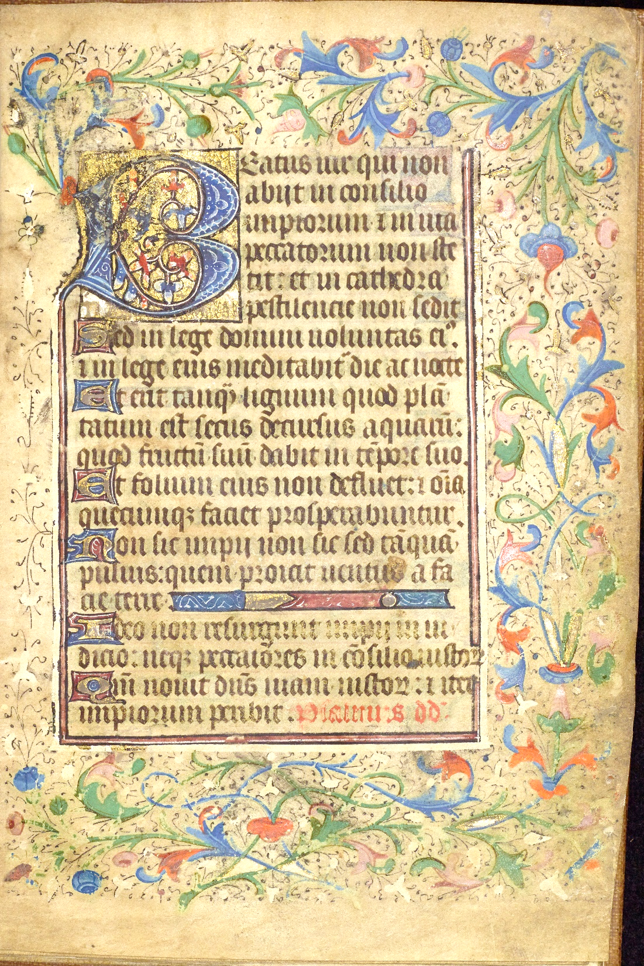
Project Planning
“…to make the physical holdings of the Rochester Cathedral library accessible to researchers, students and members of the public; to make it cross-searchable with the Canterbury Cathedral library and to confirm the University of Kent’s LibrarySearch as the principal academic discovery system in the region.”
“The Rochester Cathedral HLF project addresses equality, diversity and inclusivity by providing opportunities for specified groups and volunteers to work with the collections, and to provide increased access to the Library collection both on site and remotely. The original project application describes in detail how the library project will benefit audiences and how the project will be evaluated.”

Slide 7
Project schedule & budget agreement between institutions
Catalogue c.2,500 pre-1901 & c. 5,000 1901-2010 printed volumes
Catalogue holding records
Separate Index of inserts to be compiled
Display completed bibliographic descriptions in University of Kent resource discovery system
Materials on shelf in Rochester Cathedral
Add class mark records to catalogue
Document Communication & Engagement strategy
Deliver two workshops
Project Scope

Slide 8
Proposed Project Timeframe
Major Task | Apr 2015 | May 2015 | Jun 2015 | July 2015 | Aug 2015 | Sept 2015 | Oct 2015 | Nov 2015 | Dec 2015 | Jan 2016
Catalogue pre 1901 volumes | ▪ | ▪ | ▪ | ▪
Catalogue post 1901 volumes |  |  | ▪ | ▪ | ▪
Move books to Cathedral |  |  |  |  |  |  | ▪
Add class marks to catalogue |  |  |  |  |  |  |  | ▪ | ▪ | ▪
1.5 FTE Project Cataloguers

Slide 9
Risks
Mitigation
Reputational damage
Project delays
Loss of academic interest
Changes in budget
Building project will impact physical storage space
Materials at risk while being moved
Possible dependency on Library Management System/Resource Discovery System
Maintain good communication
Use of stage gates to monitor progress
Develop Communication & Engagement Strategy
Identify costs within Project Plan
Include provision for alternative spaces
Produce safe handling guidelines
No technical dependency which is different from other collections
Managing Risks
Notes:
12 identifiable risks

Slide 10
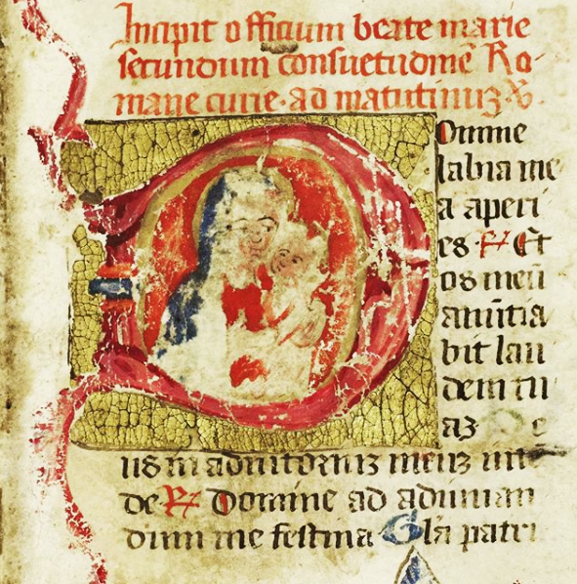
Cataloguing Standards
In 2013 the University of Kent transitioned all bibliographic records from AACR2 to RDA
Rare & special book collections partially transitioned to RDA
Forthcoming implementation of a Unified Library Management System

Slide 11
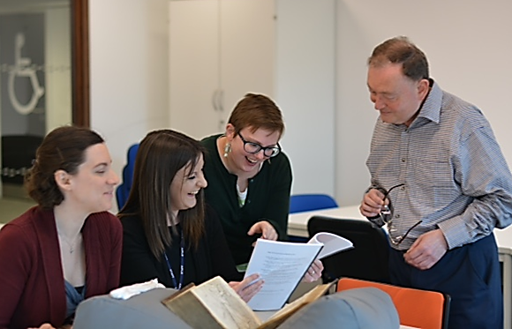
Cataloguing Review
Working group
- review current practices
- develop RDA/DCRM(b) hybrid
- implement revised standard
External to project lifecycle
Public as audience, not just academics
Global resource discovery system
Volunteer managed Cathedral library
Consider future application & revisions
Engaging with secondary stakeholder
Working group

Slide 12
Cataloguing Review: Key Changes
Change | Benefit of Change
Tag 260 replaced by 264 | Repeatable if used with variant second indictor.
Unlimited use of 7XX tags | All creators of work can be identified by an authorised heading.
Extension of abbreviated terms | Ensures local and global audiences can interpret the catalogue without the need for training
Replacement of Latin terms
Clear signature statement

Slide 13
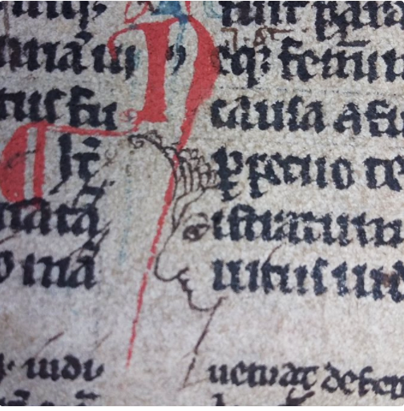
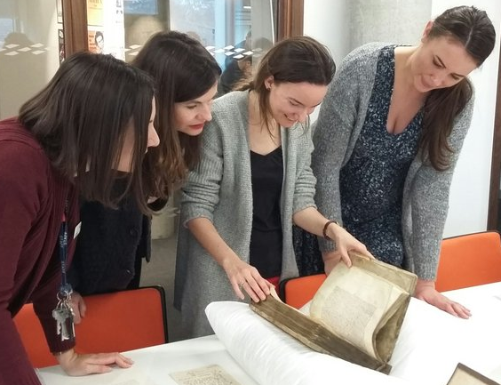
Communication Strategy
“Engage with University of Kent students and staff, at Canterbury and Medway, and Canterbury Cathedral library, in developing and furthering access and understanding of Rochester Cathedral’s library collections and to engage with community volunteers involved in the HLF project.”

Slide 14
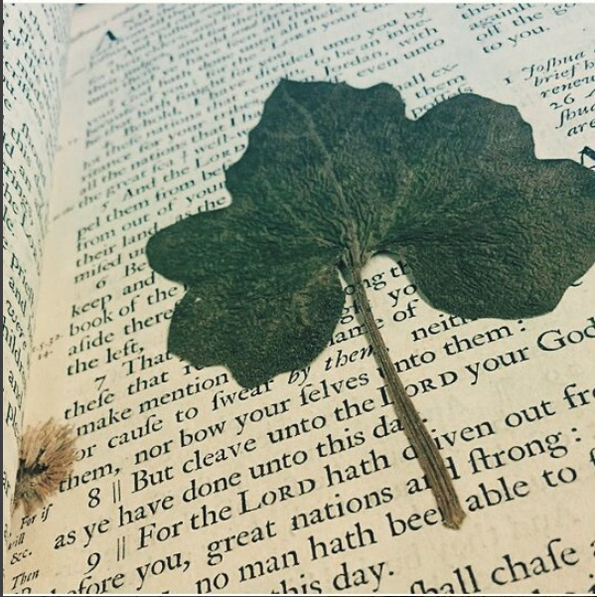
Communication & Engagement Activity
Blogging and other activities to communicate about the project amongst relevant networks and wider communities.
Delivery two workshops, in collaboration with HLF project staff, to introduce the collection to academics and researchers.

Slide 15
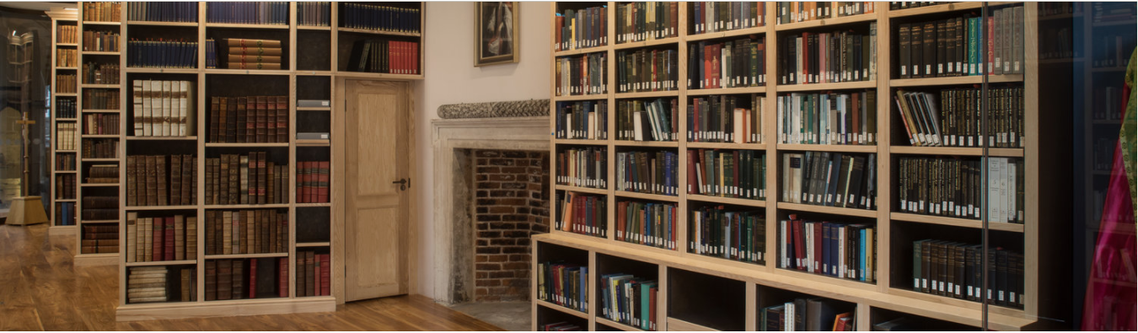
Post Project Review
© All rights reserved

Slide 16
Actual Project Timeframe
Major Task | Apr 2015 | May 2015 | Jun 2015 | July 2015 | Aug 2015 | Sept 2015 | Oct 2015 | Nov 2015 | Dec 2015 | Jan 2016 | Feb 2016 | Mar 2016
Catalogue pre 1901 volumes | ▪ | ▪ | ▪ | ▪ | ▪ | ▪ | ▪ | ▪ | ▪ | ▪ | ▪ | ▪
Major Task | Apr 2016 | May 2016 | Jun 2016 | July 2016 | Aug 2016 | Sept 2016 | Oct 2016 | Nov 2016 | Dec 2016 | Jan 2017 | Feb 2017 | Mar 2017
Catalogue pre 1901 volumes | ▪ | ▪ | ▪ | ▪ | ▪ | ▪ |  |  |  | ▪ | ▪ | ▪
Major Task | Apr 2016 | May 2016 | Jun 2016 | July 2016 | Aug 2016 | Sept 2016 | Oct 2016 | Nov 2016 | Dec 2016 | Jan 2017 | Feb 2017 | Mar 2017
Move books to Cathedral |  |  |  |  |  | ▪ | ▪
Materials on shelf in Cathedral |  |  |  |  |  |  |  | ▪ | ▪ | ▪ | ▪ | ▪
Major Task | Apr 2017 | May 2017 | Jun 2017 | July 2017 | Aug 2017 | Sept 2017 | Oct 2017 | Nov 2017 | Dec 2017 | Jan 2018 | Feb 2018 | Mar 2018
Add class marks to catalogue |  |  |  |  |  | ▪ | ▪
Other |  |  |  |  |  |  |  |  | ▪ |  |  | ▪

Slide 17
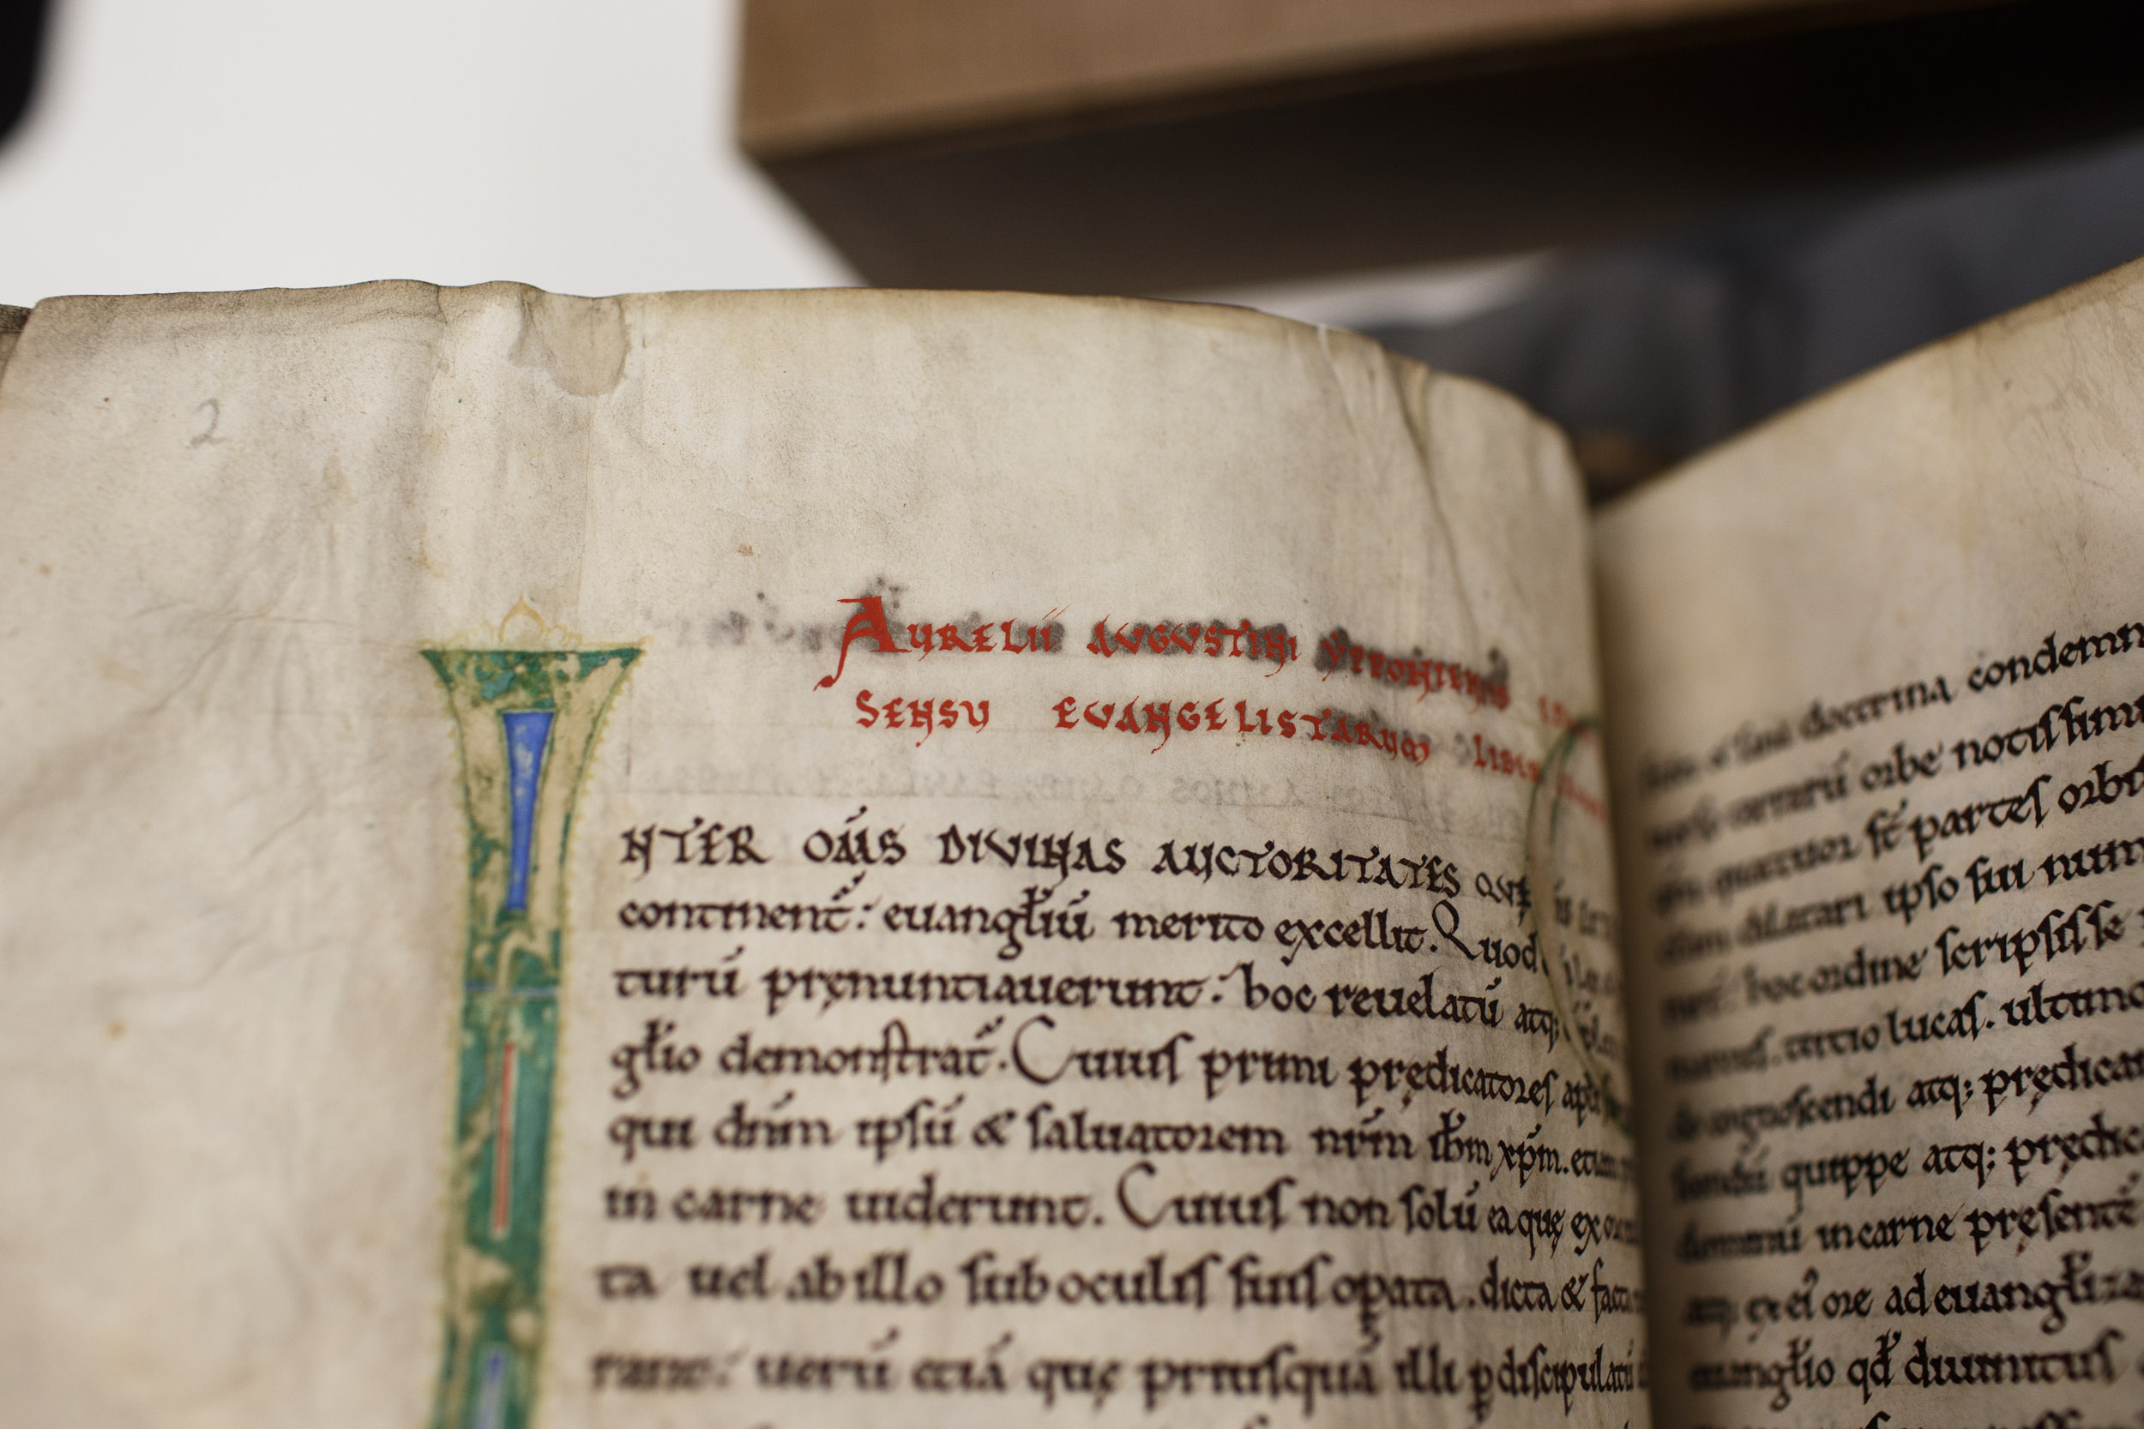
Cataloguing
Collaboration
Average time to catalogue each book was variable
Careful handling of materials
Managing movement of books during cataloguing
Outreach and engagement
Impact of parallel projects – Templeman Development & Unified Library Management System
Challenging materials required additional research
Project Steering Group Meetings
Stakeholders and communication
Move management
Volunteer training
Cathedral catalogue & reading room
Conferences, workshops and seminars
Research opportunities for students and academics / Public engagement
Trusted partnership
© All rights reserved

Slide 18
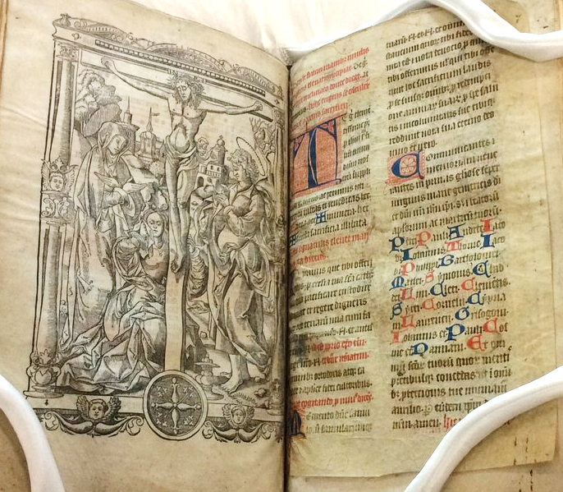
Missale ad usum
Sarisburiensis
Leaf of unknown origin
Further academic research required
Making connections with Special Collections & Archives at the University of Kent
https://librarysearch.kent.ac.uk/client/en_GB/kent/search/detailnonmodal/ent:$002f$002fSD_ILS$002f0$002fSD_ILS:540400/ada

Slide 19
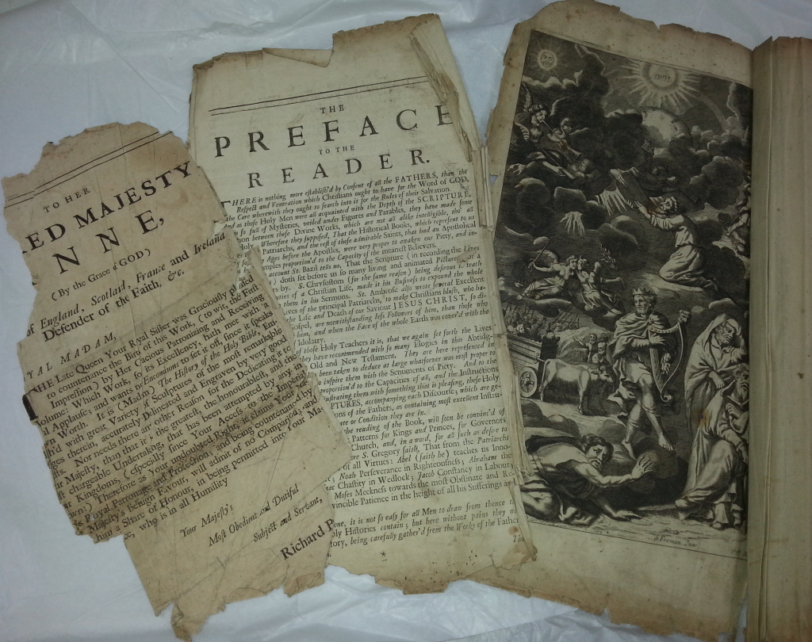
[The History of the Old and New Testament]
Partner institutions key to discovery
Importance of accurate external metadata
The clues are in the detail
Blog post: The Mystery of the Missing Title Page
https://blogs.kent.ac.uk/specialcollections/2015/11/24/rochester-cathedral-cataloguing-the-mystery-of-the-missing-title-page/
https://librarysearch.kent.ac.uk/client/en_GB/kent/search/detailnonmodal/ent:$002f$002fSD_ILS$002f0$002fSD_ILS:536903/ada

Slide 20
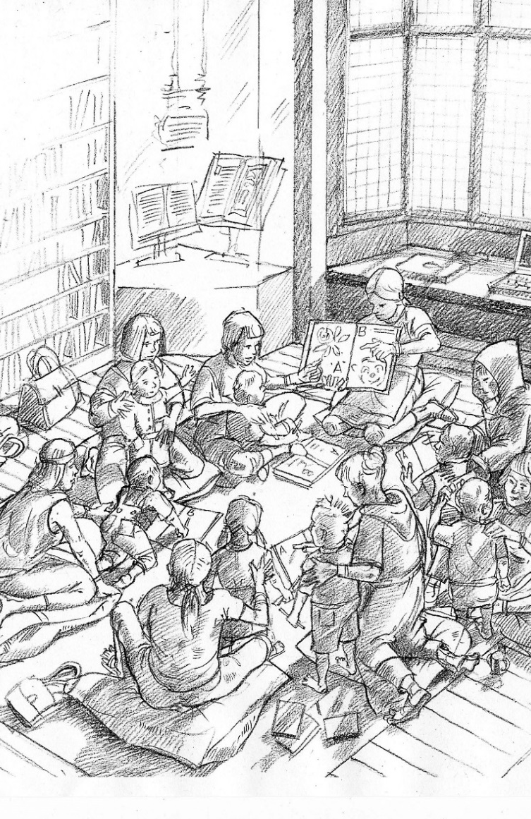
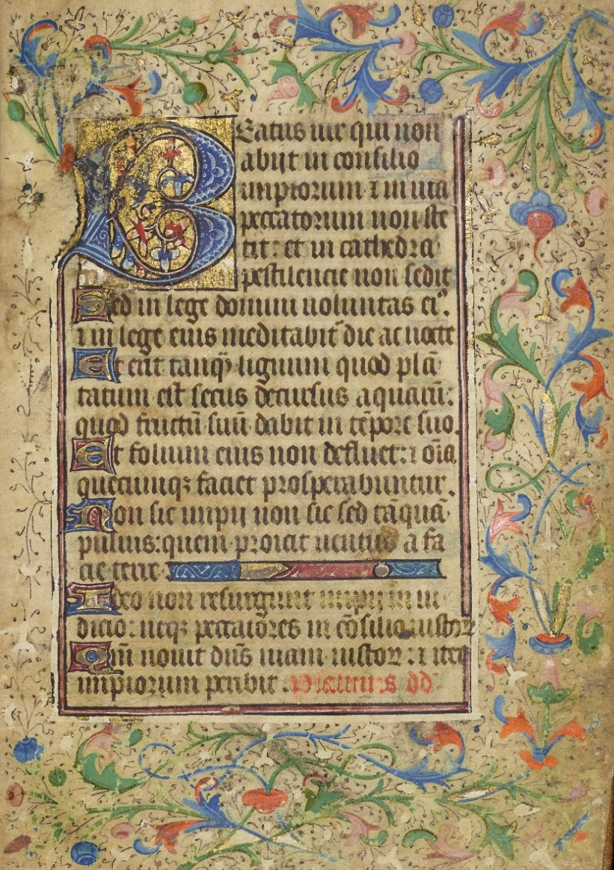
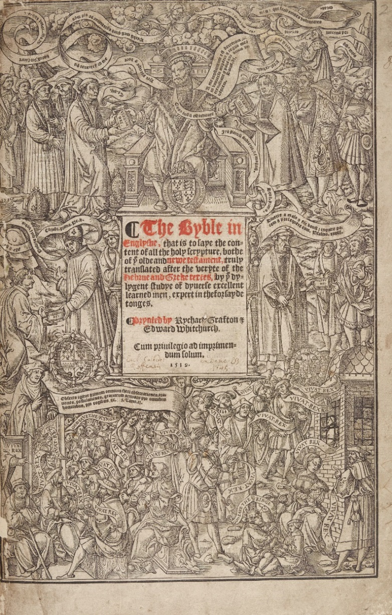
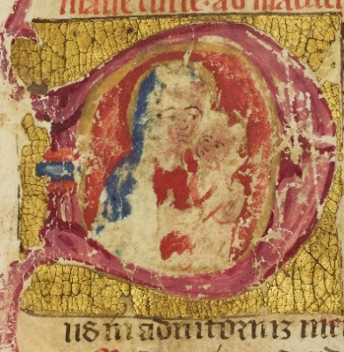
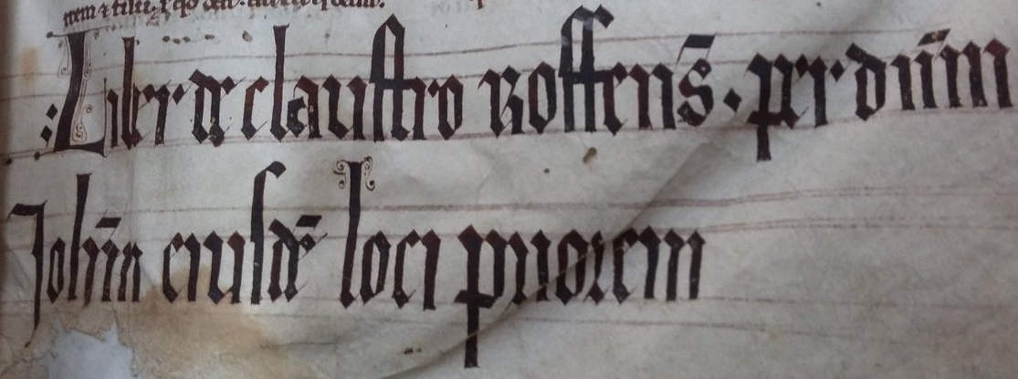
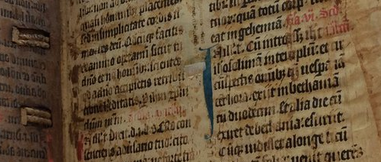
Project Achievements

Slide 21
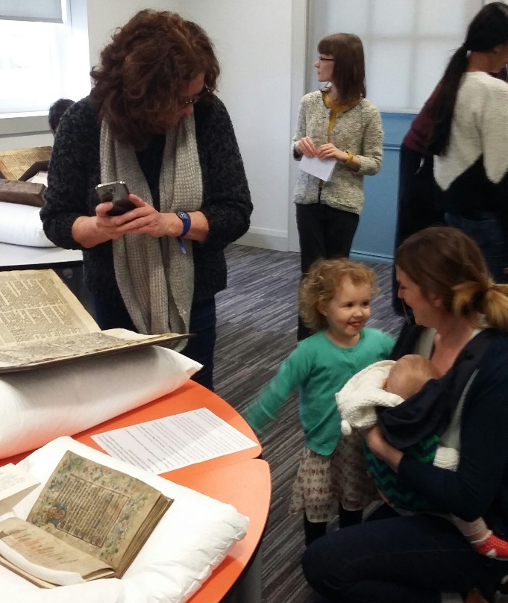
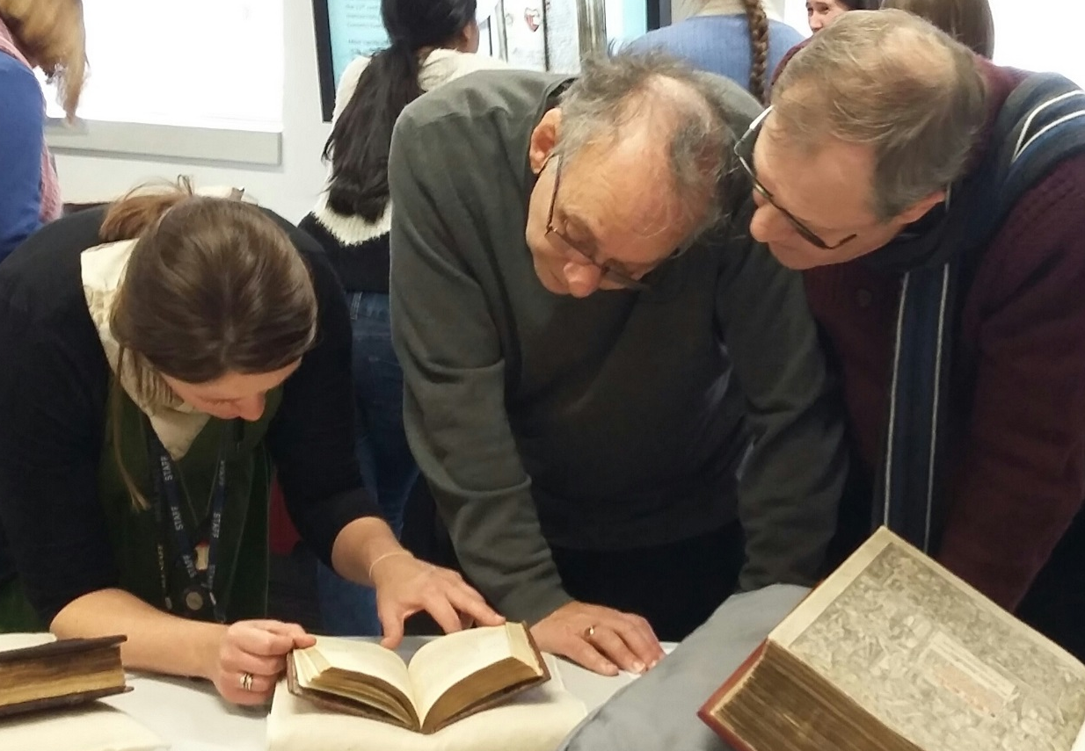
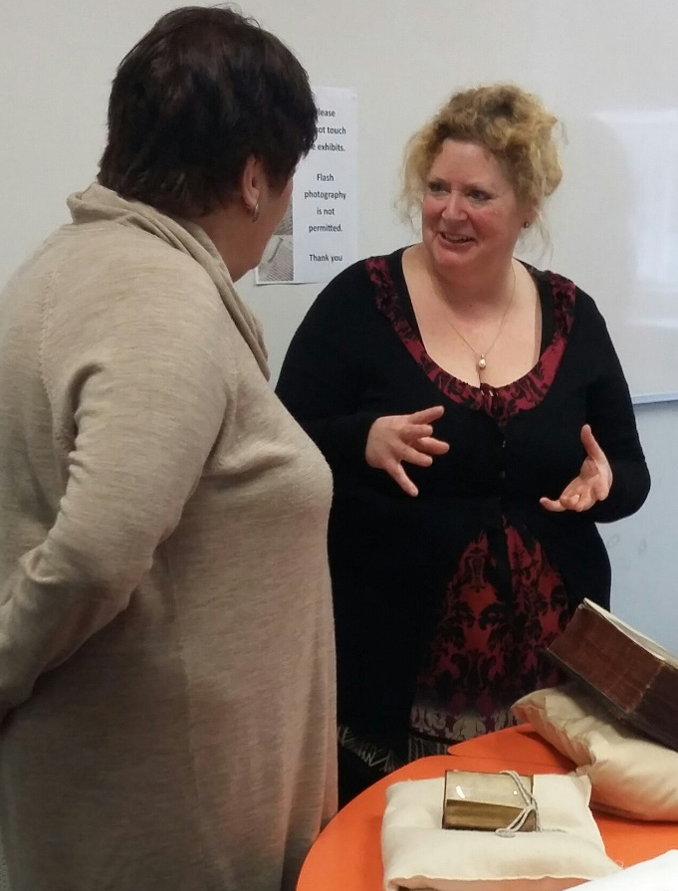
Outreach &
Engagement
Major public exhibition at our Medway campus
Medieval & Early Modern Studies Summer Festival – workshop and exhibition
Several academic led student seminars
Open lecture by Professor James Carley
Pastoralia in the Late Middle Ages Conference – seminar and exhibition
Kent Refugee and Action Network seminar
Promotion via various social media outlets have engaged global communities

Slide 22
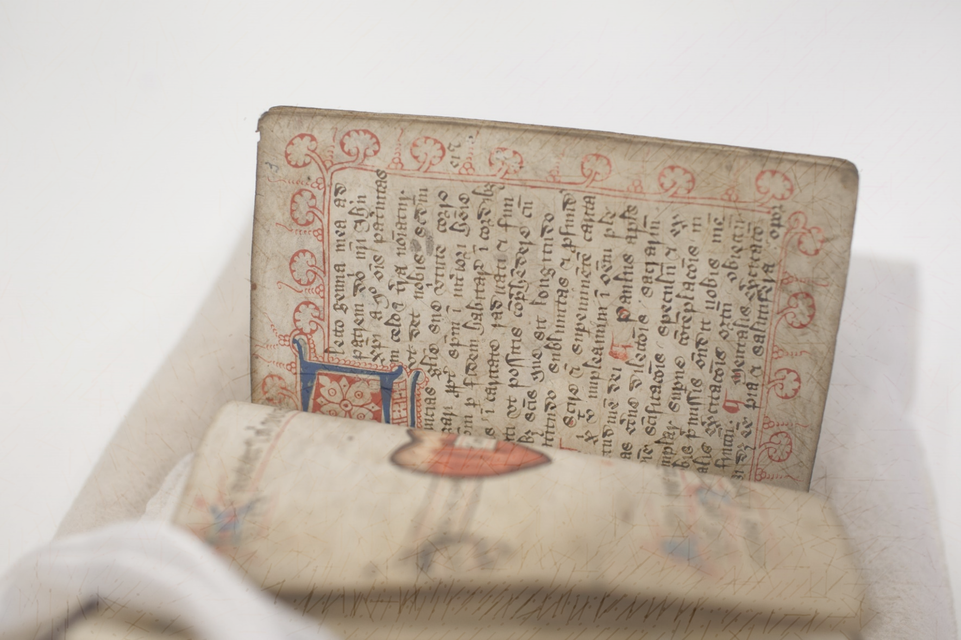
Soliloquium de quatuor mentalibus exercitiis
[manuscript A.3.13]
https://librarysearch.kent.ac.uk/client/en_GB/kent/search/detailnonmodal
/ent:$002f$002fSD_ILS$002f0$002fSD_ILS:540748/ada

Slide 23

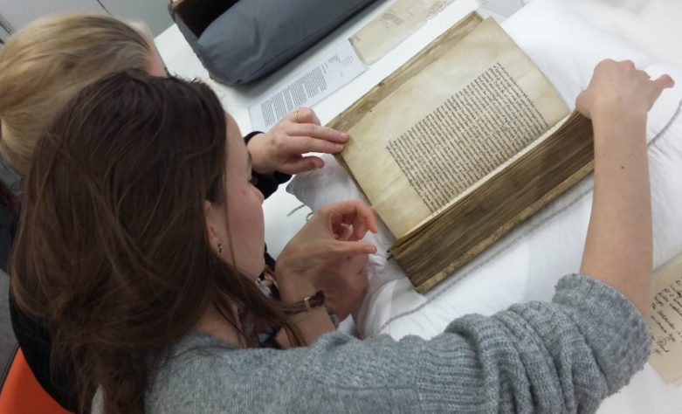
‘A.3.16 St Augustine’
Paleography paper on A.3.16 ‘De Consensu Evangelistarum Libri Quatuor / The Harmony of the Gospels’ by Laura Havemann, Medieval & Early Modern Studies Post-Graduate.
https://kar.kent.ac.uk/61336/

Slide 24
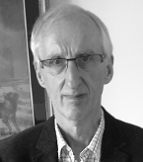
“The Medieval Library of
Rochester Cathedral Priory:
Survivors and Their Significance”
Part I
CILIP Rare Books and Special Collections Newsletter: Issue 103; July 2016; (p. 10-15)
Part II
CILIP Rare Books appnd Special Collections Newsletter, (104); November 2016; (p. 13-18) ISSN 0959-1656
Professor James Carley

Slide 25
Original research enriches metadata
‘A.3.16 St Augustine’
12th century alum tawed sheepskin binding, flesh side out, over 11mm oak boards ; extended tabs at the head and tail of spine ; section of whittawed leather to the lower board and outer corners of old boards ; 4 of 5 original medieval bookmarks of stringed leather (one missing) ; parchment (vellum) writing supports.|5Local note – University of Kent
https://librarysearch.kent.ac.uk/client/en_GB/kent/search/detailnonmodal/ent:$002f$002fSD_ILS$002f0$002fSD_ILS:544596/ada

Slide 26
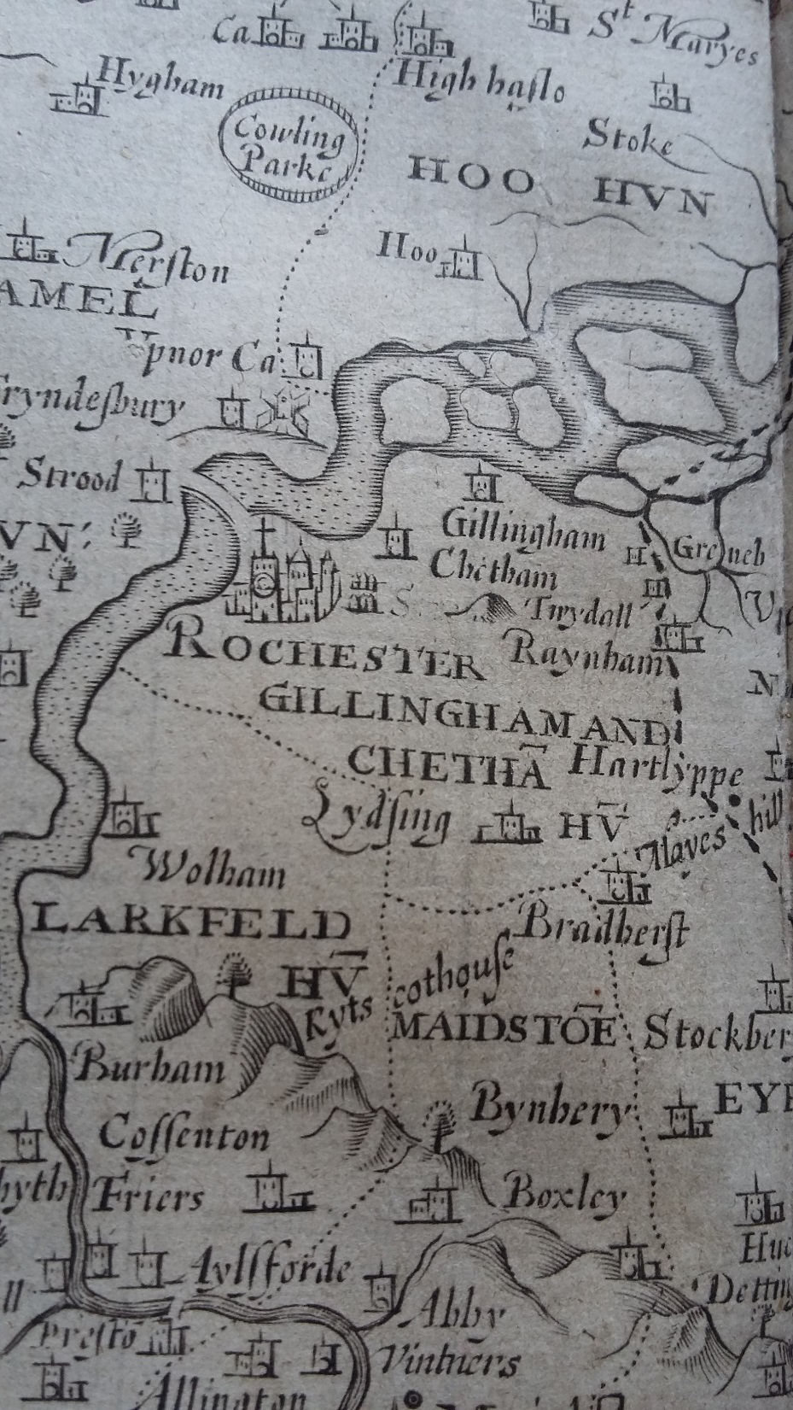
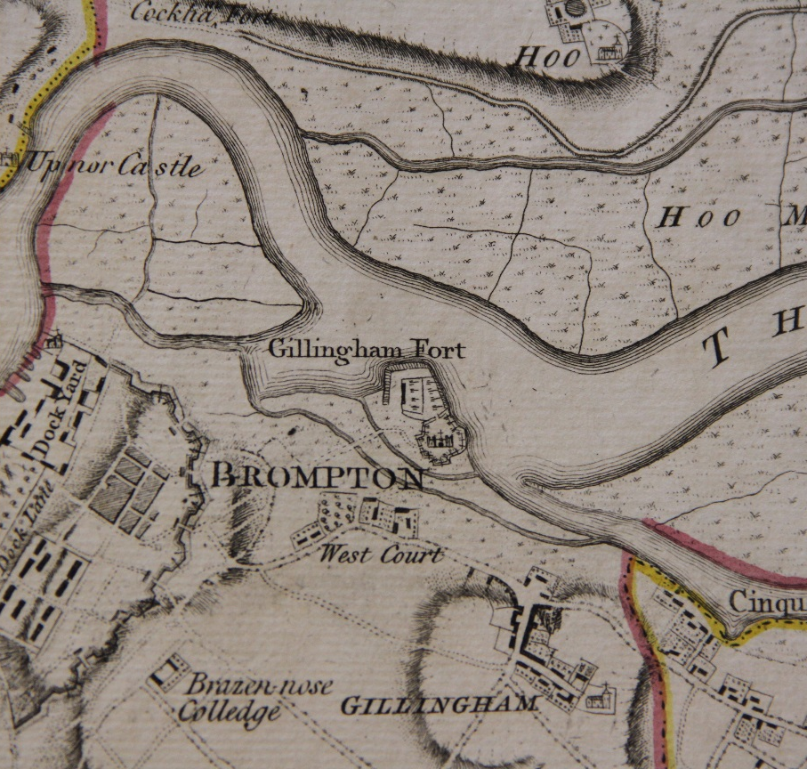
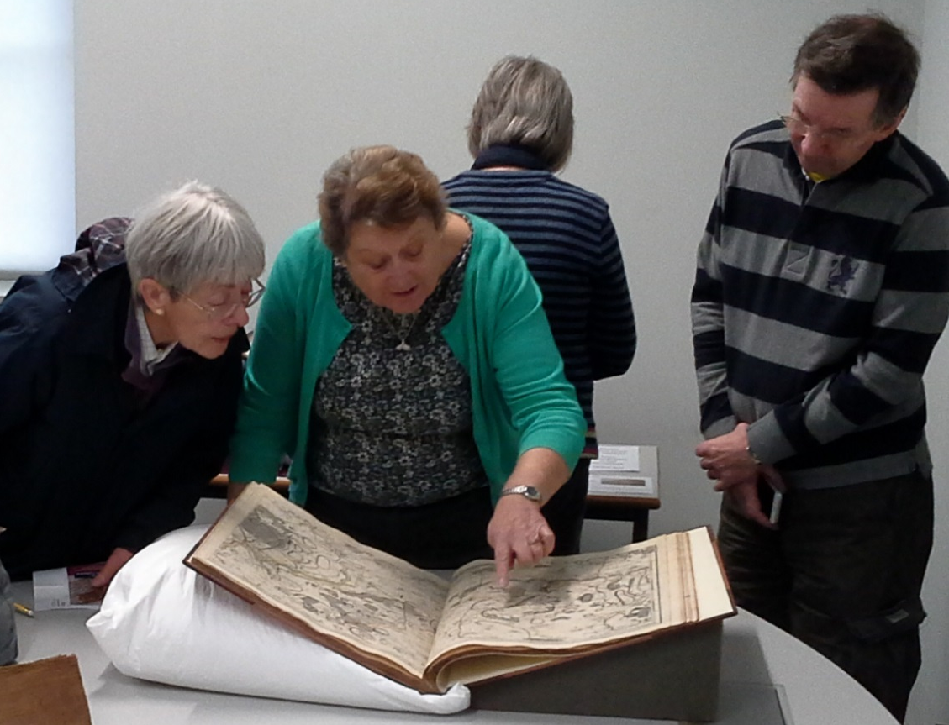
Chatham Historic
Dockyard Trust
http://thedockyard.co.uk/

Slide 27
Lessons Learned
Use project management methodologies to manage changes in project timescale
Anticipate realistic timescales for cataloguing by consulting experienced rare book cataloguers
Value the dedication & enthusiasm / Capture the knowledge of your cataloguers
Plan for all anticipated outreach and engagement within project plan – including staff resource
Consider your audience for cataloguing as well as engagement activities
Capture the power of social media
Expect the unexpected

Slide 28
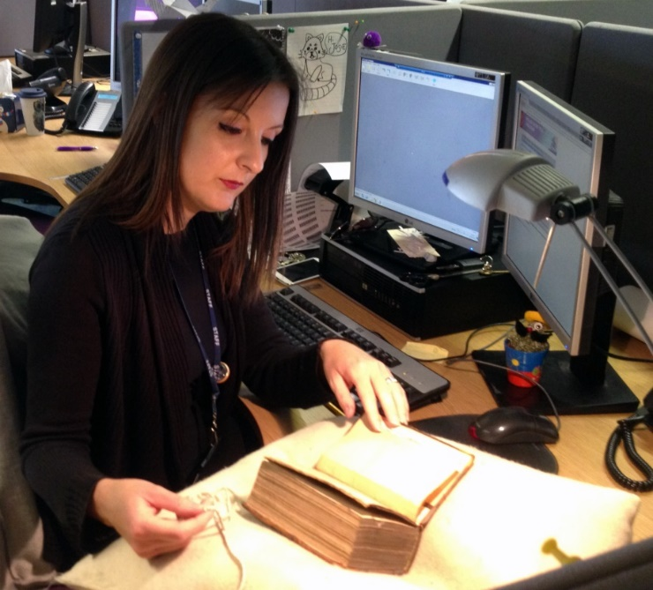

How to get in touch
j.caplehorne@kent.ac.uk
Associated Publications
Cataloguing, collaboration and cathedrals
https://kar.kent.ac.uk/57342/
Something old, something new: rare books and RDA at the University of Kent
https://kar.kent.ac.uk/57345/
@JosieCaplehorne

Slide 29
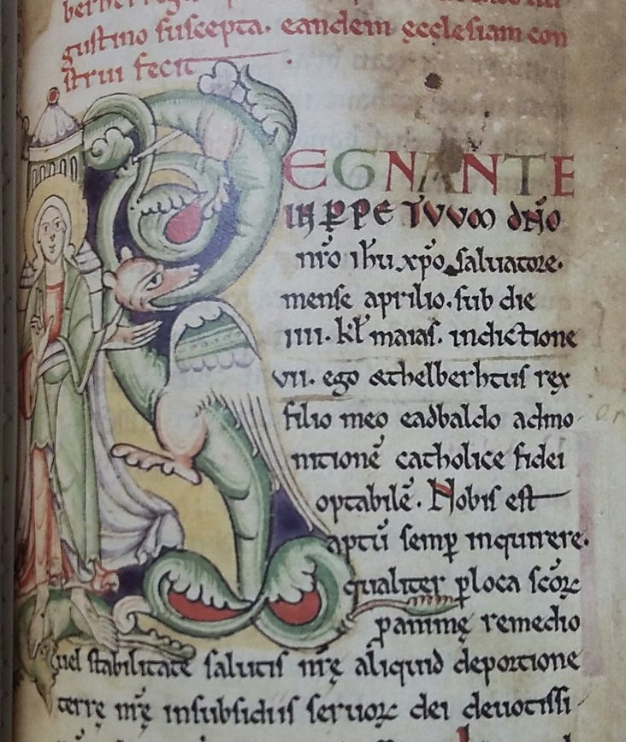


Thank you
Rochester Cathedral Library
https://www.rochestercathedral.org/the-library/
University of Kent
https://www.kent.ac.uk/
Rochester Cathedral
@RochesterCathed
rochester_cathedral_library
All images ©University of Kent unless otherwise stated

