Slide 1
Managing Your Research Data
Grants Factory
Open Access: Why Should I Care?

Slide 2
What is Open Data?
“Open data and content can be freely used, modified, and shared by anyone for any purpose”
F. A. I. R.
Findable – Accessible
Interoperable - Reusable
http://opendefinition.org/

Slide 3
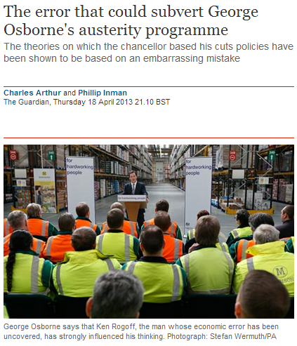
What are the benefits of Open Data?
... validation of results
www.guardian.co.uk/politics/2013/apr/18/
uncovered-error-george-osborne-austerity

Slide 4
Why should I make my data open?
Do you use other peoples data?
https://crawdad.org/nottingham/cattle/20071220/
7 citations and not all of them about cows!
Notes:
Requirements for making your data open – funder, publisher, university, colleagues, for you – because it’s a really good idea.
Look at how your research can be used and cited and how the methods you used can be used again to undertake new research (cattle movement example).
Reproducability - Crawdad
Retraction watch

Slide 5
How can I make my data open?
Does your funder have a repository or recommend a specific one?
Your publisher may archive data for you
Will they archive all of it – or just that which supports their publication?
Notes:
All of above then move onto the need for a Research Data Management Plan

Slide 6
What is Research Data Management ?
Adheres to the F. A. I. R. principles
Discovering & using data
Creating data
Documenting data
Storage and backup
Sharing data
Preserving data

Slide 7
Defining Research Data?
They can be
any media and any format
created at any stage
any level of derivation (raw, manipulated, converted, cleaned)
They must be
genuine
transparent
useful
reproducible
Recorded information, regardless of format or type, that supports or validates research observations, findings or outputs

Slide 8
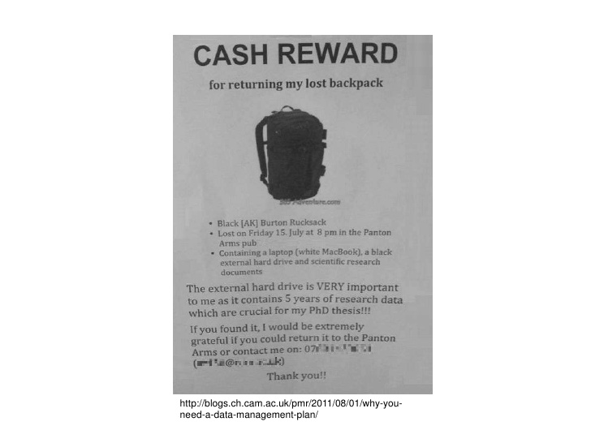
Why do I need a Research Data Management Plan?
consider your project as a whole from an early point in your project
think about the steps and different parts
plan for every eventuality
keep track of what changes you have made, and why, as your project progresses,
so you don't lose this information.
“Accidental losses often have one very important factor in common, for in over half of the cases of accidental loss we investigated, the data had been lost in a pub or restaurant ! Files, bags, laptops and memory sticks have all been lost in this environment.”
Create
Store
Document
Preserve
Share
Use
Validates and underpins your research
Do you look at other data sources?
“Don’t drink and data!”

Slide 9
When should I make a Research Data Management Plan?
“Engaging in data planning early on in your project can save you time and effort later. The decisions you make at this stage will affect how you collect, use, share and publish your data, and can prove highly beneficial in the longer term. The plan you make should stay with you throughout your project and form the basis of the documentation you'll need when you submit your data to a repository.”

Slide 10
What should I be considering?
What to include
the type of data you expect to create or use
how you will record your data, and where you will keep it
how you will organise your data and keep it safe
what data you will keep after your project
how you will share your data

Slide 11
Writing your plan…
Library webpages:
www.kent.ac.uk/library/research/data-managment
Digital Curation Centre (DCC): www.dcc.ac.uk
^{https://dmponline.dcc.ac.uk}
http://www.dcc.ac.uk/resources/data-management-plans

Slide 12
Plan to organise your data…
Activity 1: Questionnaire
Activity 2: Interviews
Original Answers
Consent forms
Spreadsheet of responses
Questions
Recordings
Transcripts
… etc
Project
File hierarchies
Naming files
Version control
Files
Files
Files
Files
Files
Files
Files
Files
Notes:
Think about the best hierarchy for files - should they be organised by: type of data:
research activities: interviews, surveys
or type of material: documentation, publications, data (example for social science)
Naming files - Meaningful file names help you know the content and status of a file.
Use terms like project acronyms, researcher’s initials, or information that describes the type of file
Add version numbers, file status, or a date
Keep file names short
Don't use spaces or special characters
File structure - Think about the best hierarchy for files. Should they be organised by:
type of data: text, dataset, images
research activities: interviews, surveys
or type of material: documentation, publications, data?
Making an effective hierarchy and sticking to it will help you reliably find files in the future, and know exactly where files should go as your project progresses.
Version control - Version control helps you distinguish between different iterations of your work, so that you can find correct versions as needed. You should decide:
how many copies of a file you need to keep
how long you need to keep them
how you will tell each version apart, for example by using a consistent naming convention (see above)
If you store files in various places, you'll need to remember to synchronise the copies regularly. You can get tools that automatically do this for you, such as Microsoft OneDrive. Make sure you maintain single master, or milestone, versions of files in a suitable format and store them in a single location.

Slide 13
Plan to manage non-digital data
Consider digitisation
Scan paper documents
High quality photographs
Convert video and audio to digital files
Consider storage
Reduce risk of damage caused humidity, light, etc.
Organise your files for ease of retrieval
Restrict access
Notes:
Protect against loss
Hard copy data, like laboratory notebooks, journals or consent forms, are at risk if not managed properly, so you should include them in your plan. Depending on the scale of materials, consider digitising them by scanning or taking a digital photo.
If that's not practical, you can protect material in other ways, such as using a fireproof filing cabinet.
With all data – digital or analogue - Keep information to help you interpret your data and give it context in the short and long term.
Record when the data was collected and by whom. Keep this information with the data files wherever possible. This will also help when you come to store or share your data.
You should take common sense precautions when storing non-digital data. For example, do not store paper where it may get damp or fade; do not store magnetic tape near a strong magnetic field. Ensure the data are filed according to an agreed system so they may be retrieved easily. If the data are sensitive, ensure they are kept locked in a filing cabinet or safe; at least two people, but only those with rights to read the data, should have the key or combination.
An additional way to protect against loss is to make copies and store them separately. It is usually most efficient to take a digital copy and store it alongside your digital data; see below for guidance on digitisation.

Slide 14
Managing access to your data
Information Compliance
http://www.kent.ac.uk/infocompliance/index.html
Research Ethics & Governance
https://research.kent.ac.uk/researchservices/ethics/
Commercially sensitive data
Notes:
You may want to restrict access to your data during your project - for example if the data is commercially sensitive or you are concerned about Intellectual Property (IP).
If so, you have to consider carefully how to store your data to prevent unauthorized access.

Slide 15
Protecting your data
Make backups | https://www.ukdataservice.ac.uk/manage-data/store/backup
Encrypt your files | https://www.ukdataservice.ac.uk/manage-data/store/encryption
Encrypt your laptop | https://www.kent.ac.uk/itservices/staff/itsupport/encryption.html
Follow University IT safety & security advice | https://www.kent.ac.uk/itservices/secure/index.html
File formats for sharing, reuse and preservation | https://www.ukdataservice.ac.uk/manage-data/format/recommended-formats
Notes:
Data can be lost in many different ways: through human error, hardware failure, software or media faults, or malicious hacking and virus infection. Digital data files can also be corrupted in storage or through file transfer

Slide 16
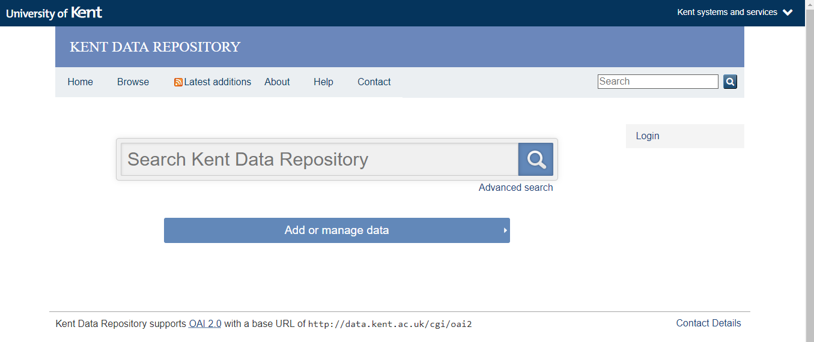
Where can I keep my research data?

Slide 17
What is the Kent Data Repository?
Meets international standards and current HEI best practice for Research Data Management
Secure, flexible research data storage
ARKIVUM data archive storage partnership
Complete registry of Kent research data - regardless of where it is stored
Designed to be F.A.I.R.

Slide 18
Features of the Kent Data Repository
Metadata templates to a standard schema
Secure file storage - of any type and size
Citable online location with DOIs for your data
Reciprocal links to records elsewhere
Access control at file-level with embargo periods
Processes for handling confidential data

Slide 19
Why use the Kent Data Repository?
Helps others discover and access your work
Allows you to publish and share all data
Meets data obligations to your publisher, funder, institution, colleagues and participants
Enables ease of reporting for HEFCE and REF

Slide 20
Where is the Kent Data Repository?
https://data.kent.ac.uk/
Where can I find KDR guidance?
https://www.kent.ac.uk/library/research/data-management/repository.html
Notes:
Guidance on creating Read.Me files

Slide 21
Help and support
Information Services Research Support
https://www.kent.ac.uk/library/research/
Email – researchsupport@kent.ac.uk

Slide 22
Notes:
This

