Slide 1

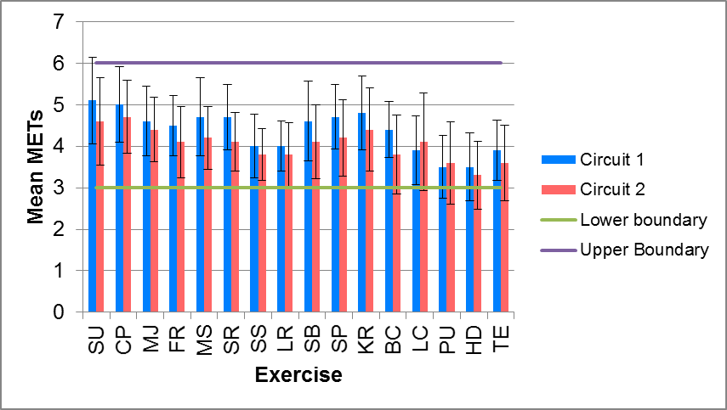
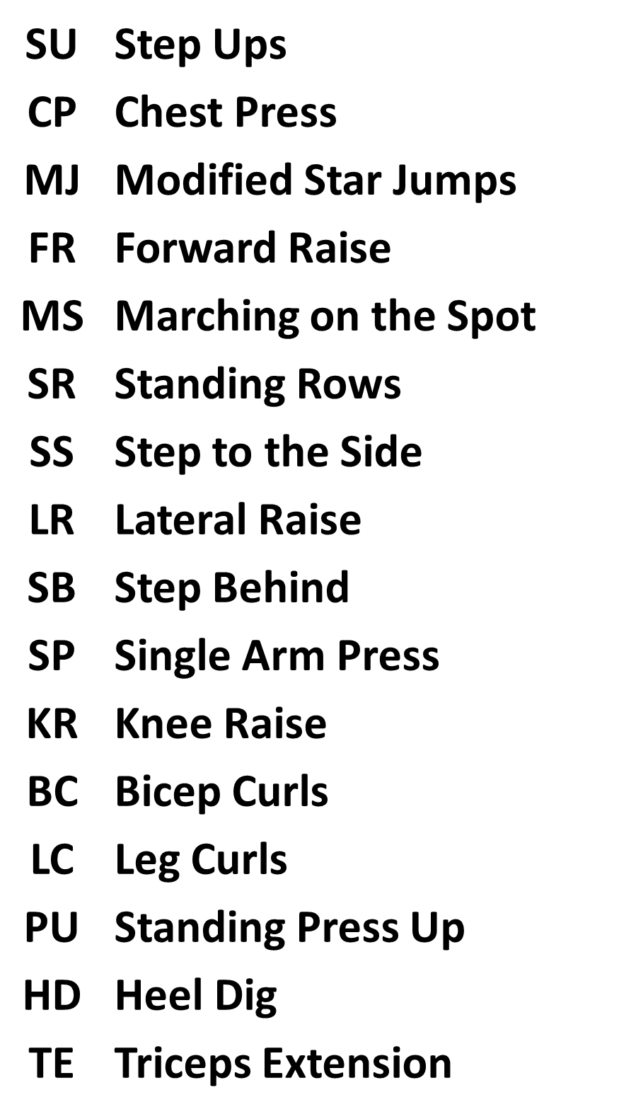
An Investigation into METs expenditure during circuit exercise
S. meadows, A. McCrann, S. sidoli, S. Wheeler, A. Bell
School of Sport and Exercise Sciences, University of Kent, The Medway Building, Chatham Maritime, Kent. ME4 4AG.
INTRODUCTION
Cardiac rehabilitation (CR) is a holistic intervention with exercise training as a core component. The normal mode of exercise delivery in Phase III & Phase IV CR is circuit-based training (CBT), with alternating cardiovascular (CV) & muscular strength endurance exercises (MSE) providing an intermittent training approach with active recovery (AR). Intensity of training can be expressed as metabolic equivalents (METs). METs represent the volume of oxygen (VO₂) requirement for a given exercise, as 1 MET is equal to 3.5 ml.kg.min⁻¹ so exercise intensity can be expressed in multiples of METs. The majority of CR participants are encouraged to engage in moderate intensity training (ACPICR, 2015), equivalent to 3 – 6 METs. Subjective effort scales, like the Borg rating of perceived exertion scale (RPE) are often used to help individualise exercise prescription. CR participants are encouraged to engage in exercise at a level of 11 – 14 on the RPE scale (= ‘light’ to > ‘somewhat hard’, but < ‘hard’). This should represent a moderate intensity effort. This study investigated MET expenditure during typical CV & MSE exercises organised into a CBT using recommended RPE levels for a group of Post-MI males aged between 50 – 75 years & a similar group of Non-cardiac males.
METHODOLOGY
Components of CBT Session
1. Pre-exercise Measurements: height, weight, BMI, resting HR & BP.
2. Resting Measurement: 10-minutes supine resting VO₂ measurement.
3. Warm Up: graded 15 minute cycling (RPE 11 - 13).
4. Circuit Exercises: 16 CV & MSE exercises alternated with a 1-minute work to 30-seconds AR / transition time. Circuit performed twice (RPE 11 - <15).
5. Cool Down: 10 minutes cycling (RPE < 11).
6. Post-exercise Measurements: HR & BP.
Participants were fitted with a gas analyser (Metamax 3B, portable gas analyser, Leipzig, Germany) and a heart rate monitor (Polar, Sweden) for VO₂ capture during components 2 – 5.
Results (Cardiac Group)
RESULTS
Table 1. Participant Demographics (mean ±SD)
 | Age (years) | Height (m) | Weight (kg) | BMI (kg.m²) *p<.05
Post-MI (n=12) | 69.50 ±4.62 | 1.73 ±0.06 | 84.67 ±16.26 | 28.21 ±4.98
Non-cardiac (n=10) | 66.40 ±7.41 | 1.77 ±0.08 | 75.35 ±9.45 | 24.07 ±2.59
Observations
Post-MI group were older and heavier than non-cardiac group, with a significantly higher BMI. All participants from both groups were physically active. CV & MSE exercises in the CBT fell within the moderate intensity MET range (3 – 6 METs) for both groups when exercising at the recommended RPE levels (11 - <15). Both groups had a resting MET value > 1, but this may have been due to lack of familiarity wearing a gas analysis mask, a pre-exercise anticipatory rise in metabolic rate or anxiety. Post-MIs had lower VO₂, METs, RPE & HR across all stages of measurement, although RER was consistently higher, suggesting they may be working more anaerobically, although perceiving less effort. Lower HR is most likely due to a medication effect (beta-blocker) in the Post-MI group. Interestingly, both groups worked at a higher mean VO₂ during the cycling warm-up, than during the CBT.
CBT Exercise Key
Figure 1. METs Expenditure During Resting & Exercise Components of CBT Session (Post-MIs only)
Table 2. Data Collection for Post-MI & Non-cardiac Groups during resting & CBT session (mean ±SD)
 | VO₂ (ml.kg.min⁻¹) |  | METs |  | RER |  | RPE (6 – 20) |  | HR (bpm)
Group | Post-MI | Non-cardiac | Post-MI | Non-Cardiac | Post-MI | Non-cardiac | Post-MI | Non-cardiac | Post-MI | Non-cardiac
Resting | 4.2 ±1.34 | 4.6 ±0.97 | 1.2 ±0.38 | 1.31 ±0.31 | 0.91 ±0.13 | 0.82 ±0.28 | NA | NA | 52 ±12.03 | 60.56 ±11.02
Warm-up | 17.1 ±4.38 | 18.5 ±2.55 | 4.9 ±1.25 | 5.23 ±0.75 | 0.96 ±0.12 | 0.90 ±0.04 | 12 ±0.76 | 12.10 ±0.74 | 97.1 ±13.67 | 100.89 ±17.05
Circuit | 15 ±3.39 | 16.32 ±1.50 | 4.2 ±0.97 | 4.66 ±0.44 | 1.04 ±0.16 | 0.99 ±0.04 | 12 ±1.19 | 12.91 ±0.46 | 102.9 ±16.28 | 107.78 ±4.47
Cool-down | 13 ±3.11 | 15 ±3.53 | 3.6 ± 0.89 | 4.31 ±0.98 | 1 ±0.14 | 0.93 ±0.04 | 9 ±1.69 | 10.10 ±1.1 | 86.6 ±9.48 | 100.67 ±12.78
CONCLUSION
The study provides novel data that attempts to capture VO₂ during a typical CR CBT session (15 mins. warm-up; 32 mins. conditioning; 10 mins. cool-down). The recommended RPE levels for CR exercise appear to facilitate a moderate intensity effort and this was reflected in the VO₂ (& MET) data collected. There appears to be some difference in energy usage between these two groups, indicated by lower METs & higher RER at all stages of measurement, but further exploration of the data will be required to confirm this. The total MET.mins achieved in the CBT was 243.90 MET.mins for the Post-MI group & 270.67 for the Non-cardiac group, suggesting the latter group worked at a higher mean effort level, reflected in the higher mean RPE in the warm-up, circuit & cool-down. Due to the 30 secs AR (walking on the spot) completed between each CBT exercise this could have added a further 46.5 MET.mins (assuming this was performed at 3 METs). The whole CBT session therefore expended approximately 300 MET.mins in 72.50 minutes of exercise at an RPE of 12 - 13 = approximately 4 METs energy expenditure per minute.
Reference: ACPICR (2015) Standards for Physical Activity and Exercise In the Cardiac Population http://acpicr.com/publications
s.meadows@kent.ac.uk

