Slide 1


Talent Management & Inequality:
The trouble with social class
Dr Samantha Evans
Kent Business School, University of Kent

Slide 2


Outline
Talent management & inequality
Social class in the workplace – is there a problem?
Should employers be concerned?
Our research project:
  Measuring social class
  Is there (dis)advantage in the workplace associated with social class?
Implications for talent management
Implications for organisations

Slide 3

What is talent?
Those individuals who can make a difference to organisational performance
(CIPD, 2015)

Slide 4
The Talent Management Cycle
Workforce Analysis – What are your key metrics?
1. ANALYSE
Recruitment, selection & induction
2. RECRUIT
Career & development plans
3.DEVELOP
Engagement; performance management; rewards
4. RETAIN

Slide 5

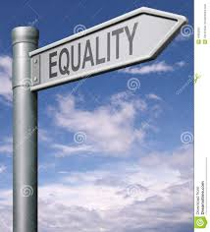
Talent Management & Inequality
“We can’t talk about inequality without talking about talent” (Professor Roger Martin, Harvard Business Review, 2014)
We can’t talk about talent without talking about inequality
So………

Slide 6
Inequalities in the workplace: protected characteristics
Age
Sexual orientation
Marriage & civil partnership
Sex
SOCIAL CLASS
Pregnancy & maternity
Disability
Gender reassignment
Race
Religion & Belief

Slide 7
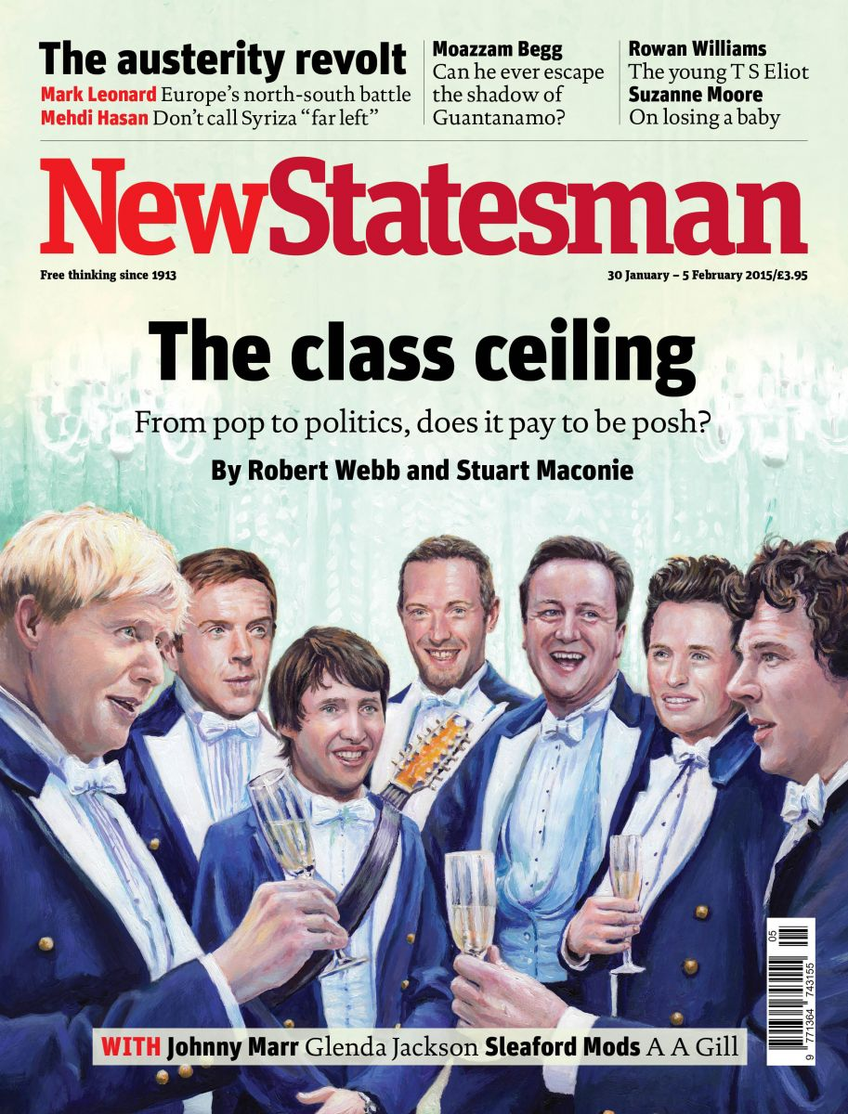
Social class in the workplace: is there a problem?
The UK is one of the most unequal developed countries in the world (Joseph Rowntree Foundation, 2015)
Many UK’s professions have become more socially exclusive over time (Milburn, 2012)
Problems associated with:
  the progression of employees who do achieve social mobility through their employment (Hughes, 2004; Friedman, Laurison and Miles, 2015)
  the existence of a ‘class ceiling’ (Friedman, O’Brien, and Laurison, 2016)
Notes:
In the UK 7% of the population attend independent schools BUT
75% of judges
70% of finance directors
45% of top civil servants
32% of Members of Parliament (MPs)
……..are independently schooled
Britain remains too much a closed shop society. The glass ceiling has been raised but not yet broken. Despite the narrowing of the gender pay gap, the top professional jobs still tend to go to men not women. Despite increasing numbers of people from black and ethnic minority backgrounds in professional jobs, many professions are still unrepresentative of the modern society they serve. And most alarmingly of all there is strong evidence, given to the Panel, that the UK’s professions have become more, not less, socially exclusive over time.

Slide 8
Should employers be concerned?
Growing recognition that social class differences play a role in employee opportunity in the workplace & organisational performance
AND
Some argue that social class & income inequality arises first and foremost in the workplace and it is there that the remedies must start
YET
There is little research on social class inequality within organisations in the UK or support for organisations to address social class inequalities

Slide 9
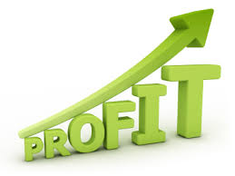
Just a thought……….
  If the UK would gain up to £23 billion - the equivalent to 2% of GDP- by better harnessing women’s skills in employment how much could your organisation gain through tackling social class inequality?
Notes:
How confident can you be as an organisation that you are not undermining the talent available to your organisation – both from within your organisation through internal promotion & performance criteria and succession planning. And from external sources through your talent management strategies; talent pipelines; employer brand etc.?
Most research is focused on societal level inequalities
BUT little is known about the extent and true costs of social class inequality within organisations & its impact on talent management
Why?
Inherent problems around measuring class makes even the first stage of the talent management cycle a challenge!

Slide 10
Our research project
How might social class differences lead to (dis)advantage in the workplace?
A survey measuring the following:
  Social class (objective & subjective)
  Class travel/ mobility
  Class discrepancy in the workplace
Follow up interviews to find out the extent to which social class plays a role in employees’ experiences & opportunities in the workplace.
Notes:
The number of self-classified working class interviewees was five, with eight middle class, and no one identifying themselves as upper class. Of the fifteen interviewees, eight had class travelled from working class origins to now identifying themselves as middle class, while two interviewees indicated that they had moved from a middle class upbringing to now identifying themselves as working class. The remaining interviewees had stable inter-generational class.

Slide 11
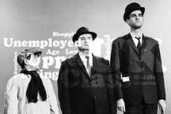
Measuring social class
Objective
Subjective
Respondents asked questions about education; parents’ education; income; location; occupation.
Responses coded & standardised to create a composite measure of overall objective social class on a 0-5 scale
Respondents asked to depict their social class on a continuum range of 0 (working/lower class) to 5 (upper class) in three areas:
Social class origin (i.e. during childhood)
Current social class
Social class of work colleagues

Slide 12
Employee experiences of social class in the workplace
“I didn’t know how to behave…I had no idea of professional conduct which you learn probably in a private school, so I had to learn all that on the job & it was hard”
“When you have to work with someone from another class it’s like being with someone from a different culture”
“I’ve always associated networking as quite a class based thing – it’s what middle class people do.....I never had any reference points growing up to understand how to network or that I could be associated with that – that’s what other people do”
“So you’re acting all the time….it’s having to bite your tongue. So you’re finding that you’re a chameleon half the time and sometimes it would just be great to just be yourself….but you can’t”

Slide 13
Is there (dis)advantage in the workplace associated with social class?
“I had a formal complaint made about me from a colleague saying I was unprofessional because of my accent (‘how can she meet anyone speaking like that?’)”
“The system has been rigged for so many years & you don’t realise it, until you get older, that it all comes back to life chances”
“I think I could have done a lot more with my career….I think I could have done way, way more”
“Definitely, in some ways limited opportunities”
Notes:
The crossing of class boundaries at work are argued to illuminate the processes of class advantage/disadvantage . Most likely to occur for employees who work in 'class discrepancy roles' who are more liable to engage in class work to overcome differences in their resources of capitals & progress in their careers (Gray & Kish-Gerphart; 2013)
Such positions are likened to feelings of dislocation (Hughes, 2004) or what Bourdeieu (2007) refers to as cleft habitus & Lahire (2011) refers to a 'split self

Slide 14
How can social class influence talent within organisations?
“It’s about ticking all the boxes and they’re more difficult to tick from a working class background”
“It is about what class brings you, what it allows you to do and not about who you are as a person”
Notes:
Employees who class travel upwards through their career feel at a disadvantage in the workplace:
In summary one interviewee described how social imprint becomes embedded in interactions from school through to the workplace and how this impacts an individual’s potential opportunities:

Slide 15
Implications for talent management
ANALYSE
What is the social class composition of your workforce?
RECRUIT
What is the influence of your employer brand in recruitment success?
How is unconscious bias affecting selection decisions?
What is the social class profile of your organisational leaders & role models?
DEVELOP
Are your talent pipelines & succession plans maximising the potential talent within your organisation?
How could you better support employees to make use of developmental opportunities? e.g. what training & advice do you offer about networking?
How do you use mentors to support and develop your employees?
RETAIN
Is your criteria for performance and promotion free from social class biases?
How might unconscious bias be affecting performance assessments or promotion decisions?
How do your employee engagement; performance management, reward and other HR metrics relate to the social class composition of your workforce?

Slide 16

Implications for your organisation
Social class inequality has the following impact on organisations:
By addressing social class inequalities within your organisation you can:
Deprives organisations of valuable talent
Negatively impacts on individual & hence organisational performance
Results in inequality of opportunity in the workplace
Undermines CSR, ethical & diversity strategies
Manage valuable talent
Attract valuable talent
Improve performance
Improve equality
Enhance the organisation’s ethical principles

Slide 17
THANK YOU!
ANY QUESTIONS?
S.J.Evans@kent.ac.uk

Slide 18
References
CIPD Talent Management: An Overview (2105). CIPD Factsheets. (http://www.cipd.co.uk/hr-resources/factsheets/talent-management-overview.aspx)
Friedman, S., Laurison, D. and Miles, A., (2015). Breaking the ‘class’ ceiling? Social mobility into Britain's elite occupations. The Sociological Review,63(2), pp.259-289.
Friedman, S., O’Brien, D. and Laurison, D., (2016). ‘Like Skydiving without a Parachute’: How Class Origin Shapes Occupational Trajectories in British Acting. Sociology, p.0038038516629917.
Hughes, C. (2004). Class and Other Identifications in Managerial Careers: The Case of the Lemon Dress. Gender, Work and Organization [Online] 11:526–543.
Joseph Rowntree Foundation (2015). Social mobility wars are back – who’s winning and why do we care? (https://www.jrf.org.uk/blog/social-mobility-wars-are-back-whos-winning-and-why-do-we-care)
Martin R. (2014) ‘We can’t talk about inequality without talking about talent’, Harvard Business Review, 23 September.

