Slide 1
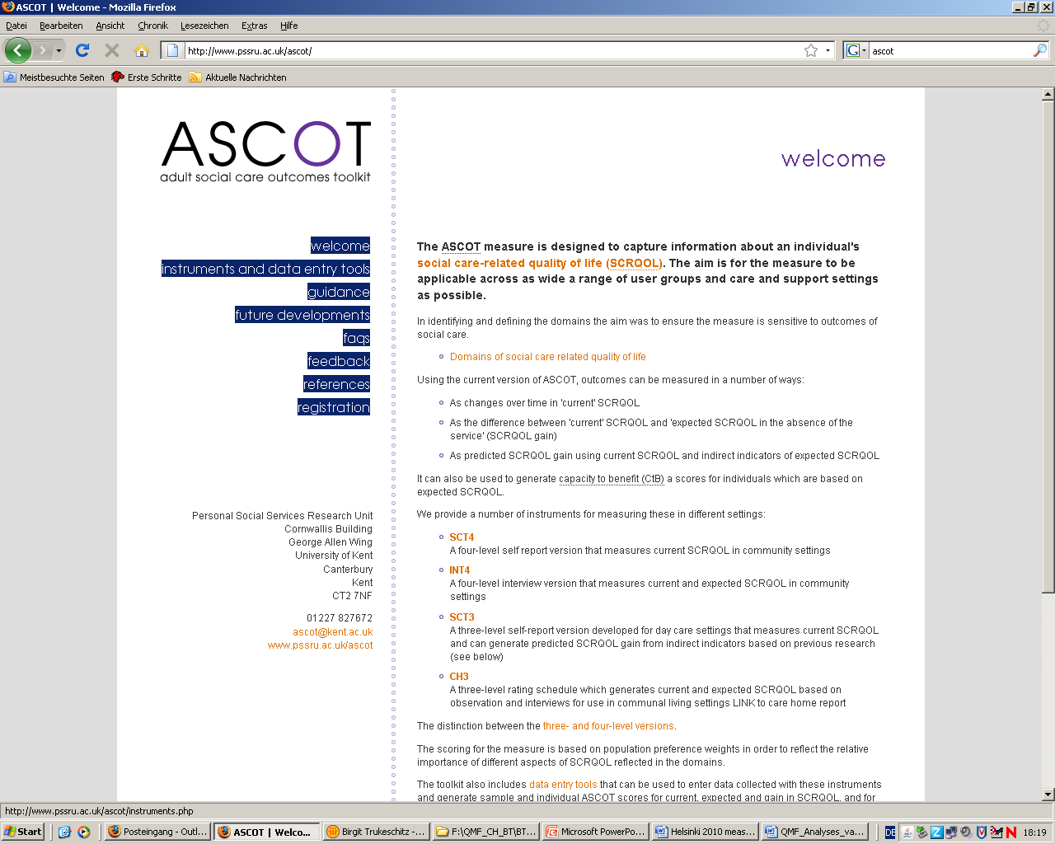
Measuring outcomes through observation: current uses and future developments
ASCOT Workshop 2012
Ann-Marie Towers

Slide 2
The observational approach
Designed for use in care homes
Inclusive approach, ideal when service users not able to take part in structured interviews.
Collect evidence about residents through:
Structured observations
Interviews with staff and/or family members
Interviews with residents where possible
Use this evidence to rate residents’ needs and produce ASCOT scores.

Slide 3
Training recommended
Need to know what to look for and relate this to the ASCOT domains
Sometimes what we don’t see is more important than what we do see
Weigh up evidence from different sources
Sometimes people have different perspectives
Need to be consistent in our approach to rating
Guidance is available to download:
http://www.pssru.ac.uk/ascot/guidance.php

Slide 4
Training Course
2 day training course
Walk through methodology
ASCOT domains and levels in detail
Real video clips of good and bad practice
Principles of engagement and active support
Group activities and vignettes to practice ratings
Overview of scoring and spreadsheets
Details of courses on our website:
http://www.pssru.ac.uk/ascot/training-and-events.php

Slide 5
Current users
People interested in measuring outcomes in:
Care homes (providers, LAs, researchers)
Extra care housing (one London Borough)
Organisations concerned about quality of care
Observational element used by one PCT to look at residents’ QoL and identify poor practice
Adapted in one LA for their QM team:
Home level, not resident level
Observation, not interviews
Qualitative evidence, not scores

Slide 6
International research interest
Research teams from:
Denmark (nursing home residents)
Austria (older home care recipients)
Australia (older home care recipients)
Considerable interest in adapting the approach for use in people’s own homes
Will be able to learn from their research
Helpful to make international comparisons

Slide 7
Future work
Adapting and testing the approach for use in:
Extra care housing (ASSET: Evans, Darton et al)
Home care
Cognitive testing and development work with proxies (staff and family interviews)
Further develop interviews with residents
Explore usefulness of a ‘home level’ approach
Waiting for feedback from the QM team using it
Feasibility study looking at whether the ASCOT can be used to improve care practice…
Notes:
ASSEST adult social services environment and settings

Slide 8
ASCOT and care home practice
ASCOT users told us that simply reflecting back the evidence collected during observations can change practice.
Raise awareness of what life is like for residents, e.g.
Mrs C was only spoken to once in 2 hours
Mr T had to wait 15 mins for help getting to the toilet
Staff are shocked because they are so busy ‘doing’ they do not realise/notice

Slide 9
Pilot study?
Measure baseline outcomes in small sample of homes
Conduct an intervention with the staff team, using the ASCOT evidence
Come back 6 months later and see if any changes in practice and resident outcomes
Writing proposal for feasibility study now
Including a lit review and consultations with homes/providers during design phase

Slide 10
Contact information
Anyone interested in knowing more about this study or about measuring outcomes in care homes more generally, please email:
Ann-Marie Towers: A.Towers@kent.ac.uk
Nick Smith: N.J.Smith@kent.ac.uk
Available in the break/lunch today
Workshop session this afternoon

