Slide 1





Using professional standards to inform information literacy work
David Bedford
Academic Support Librarian, Drill Hall Library
Notes:
Presentation to LILAC 2016 (Librarians’ Information Literacy Annual Conference), Dublin, March 2016.
All professions have to beware of becoming blinkered, seeing only their own context and rules of operation – librarianship is no exception. In today’s presentation, I hope to show how the standards of other professions can be used to inform our own work, particularly in the higher education field.

Slide 2

Procedure
Context
What employers (say they) want
How we can use it, with examples
Why it matters
Notes:
I will cover my own context very briefly, then look at other professions standards from three perspectives – what employers say they want, how we can use it and why it matters.

Slide 3
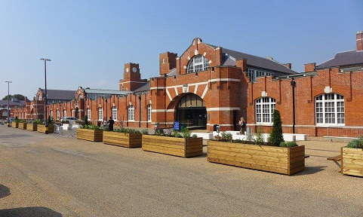
Context
Notes:
My context is a slightly unusual one. I work at the Drill Hall Library in Medway, meaning that I support students from 3 different institutions. Each has their own programmes, committees and cultures, and each uses different technologies for their Virtual Learning environments, database providers and other essential functions. While this can be confusing for us in the library, it does mean that we are in the habit of making as much of our work institution-neutral as possible. So what I am talking about today has already been applied to my work with 3 very different institutions.
Within the Drill Hall Library, I work with healthcare students from all 3 universities, on courses leading towards professional registration in such roles as nursing, midwifery, pharmacy, speech and language therapy, paramedics, radiography etc. A large part of this involves training and teaching, ranging from practical hands-on workshops to delivering more theoretical lectures as part of modules on research skills and evidence-based practice.
Working alongside the academic teams for these courses, it soon became apparent that our involvement with them is most definitely about preparing the students for the world of professional life post-graduation as well as getting them through their studies. Of course, we all believe this is true for all the people we work with, but I found a lot of evidence that this was an explicit requirement, particularly whenever the words “evidence-based practice” floated across the horizon.

Slide 4

What employers want:
Investigations
Notes:
Being a curious sort, I wanted to see if there was written evidence that I wasn’t making this up. Starting with the Nursing and Midwifery Council as well as the Health and Care Professions Council, who are the two key regulatory bodies for the health professions, I began to find out what is expected of students and new professionals with regard to information literacy, or information skills, or whatever you want to call the library value-added.

Slide 5

What employers want
Notes:
Pleasingly, as I researched, a picture of general agreement emerged. The health professions absolutely want their new recruits to have skills in the digital and information sphere, and they want these to be taught as part of their university education. In some cases, these are also explicitly referenced in the codes of conduct which all registered professionals must abide by.
Enough preamble! What do these bodies actually say? I could use all the time remaining to just read out key quotes, but I won’t do that – I’ll provide some links for further reading. In general themes, however, there is a very clear picture, particularly where reference is made to evidence-based practice. This is a key movement within medicine and health, which ties together a professionals’ own knowledge and experience with the needs of a specific context, patient or service user and good quality “scientific” evidence. Where evidence-based practice is mentioned in standards for education and training, this breaks down into a number of areas, some of which should sound extremely familiar.

Slide 6
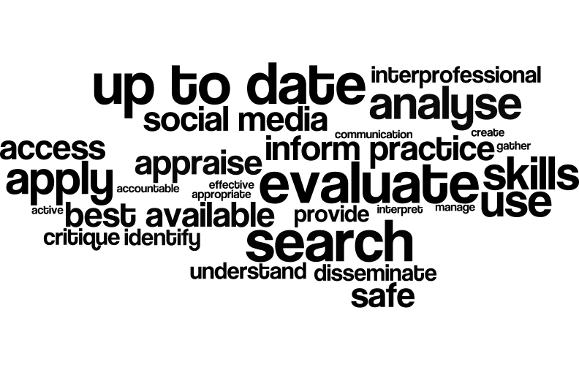
What employers want
Notes:
This slide shows relevant words used in the documents from the various professional bodies, particularly the standards for education and training. Looking at them, they gather quite neatly into some general areas. Identifying an information need. Searching for and gathering information. Critiquing and evaluating information. Using and disseminating information. That’s beginning to sound suspiciously like a lot of our models for information literary such as SCONUL’s Seven Pillars or ACRL’s Information Literacy Competency Standards. One particular section of the standards for midwifery education is a particularly good match – “it is essential that the best available evidence informs midwifery practice. This is achieved by searching the evidence base; analysing; critiquing and using evidence in practice.”
If you then add in references to informed and professional use of social media, another really key theme, it’s a Full House of the areas of the digital literacy sphere which we might normally think of as belonging to our professional sphere.
Comparing these educational requirements to documents relating to practicing professionals was also interesting. In almost all cases, the same skills and behaviours are manifested in codes of conduct, professional standards and competency documents as are found in the education and training standards documents. The Nursing and Midwifery Council’s Code of Conduct includes a section headed “Always practice in line with the best available evidence.” Everyone knows that a dog is for life, not just for Christmas. Thankfully, the medical and health professions recognise that information literacy is for life, not just for university.

Slide 7
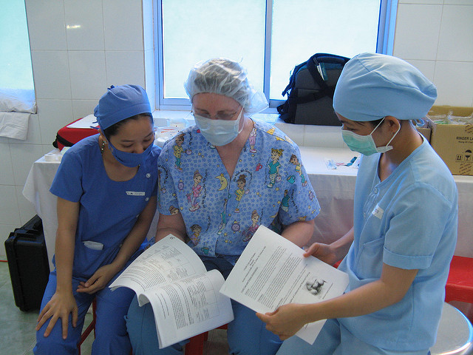
How we can use it:
Staff
Notes:
Good news for us then! We’re not just making our role up, and the skills we can teach have a real impact in the workplace, or should anyway. So what do we do about it?
First, we can use the documents to help frame discussions with academic staff. Having concrete educational requirements to point to does wonders in a conversation where you’re trying to explain why library input would be beneficial. You may need to cross-reference to something like CILIP’s Professional Skills and Knowledge Base – I can’t be the only person to have had conversations with other staff who (quite understandably) have no idea what it is that librarians do and know, so it is useful to be able to show that the areas which I am highlighting are indeed areas within my professional area.

Slide 8
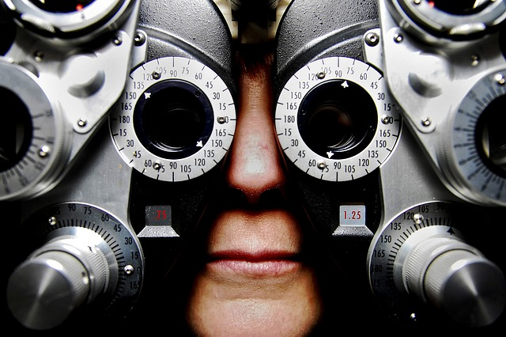
How we can use it:
Students
Notes:
Secondly, you can use this information to snare those students who are sitting in your sessions with a “why am I here?” look on their faces and determinedly crossed arms. Sometimes the carrot of “this can help you get better marks” isn’t enough, so we can make the carrot extra juicy with these standards. Like most of us, I tend to start sessions by saying what I’m going to cover. It’s relatively easy after that to add a quick “why?” if necessary, including a quote from their professional body which ties in with the session. For instance – The HCPC says that paramedics must “be able to evaluate research and other evidence to inform their own practice” and the skills we’re learning today are a key part of that.
Reference to the standards can therefore help students see the point of our sessions more clearly.

Slide 9
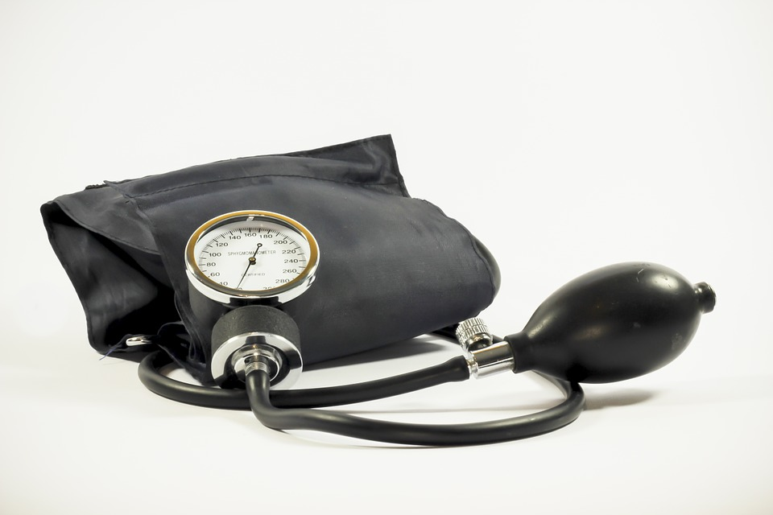
How we can use it:
Ourselves
Notes:
Thirdly, the standards, principles and so on can help structure information literacy work. Knowing what is required by students’ future employers provides a set of goals which may match or complement their programme’s learning outcomes. These skills are skills which are unlikely to be taught by anyone else the students come into contact with, so we can use these standards to assess whether our work is achieving what the students need. Are we covering all the skills required by their professional body? Are we providing sessions which will build to a point where they are equipped as information literate professionals?
So that’s the theory, how has this worked out in practice? I’ll talk now about 3 different sessions I’ve run which have incorporated the health profession’s standards in different ways.

Slide 10
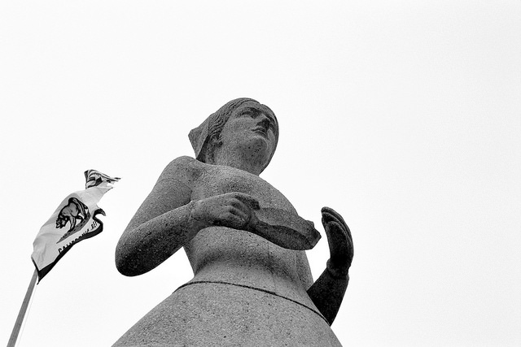
Example 1 : PNP
Notes:
One session which I have run and which colleagues have run at the Canterbury campus of Canterbury Christ Church University is entirely structured around the requirements of a professional body. The Royal College of Nursing publishes a set of Principles of Nursing Practice, 8 statements which are intended to encompass the behaviours and attitudes of the nursing workforce.
These statements have proven to be a useful way to structure an information literacy session part way through students’ first year, which allows for the introduction or practice of several key skills. Some of the Principles are rather lengthy, so we work together as a whole group to boil one of them down to a couple of key phrases, which is a useful way in to the practice of developing keywords for searching. The students then work in smaller groups to develop keywords for other Principles, before I demonstrate how to use these to locate relevant information. Students are then given opportunities to search using the Principles of their choice, and the session is intended to show that the same skills and approach are used regardless of where the search may be carried out.
Following these activities, if there is sufficient time remaining, I highlight Principle F, which helps demonstrate the ongoing value of the skills which are covered. This principle – “Nurses and nursing staff have up-to-date knowledge and skills, and use these with intelligence, insight and understanding in line with the needs of each individual in their care.” – includes the concept of evidence-based practice and information literacy as well as the more general idea of continuing professional development. The guide which expands on the principle specifically mentions the importance of nurses being able to identify, appraise and analyse the latest research, advocating the use of a range of different information sources. This can lead to some quite interesting discussions!

Slide 11
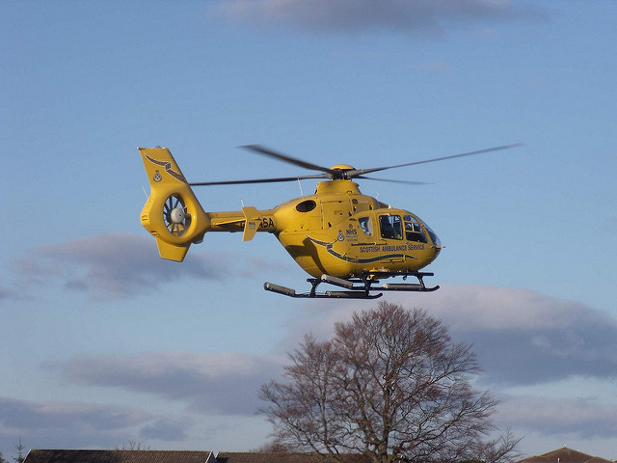
Example 2: Exploration
Notes:
Another session I have run with various different health profession students in second and third years of their courses was developed following a request from Paramedic Science to help their students see the value of material that wasn’t written with paramedics in mind. This is a particular issue for this group of students, as it is a very young discipline academically, but it is not exclusive to them.
Using the intended outcome of introducing students to resources outside of their own profession, I was able to structure the session to cover several of the skills which surface in the professional standards and which tie in to our own information literacy frameworks, particularly identifying a need for information, gathering information and appraising it – in this case, appraising unfamiliar information sources to assess their relevance to a particular information need.
I have used a variety of different activities to support this. As an introduction, I normally unload a whole load of books which refer to a particular topic and challenged students to locate information on this topic and assess whether it relates to their own professional context – with paramedics, the topic of airway management has proven effective. This has led to some very lively debates, which I tend to be able to steer rather than participate in actively. Generally, the conclusion has been that almost all of the information written with other professions in mind is equally relevant to their practice, though some contextual adaptation may be needed.
I also get the students to explore an electronic information resource which is more or less explicitly aimed at a different professional group. Paramedics look at the British Nursing Index. Obviously with particular topics in mind which will surface relevant information! There is always some initial reluctance to overcome, but this has proved to be an eye-opener to many students, that they can find really high quality information by widening their horizons.
Although paramedics are the profession to have entered the higher education sphere most recently, the general idea and structure of this session is just as relevant to other professions. Nursing as a profession has a veritable mountain of literature devoted to it, but this still applies. The Royal College of Nursing has an information literacy competency framework which states nurses should be able to show they have knowledge and understanding of how to “access and use sources from other disciplines, for example medicine, management, education or social care”, and the concept of an interprofessional aspect to evidence-based practice occurs in several of the other documents I’ve been referring to.
The principles of this session are easily adaptable to nursing or other professions – for instance, child nursing students might look at a mental health issue and use the British Education Index for a search outside their usual area.
Academics have confirmed that following these sessions the rate of citation of relevant, quality material ostensibly aimed at other professions has increased.

Slide 12
Example 3: Tweetorial
twɪtə
Notes:
Reference to standards and guidelines was also key to understanding how to structure a “Tweetorial” I was asked to facilitate to introduce the idea of using Twitter in professional practice to Speech and Language Therapy students. While aspects like what Twitter is and the mechanics and conventions of its use are generic, it was the use of regulatory bodies’ material which was able to make the session practical and relevant for the students. The Health and Care Professions Council provide some light touch guidelines on social media use, which basically translate to “don’t break the Code of Conduct” online. Referring therefore to these guidelines and the “Standards of conduct, performance and ethics” allowed the session to become a living, breathing one, including a properly informed debate about acceptable uses for social media, rather than a dry “how to” followed by a list of recommended accounts to follow.
Other sessions which have developed either directly out of engagement with professional standards or using them to inform the structure have included sessions focussing on sources which will be available to students after leaving university. In these sessions, I have tried to get students to understand and experience that use of these sources is governed by the same skills and knowledge as use of university-subscribed sources. This can be government, NHS or independent sources.

Slide 13
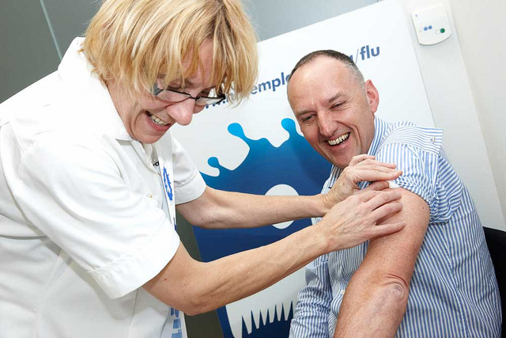
Why it matters
Notes:
This all matters in several different ways. A current “big thing” in UK higher education is employability, and this work ties in very closely to that in a demonstrable way. Of course there is still an element of “how to deal with the IT system” and certainly quite a lot of “you need to do this if you want good marks”, but engagement with the wider professional context of these skills and knowledge makes my work more interesting and rewarding, and also gives greater value to the contact time for the students. Recent research by Informall (which I heard about too late to add to the references section of these slides) suggests that graduates as a whole are not very good at transferring their alleged transferable skills from the ivory tower of higher education to the real world of work. Aligning our work with what employers say they want, introducing the use of resources which will be available beyond their university career and therefore emphasising real world use of the skills we teach and habits of mind we would like to engender may go some way towards addressing this problem.
One of my favourite feedback comments, which came from the Principles of Nursing Practice session was “Wasn’t new, but I really needed reminding how to search keywords and phrases. I’ve been getting it wrong for weeks!” I feel this really shows how what we teach or train is really more about fundamental skills than it is about the interface of the particular database or discovery system we are working with.
So, professions outside of librarianship certainly value the skills and competencies which form part of our domain. These can be a useful tool to open up conversations with academics, engage students and structure information literacy delivery. Making this explicit can help students understand the ongoing importance of our sessions and materials.
Before I put up the obligatory “any questions” slide, I thought I’d address one burning question. What about professions outside of health?

Slide 14


“But wait…”
Notes:
Well, the short answer is I don’t know, but we are in the process of finding out. Many university qualifications are accredited or validated by external bodies in science, journalism, business, education and so on. These organisations must have criteria for validation and hopefully will have them freely available online. The evidence-based practice movement has spilled out well beyond health and medicine, into education, librarianship and other spheres. And digital literacy is a key buzz phrase. I have no doubt that librarians working with students heading into a wide variety of professions can use these ideas in their own contexts.

Slide 15

Questions?

Slide 16
References and reading 1 - HCPC
HCPC (2014a) Standards of education and training. London: Health and Care Professions Council. Available at: http://www.hcpc-uk.org/publications/standards/index.asp?id=183. (Accessed 3rd Feb 2016).
HCPC (2014b) Standards of proficiency – speech and language therapists. London: Health and Care Professions Council. Available at: http://www.hcpc-uk.org/publications/standards/index.asp?id=52. (Accessed 3rd Feb 2016).
[see also similar documents for other allied health professions]
HCPC (2016) Standards of conduct, performance and ethics. London: Health and Care Professions Council. Available at: http://www.hcpc-uk.org/publications/standards/index.asp?id=38. (Accessed 3rd Feb 2016).
HCPC (no date) Use of social networking sites. Available at: http://www.hpc-uk.org/registrants/standards/socialnetworking/ (Accessed 3rd Feb 2016).

Slide 17
References and reading 2 - NMC
NMC (2009) Standards for pre-registration midwifery education. London: Nursing and Midwifery Council. Available at: http://www.nmc.org.uk/standards/additional-standards/standards-for-pre-registration-midwifery-education/. (Accessed 3rd Feb 2016).
NMC (2010) Standards for pre-registration nursing education. London: Nursing and Midwifery Council. Available at: http://www.nmc.org.uk/standards/additional-standards/. (Accessed 3rd Feb 2016).
NMC (2015) The Code: professional standards of practice and behaviour for nurses and midwives. London: Nursing and Midwifery Council. Available at: http://www.nmc.org.uk/standards/code/ (Accessed 3rd Feb 2016).

Slide 18
References and reading 3 - Other
GDC (2011) Preparing for practice: Dental team learning outcomes for registration. London: General Dental Council. Available at: http://www.gdc-uk.org/Dentalprofessionals/Education/Pages/Dental-team-learning-outcomes.aspx (Accessed 3rd Feb 2016).
GPhC (2011) Future pharmacists: Standards for the initial education and training of pharmacists. London: General Pharmaceutical Society. Available at: https://www.pharmacyregulation.org/education/education-standards (Accessed 3rd Feb 2016).
Physician Assistant Managed Voluntary Register (2012) Competence and Curriculum Framework for the Physician Assistant 2012. London: Royal College of Physicians, Faculty of Physician Associates.
RCN (2010) Principles of nursing practice. Available at: https://www.rcn.org.uk/professional-development/principles-of-nursing-practice (Accessed 3rd Feb 2016).
RCN (2011) RCN competencies. Finding, using and managing information: nursing, midwifery, health and social care information literacy competencies. London: Royal College of Nursing. Available at: https://www.rcn.org.uk/professional-development/publications/pub-003847 (Accessed 3rd Feb 2016).

Slide 19
Image credits
ReSurge International (2007) doctor and nurses. Available at: https://flic.kr/p/3myrjH (Accessed 26th February 2016).
Michael Fraley (2014) Laguna Honda Hospital 03. Available at: https://flic.kr/p/oFVXz1 (Accessed 26th February 2016).
Dave Conner (2009) Air Ambulance – Inverness Scotland. Available at: https://flic.kr/p/5WKEqJ (Accessed 26th February 2016).
NHS Employers (2012) Nurse jokes with patient. Available at: https://flic.kr/p/doTUxZ (Accessed 26th February 2016).
Other images available from Pixabay under CC0 licence. https://www.pixabay.com

