Slide 1
Copyright Literacy Survey Review
Jane Secker and Chris Morrison
LSE and University of Kent
Notes:
Photo: Adventures in Copyright from Flickr licensed under CC: https://flic.kr/p/9dyrHe

Slide 2
Copyright
Notes:
Jane to provide a background to study (e.g. presentation at ECIL).
Explain why we should study this now (e.g. copyright reform and position of libraries).
Something about how even back in 1993 Follett Review of Libraries recognised the increasingly important role librarians would play in copyright issues – related to the electronic environment
Mention the previous study by Oppenheim

Slide 3
Copyright !? Get me out of here
Notes:
Jane to provide a background to study (e.g. presentation at ECIL).
Explain why we should study this now (e.g. copyright reform and position of libraries).
Something about how even back in 1993 Follett Review of Libraries recognised the increasingly important role librarians would play in copyright issues – related to the electronic environment
Mention the previous study by Oppenheim

Slide 4
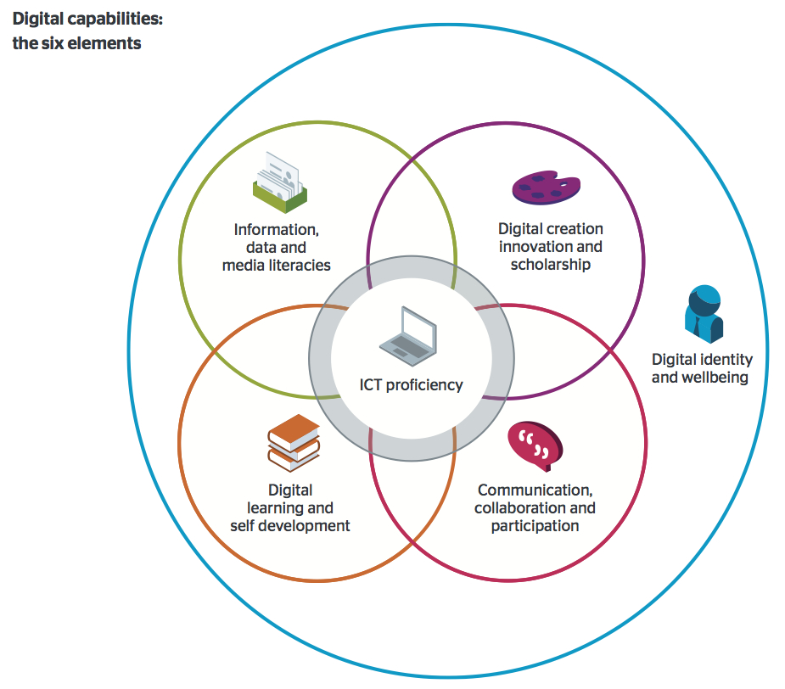
What is Copyright literacy & why does it Matter?
I think awareness of copyright and the intellectual property of other people is central to the 'information, media and data literacy' element of the digital capabilities framework.
Understanding one's own copyright and IPR also comes into 'creation, innovation and scholarship'. And I don't think it's too far-fetched to argue that in an academic setting, copyright has implications for academic identity.
Helen Beetham writing about digital capability in 2015
Jisc (2015) Six Elements of Digital Capabilities
Notes:
The quote you might be thinking of comes from a report that is still only in draft, but which I've mentioned at a couple of events. The key point I make here (headlined) is that 'Institutions need digital specialists but also distributed digital know-how'. I go on:
Everyone needs to know enough about how digital technology is impacting on their subject area or professional practice:
to act safely and responsibly with digital data and systems;
to meet legal requirements e.g. data protection, equal access, reasonable adjustments, copyright;
to avoid reputational damage to themselves or their organisation;
to realise the value of technologies that have been invested in on their behalf;
to play their part in institutional processes that are dependent on IT systems e.g. QA, assessment;
to access relevant specialist expertise when they need it for particular tasks or challenges.
I have also given copyright/IPR as a specific example of this requirement for generic know-how to draw on specialist expertise - and for both to be invested in. So most HEIs now have someone with expertise in copyright law who can act on behalf of the University in defence of its own IPR and can also advise in cases where individual members of the university are accused of breaches. But all members of staff need to know that the issue exists, that they have individual responsibilities including under the law, that they can damage their own and the university's reputation by acting carelessly, and that there are resources of advice and support available should they need it

Slide 5
Some key dates
1993 Copyright recognised as important in the electronic environment: Follett Review of Libraries
1999 CLA launch first scanning licence to allow digitisation of readings via transactional clearances
2004 Oppenheim and Woodward survey of copyright advice and guidance in UK higher education libraries
2014 significant amendments including new exceptions to Copyright, Designs and Patents Act 1988 and orphan works licensing scheme
2005 first blanket licence from CLA to allow scanning from paper and copying digital originals – with reporting
Notes:
There are many other dates that could go on here though
2003 EU directive

Slide 6
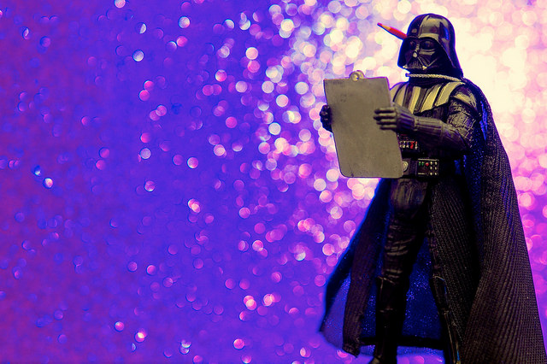
methodology
Notes:
The survey was made available online using the open source survey tool: LimeSurvey and consisted of 4 sections. It included closed, half-open (through applying 5-degree scale of Likert) and open questions.
The survey aimed to establish the knowledge and awareness of the respondents on issues of copyright.
It also explored the attitude of the respondents towards the development and application of copyright policies in library and cultural institutions.
The survey examined attitudes towards the education and continuing professional development of information professionals about issues of intellectual property, for example in programmes on library and information science, archival science and cultural heritage sciences. Finally the survey gathered demographic information and information about the educational and professional experience of the respondents.
The target group were managers and professionals responsible for the information service of users in library and other cultural institutions (archives, museums etc.). The intention was that as many library and information professionals and cultural heritage workers would complete the survey as possible with the aim of collecting data from the profession as a whole, and not from those with specific responsibility for copyright. Multiple submissions were therefore encouraged from staff at the same institution.
Talk about survey instrument with mostly closed questions, translated into English and then tweaked for the UK. Mostly quantitative data with some qualitative.

Slide 7
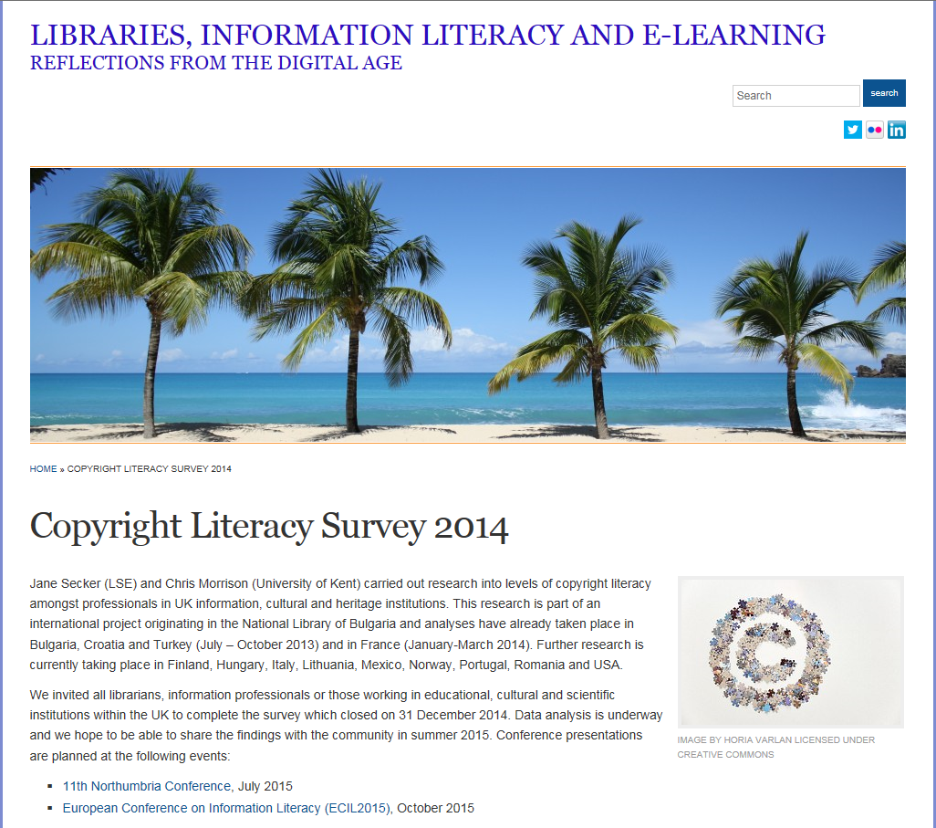
Notes:
5 minutes
Jane

Slide 8
findings
Notes:
CM to dump the relevant charts

Slide 9
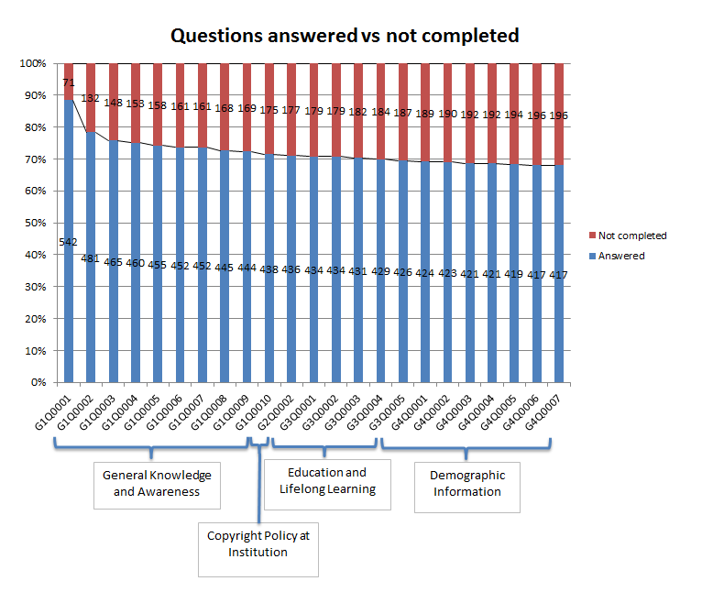
findings

Slide 10
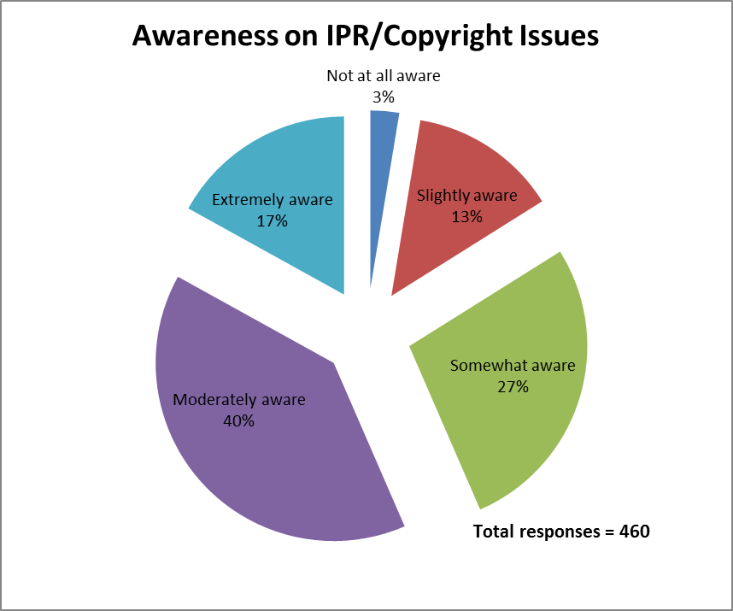

Slide 11
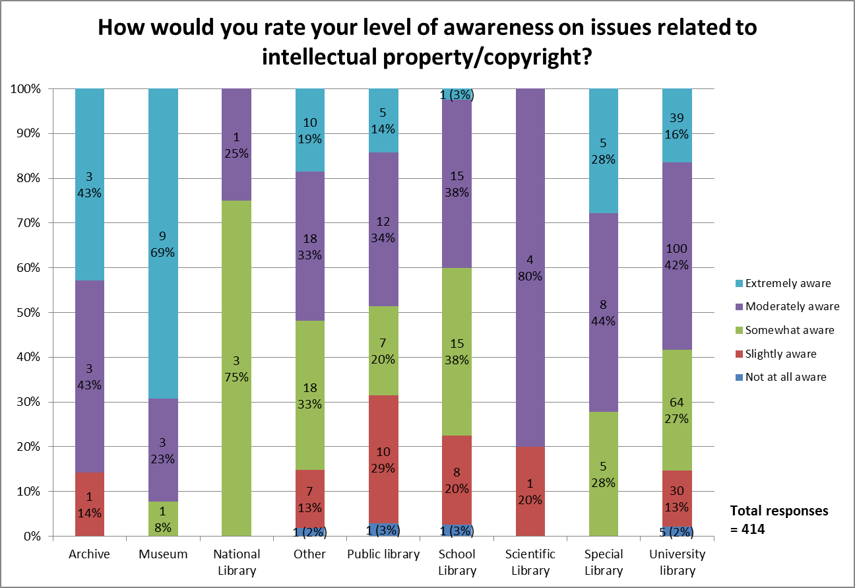

Slide 12
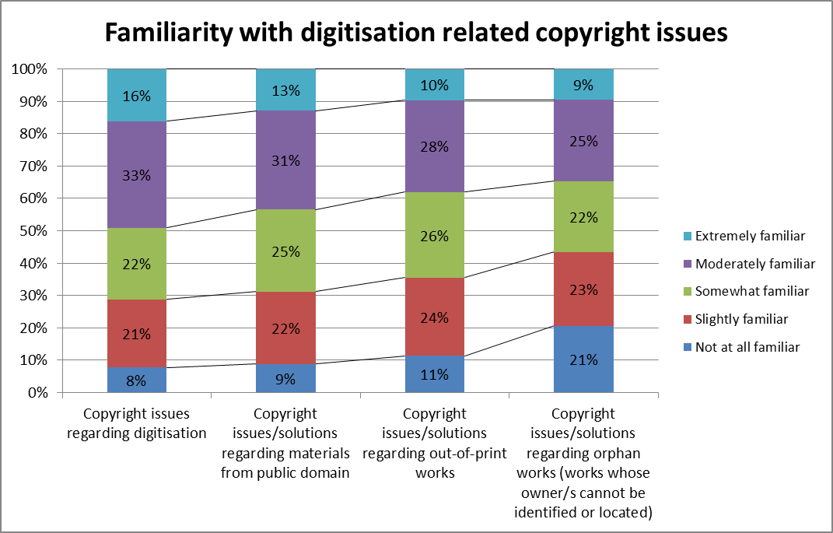

Slide 13
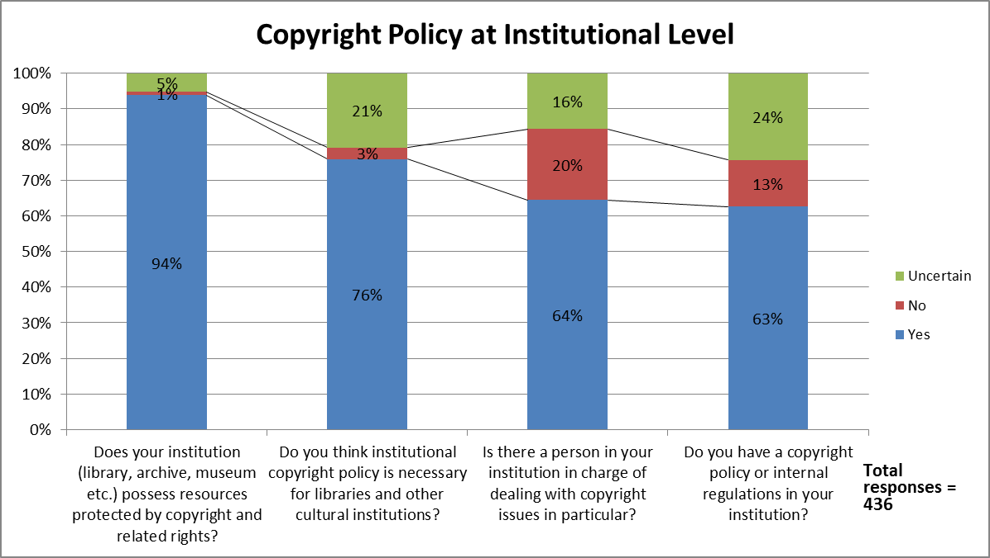
Notes:
Just mention the comparison with overseas institutions rather than show another slide. 71% in the Todorova report said they had no personnel specifically appointed to be in charge of copyright issues.

Slide 14
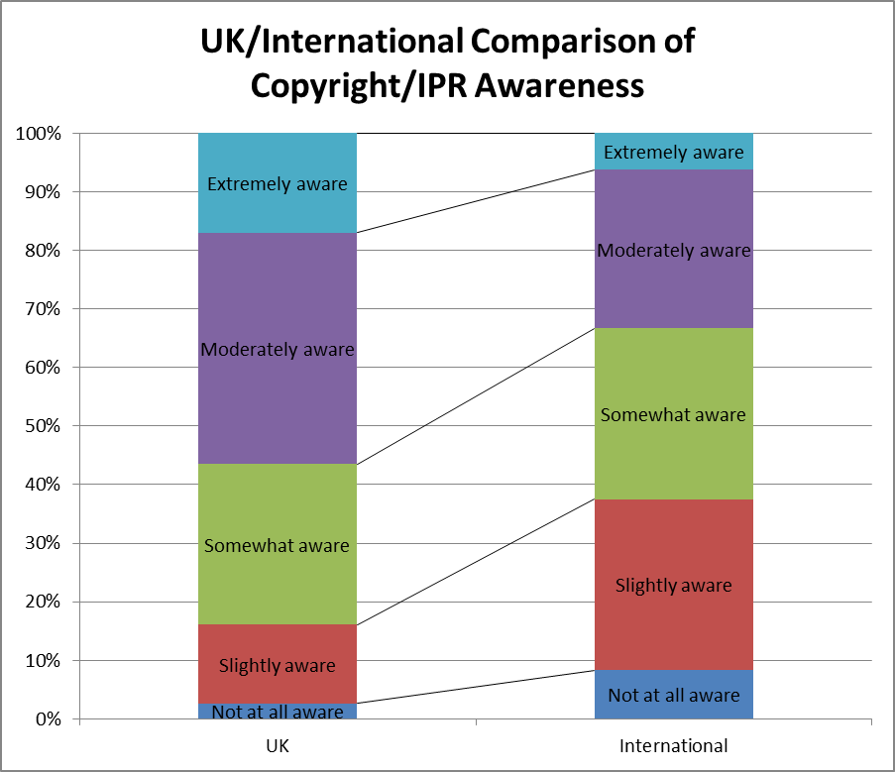
Notes:
Note – we don’t have access to the full data so this isn’t really that accurate a comparison – The Todorova statistics (p.143) only add up to 96% so I’m assuming that the other 4% didn’t answer. This is in contrast to our findings where 25% didn’t answer this question. However we had 460 responses.
Todorova does say that of the international responses the self-evaluated awareness level is lowest for Croatian and Bulgarian respondents and highest for the French. The Turkish respondents had moderate levels of awareness.

Slide 15
LIS Education and CPD
Topic / Issue | LIS Education | LIS CPD
Overview of UK copyright legislation | 68 | 48
Recent updates to the law | 6 | 67
Copyright exceptions / relation to licences | 43 | 23
Practical application of copyright law | 34 | 30
Digital copyright / copyright and the internet | 33 | 20
Creative Commons / copyleft | 31 | 15
Fair dealing | 27 | 16
Specific Licensing schemes e.g. CLA, ERA | 27 | 15
As per previous answer | 0 | 41
Exceptions for libraries | 24 | 15
Open access and institutional repositories | 23 | 15
International copyright law | 20 | 14
Licensing of digital resources | 20 | 13
How to protect IP | 16 | 17

Slide 16
Education & cpd: what should it cover?
General copyright awareness / copyright duration/ using images /fair dealing and quotation / digital content rights / creative commons / understanding terms & conditions & re-use licenses / implications of non-compliance (but in a good way using carrot not stick)…. Whatever it is it needs to be clear and as jargon free as possible to stop people glazing over.

Slide 17
Education & cdp: what should it cover?
General copyright awareness / copyright duration/ using images /fair dealing and quotation / digital content rights / creative commons / understanding terms & conditions & re-use licenses / implications of non-compliance (but in a good way using carrot not stick)…. Whatever it is it needs to be clear and as jargon free as possible to stop people glazing over.

Slide 18
Focus on positives
Copyright education should:
…reflect the fact that most LIS practitioners have significant exemptions and freedoms as regards copyright. Much existing copyright education is effectively written from a commercial rightsholder perspective and tends to be unduly dogmatic as a result.

Slide 19
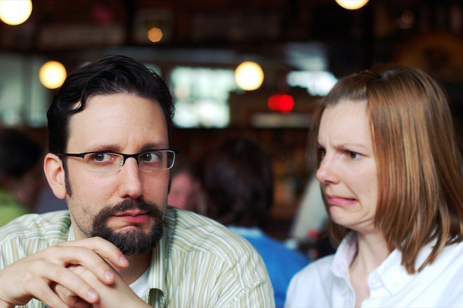
Feel the fear
I think copyright can seem daunting if you are not familiar with it, and by encouraging an awareness at an early stage, this would reduce any anxieties to follow.
I find that people are often scared of copyright…

Slide 20
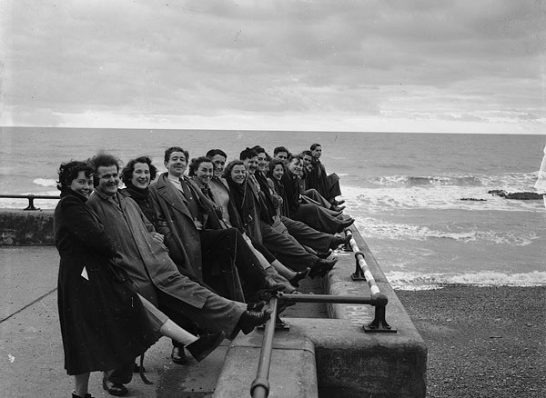
Embedding in LIS education
I have just finished my MSc and we had limited information on copyright law provided, the little I know I know because colleagues have shared it with me.
I don't remember copyright issues being addressed at all in my Postgraduate course and I think this was unfortunate.

Slide 21
Keeping up to date
…I still need to know what I am allowed to do and for whom, especially as digitisation has changed the field completely. We need updates on how legislation has changed and what a difference this makes to our work.

Slide 22
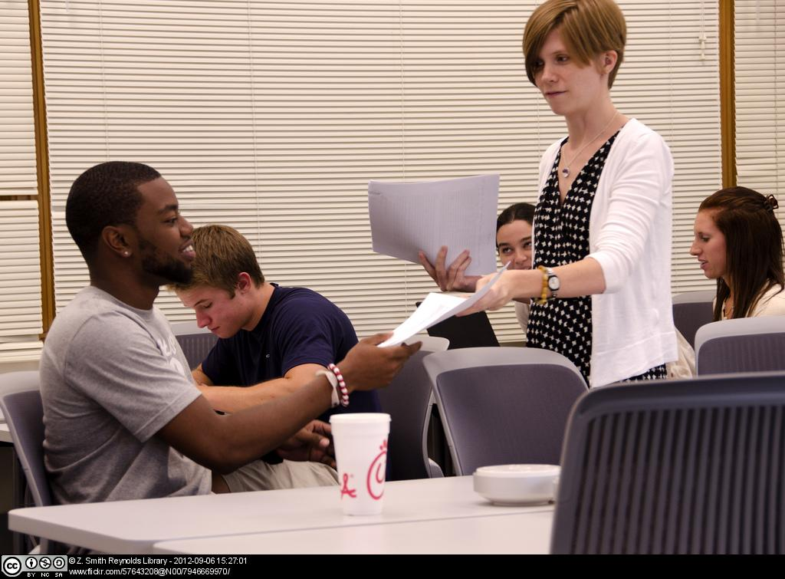
Train the trainers
Encouraging more general awareness of copyright issues so librarians/info specialists can educate academics about complying with copyright law. Also practical awareness for students’ creative work and using [copyright] material in their own work.

Slide 23
So what does this mean?
Notes:
Where next and implications for performance measurement -
How do you measure that your are doing the right thing?
Methodology and shortfalls of our study
How best to provide copyright support
Confidence vs knowledge

Slide 24
Copyright Support models
Should institutions have a dedicated person or should everyone do a bit?
Notes:
The above image was created by Access Copyright in Canada as part of an “educational” campaign. I’ve put it in here as a bit of a tongue in cheek comment about the role of the copyright officer and to that extent I think it’s ok as a quotation, a parody and illustration for instruction at the event itself. However I wouldn’t post this on the web.

Slide 25
Embedding and measuring copyright literacy
Notes:
Measuring the impact of copyright illiteracy?
Baselining
Measurement of copyright enquiries – of no questions that is a worry! You want your queries going up!
Jane’s examples of embedding copyright into other sessions – like children and vegetables! E-learning and creating content (includes copyright and CC)
Teaching in a Digital Age – has loads of things about copyright in it including a whole week what was dedicated to open education and CC

Slide 26
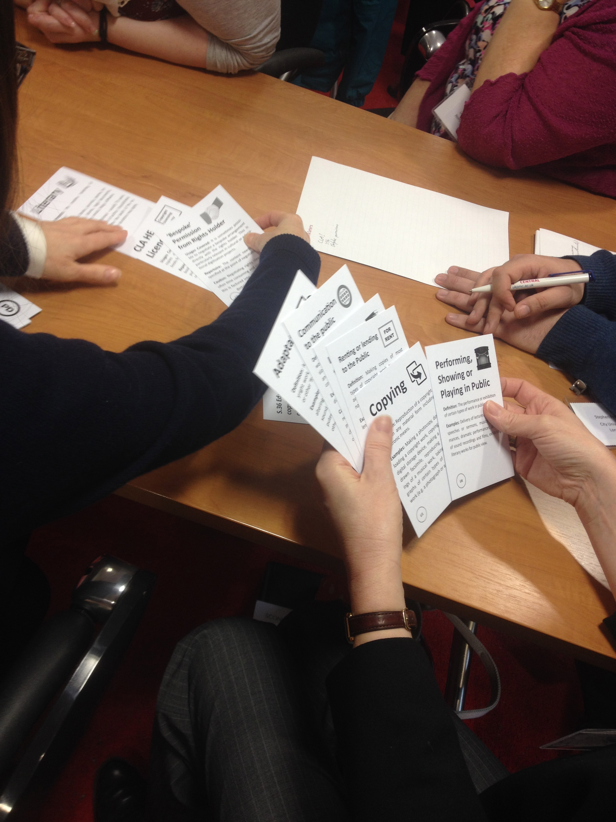
Conclusions and further research
Need for more cross country analysis
Librarians likely to compare favourably to other professionals?
Need more qualitative data to investigate
How copyright literacy is effectively embedded
How to develop a effective approach to copyright literacy
Understand the role of the generalists vs dedicated copyright professional
More engaging training

Slide 27
References and futher reading
Morrison, C. (2015) Copyright the Card Game. Retrieved on July 20, 2015 from: http://find.jorum.ac.uk/resources/19369
Morrison, C. & Secker, J. (2015) Copyright Literacy Survey: high level summary. Available at: https://janesecker.files.wordpress.com/2015/06/copyright-literacy-uk-high-level-summary-report-morrison-secker-20151.pdf
Oppenheim, C. & Woodward, I. (2004). A survey of copyright advice and guidance in UK higher education libraries. Library and Information Research, 28, (89). Retrieved July 13, 2015 from http://www.lirgjournal.org.uk/lir/ojs/index.php/lir/article/view/167/214
Secker, J. (2010) Copyright and E-learning: a guide for practitioners. Facet Publishing: London (2nd edition with Chris Morrison coming in 2016)
Teaching in a Digital Age (2015). University of London International Programmes. Retrieved July 18, 2015 from: https://tda23things.wordpress.com/
Todorova, T., Trencheva, T., Kurbanoğlu, S., Dogan G., & Horvat, A. (2014) A Multinational Study on Copyright Literacy Competencies of LIS Professionals. Presentation given at 2nd European Conference on Information Literacy (ECIL) held in Dubrovnik. October 2014. Retrieved March 13, 2015 from http://ecil2014.ilconf.org/wp-content/uploads/2014/11/Todorova.pdf
Notes:
Jane to add these from the ECIL paper

Slide 28
Image Credits
Images from Flickr licensed under Creative Commons
Slide 1: Adventures in copyright by opensource.com: https://flic.kr/p/9dyrHe
Slide 3: Startled cat by Kelly Wilson: https://flic.kr/p/5XpzSf
Slide 6: Darth Grader by JD Hancock: https://flic.kr/p/pxJ3o5
Slide 17: Open by velkr0: https://flic.kr/p/mzqM
Slide 18: If you are not confused by Brian Talbot: https://flic.kr/p/frJ48
Slide 20: Video tape archive storage by DRs Kulturarvsprojekt: https://flic.kr/p/aUgdnB
Slide 21: LIB100 Classroom Fall 2012 by Z Smith Reynolds Library: https://flic.kr/p/d7dL8d
Slide 22: Signpost by Peter Nijenhuis: https://flic.kr/p/7puvNq
Others
Slide 4: Jisc 6 elements of digital literacy from: http://digitalcapability.jiscinvolve.org/wp/
Slide 15-16: Microsoft ClipArt
Slide 19: Views of Aberystwyth from National Library of Wales (no known copyright)
Slide 24 and 25 by Jane Secker licensed under CC-BY-SA

