Slide 1
Opening Up OpenStack’s Identity Service
David W Chadwick, Ioram S Sette, Kristy W Siu

Slide 2
CONTENTS
Introduction to OpenStack
Federated Access in OpenStack
Support for Virtual Organisations
Future Work

Slide 3
OpenStack
Most popular open source cloud software
Set of services accessed via RESTful APIs
  Nova the compute service
  Neutron the network service
  Swift the filestore service
  Cinder the block storage service
  Keystone the identity service
  Horizon the dashboard/GUI web access service
  Plus several others…..

Slide 4
Keystone Identity Service
Based on Kerberos design
User authenticates to Keystone
User is given an access token, either unscoped or scoped to a particular project/service
User passes scoped token to service
Service either validates token itself (PKI token) or passes it to Keystone for validation (UUID token) or uses a symmetric key shared with Keystone (Fernet token)
User is then granted or denied the requested access

Slide 5
Keystone Construction
Modular construction of interconnected services
Identity service
  Holds data about users, their groups, their pws in SQL database
  Can have an LDAP backend to hold this info
Resource service
  Holds data about projects and domains
Assignment service
  Holds data about roles, and users assigned to roles in projects
Token service
  Manages and validates scoped and unscoped tokens of all types
  Note that all tokens are currently bearer tokens
Service Catalog
  Holds information about OpenStack services and their endpoints
Policy Service
  Holds authz policy for accessing Keystone APIs (CRUD on users, roles, projects, domains etc.)

Slide 6
Keystone Authentication
Originally supported 3 authn mechanisms:
Password (un/pw stored internally or in LDAP backend)
External, meaning that Keystone was front-ended by an Apache web server that performs the authn and passes REMOTE_USER to Keystone
Token, meaning that the user already has a Keystone token
No support for federated authentication but does allow other authn methods to be plugged in

Slide 7
Protocol Independent Federated Access
In 2012 University of Kent added protocol independent federated access to Keystone by adding a Federated Authentication plugin module to Keystone
Comprised two components
Protocol independent trust management
  Trusted IdPs, Trusted Attributes, Trusted Attribute Mappings
Protocol handling component that always returned users identity attributes in the same format, essentially name/ID, set of identity attributes and IdP that issued them
  One plugin per federation protocol
  Meant that any number of IdPs and federation protocols could be simultaneously supported

Slide 8
3 Trust Filters
Trusted
IdP filter
IdPs
Trusted
Attribute
filter
Attribute
Mapping
Rules
filter
Keystone
Attributes
Attributes from
Trusted IdPs
Trusted Attributes
from Trusted IdPs

Slide 9
Federated Keystone Today
Took our design to Keystone group
They decided to support federation via Apache front end (only), to minimise their subsequent support effort
Apache federation plugin returns set of environmental variables to Keystone containing
  REMOTE_USER – authn name of user
  Identity attributes from federation protocol

Slide 10
Federated Keystone Core Release
Configured with list of Trusted IdPs
Configured with multiple sets of Mapping Rules
Configured with a Protocol which binds one set of mapping rules to one IdP
  In (mistaken?) belief that an IdP can support multiple protocols (even though Apache cannot)
  And it is best to have mapping rules per IdP protocol
Not a good design for large academic federations where hundreds of IdPs might have the same mapping rules based on eduperson schema
  Currently fixing this so that a protocol can be bound to one set of mapping rules and a set of IdPs

Slide 11
Mapping Rules
A mapping consists of a set of mapping rules. Each rule:
  Specifies the set of identity attributes that a federated user must possess
    Attribute values are listed as “any_one_of” or “not_one_of”
  A Keystone group (or user) that the user maps to
The admin separately specifies the roles and projects that group members are assigned to (via the existing assignment API)

Slide 12
Issue 1 – Accessing List of Trusted IdPs
Unauthenticated users cannot access the list of trusted IdPs, so how do you return the list for them to pick from?
  Underlying problem is with policy engine since you cannot configure public access to an API (only access to all authenticated users). Public access has to be hardcoded by skipping the policy checking step altogether
  Solution proposed is to create another API call (get public IdPs) which has no policy checking, because changing policy engine was too complex and responsibility of another OpenStack group

Slide 13
Issue 2 – No Trusted Attributes Policy
Trusted attributes policy is implicit in binding a mapping rule to an IdP
  In Kent’s design you listed the set of attributes that each IdP was trusted to issue, then had one common set of mapping rules
However, mapping rules support regular expressions, so it is possible for poorly constructed rules to accept untrusted attributes
Furthermore, once multiple IdPs can use same mapping rules, then nothing to stop any IdP issuing attributes from the set that they are not supposed to

Slide 14
Issue 3 – Requires Apache
Relies on Apache to handle federated protocol
So need the Apache plugin mod_fed_protocol to be available
Apache cannot support multiple federation protocol plug-ins simultaneously e.g. mod_shib, mod_mellon and mod_moonshot
So need a proxy IdP that talks one protocol to Apache (say SAML) and multiple protocols to other IdPs

Slide 15
Issue 4 – User Access Rights
Not all users from one IdP should have the same access rights at OpenStack and different users from different IdPs may need the same access rights at OpenStack
Solution. Create a Virtual Organisation (VO) where different users from different IdPs are mapped into the same VO role (≅ Keystone group) and will then have the same roles in OpenStack projects
Problem. IdPs will not assert the attributes that SPs need to differentiate between users
Its very difficult (almost impossible?) for SPs to get the specific attributes they need for authz to be added to corporate LDAP servers

Slide 16
Integrating VO Management into Keystone
Use the federation attribute mapping service to form VO roles/groups
Attribute
Mapping
Fe
User 1
IDP 1
Id Atts
Keystone Groups
Keystone
Id Atts 1
IDP 2
Id Atts 2
Domain,
project, roles
User 2
A Federation
OpenStack
Service
Some VO

Slide 17
Mapping Issue
VO Administrator typically does not know what unique ID the IdPs will assert for each VO member
  E.g. SAML persistent ID
Neither does the user
  unless it is a globally unique name like ABFAB Network Access Identifier - username@realm
Solution – VO Role Registration by Invitation

Slide 18
Invite Users to Register to a VO Role
VO Administrator creates a Keystone group (≅ VO role) and gives it permissions (domains, projects, roles)
Sends group name and pw/PIN to invited VO members out of band
VO member authenticates to Keystone via his/her IdP
Asks to join group and provides pw/PIN
Keystone (semi-)automatically creates a mapping rule from user’s unique IdP asserted ID to group name

Slide 19
Security Safeguards
Unauthenticated users cannot access the service
Authenticated users who specify a wrong pw/PIN 3 times are put in a black list and cannot authenticate to Keystone again until removed from it – stops pw cracking attacks
Joining a role can be made “administrator confirmed” where requests go into a pending queue to be OKed by the VO administrator

Slide 20
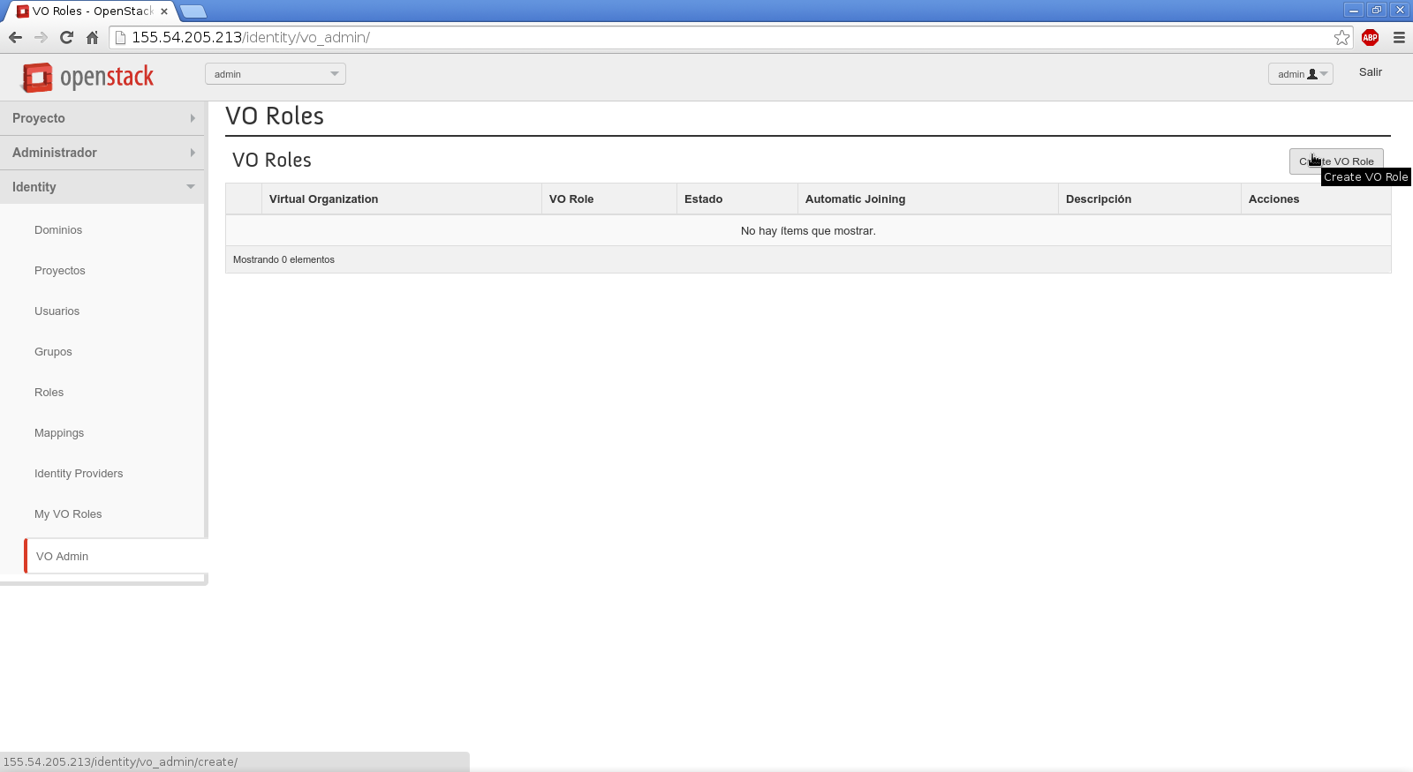
Administering VO Roles

Slide 21
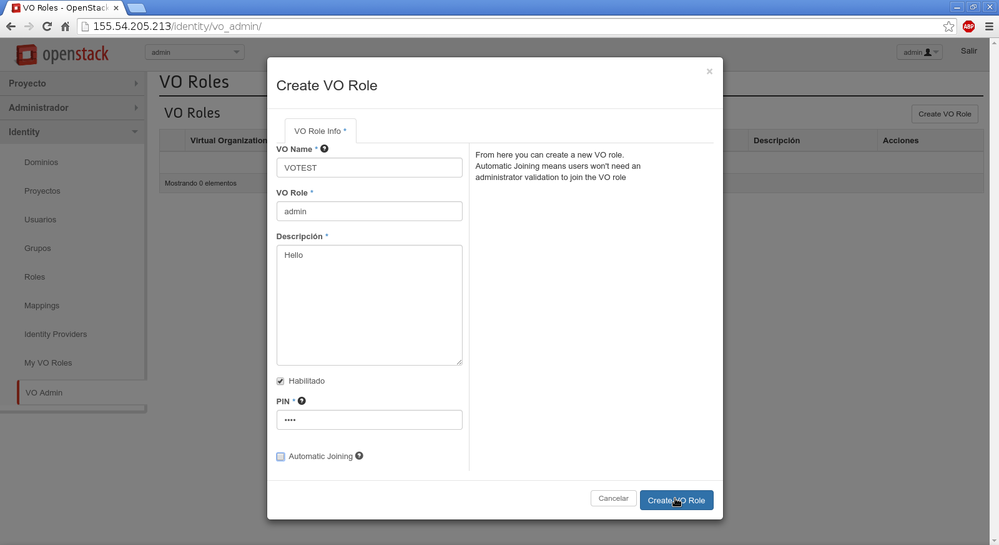
Creating a VO Role

Slide 22
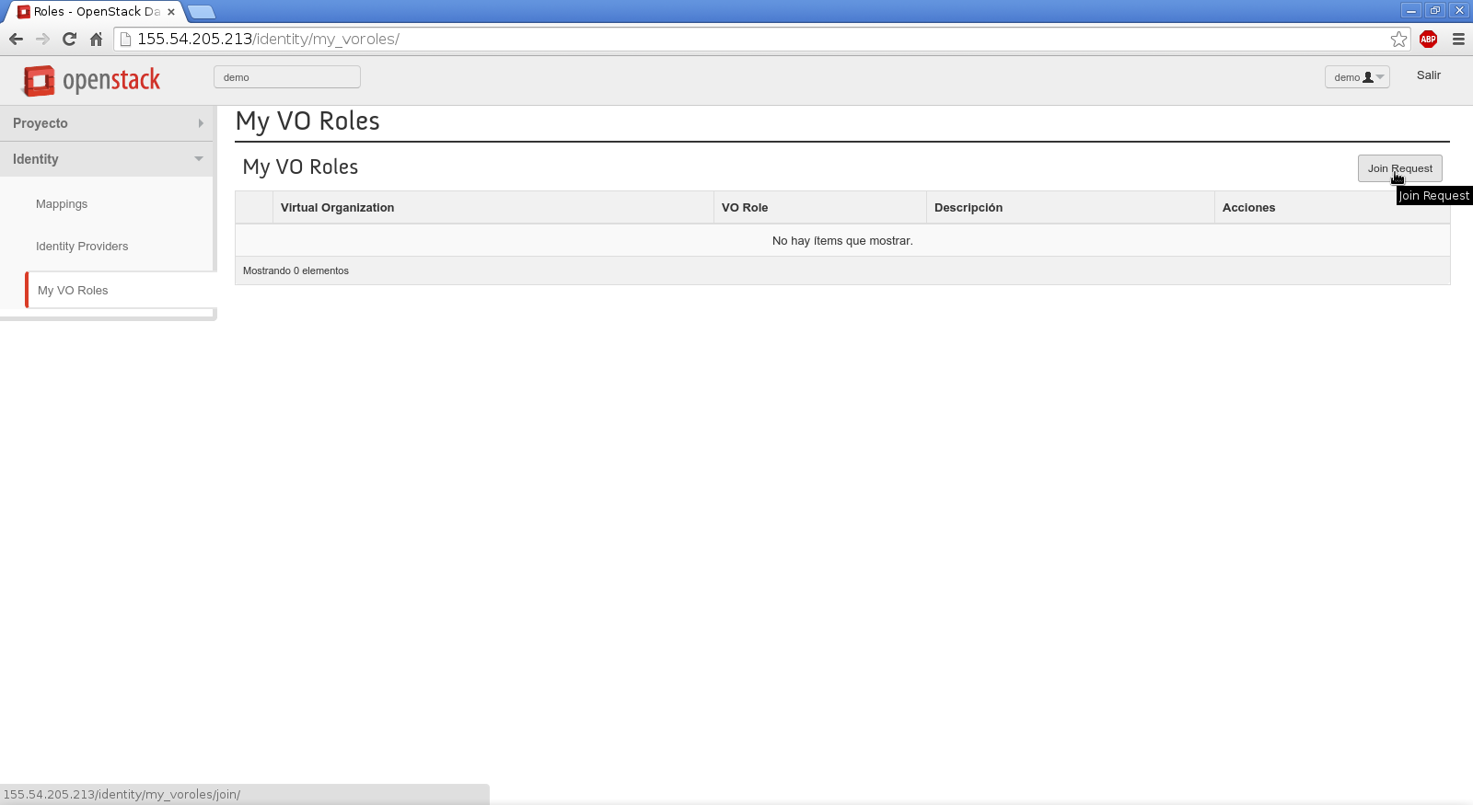
Viewing My VO Roles

Slide 23
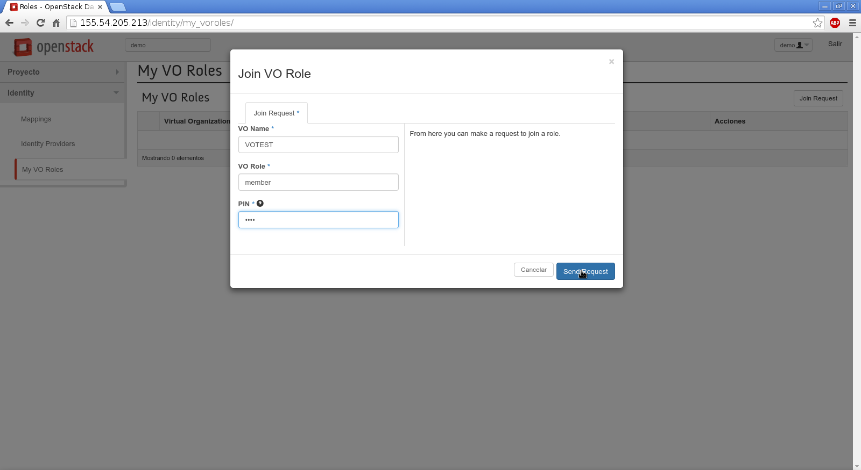
Joining a VO Role

Slide 24
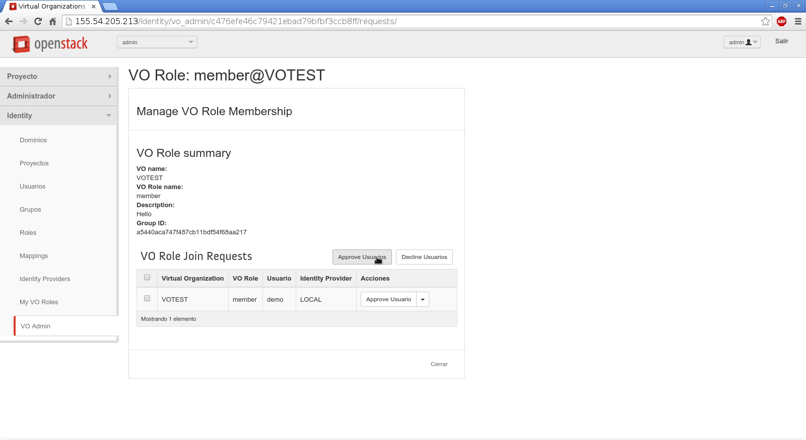
Admin Approves VO Join Request

Slide 25
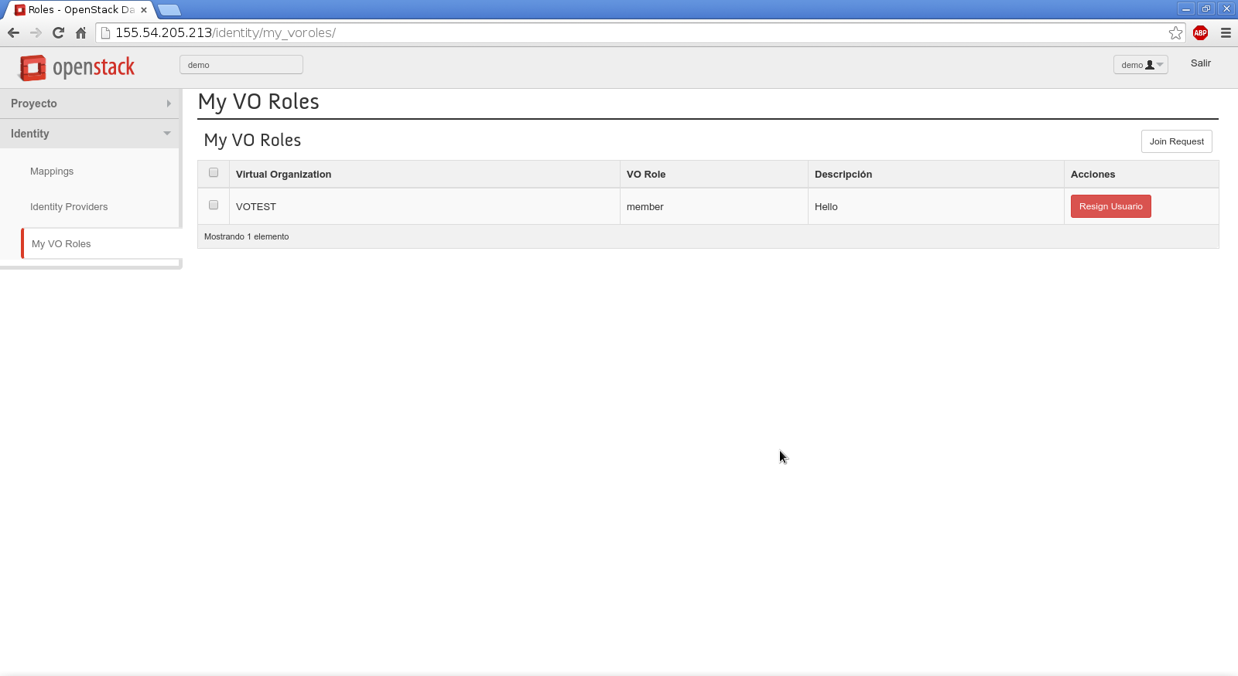
User Sees New VO Role
User can resign from VO role
anytime he/she wants

Slide 26
Future Work
Get VO concept accepted into Keystone core
Add support to share VO roles (≅ Keystone groups) between services
  API call to get VO roles
  Add code in Keystone federated authn to fetch VO roles from a remote Keystone (attribute aggregation)

Slide 27

Any Questions

