Slide 1


Dr. J. Ramlackhansingh
Hector Earnshaw
Sony Tene
Dr. Philip Chan
Are Group Stations Helpful in Selecting Medical Students as Part of Multiple Mini Interviews?

Slide 2
Outline
Background
Methods
Results
Discussion
Conclusions
Questions/Thanks

Slide 3
Background
MMIs (7 stations)
  6 stations 7 minutes each, focus different for each station
  1 group station, 40 minutes; all applicants completing previous 6 stations (plus 2 rest stations)
Group station
  Leaderless space
  7 to 8 applicants, sit in a horseshoe arrangement, facing facilitator
  Assessors (1:2) behind the facilitator, facing applicants
Discussion task (common knowledge topic)
Assessment mostly on skills relevant to teamwork, communication, and working with others.

Slide 4
Examples of characteristics assessed
Influencing others
Independent mindedness
Creativity
Feedback to others’ ideas
Realism
Emotional intelligence

Slide 5

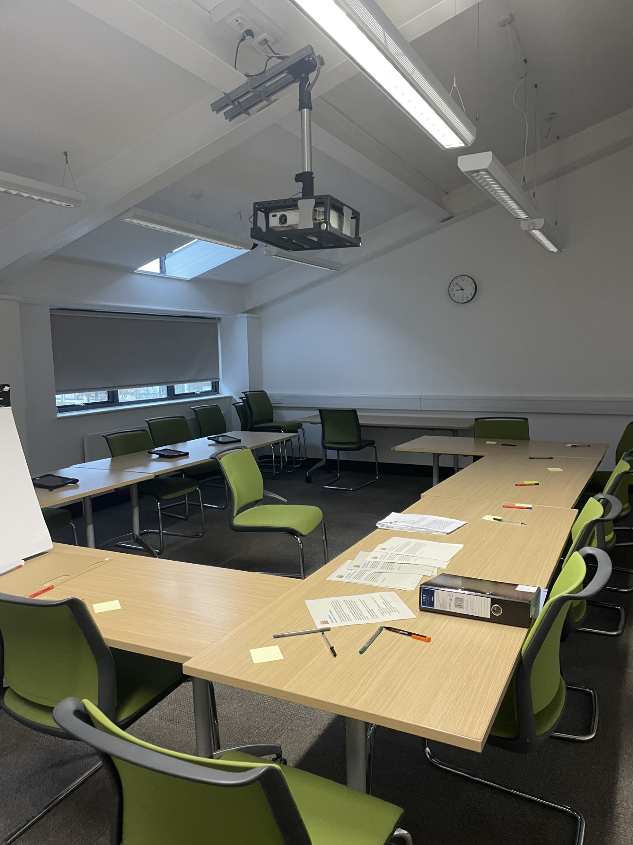

Slide 6
Methods
MMI n=478
Results of group station compared to same candidates’ scores on other MMI stations (for years 2022-2025). Rank correlation used to see if the group station reproduced any other station or contributed new information to the overall assessment.
Debrief survey n=419
Questions on the MMI stations, including group station; with Likert scale answers
Conducted by two trained student facilitators (HE,ST), with volunteers recruited after completing MMI. Structure to explore fairness, preparation, difficulty
7 Focus groups, n=30
Elements of Bourdieu’s concepts of habitus, capital, and Goffman’s dramaturgical theory used in qualitative analysis
Notes:
Need to say it was mixed methods study (explanatory sequential)

Slide 7
Quantitative Methods
Pearson’s Rank Correlation used to compare scores of each candidate on the group station to their score on each individual station.
H0: high correlation between the group station and any one of the individual stations would mean there is redundancy in the group station.
H1: low correlation with all individual stations would indicate it identifies unique candidates and adds new information to the overall assessment.

Slide 8
Quantitative Results
Station Comparison | R value (Correlation) | R Squared Value
Station 1 and Group Station | 0.166 | 0.0276
Station 2 and Group Station | 0.0420 | 0.00176
Station 3 and Group Station | 0.203 | 0.0412
Station 4 and Group Station | 0.115 | 0.0132
Station 5 and Group Station | 0.182 | 0.0331
Station 6 and Group Station | 0.180 | 0.0324
Average score Station 1-6 and Group Station | 0.314 | 0.0988

Slide 9
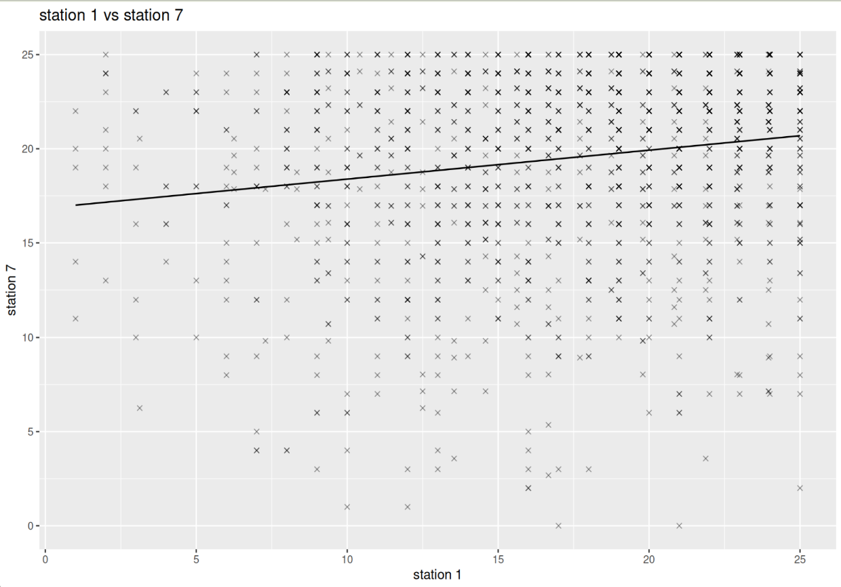
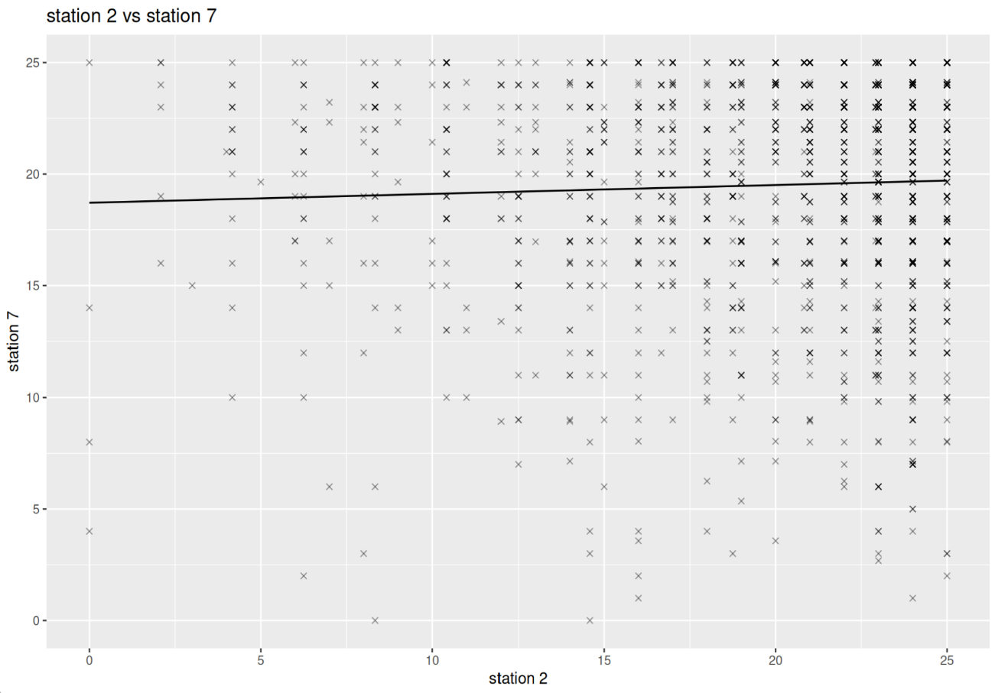
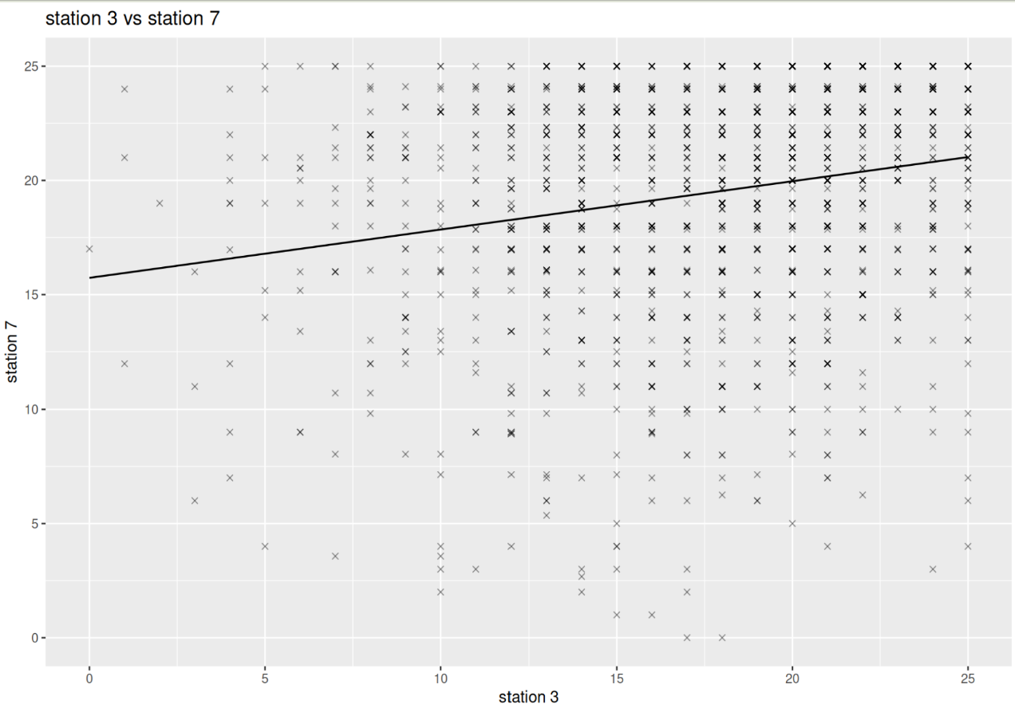
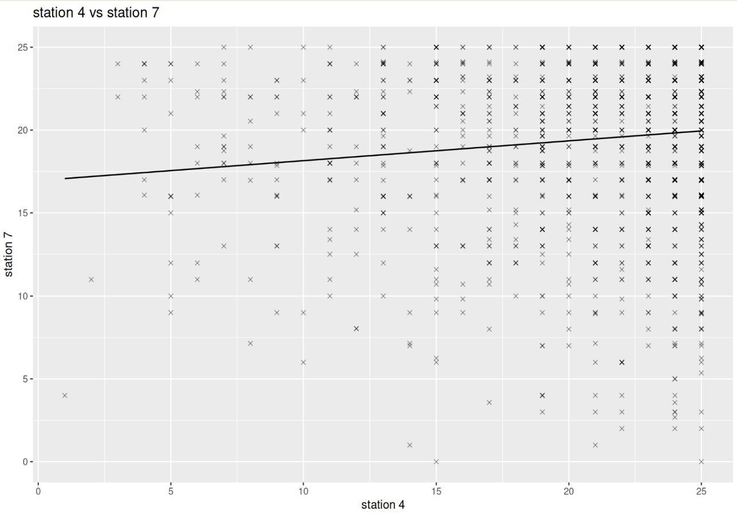
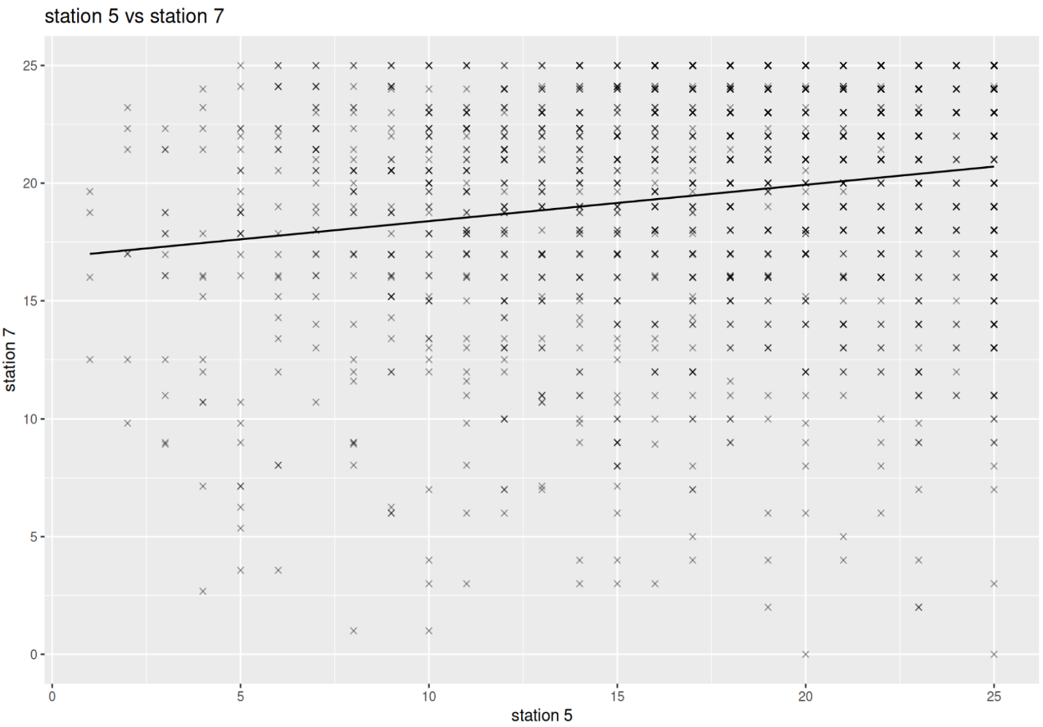
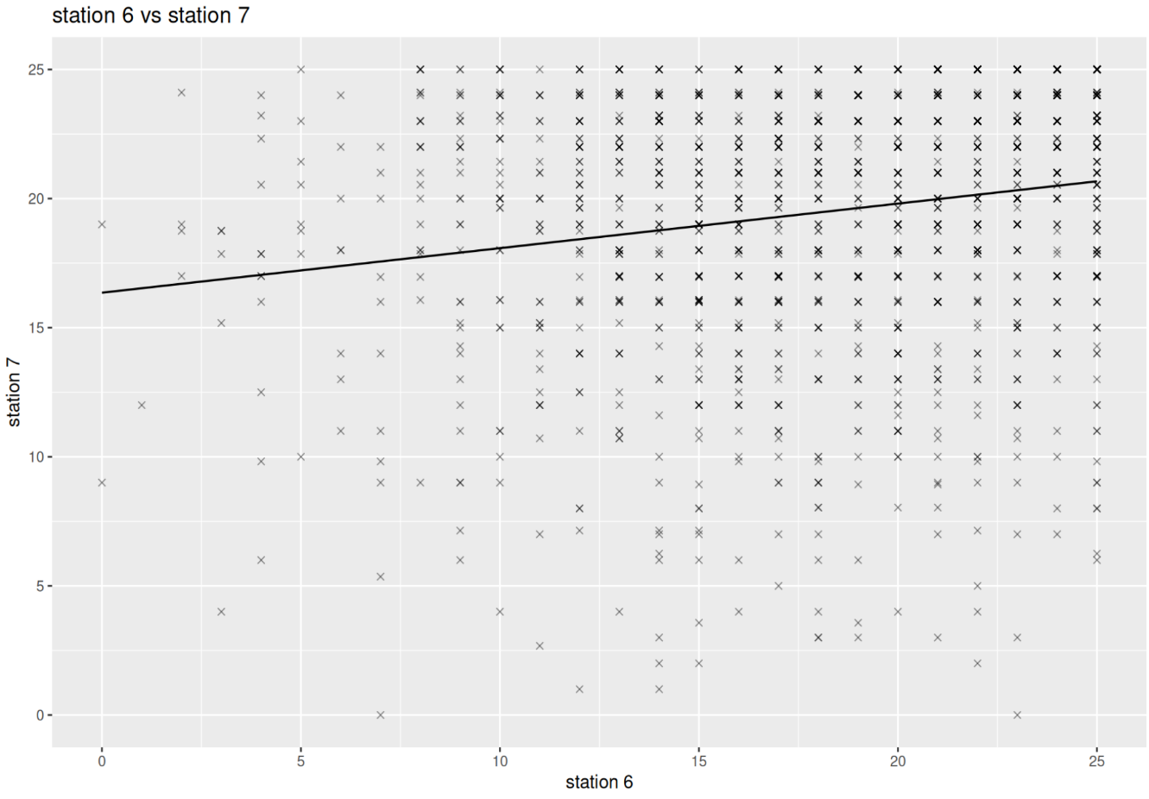

Slide 10
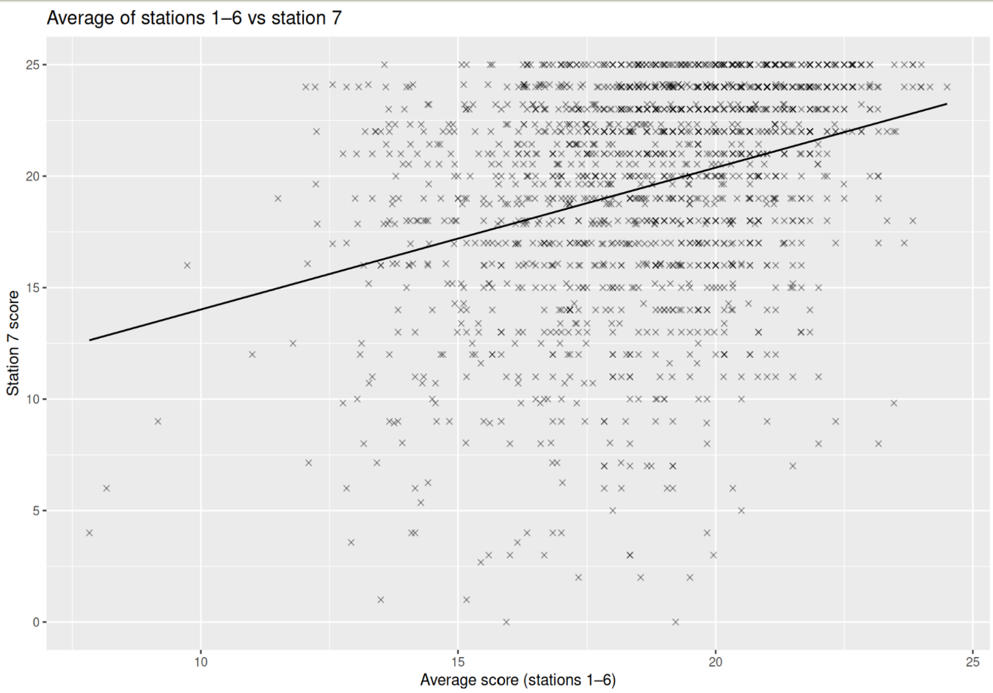

Slide 11
Quantitative Results Analysis
Low correlation between scores of candidates on the group and individual stations
Multivariate analysis shows a slightly stronger, but still relatively weak correlation
The group station does not reproduce candidates selected by any other station, and adds new information to the selection process

Slide 12
Survey Results
419 responses
80% thought the Group Station was a 'Good' or 'Brilliant' experience
99% thought they were treated 'fairly and equally' within the Group Station
91% felt that the Group Station was a 'fair test'
39% felt that the Group station was 'overall a difficult test'

Slide 13

General views on Group interviews: Overall positive
It's all about working in teams, whether it's your studies or whether it's going into the profession.
I think being able to assess people's competencies and their flaws in teamwork is a good thing to highlight prior to the course.
It was like a chance to sort of showcase your own personality a bit more
With the group discussion I felt a bit more intimidated

Slide 14
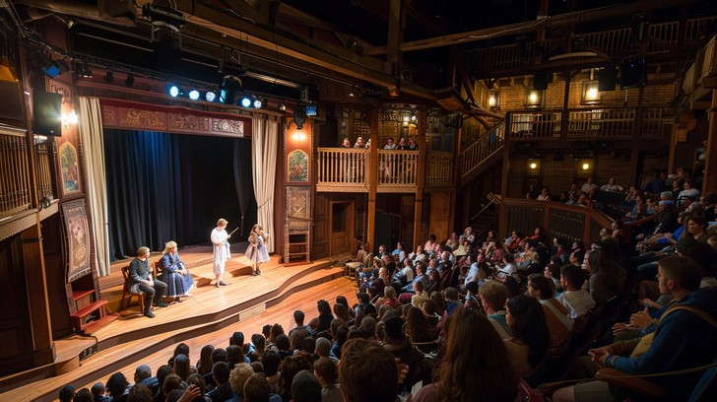
Erving Goffman
Dramaturgical theory—teams and the individuals in those teams
          -Roles
          Scripts
Impression Management: Individuals actively manage themselves—their performance
                Front stage
                Backstage: preparation for performance
Notes:
Roles-image that the individual wants to display
Scripts-interpersonal interactions—conversations between people,

Slide 15
Performance and making an Impression
Like you don't want someone that is like a
know-it-all and just doesn't stop talking…
…someone that's interrupting loads
they're not as an ideal candidate
Everyone's trying to take the spotlight in a way
I could perform better…
I was trying to do answers and
work with team dynamics
You can fake it till you make it.
…making sure everybody's voice is heard,
making sure nobody’s left out
I've got to say something but
not say too much.
Notes:
We are aware that any interviews are a performance, but we are also aware that the practice of medicine itself is also a performance
Impression management refers to the processes by which social actors try to create, maintain or modify the ideas others have about them

Slide 16



Bourdieu
Habitus: Dispositions-way you are socialised to see and act in the world
..people who had spoken earlier and gotten the most obvious points came off as more confident perhaps…
be confident enough to speak up
those who were less confident and perhaps wanted to speak towards the end, the main points had been said
someone who is perhaps … who's more confident…would like to take control, …they're dominating the conversation
it's just points have already been said and that less confident people can be disadvantaged
Notes:
a “know-how”, or an action that does not require knowledge or conditioning. The dispositions of habitus are formed through lived experiences in a specific field (Emmerich, 2013). Bourdieu wanted to differentiate habitus from “habit”, which suggests a pre-conditioned, learned behaviour (Crossley, 2013). Bourdieu saw habitus as being flexible and not dependent on prior knowledge or expertise. Habitus formation begins at birth, through lived experiences, and it determines the way the individual reacts in different situations.

Slide 17

Capital
They basically sat us down in a group,
Like in our lunch time,
and they had a task for us to do.
We’d discuss as a group,
they’d give us feedback,
I think that was helpful
…a friend of mine whose currently at medical school
organised a Zoom call with a group of people
…I did practice alot
Our school was quite helpful they gave one practice MMI circuit
So, I like messaged a few people and then we arranged like a Zoom call, and we did a group task for 40 minutes and then reflected on it.
Yeah, I did that like twice.
Notes:
Capital in the field—applicants felt they had a perceived advantage

Slide 18
  Teamwork
    Collaboration
    Leadership skills
    Communication skills
    Professionalism (turn-taking/not interrupting)
I don't want to also let other people like not speak.
I want to let them speak and share their points as well.
I think you can assess how people work in a team
Everyone kind of collaborated, which was nice
I think it was important to see how people work with other people
You can get your personality across more, how you deal with pushback or
disagreements in real time
if you have no ideas, don't be afraid to listen to the other people's ideas and kind of bounce off of them….actually being able to listen as well as communicate…

Slide 19
Why is this important?
Practical perspective:
  Group work/Team work important in medical practice
  Dealing with the unknown/unpredictability
    Team members
    Patients
    Diagnosis
Assessment in admissions
  Assessor role changed --not part of the verbal dialogue, now observing

Slide 20
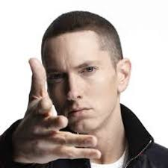
Considerations
How to account for performance?
  ‘Look if you had one shot or one opportunity to seize everything you ever wanted in one moment would you capture it or just let it slip?’ (EminemMusic, 2025)
Recognise and acknowledge ‘circle pedagogy’
  Indigenous pedagogy, ‘Talking Circles’ (Barkaskas and Gladwin, 2021)
  Freire-- Culture Circles (Brown, 2011)

Slide 21
Conclusion
Original question: Are Group Stations Helpful in Selecting Medical Students as Part of Multiple Mini Interviews?
YES!
Our findings support that the group interview does test for qualities that individual MMI stations cannot
  Teamwork
  Collaboration
  Communication skills
  Leadership
All elements of the General Medical Council (UK) ‘Good Doctor’ and support RCPSC CanMEDS framework
Notes:
Royal College of Physicians and Surgeons of Canada

Slide 22
References
Goffman E. The presentation of self in everyday life. 1959. Garden City, NY. 2002;259:2002.
Barkaskas, P. and Gladwin, D. (2021) ‘Pedagogical Talking Circles: Decolonizing Education through Relational Indigenous Frameworks.’, Journal of teaching and learning, 15(1), pp. 20–38.
Bourdieu P. Outline of a theory of practice. 1977;(ue Vol. 16)). http://search.ebscohost.com/login.aspx?direct=true&AuthType=ip,url,uid&db=e000xna&AN=589175&site=ehost-live&scope=site
Bourdieu P. The forms of capital. In: Richardson JG, ed. Handbook of Theory and Research for the Sociology of Education. Vol 241. 1986:19.
Brown, A. (2011) ‘Consciousness-Raising or Eyebrow-Raising? Reading Urban Fiction with High School Students in Freirean Cultural Circles.’, Penn GSE Perspectives on Urban Education, 9(1), p. n1
EminemMusic (2025) Marshall Mathers. Available at: https://www.youtube.com/watch?v=-aFmFmPVPBQ (Accessed: 31 March 2026).
Foucault, M. (1979) Discipline and punish: The birth of the prison. Vintage Books ed.). Vintage Books.
McGaghie, W. C. (2018). Evaluation apprehension and impression management in clinical medical education. Academic Medicine, 93(5), 685–686.
Markowitz, D. M. (2023). Self-presentation in medicine: How language patterns reflect physician impression management goals and affect perceptions. Computers in Human Behavior, 143, 107684. https://doi.org/https://doi.org/10.1016/j.chb.2023.107684

Slide 23

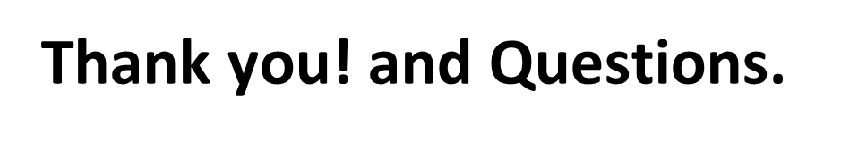

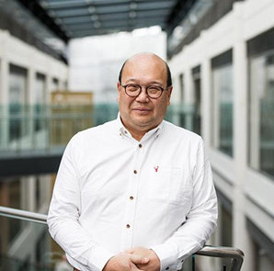
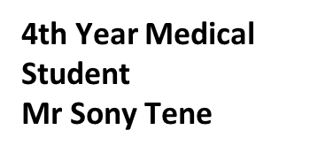
Lead for Admissions,
Vascular Surgeon
Dr Philip Chan
Thanks to Harriet Gifford for help with Power Point.

