Slide 1

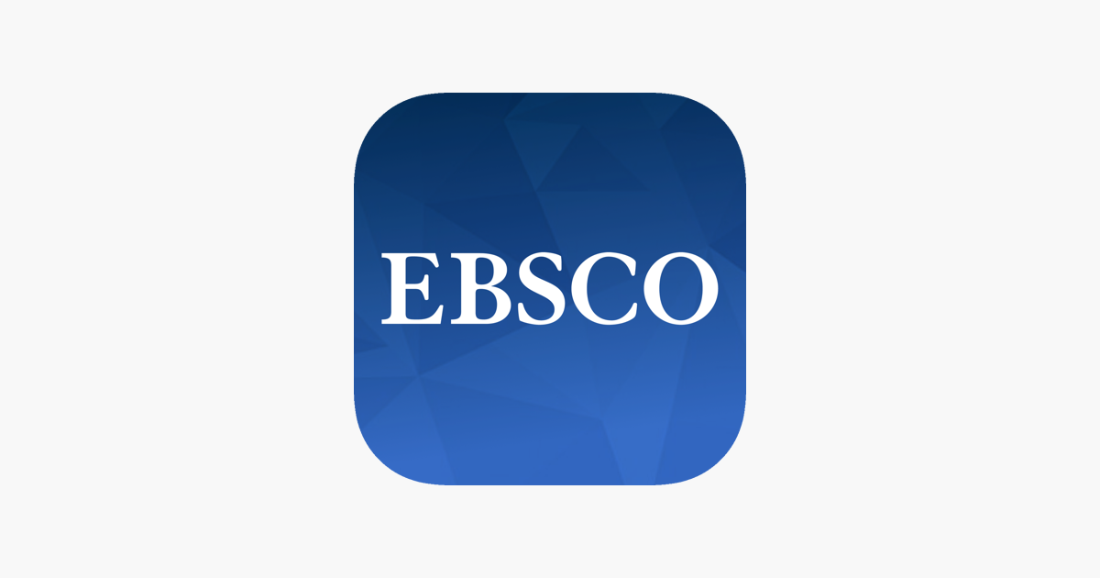
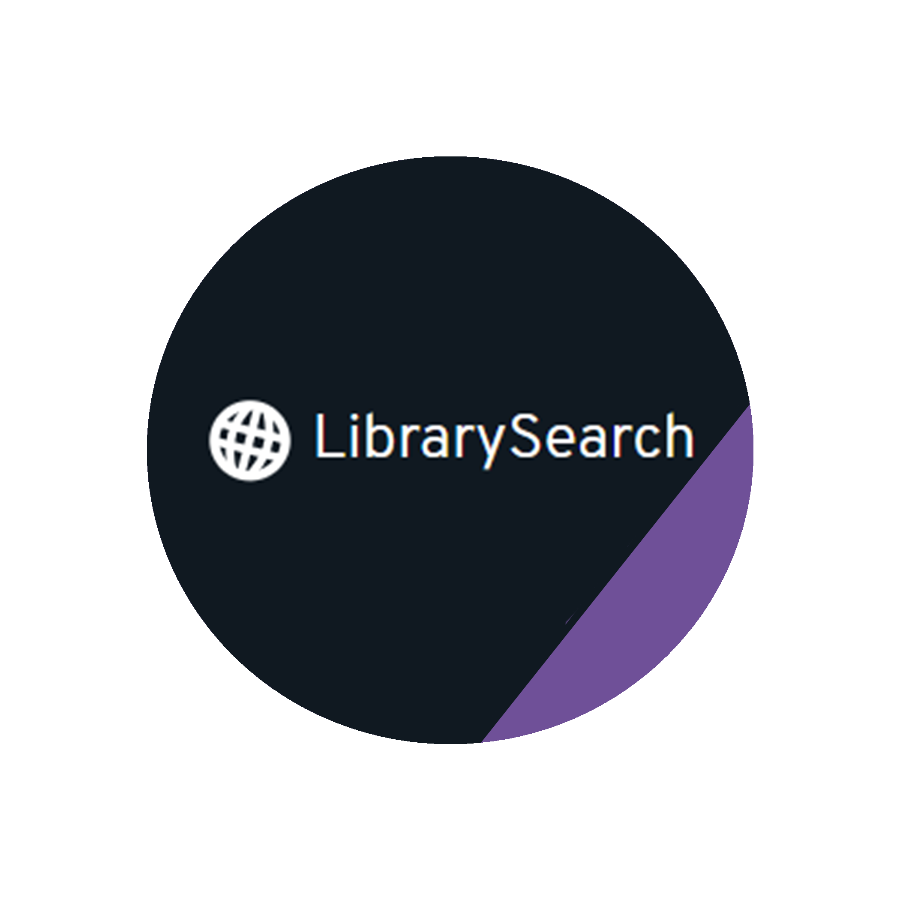






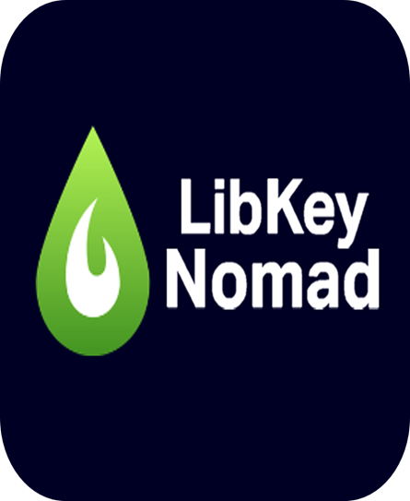
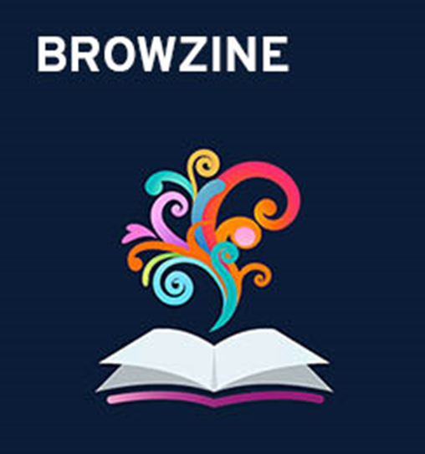

Metadata and Discovery at the University of Kent
Have you ever wondered how resources are made discoverable in library catalogues? We use a wide range of systems to import (meta)data into our catalogue, from Library Management and E-resource Management Systems to digital asset managers and University's webpages, providing a single digital interface for users to find resources, called LibrarySearch.
Our discovery operations are coordinated with academic and non-academic partners, namely the University of Greenwich, Canterbury Christ's Church University, Universities at Medway, Canterbury Cathedral and Rochester Cathedral.
Symphony
Symphony is an integrated library system software provided by SirsiDynix. Shared with other university partners, it is central to our library operations, from acquisitions, to circulation, to cataloguing. Employing the MARC21 Bibliographic Format, Symphony allows for creating, editing, importing and exporting catalogue data. Currently, it is used via a locally-installed client, Workflows, but it will soon be available also via a cloud-based client, SymphonyWeb.
EBSCO
We use Ebsco to manage our e-resources, both subscriptions and resources purchased in perpetuity.
We activate and de-activate individual e-journals and e-books, activate prescribed packages such as Read and Publish deals. We also create custom packages and titles when needed. Ebsco Discovery Service is integrated into Library Search via Full Text Finder.
Portfolio
Portfolio is a digital asset manager which integrates SirsiDynix's discovery tool Enterprise. Besides providing access to multimedia collections, it allows for flexible surfacing of batches of MARC records.
Digital Resources Directory
Our Digital Resource Directory is an information resource list curated by the Library team on the University's website. It hosts links to databases and e-resources which are not accessible via EDS. Its entries are also integrated into LibrarySearch.
Kent Academic Repository (KAR)
KAR is our institutional research repository. Its mission is to provide reliable, long-term, and open access to University of Kent research. It provides an official record of research works, preserves research works digitally and manages Open Access.
CALM
Calm is archive management software created by Axiell. It is used by Special Collections and Archives to accession and catalogue all our archival collections, and to manage loans out to other organisations.
It is used for reporting to external funders and governing bodies, demonstrating compliance with community standards, feeding information to academic profile webpages and showing information about use and reach of research works.
Calm complies with ISAD(G) and EAD standards and uses a hierarchical structure to manage data. Catalogue data in Calm is made available to users through Calmview (Axiell's own web-based user interface) and through Librarysearch using the Open Archives Initiative Protocol for Metadata Harvesting (OAI-PMH).
Integrated Discovery Tools
Connected Services
Talis Aspire connects academic schools and students to library holdings directly within their course resource lists, keeping the library at the heart of teaching and learning.
Libby provides a leisure reading collection made up of e-books and audiobooks that are not directly related to academic study, which students can access for free via the Libby
app.
LibKey Nomad is a browser extension that delivers one-click access to the full-text articles of library-subscribed and open access journals.
BrowZine allows students to browse, read and follow scholarly journal content on mobile devices, laptops or PC’s. It brings together subscription and Open Access material into a single place.
Scan
and
Deliver!
Our Scan and Deliver service makes it quicker and easier for staff and students to request and receive e-book chapters and e-journal articles from items we don't hold in our Library collections.
University of Kent
Simone Monti, Emma Solway and Clair Waller
Library Collections

