Slide 1


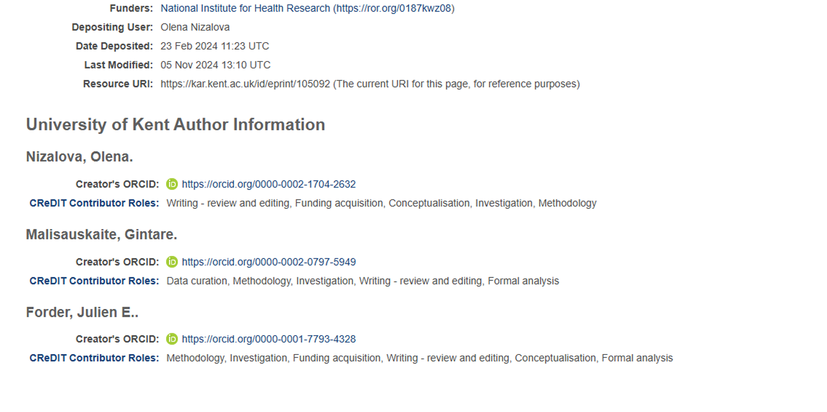

CREDIT WHERE CREDIT’S DUE
A standardised and transparent approach to authorship
Introduction
Have you been involved in a research project and wished that there was more clarity about the role you played?
The findings are normally published as journal articles.
The CRediT (Contributor Roles Taxonomy) is a standardised system for describing author contributions to a research article. This provides a practical means of recognition and visibility for our technicians working in research.
For these reasons we have integrated CRediT into our institutional repository, the Kent Academic Repository (KAR), where our university’s research outputs are made available to the world.
The 14 CRediT roles
Conceptualization
Data curation
Formal Analysis
,
Funding acquisition
Investigation
Methodology
Project administration
Resources
Software
Supervision
Validation
Visualisation
Writing - original draft
Writing -reviewing & editing
Published article showing CRediT roles
How CRediT roles display in KAR
What you can do
Mention the CRediT taxonomy to your project team in case they are not yet aware of it.
Discuss author roles to establish whether you and the role you played can be included in the research articles.
Remember you can add your research outputs to your institutional repository.
University of Kent, Library Services
Suzanne Duffy and Rosalyn Bass
Open Research Team

