Slide 1
The Effects of Direct Payments on Well-being of Older People in England
Jinbao Zhang¹, PhD
Julien Forder¹, PhD
¹Personal Social Services Research Unit, University of Kent

Slide 2
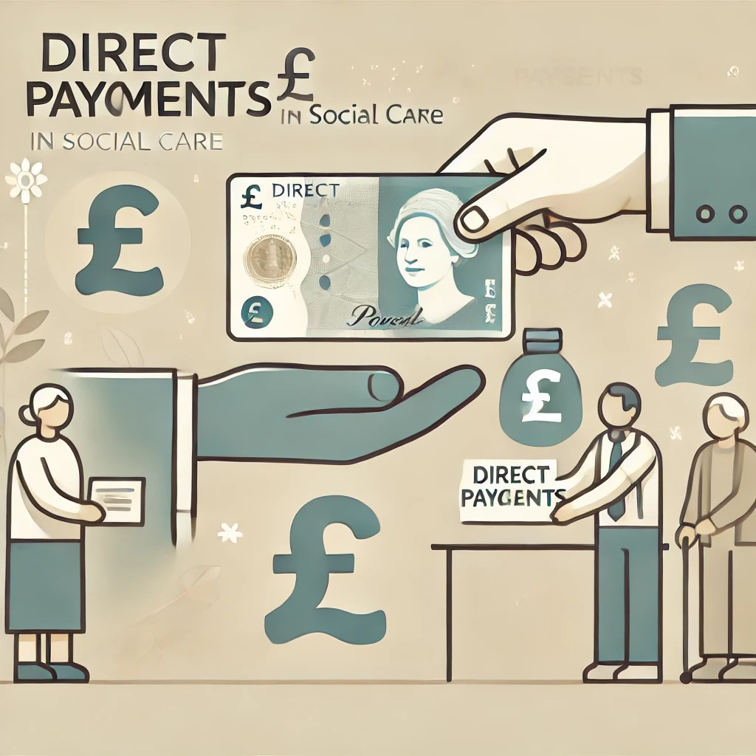
Introduction
What is self-directed care?
Known as cash-for-care, participant-/consumer-directed care
Target older adults in need of home- and community-based services
A service model that permits older adults to direct their service arrangements, e.g.,
Germany: cash benefit in long-term care insurance (1995)
England: Direct Payments (1996)

Slide 3
Introduction
Self-determination theory posits that three psychological needs are essential for optimal functioning and well-being (Deci and Ryan 2012)
Autonomy: perceived choice and control over one’s life
Relatedness: feeling connected to others
Competence: the ability to effectively interact with environments
The fulfillment of these needs is influenced by social environments, e.g., care policies
Self-directed care (vs. managed services) yields positive outcomes, especially for younger people
Delayed institutionalization, reduced acute care admissions and emergency department visits, as well as improved self-determination, sense of security, and quality of life (Benjamin and Matthias 2000; Carlson et al. 2007; Fleming et al. 2019; Pattyn et al. 2021, 2023; Yuan et al. 2022; Yoshino CA and Atkins 2023)

Slide 4
Introduction
Concern about the effectiveness of self-directed care for older adults due to their limited competence to navigate care systems (Williams et al. 2017; FitzGerald Murphy and Kelly 2019; Kelly et al. 2021)
Lower self-rated health and psychological well-being in England (Moran et al., 2013)
No significant difference in stress, self-rated health, or SCRQoL (Woolham et al., 2017)
More research to examine the impact of self-directed care on older adults
E.g., unmet needs, a crucial indicator of measuring the effectiveness of social care

Slide 5
Introduction
Older adults may benefit unequally from using self-directed care due to their ability to manage administrative burdens (Woolham et al. 2017; Xie et al. 2024)
Bourdieu (1989) capital theory conceptualizes inequalities into three types:
Social capital: resources embedded within one’s social networks, e.g., the availability of informal caregivers
Cultural capital: symbolic and informational resources for action, e.g., education level
Economic capital: wealth and income.
Health capital: health-related resources, e.g., mental capacity (Hyry-Honka et al. 2012)
Little is known about the heterogeneous treatment effects of self-directed care on older adults

Slide 6
Introduction
Objectives:
Examine the impact of self-directed care on older adults’ well-being
Explore heterogeneous effects across individual characteristics
Study setting: Direct Payments in England
High performance in self-direction among 11 programs in seven countries (Zhang et al. 2023)
Personal budgets for eligible older adults receiving home- and community-based services
Managed services by local authorities
Managed services by a third party, e.g., care providers
Direct Payments
Recent initiatives to mitigate administrative burdens
Permit family members to be representatives
Offer information and support
Pre-paid cards
These efforts may mitigate inequality in benefiting from using Direct Payments

Slide 7
Methods
Data: English Longitudinal Study of Ageing (ELSA)
Wave 6-10 (2012-2023)
Older adults: aged 65+
Sample size: n = 568 ( No. of Direct Payments = 402, No. managed services = 166)
Dependent variables
Unmet needs (continuous): 0 – 6, with higher values indicating higher unmet needs
Unmet needs (dummy): 0 = met, 1 = unmet
Depressive symptoms: CES-D8
Quality of life (QoL): CASP-19
Independent variable: Direct Payments use (0 = managed services, 1 = Direct Payments)

Slide 8
Methods
Covariates: sex and:
Health capital: age, ADLs, IADLs, and unmet needs reported in the preceding survey
Social capital: household size and the availability of informal caregivers
Cultural capital: education level
Economic capital: annual income
Analysis
Propensity score matching (PSM)
Abadie and Imbens’ (2016) approach
Doubly robust estimates (de Zwart et al., 2017; Nguyen et al., 2017)
Matching-smoothing method (Guo & Fraser, 2015; Xie et al., 2012)

Slide 9
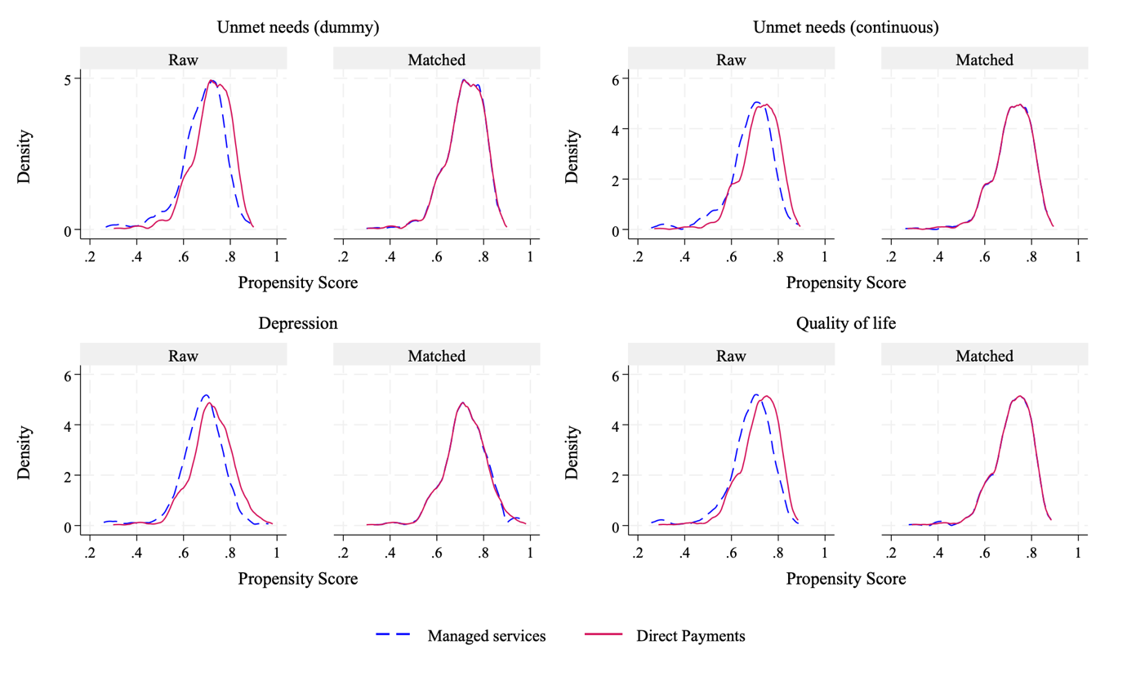
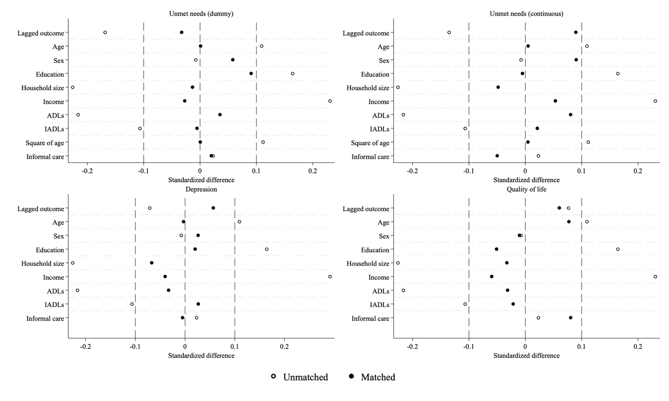
Matching quality
Fig 1. Distribution of propensity scores before and after matching
Fig 2. Standardized bias across covariates

Slide 10
Results
Fig 3. Effects of Direct Payments on well-being
Direct Payments reduced the likelihood of experiencing unmet needs by 20%
Users of Direct Payments reported 0.64-0.70 fewer unmet needs than managed services users
No significant effects on depression and QoL

Slide 11
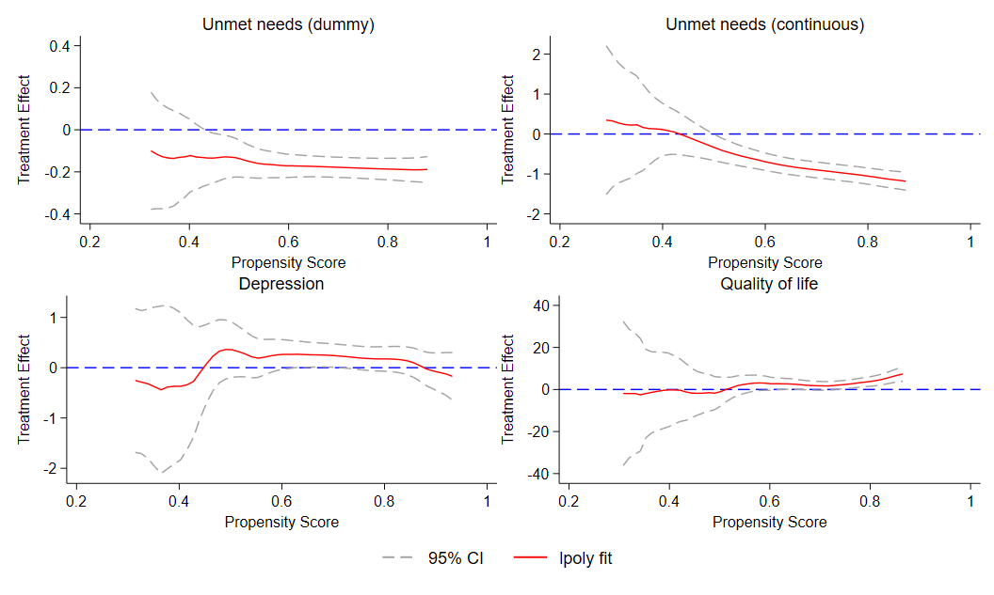
Results
Fig 4. Heterogeneous treatment effects

Slide 12
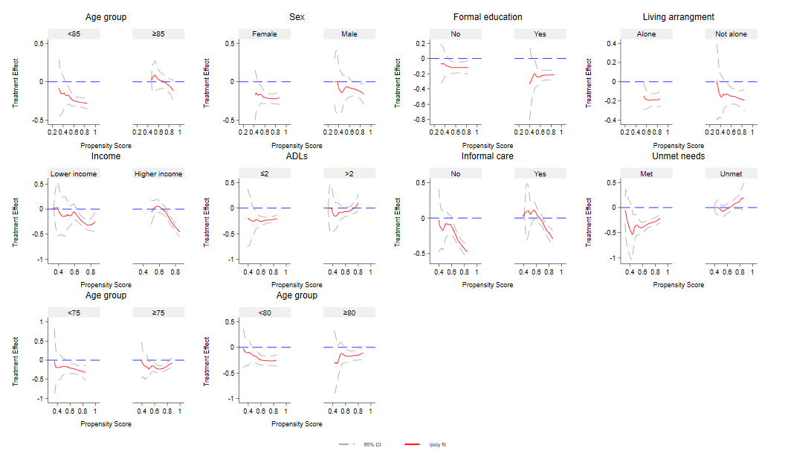
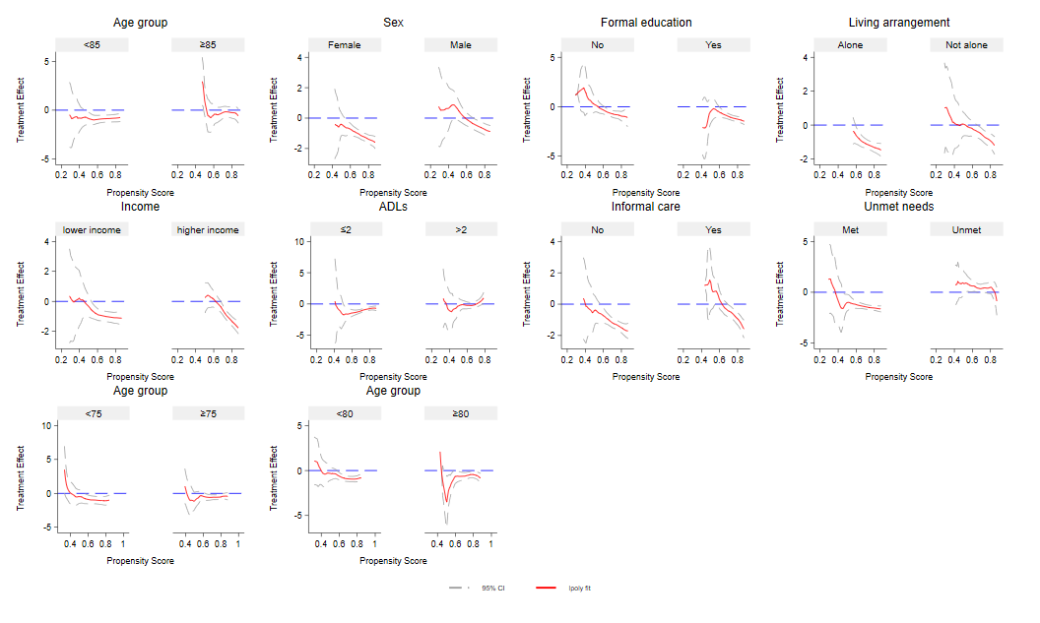
Results
Fig 5. Heterogeneous treatment effects on unmet needs (dummy)
Fig 6. Heterogeneous treatment effects on unmet needs (continuous)

Slide 13
Fig 6. Heterogeneous treatment effects on unmet needs (continuous)
Direct Payments significantly reduced unmet needs for older adults under 85, with fewer (≤2) ADL limitations and experiencing no unmet needs in their last interview.

Slide 14
Discussion
Direct Payments are effective in reducing unmet needs
Reflect LA’s initiatives to mitigate administrative burdens, thereby addressing barriers identified in earlier research (Moran et al. 2013; Woolham et al. 2017)
No statistically significant effects on depressive symptoms and quality of life
Both Direct Payments and managed services users receive limited budgets for addressing psychological needs (Moran et al. 2013)

Slide 15
Discussion
The effect on unmet needs varies across the likelihood of using Direct Payments
Individuals with limited health capital were less likely to benefit from Direct Payments
Older age, more physical impairments, and whose needs were unmet in the preceding survey
Consistent with previous literature, highlighting the importance of health status in exercising self-direction (Williams et al. 2017; Carey et al. 2019; Davey 2021; Pattyn et al. 2021)

Slide 16
Discussion
Theoretical contributions
Advance research on the effectiveness of self-directed care for older adults.
Enrich the literature on self-directed care and inequality in well-being
Practical implications
LAs could promote access to Direct Payments
Offer support for those with limited health capital

Slide 17
Discussion
Limitations
Cannot control for all observed factors, e.g., care relationships
Cannot control for unobserved time-varying factors
Unable to reveal local variations in policy implementation

Slide 18
Thank you
Jinbao Zhang, PhD
J.Zhang@kent.ac.uk

