Slide 1
Interventions to Facilitate Access to Long-Term Care for Community-Dwelling Older Adults: A Scoping Review
Jinbao Zhang¹, Alan Dargan¹, Wenjing Zhang², Julien Forder¹
¹Personal Social Services Research Unit, University of Kent
²Health & Social Care Workforce Research Unit, King’s College London

Slide 2
Introduction
By 2050, 1/6 people worldwide will be aged 65+ (United Nations, 2019)
A growing demand for long-term care (LTC)
LTC: personal care and related services for people with functional impairments
In England, 3,910 care requests per day (NHS Digital, 2023)
73% came from the community
26% originated from hospital discharge and other routes
Given the high volume of care requests from the community, it is essential to ensure older adults obtain adequate and timely services.

Slide 3
Introduction
Older adults often find it challenging to access LTC
Complex care systems, e.g. lacking transparency in eligibility criteria
Limited communication skills (Baxter et al., 2021; Erlandsson et al., 2022)
Support is needed to address these barriers

Slide 4
Introduction
Previous evidence synthesis focused on interventions that facilitated access to specific services, e.g. dementia-specific community services (Røsvik et al., 2020; Kokorelias et al., 2023)
Lacking evidence on access to other LTC, e.g. residential care
Unknown about the characteristics and mechanisms of interventions that promote access to LTC
Objective: identify and map existing evidence on interventions that facilitate access to LTC services for older people living in the community
What are the characteristics of the interventions?
What outcomes have been reported from these interventions?

Slide 5
Methods
Following the Joanna Briggs Institute (JBI) methodological guidance for scoping reviews (Peters et al., 2020)
Eligibility criteria
Table 1. Inclusion and exclusion criteria
Framework | Inclusion criteria | Exclusion criteria
Participants | Older people who aged 65 or over as the target group. | Younger people aged below 65.
Concept | The purpose or outcome of interventions was facilitating access to long-term care services. | 1) No interventions. 2) The objective or outcome of the intervention was not related to access to long-term care.
Context | Home- and community-based settings. | Not at home or in the community, e.g., hospitals and nursing homes.
Types of evidence sources | All study designs, including quantitative, qualitative, and mixed methods. | Commentaries, editorials, protocols, and conference proceedings.

Slide 6
Methods
Search strategy and study screening
Sources: Medline, PsycINFO, CINAHL, Social Sciences Citation Index (SSCI), and the Cochrane Database of Systematic Reviews
Period: 1st January 2013 – 31st July 2023
Data synthesis
Qualitative content analysis (Pollock et al., 2023)
Inductive, open coding
Three researchers collaboratively coded included articles

Slide 7
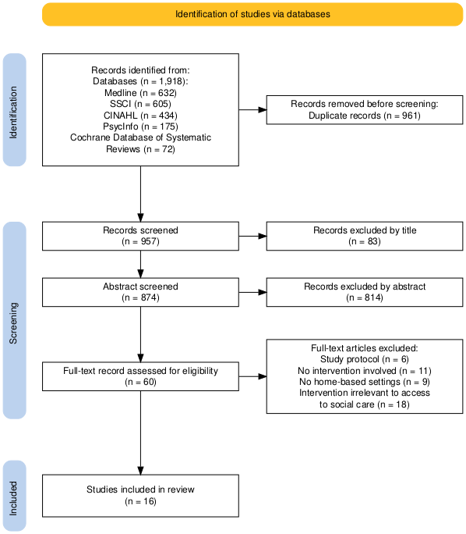
Results
Fig 1 The Preferred Reporting Items for Systematic Reviews and Meta-analyses flow diagram for article selection

Slide 8
Author, year of publication | Location | Aims | Study design | Study participants | Key components of the intervention | Frequency and duration | Key findings
Early identification (n = 6)
Bannenberg et al. (2021) | Norway | Evaluate the impact of preventive home visits for older adults | Difference-in-difference | Age 80+; n = 4,056 | Information and referral | 60-80 minutes, with repeated visits offered as needed | Decreased nursing home utilization; non-significant increase in home care use
Bleijenberg et al. (2016) | Netherlands | Determine the effectiveness of a proactive primary care program on preserving daily functioning | Randomized controlled trial | Age 60+ (mean = 74.2); n = 3,092 | Screening, geriatric assessment, care planning, and care coordination | 1 year | Small sample size limited analysis of admissions to nursing homes and assisted-living facilities
Kerse et al. (2014) | New Zealand | Assess whether case finding reduces disability among older patients | Randomized controlled trial | Age 75+ (mean = 80.3); n = 3,893 | Screening and referral | Every year for 3 years | Increased residential care use; non-significant effects on the use of home help and personal care, with control group receiving more intensive services
King et al. (2018) | New Zealand | Evaluate the effect of a systematic case finding on healthcare use | Controlled before-after design | Age 75+ (mean = 81.3); n = 1,400 | Screening, comprehensive assessment, and care coordination | 2 weeks | Non-significant difference in residential care admissions between groups
Morris et al. (2019) | United States | Describe a technology-supported meal-delivery service | Descriptive analysis | Age 65+ (mean = 77.4); n = 867 | Screening and referral | 12 months | Of 239 alerts, drivers identified 12% for personal care; coordinators made 132 referrals, 24% for personal care
Whate et al. (2021) | Canada | Examine the performance of the interRAI ED screener in predicting adverse outcomes | Retrospective study | People aged 65+ (mean = 71.7) with less severe conditions; n = 2,810 | Screening and referral | Not specified | The screener effectively predicted increased home care use in high-risk individuals
Integrated care (n = 5)
Briggs et al. (2022) | Global | Determine the effectiveness of Comprehensive Geriatric Assessment | Cochrane review | 21 studies included; people (65+) with frailty or at risk for poor outcomes | Multidimensional interdisciplinary assessment and coordinated care plan | 6-36 months, with a median follow-up of 12 months | Non-significant effect on nursing home admissions over 12 months
Deschodt et al. (2020) | Global | Identify core components of nurse-led integrated care and evaluate its effectiveness | Systematic review and meta-analysis | 19 studies included, mean age = 71.8-85 | Screening, holistic assessment, individualized care plan, care coordination, and referral | 3-24 months | Non-significant effect on nursing home admissions
Elston et al. (2019) | England | Assess the impact of holistic link-workers for clients | Before-and-after design | People aged 50+ (mean = 79.6) with complex health needs | Information, practical support, and advocacy to access services | A 30-40-minute conversation, with a 12-week follow-up | Increase in the utilization of community and social care
Weeks et al. (2018) | Global | Synthesize evidence for the impact of transitional care on healthcare utilization | Systematic review | 23 studies included; people aged 60+ (mean = 76.3) with at least one medical diagnosis | Information, assessment, coordination, and support with accessing services | 3-20 (mean = 7.5) contacts. Length of time: 5.8 days - 3 years (mean = 5.5 months) | Non-significant effect on nursing home admissions
Yous et al. (2023) | Canada | Explore the experiences of older adults in a self-management intervention | Qualitative (interview) study | People aged 65+ (mean = 71.7) with diabetes and at least one other chronic conditions; n = 45 | Care coordination and navigation support | 6 months | Older persons felt connected to community resources and were referred to social support services
Partnership (n = 2)
Groenvynck et al. (2021) | Global | Develop a model to optimize transition from home to nursing homes | Literature review and expert consultation | 20 studies included | Support, information, communication, and time | Not specified | Partnership is essential through the transition process
Ploeg et al. (2017) | Canada | Understand how family physicians facilitate access to community services for older persons | Qualitative (interview) study | 23 family physicians | Information, referral, and encouragement | Not specified | Strategies to facilitate service access: team communication, encouraging access, and initiating service linkages
Other types (n = 3)
Liimatta et al. (2016) | Global | Assess the effectiveness of preventive home visits | Systematic review | 19 studies included; people aged 65+ | Multidimensional assessment | 3-36 months | Reduced nursing home admissions
Markle-Reid et al. (2013) | Canada | Evaluate the effectiveness of nurse-led health promotion and disease prevention interventions | Randomized controlled trial | People aged 65+ (mean = 81.9) with chronic health conditions; n = 498 | Multidimensional assessment, referral, and coordination | 6 or 12 months | Non-significant effect on long-term care utilization
Newbould et al. (2022) | Global | Identify challenges and solutions to facilitate older adults with mental health needs to access social care | Scoping review | 26 studies included; People aged 65+ with social care and mental health needs | Information and professional support | Not specified | Of the 26 included studies, only five described specific interventions to facilitate service access

Slide 9
Results
Study characteristics (n = 16)
60% of included articles published since 2019
Geographical distribution
Canada: n = 4
Europe: n = 3
New Zealand: n = 2
United States: n = 1
International reviews: n = 6
Research designs
Literature review: n = 6
RCT: n =3
Quasi-experimental designs: n = 3
Cross-sectional: n = 2
Qualitative: n = 2

Slide 10
Results
Characteristics of older adults in included studies
Specific health conditions, e.g. diabetes and mental illness: n = 7
Advanced age, e.g. 80+: n =4
No specification: n = 5
Outcomes in included studies
Nursing home: n = 7
Home- and community-based services: n = 6
No specification: n = 4
Residential care: n = 2
Assisted-living facilities: n = 1

Slide 11
Results
Intervention types and outcomes
Early identification: n = 6
Integrated care: n =5
Partnership: n = 2
Other types: n = 3

Slide 12
Results
Early identification (n = 6)
Target: population level
Providers: healthcare professionals, e.g. nurses and GP
Meal delivery drivers (Morris et al., 2019)
Aim: identify high-risk older adults at an early stage
Outcomes
Enhanced access to HCBS and residential care (n = 2)
Uncertain results: n = 4
Highlight benefit in maintaining health and improving service access

Slide 13
Results
Integrated care (n = 5)
Providers
Interdisciplinary teams, e.g. GP, nurses, therapists and social workers (n = 4)
Care coordinators: n = 1
Aim: coordinate health and social care and address complex needs
Outcomes
No significant effect on nursing home admissions ( n = 3)
Increased access to LTC: n = 2

Slide 14
Results
Partnership ( n = 2)
Shared decision-making and collaborative working relationships among stakeholders
Focus on reporting processes rather than measuring intervention outcomes
Other types (n = 3)
Health promotion (n = 2)
Aim: maintain and improve older adults’ health and reduce high-cost healthcare utilization
Mixed evidence
Address resistance to use LTC among older adults with mental illnesses (n = 1)

Slide 15
Results
Table 3 Key components of the interventions by service types
Dimension | Components | Description | Early identification | Integrated care | Partnership | Other types
Approachability | Screening | Proactive identification of individuals with high needs by designated staff | √ | √
 | Information | Information about available services and application procedures, potentially tailored to individual cultural, linguistic, and personal needs | √ | √ | √ | √
Availability & accommodation | Referral | Referring individuals with care needs to appropriate services by designated staff | √ | √ | √ | √
 | Practical Support | Tangible assistance in overcoming barriers to service access, e.g. advice, advocacy, system navigation, and ongoing follow-up |  | √ | √ | √
 | Time | Adequate time to ensure continuity of care and enhance preparedness for receiving care |  |  | √
Appropriateness | Assessment | Multidisciplinary evaluation of an individual’s holistic needs, including medical conditions, physical and cognitive capacities, psychological well-being, and environmental factors. | √ | √ |  | √
 | Care planning | Creating a personalized care plan to meet the individuals’ needs and preferences | √ | √
 | Care coordination | Collaboration among services and providers to provide comprehensive care | √ | √ | √ | √
Acceptability | Emotional support | Providing encouragement and understanding to build confidence for individuals/families accessing care, e.g. compassion from healthcare professionals |  |  | √
 | Communication | Open, comprehensive, and timely dialogue among all stakeholders, addressing key matters for older adults and families, e.g. concerns, service preferences, and peer experience sharing |  |  | √
Most widely used: information provision, referrals and care coordination

Slide 16
Discussion
Four types of interventions were identified: early identification, integrated care, partnership and other types
Most adopted components: providing information, facilitating referrals and offering coordination
Early identification is promising for enhancing access to LTC
Proactive, population-level strategies
Identify high-risk individuals

Slide 17
Discussion
Healthcare professionals play a major role in delivering interventions
Non-healthcare professionals are also important, especially in settings facing healthcare workforce shortages
Two-thirds interventions target older adults with advanced age or specific health conditions

Slide 18
Discussion
Limitations
Only included papers published in English
Omitted grey literature
Cannot evaluate the effectiveness of interventions (Peters et al., 2022)

Slide 19
Thank you
Jinbao Zhang, PhD
J.Zhang@kent.ac.uk

