Slide 1


Considering resident-level quality of life in an older adult care home minimum data set
Stacey Rand, Personal Social Services Research Unit (PSSRU),
University of Kent
Ann-Marie Towers, Stephen Allan, Nick Smith, Sinead Palmer¹, Jenni Burton²,
Rachael Carroll, Adam Gordon³, Claire Goodman†
¹ University of Kent; ² University of Glasgow; ³ University of Nottingham; † University of Hertfordshire

Slide 2

Why include QoL in MDS?
Promoting older people’s QoL is a priority
An important indicator of quality & safety of care, from residents’ perspectives
What are the challenges?
No established consensus on how to measure QoL
  Although consensus is emerging…
Availability of QoL measures developed and/or tested in care homes
Self-report is challenging

Slide 3
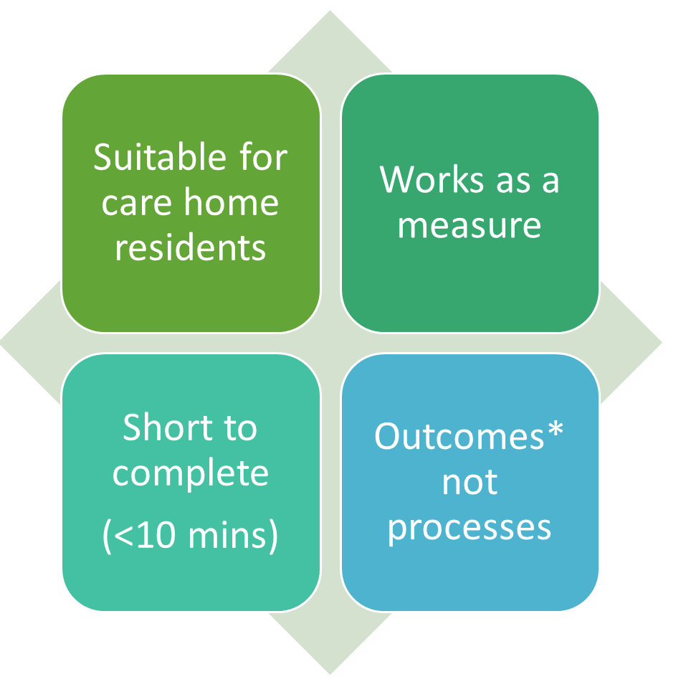
Selecting QoL measures for the DACHA MDS pilot
Shortlist criteria based on stakeholder consultation (Round 1)† and systematic review (Siette et al, 2021)
Consultation (Round 2)† identified final list
  ASCOT-Proxy. Care-related QoL
  ICECAP-O. Capability wellbeing for older adults
  EQ-5D-5L Proxy 2. Health-related QoL
  QUALIDEM. Dementia specific QoL
  All proxy-reported by care home staff via digital social care records (DSCRs)
*Outcomes = quality of life = what matters to people in their lives, to live well
†Akdur et al (In press). National stakeholder consultation on measuring care home residents’ quality of life. NIHR Journals Library.

Slide 4
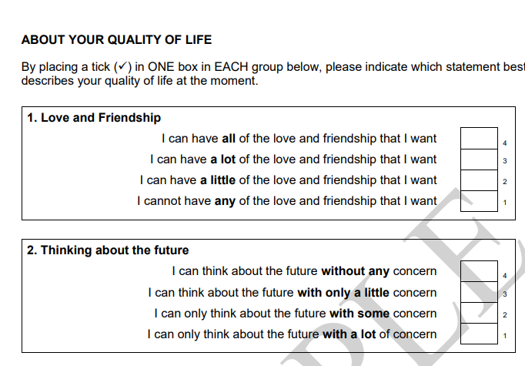
Data Collection of QoL Measures in the DACHA MDS pilot
Aim: To assess feasibility, validity, reliability, and usefulness of QoL measures, to inform which measure(s) to recommend for inclusion in an MDS
QoL measures adapted from paper format into digital care record software
Data collection
  Two waves = Mar/Apr and Oct/Nov 2023
  Some support provided to care home staff – but minimal, to test feasibility of data entry/collection in practice
  Data extracted for 748 (Wave 1) and 711 (Wave 2) residents
©Joanna Coast and Terry Flynn
(https://www.bristol.ac.uk/media-library/sites/social-community-medicine/images/centres/heb/ICECAPO%20sample.pdf)
Notes:
QoL measures adapted from paper format into digital care record software
Tested/refined through DACHA team review and software provider adjustment
Data collection
Two waves = Mar/Apr, Oct/Nov 2023
By care home staff proxy report.
Some support provided – but minimal, to test feasibility of data entry/collection in practice
Data extracted for 748 (Wave 1) and 711 (Wave 2) residents
To assess feasibility, validity, reliability, and usefulness, to inform which QoL measure(s) to include in the MDS.

Slide 5


Psychometrics of QoL measures – do they ‘work’?
Applied psychometric methods to assess the validity and internal consistency (Does they measure what we expect them to? Do the questions fit together as a scale?)
Three of the four QoL measures had acceptable properties:
  ASCOT Proxy-Resident
    But not ASCOT-Proxy-Proxy. Consistent with another study of carers of people with dementia (Silarova, Rand et al, 2023).
  ICECAP-O
  EQ5D-Proxy 2

Slide 6
Psychometrics of QoL measures – do they ‘work’?
QUALIDEM did not work as well as expected, based on previous research
  The DACHA study is the first study that psychometrics of the English language version
    Original QUALIDEM measure developed in Dutch, with German and Danish translations also available
  Excluded residents with very severe cognitive impairment
    Some questions not suitable for these residents
  Items (questions) did not ‘group’ into expected subscales
    Only six subscales vs. nine original subscales proposed by developers
  Low internal consistency for one of six subscales

Slide 7

Psychometrics of QoL measures – are they feasible to complete?
An indicator of feasibility and acceptability % missing data
  High % missing data for a question (item) can indicate an issue with that particular question
Compared for Wave 1 only
  Wave 2 % missing data also affected by drop out of whole care homes, residents going into hospital or dying
And only when care staff completed ≥1 item in each measure
  Missing data were low (<5%) for all measures, except for…
    ASCOT-Proxy-Resident:
      Dignity (6.8%) and Control (5.1%)
    QUALIDEM 1: Positive and negative affect
      Is cheerful (19.9%) – due to an error in software system!
    QUALIDEM 4: Boredom and disengagement
      Not able to do anything (5.1%)

Slide 8

Cognitive interviews - feasibility/acceptability
Cognitive interviews focus on how people answer questions rather than only their answer
  Comprehension
  Recall/retrieval from memory
  Judgement
  Response
Designed to improve survey design or explore the feasibility and acceptability of questions
  In the study, the focus was feasibility/acceptability
Aims: How do care home staff complete the QoL measures - ASCOT-Proxy, ICECAP-O, EQ-5D-5L & QUALIDEM? Are they feasible and acceptable?
Nine online interviews with care home staff who completed the MDS
Analysed using a modified version of Tourangeau’s model of cognitive response process
Comprehension
Recall/retrieval
Judgement
Response

Slide 9
Cognitive interviews - feasibility/acceptability
Comprehension of question: comprehension of questions often as intended; however, some issues identified with specific terms – such as the ICECAP-O “future” item being about the next 5-10 minutes.
Recall/retrieval of relevant information: data collection method used by care homes influenced by question type and staff perception of whether resident could answer the question (with help).
Judgment/estimation process: recognition from some participants that questions reflect the quality of care provided by the care home, leading to potential bias.
Response process: usually adequate response options; however, occasional issues mapping views to answers options.
  E.g., QUALIDEM “is angry”. Answer scale based on frequency, but participant answer based both on frequency and intensity.
Notes:
Comprehension of the question: most of our residents, they’re living with dementia, so I think sort of long-term future, as in, you know, next year, is not really relevant to them. So, I just think about the future is the next ten minutes or the next five minutes for them, is what they’re concerned about or what’s giving them concern… the lady I’m thinking of... She gets more concerned about the sort of here and now, and, you know, the thought of the next part of the day or whatever it is, not really concerned about tomorrow or next week.” (SWAP02)
Retrieval of relevant information: When answering ASCOT and ICECAP (which ask how a resident feels) more likely to ask resident than for QUALIDEM (which presents an observational statement) , more likely to ask resident if the resident has capacity.
Judgment/estimation process: example of ASCOT Personal cleanliness, “It is difficult for one, I would be honest, it is reflective of the nursing home, it is reflective of the institution.” (SWAP04)
Response process: “There can be people that are not angry but they’re just cross a lot of the time, and you would think to answer sometimes, whilst there’s other people that are very angry sometimes and then you would think about answering frequently, just because of the level…It’s more about how it sort of upsets the environment. So, you know, if you have one person that comes up to you every other day and says, “I’m a bit upset about this,” maybe you’d say sometimes. But if this other person, every other day, sort of shouts and throws things around, and actually walks up to someone and threatens them, I’d say frequently, just because of the intensity difference.” (SWAP03)

Slide 10
Summary and Conclusions
QoL measurement in care homes is feasible and acceptable
Shortlist of three measures: ASCOT-Proxy, ICECAP-O, EQ5D
  Consideration is needed of, e.g.,
    Which measure(s) should be collected?
      Acceptable and usable by stakeholders
      Good measurement properties
      Feasibility/acceptability of completion within routine care
    Data collection by care staff proxy report
      Not interchangeable with self/resident-report
      Better coverage and consistent for all residents
        e.g. not exclude those unable to self-report, nor with family to report on their behalf
      Ethical concerns expressed by staff – consistent with previous studies (e.g. Caiels et al, 2019)
    Need for support/guidance for care staff to complete questions
Why we are collecting these data…
How is care supporting people to live as well as they can?

Slide 11


s.e.rand@kent.ac.uk
@DrStaceyRand
Any questions?

Slide 12
Acknowledgements & Disclaimer
Acknowledgements. DACHA team: Claire Goodman, Lisa Irvine, Gizdem Akdur, University of Hertfordshire; Sarah Kelly, University of Cambridge; Guy Peryer, Anne Killett, University of East Anglia; Barbara Hanratty, Vanessa Davey Newcastle University; Jenni Burton, University of Glasgow; Karen Spilsbury, University of Leeds; Adam Gordon, Rachael Carroll, University of Nottingham; Iain Lang, Jo Day University of Exeter; Ann-Marie Towers, Sinead Palmer, Lucy Webster, Stacey Rand, Stephen Allan, Nick Smith University of Kent; Therese Lloyd, Liz Crellin, Richard Brine, Freya Tracey, The Health Foundation; Liz Jones, Julienne Meyer, National Care Forum; Pamela Blades, PPIE; and NIHR ARC East of England.
Disclaimer. This study is funded by the National Institute for Health and Care Research (NIHR) (HS&DR 127234/Health Service Delivery Research programme] and supported by NIHR ARC East of England. The views expressed are those of the author(s) and not necessarily those of the NIHR or the Department of Health and Social Care.

