Slide 1

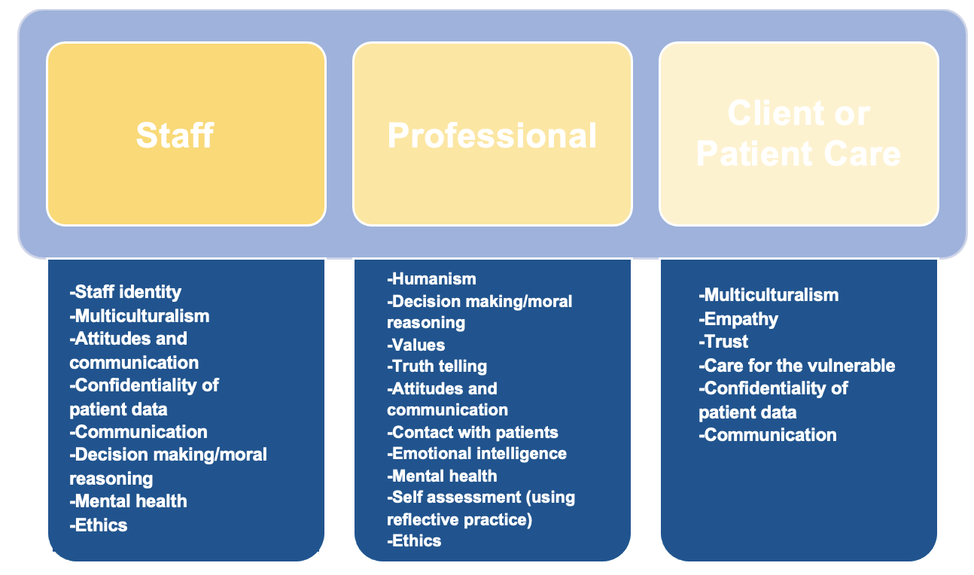




Barriers and Facilitators of Professionalism in Undergraduate Medicine: A Mixed Methods Systematic Review Protocol
Joshua Sagisi, Nicole Davi, Dr. Nagina Khan, Chantel Aftab, Sohyun Ahn, Prof Walther N K A van Mook, Prof Subodh Dave, Prof Wolfgang Gilliar
1. University of Birmingham, Medical School. 2. Queen’s University Belfast, Medical School. 3. South London and Maudsley NHS Foundation Trust. 4. Touro University, Nevada. 5. University of Exeter, Medical School. 6. Chair, Royal College of Psychiatrists South West Division. 7. Hon. Asso. Professor, University of Nottingham. 8. University of Bolton. 9. Dean Elect, Royal College of Psychiatrists
INTRODUCTION
Role Modeling
Developing insight of patient’s context
Human Virtues
Understanding Environmental Context
Reflective Influence
Higher Values
Integrity
Respect for patients
Altruism
Balancing external pressures of healthcare
Mentoring Simulation
Patient Involvement
Hidden Curriculum
Reflective Practice
Real Environments
Information technology
RESULTS
Impact
Professionalism is an important aspect of medical training and health systems work, however it’s integration into teaching varies. Context and learners’ perspectives are crucial in undergraduate medical education (UME) because students need to develop a sense of coherence—a construct that contributes to resilience in working with complex environments.
The shifting debate in UME emphasizes that education remains learner centered and ought to be guided by learner needs¹ to provide unique insights into the interventions, but also the context in which the learners are taught.² We contend that identifying and integrating approaches from the learner perspective is important for supporting medical students and can increase satisfaction in their work and career, and professional
competence.
Screened papers highlighted that medical schools could engage human virtues in medical practice through emphasis on teaching higher values, integrity, respect for patients, and altruism. Understanding environmental context was related to developing insight of patients’ context whilst balancing external pressures of healthcare. The highly efficient approaches with reflective influence were demonstrated through role modelling, mentoring simulation, patient involvement, hidden curriculum, reflective practice, real environments, and use of information technology.
By identifying the barriers and facilitators of professionalism in medical school curriculum from the learners’ perspective we can influence educator perspectives to gain a better understanding of professionalism concepts for improved ways of teaching that generate the most well-equipped physicians to best serve our communities.
Our research will reveal medical students’ views towards professionalism education and provide a framework for the most effective methods of receiving adequate professional training as well as relevant themes that contribute to professionalism in contemporary healthcare.
Benefits to staff, professional, and client or patient care:
aim
To explore undergraduate medical students' views on professionalism and identify the barriers and facilitators to integration in UME.
METHODs
CONCLUSIONS
REFERENCES
The following databases were searched: PubMed, Embase, Scopus, PsycInfo, and ERIC
Inclusion criteria:
  Undergraduate medical students internationally
  Articles published from 2010 to 2021
  English written studies
  All study and literature types.
Included studies will be critically appraised using the mixed methods appraisal tool (MMAT).³
  Data will be extracted from selected studies
  Qualitative research findings will be pooled
  If pooling is not possible, findings will be presented in narrative form converting quantitative data into qualitative data
  Thematic analysis approach will be used for analysis.
Preliminary findings from the literature point to introducing the professionalism related constructs early on in undergraduate medical education to impact learners’ understandings. This would ensure that students are appropriately prepared for the subsequent years of professional practice with patients. By doing so it could lead to the inclusion of intrinsic values of students, thus settling any discord between what is taught and why the students believed they had selected a career in medicine and healthcare.
It is contended that satisfaction of working in a medical career and clinical competence can improve if the students’ perspectives and teaching are aligned to patient outcomes, and not just to the pressures of healthcare environments.
1. Mann K V. Theoretical perspectives in medical education: Past experience and future possibilities. Med Educ. 2011;45(1):60–8.
2. Kamdar G, Kessler DO, Tilt L, Srivastava G, Khanna K, Chang TP, et al. Qualitative evaluation of just-in-time simulation-based learning: The learners’ perspective. Simul Healthc [Internet]. 2013 Feb [cited 2021 Jul 22];8(1):43–8. Available from: https://journals.lww.com/simulationinhealthcare/Fulltext/2013/02000/Qualitative_Evaluation_of_Just_in_Time.8.aspx
3. Hong QN, Pluye P, Fàbregues S, Bartlett G, Boardman F, Cargo M, et al. Mixed Methods Appraisal Tool (MMAT), Version 2018. User guide. McGill [Internet]. 2018 [cited 2021 Sep 13];1–11. Available from: http://mixedmethodsappraisaltoolpublic.pbworks.com/w/file/fetch/127916259/MMAT_2018_criteria-manual_2018-08-01_ENG.pdf%0Ahttp://mixedmethodsappraisaltoolpublic.pbworks.com/
CONTACT INFORMATION

