Slide 1
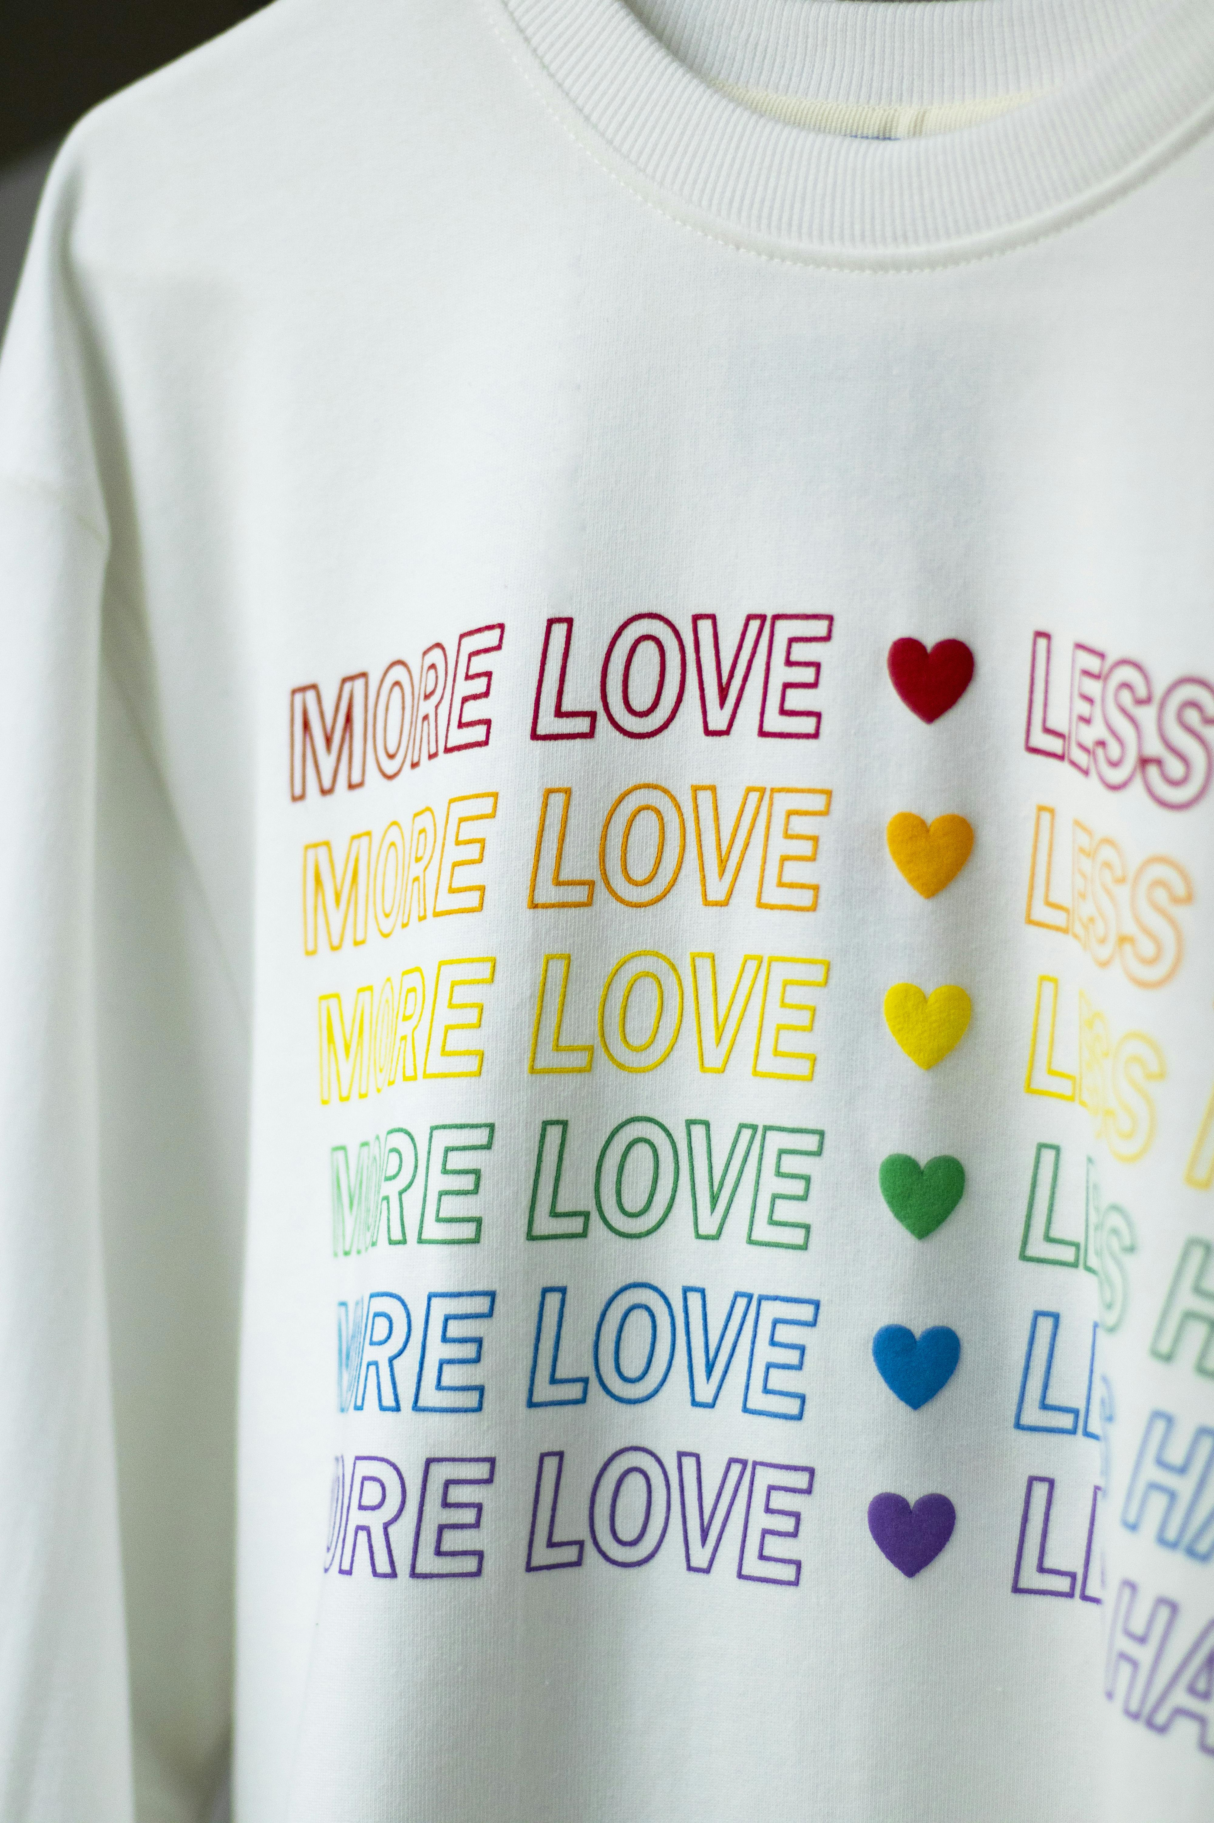
EDIA: Equality, Diversity, Inclusion and Adversity
Nurturing an inclusive research culture in the face of sector wide challenges
Josie Caplehorne and Dr Jennifer Leigh

Slide 2


A little bit about us
Josie Caplehorne (She/Her)
Research and Innovation Support Manager (Culture and Governance), University of Kent
Staff Disability Network Co-Chair, University of Kent
ORCiD: 0000-0001-5984-2032
Jennifer Leigh (She/Her)
Reader, School of Social Sciences, University of Kent
Honorary Professor, Department of Chemistry, University of Liverpool
Staff Disability Network Co-Chair, University of Kent
ORCiD: 0000-0002-3672-1462

Slide 3
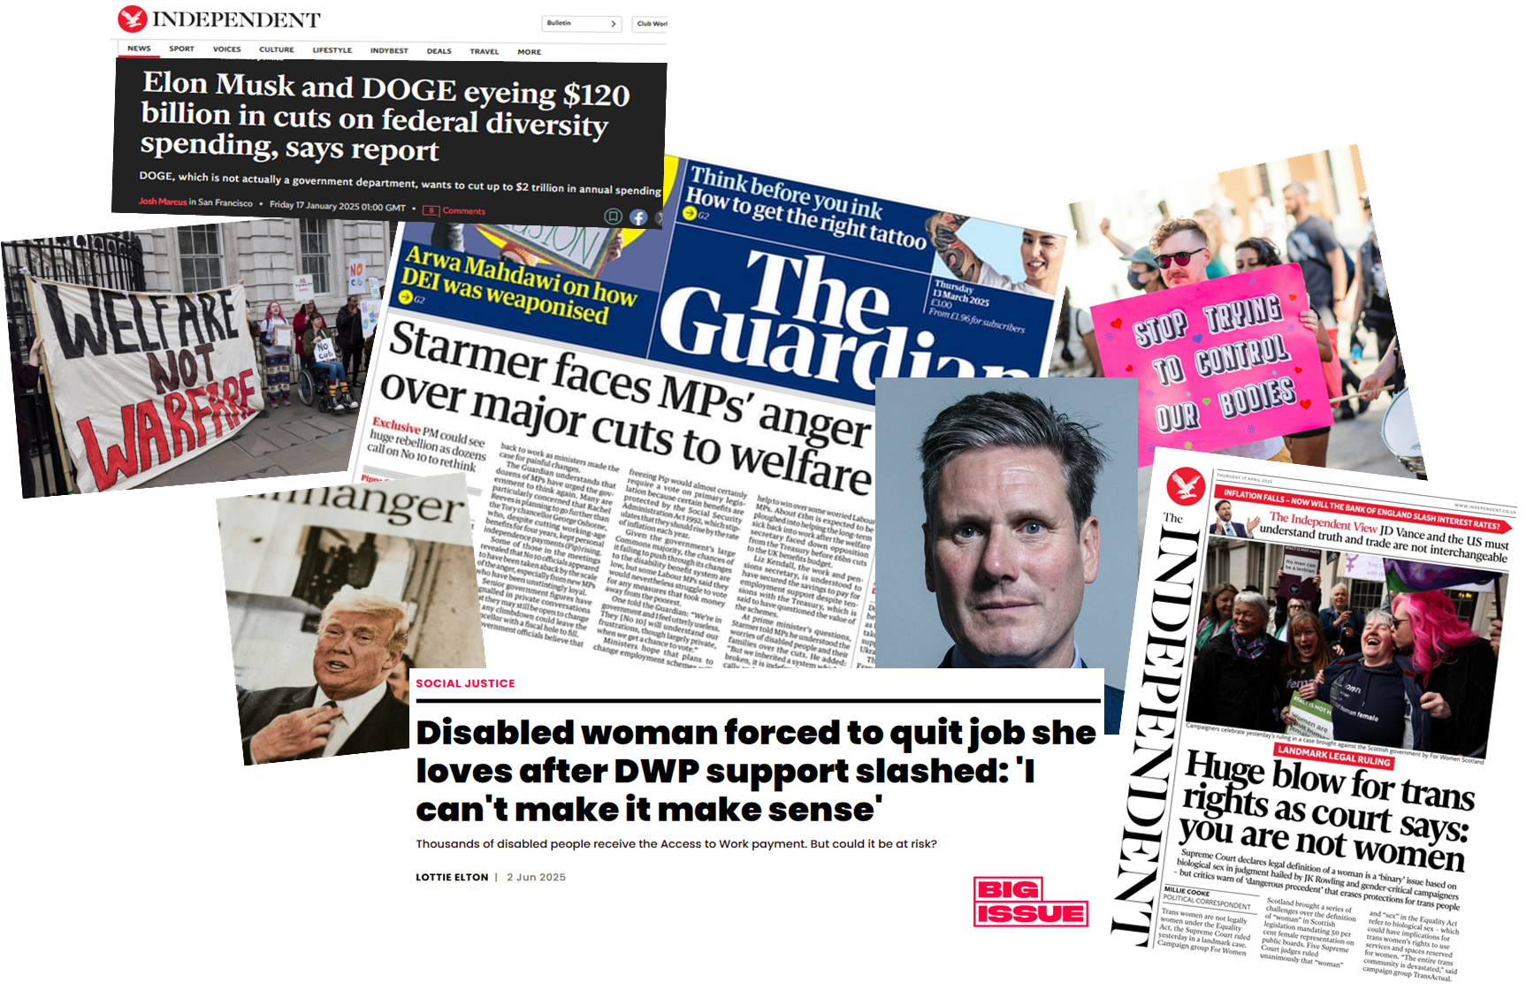
Global war on the marginalised
Growing national and global toxic narrative is fuelling a war against equality, diversity, and inclusion.
Notes:
There is a growing national and global toxic narrative that is fueling a war against equality, diversity, and inclusion across the board. The headlines are damning.

Slide 4

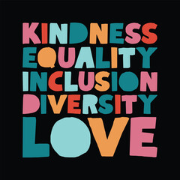
Weaponising equality (U.K)
Change to UK law to define women and men by their biology at birth, preventing trans people being recognised by law
UK Government mandated changes to eligibility for Personal Independence Payments (PIP)and universal credit to save £5bn a year by 2030 and get more people into work.
UK Department for Work and Pensions (DWP) planning two cost-cutting waves, making it much harder for disabled people to secure disability employment programme (Access To Work) support
Government ‘Keep Britain Working’ review tackling ‘health based economic inactivity and promoting healthy and inclusive workplaces’
Notes:
For example, in the United Kingdom, our Government are making it much harder for disabled people to access Personal Independence Payments (PIP), a lifeline for many that helps with the extra costs that can be incurred when living with a long term chronic health condition or disability. Additionally, the ruling, guidance and surrounding media coverage of the recent Supreme Court ruling, and interim Equality and Human Rights Commission (EHRC) guidance on the legal definition of 'woman' within the Equality Act 2010, is already causing real harm to staff and students working across Higher Education.

Slide 5
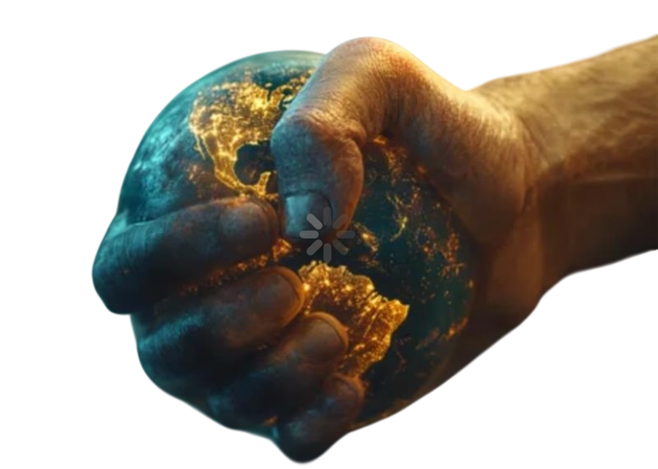
Weaponising equality (Global)
New Zealand’s populist party introduced bill to define women and men by their biology, preventing trans people being recognised by law
US Government defunding and erasing Equality, Diversity, and Inclusion (EDI) initiatives
106,000 Black women lost their jobs in the US in April 2025
DOGE threatening education departments with funding cuts if they fail to stop and remove EDI initiatives
US Stop WOKE Act (Individual Freedom Act, 2022) – prevents teaching of topics such as race, gender, racism, and social privilege
Trump administration asking international companies to comply with their EDI bans
Notes:
Further afield, such as the Government’s of the United States and New Zealand, the rhetoric feels no different. Safe spaces and legal protections for trans people are being lost, funding for EDI initiatives is being eradicated, and there is increasing pressure for other countries to follow suit if they want to stand a chance of working with international partners.

Slide 6





Increased awareness of exclusionary practices in Higher Education
Notes:
From the point of view of U.K. Higher Education, there have been increased awareness of exclusionary practices. This awareness has been born of factors such as Athena Swan, Race Equality Charter and the #BlackLivesMatter movement. However, they are not a fix all, and whilst they can go a long way to recognizing societal inequalities, there are factors at play across Higher Education in the UK that are making the environment much harder to be part of.

Slide 7








Adversity in Higher Education
Significant impact on U.K. undergraduate recruitment
Reliance on international student recruitment
Unsustainable funding model
Scottish Government funding decreased in value
Ban on international taught postgraduate students bringing family
Increasing costs, with inflation pushing up prices across the board
Impact of increases to employer’s National Insurance payments
Leadership not planning for the worst when things were at their best (or better)
Notes:
Academic institutions across the United Kingdom are facing compounding financial and operational adversities in a way that have never been experienced:
“Significant variability across the sector” for U.K. undergraduate recruitment
Unsustainable funding model
“Reliance on international student recruitment to cross-subsidies both teaching and research activities”
Projections that a “significant reduction in international students will plunge 84% of providers into deficit” followed by the ban on taught postgraduate students bringing family members to the U.K.
“Increasing costs, with inflation pushing up prices across areas such as staffing, research, estates, and utilities”
Impact of increases to employer’s National Insurance payments
'For far too long vice-chancellors have helped fuel this crisis by fighting to hoover up domestic and international students, creating a cycle of boom and bust. When times were good, they failed to invest properly and now they are asking staff and students to pay for the price of their mismanagement. Bodies tasked with overseeing university governance have been hollowed out and are all too often asleep at the wheel, allowing vice-chancellors to act like reckless CEOs. Labour should launch a root and branch review of the sector's governing structures while putting an end to university leaders being rewarded for failure with gigantic pay packets.’ (https://www.ucu.org.uk/article/13935/University-crisis-will-see-over-10000-staff-lose-their-jobs-fears-UCU)
https://www.timeshighereducation.com/news/increased-risk-market-exit-after-ps34-billion-losses-ofs
https://www.timeshighereducation.com/news/uk-university-redundancies-latest-updates

Slide 8
Instability in Higher Education
Casualisation of working conditions are systemic across Higher Education and compound inequalities
Cycles of restructuring and redundancies have a negative effect on welfare of employees regardless of jobs losses
Loss of departments, degree programmes, and highly experienced staff
Confused and divergent messaging – student is a customer, not a scholar
Lack of support for unfunded research projects and the inequalities that are further compounded
UK Higher Education shrinkage
US restrictions impacting research and innovation projects across the globe – increased workloads on project leads/co-leads to pick up the pieces
Notes:
This, when considered with the advertises outlined on the previous slide, create an environment where adversity is being acutely felt and experiences by all.

Slide 9
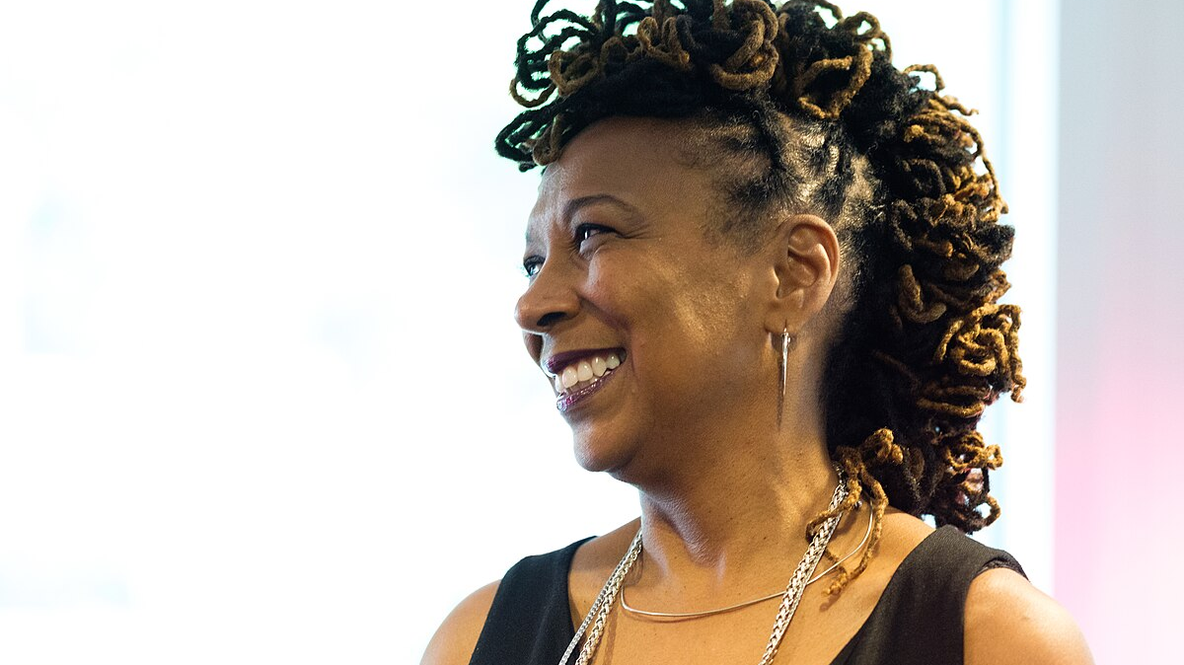
Identity visibility and intersectionality
“Identity is not always visible, but it is always intersectional”
Kimberlé Crenshaw, 1989

Slide 10
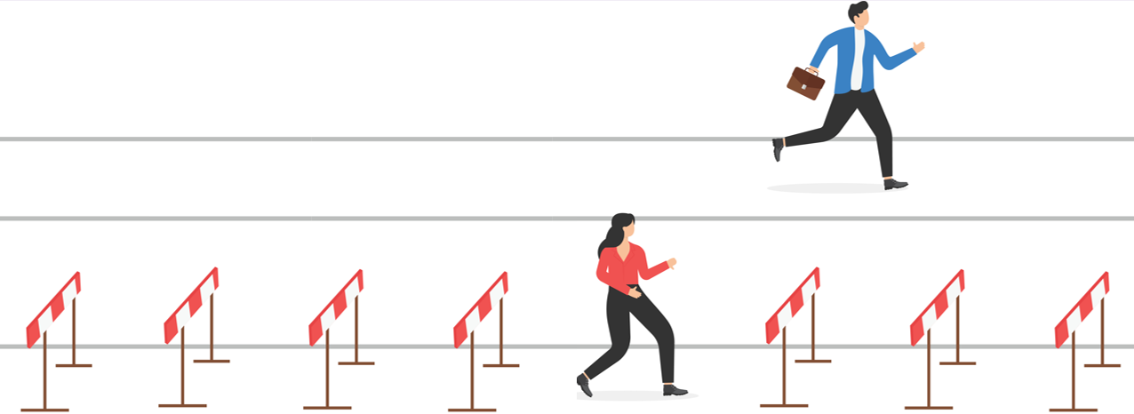
Inequality of adversity
Adversity and instability in any sector impacts everyone, but it does not impact everyone equally
Notes:
However, there is an embedded inequality of adversity experienced by those working across the sector. Yes, we all know that it’s a very difficult sector in which to work and thrive, but adversity and instability in any sector does not impact everyone equally, and we’ve got some data to show this.

Slide 11
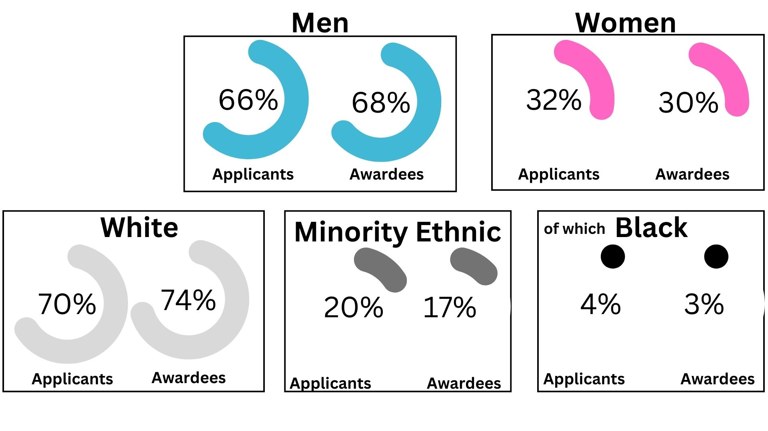
UKRI data 2016-2022

Slide 12
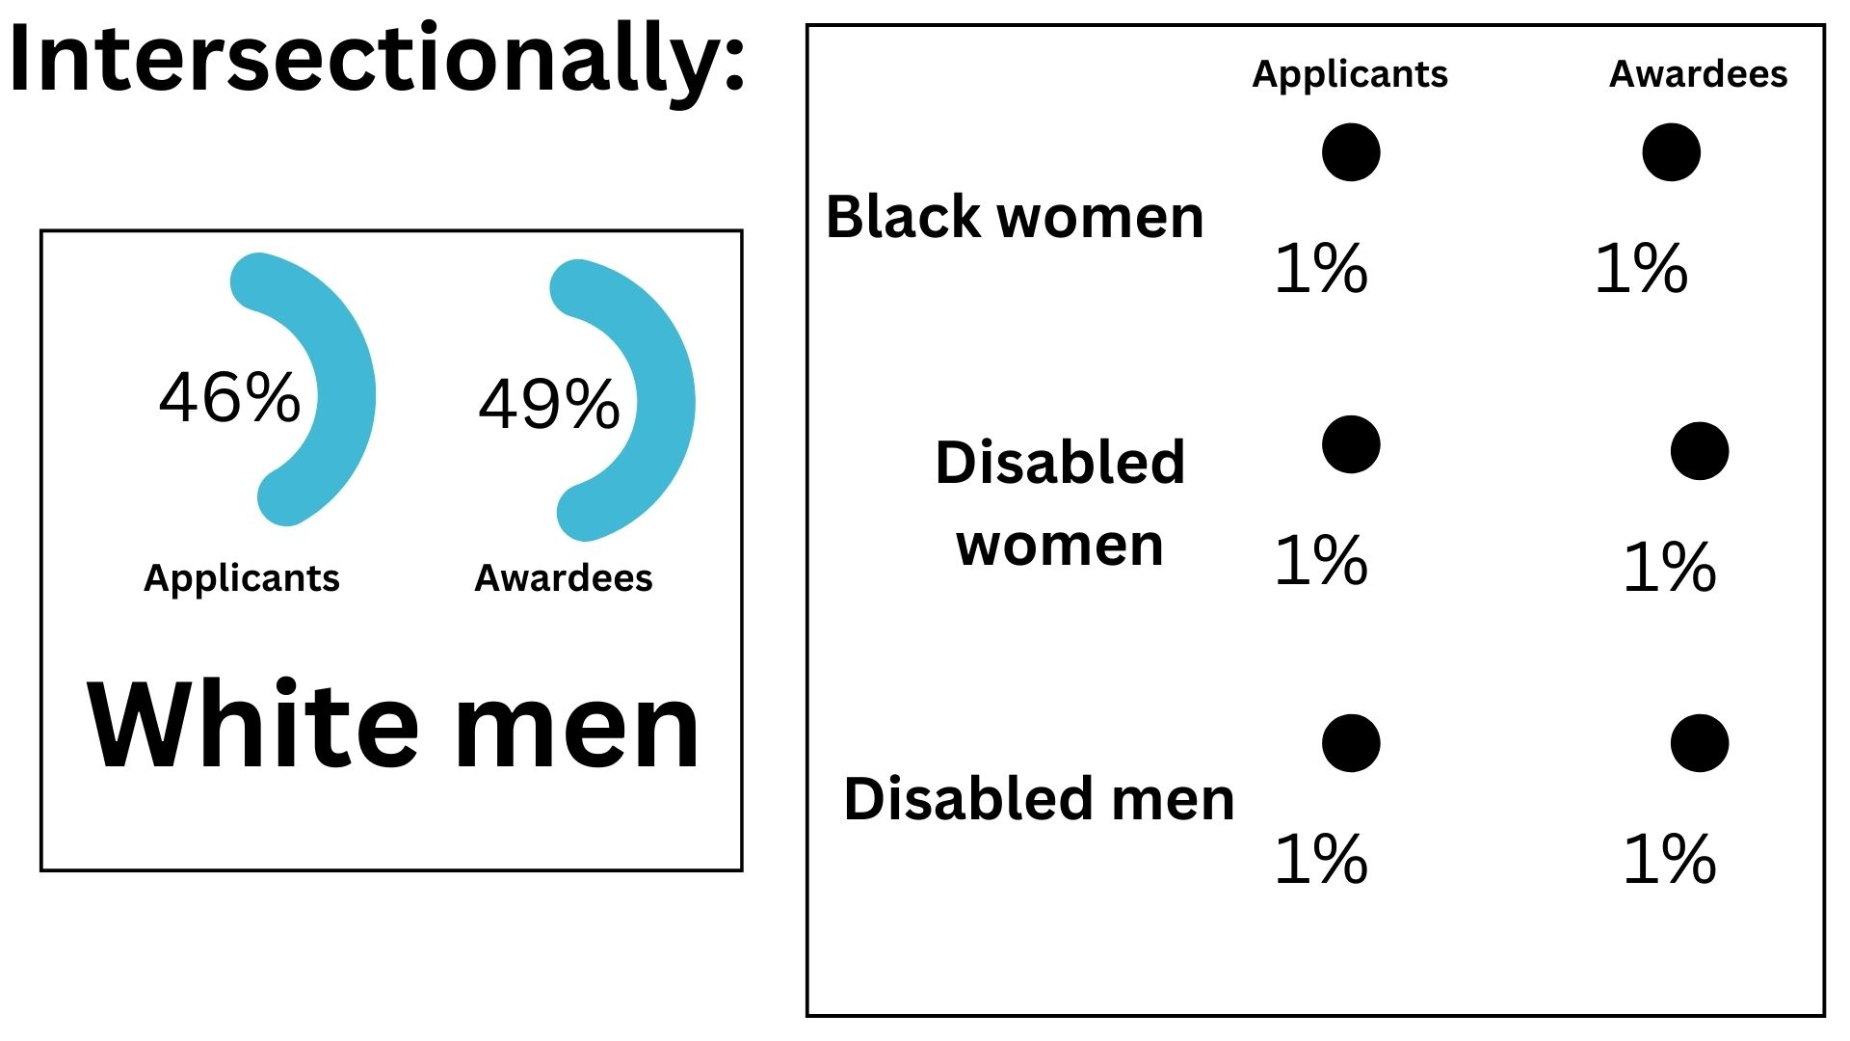
Intersefctionally:

Slide 13
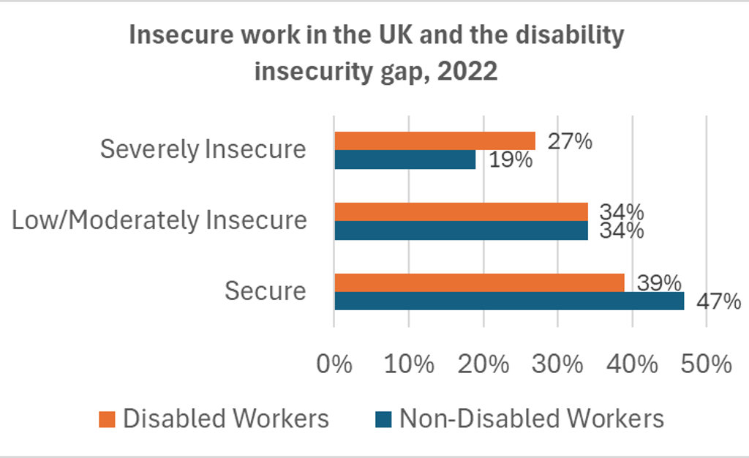
Insecure work in the United Kingdom and the disability insecurity gap, 2022
Notes:
Source: Work Foundation calculations of the Office for National Statistics Labour Force Survey –April-June 2022

Slide 14
Disabled (intersectional) workers
A report from the University of Lancaster has found that:
27% of disabled workers (1.3 million) in severely insecure work in the UK, compared to 19% of non-disabled workers
Severely insecure work can worsen a disabled worker’s health and prospects of gaining secure employment
Disabled women face dual disadvantage and are approximately 2.2 times more likely to be in severely insecure work than disabled men
Disabled workers from ethnic minority backgrounds are more likely to be in severely insecure work relative to white disabled workers (29% versus 26%)
One in three autistic workers (38%) and a quarter of people with mental health conditions (28%) are in severely insecure work compared to 20% with other disabilities and conditions.

Slide 15
Inaccessible cultures in HE
“I…cannot work the long hours…I did before I was unwell. … This makes it extremely challenging to be as productive as I used to be. I am certain…this will affect my ability to publish and “keep up” with my contemporaries, and…I suspect that this will affect how I am compared to others when applying for a permanent academic role and grants.”
“I would really struggle to stay studying in a lab now” Senior clinical scientist
Covid levelled the playing field. What I had asked for over many years, to work from home, became the norm and I didn’t need to fight for it anymore. Now it’s only about disabled people again, I’m back to fighting - and its exhausting”
Professional Services
“Ivory tower ableism is not accepting of illnesses, and there is a culture of not taking holidays or sick leave” PhD student
“Constant change has caused me to feel terrified of redundancy. Commuting, the only real option I’ll have if I lose my job, will take a negative toll on my already ill health. I lose sleep worrying about it as I know I won’t cope”
Professional Services
“I stayed at the same university because of support, but will there be consequences for that?” “Yes”
PDRA (Post Doctoral Research Associate)
Notes:
These are just some of the many experiences people working and studying in Higher Education have experienced. It could be easy to assume these are ancient history, that all the barriers and problems have been solved because of the initiatives we outlined earlier, but that is not the case. Sadly, whilst an entire organisation might be able to demonstrate that it’s achieved a certain inclusion badge or status, the day-to-day experiences of marginalised people are still entrenched in inequalities, barriers, biases, and discrimination.

Slide 16
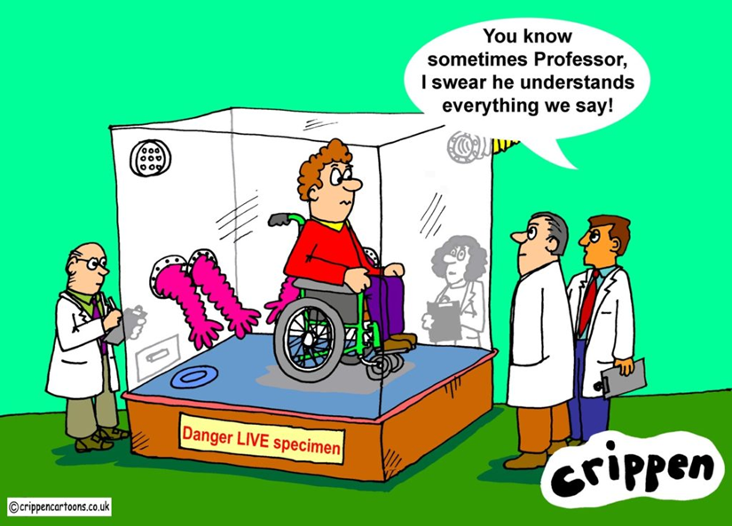
Burdens
Just because I am disabled, it does not mean I am not capable. No, it is not true that my [visual impairment / hearing impairment / physical disability / neurodivergence / mental health / chronic pain*] means that I do not belong in science. Yes, I can still do my job. No, I cannot work the 70+ hours a week that seems to be necessary in academia right now, but that is because it is inhumane. Not because I am disabled.
*please delete as applicable
Notes:
There were 5.5 Million disabled people in the UK in 202452 and the government is failing us badly. More than 200,000 people (by their count) are on disability benefits and want to work.142 If governments really want to
reduce economic inactivity143 and support disabled people to get and keep employment they need to make the systems add up.
It’s not rocket science. Except when rocket science is actually your job…
Why aren’t disabled scientists being funded?Why are there so few disabled medical doctors and academics? Why is there an assumption that disabled people can’t
have professional careers? Why do we face career blocking, bullying, and fail to progress? People are scared of saying they are disabled. Coming out as a neurodivergent scholar56 becomes infinitely more risky when autism is
seen as a danger to society. I think they are happier with disabled people stacking boxes than doing science.

Slide 17
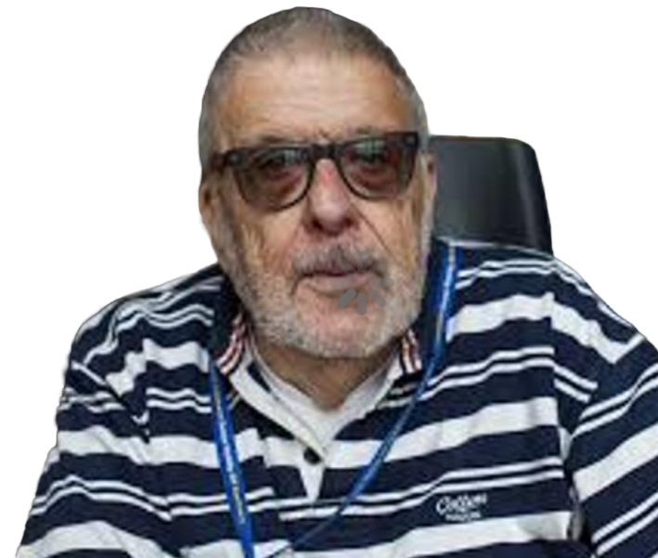
“Social Model of Disability”
“I did want to provide an alternative, more optimistic picture that wasn’t about simply seeing disability as purely tragic, disabled people as unemployable and so on. It was about having an optimistic view of what disabled people could achieve if many of the barriers they faced were removed.”
Professor Mike Oliver (1945 – 2019)
Notes:
Are the odds stacked against us? Well, yes if we consider the Social Model of Disability, coined by Professor Mike Oliver. The Social Model of Disability looks upon the disabled person as being barred by society, rather than the disabled person being the problem at all. Oliver became a key advocate of the social model of disability. This is the idea that much of the inconvenience and difficulty of living with a disability is not an inherent feature of the disability itself, but a failure of society to adapt to the needs of disabled people.

Slide 18
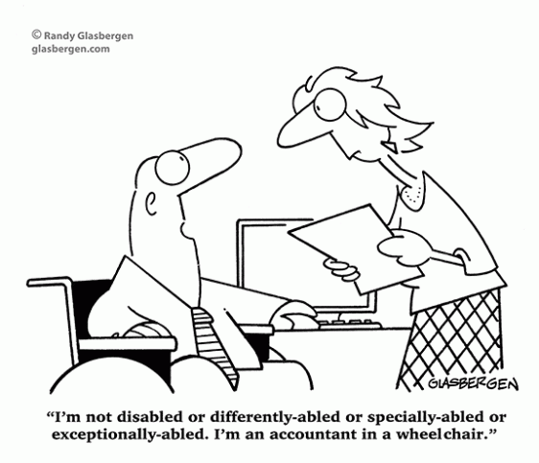
Are the odds stacked against us?
“I’m not disabled or differently-abled or specially-abled or exceptionally-abled. I’m an accountant in a wheelchair.”
© Randy Glasbergen
Notes:
Discourses:
Benefit scroungers
Lazy
Undeserving
Hate crimes
Self diagnosis
Fashionable (TikTok)
Students not staff
‘Curing’ disability
Eugenics
Superhuman / inspiration porn

Slide 19
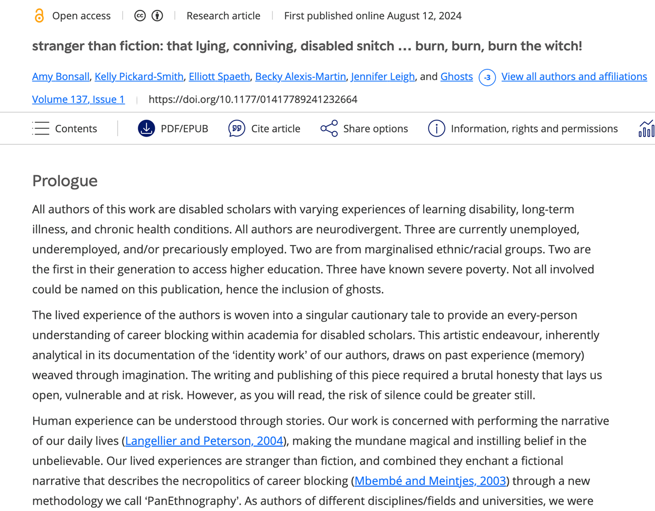
Stranger than fiction: That lying conniving disabled snitch… Burn, burn, burn the witch!
Notes:
Career blocking

Slide 20

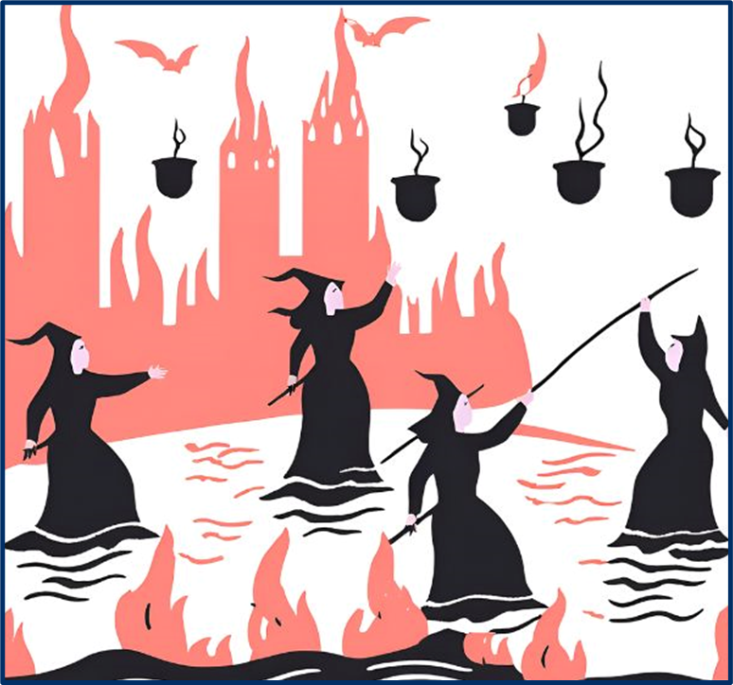
A PanEthnography of witches
Notes:
“There have always been witches in my family. I mean actual real bona fide witches. It’s just a thing, you know? I didn’t actually realise that there were families that weren’t witches.
Back in the day, witches were ‘othered’. They were different. Maybe they didn’t move quite like everyone else or want to be around people all the time. Maybe smells or sounds bothered them more than others, or they had their own ways of doing things that were a bit different. Had a separate perspective on the world. Remind you of anything? Sensory sensitivity or neurodivergence perchance?
But it’s easy to blame someone who doesn’t quite fit in when things are going wrong, or resent them for knowing more or seeing more than you. Like the witchfinders did! Encouraging neighbours to denounce potential witches; those othered ones.
I don’t want to have to be different. When disability is masked and I am hiding the extra energy and time I take to do things others might find easy I’m charged with not being disabled enough to need help. Drowned. Unmasked, I’m incompetent and not worthy of being part of academia. Burned. You know what? I am competent, and I am disabled. This shouldn’t be some fucking witch hunt where I die either way.
From there it’s a small step to the lake or the stake.
innocence drowns
guilt burns
damned either way.
burn the witch they say.
This is a witch trial. I would have much preferred to just get on with my bloody job; which I am bloody good at by the way. This utter bullshit of trials (and tribunals) makes my very bones ache with frustration—there’s no power in any of this, there is no power in a grievance. It’s all about hierarchy, and the hierarchy is controlling. The system closes down to protect only itself.”

Slide 21

Inclusive behaviours versus exclusionary behaviours
Acceptance
Accessible (by design)
Advocacy
Allyship
Belonging
Community
Equity
Inclusive Practices
Kindness
Learning
Positive culture
Value
Assumptions
Blame
Bullying & Harassment
Discrimination
Exclusionary Practices
Hate
Inaccessibility
Inequity
Intolerance
Scapegoating
Toxic culture
(Un)Conscious Biases
Notes:
So far, we have highlighted the factors of social inequality, the challenges facing U.K. based Higher Education environments, and the culture that many of us are working within. It’s easy to think that only academic staff are faced with these systemic challenges and embedded inequalities, especially when it relates to research and innovation, but it can be anyone and everyone who works and studies within this environment. It extends from our academic colleagues to our Professional Service and Technician colleagues, our students, and our collaborators. Our strength is in recognising that we are a community, in acknowledging and understanding the experiences of others, and in questioning our own biases (whether we think we have them or not). It’s about really paying attention, thinking about, and actively choosing the kind of (research) culture we want to be part of, and who we can all choose to be within that environment. It’s easy to think that, because of the positive initiatives and inclusion ‘marks’ that an institution may have, that its easy/easier being marginalised in Higher Education than in other sectors. However, there is often a fight with being singularly or intersectionally marginalised, and it can be exhausting.

Slide 22

What (and who) do we lose when equality, Diversity, Inclusion, and Accessibility (EDIA) is a 'nice to' not a 'need to' have?
Notes:
Josie: If we don’t do these things there are real risks for the sector and society as a whole. When EDIA is seen as a nice to have and not a need to have, then you, your family, friends, colleagues, collaborators, neighbours, etc., will face live with the dangerous consequences.

Slide 23

“A loss of fairness, justice, and humanity”
A fundamental breakdown of our society
Social division and polarising rhetoric exacerbated
Victim blaming resurfacing as the norm, harassment tolerated and excused
Marginalised individuals and communities blamed and living in fear
Healthcare systems failing to meet the needs of everyone
Increased unemployment due to barriers to access or stay in work:
  wasted talent
  reduced innovation, stagnation of creativity, and a decline in workplace productivity
  narrower perspectives and lost opportunities for problem solving and collaboration
  Increased social welfare payments due to unemployment/employment barriers
Hindering of social and economic progress
Criminal injustices and, at their worst, war
Notes:
Obviously, no one wants this!
https://www.strawberrywordscourses.co.uk/blog/imagine-a-world-without-diversity-equity-and-inclusion-dei

Slide 24

How can
I help?
(Testimonials to read and return to)
Notes:
It’s not all doom and gloom and we have the collective power to be the agents of change, to be the ones who nurture the environments we want to live, work and thrive in, and we have some lovely examples over the next few slides of how people working in Higher Education have been made to feel valued, have been treated equitably, and the positive differences it has made to them all.

Slide 25
“It took so little effort”
“I didn’t have to ask for accessible versions of forms – they just were. Paperwork was sent…before meetings…and scheduled in core hours (10-2)…there was always a hybrid option.
They don’t use heavy air fresheners or cleaning chemicals. The lifts work and…automatic door access everywhere. [My] mentor…knew about disability, and what they didn’t know they…found out. They made sure that I wasn’t left out of the ‘politicking’ in the department and at a disadvantage.
They checked I had recognition for the extra labour…mentoring others and chairing the disability staff network. I was consulted before equipment and software were ordered to check accessibility. Everyone has access to a quiet space if they don’t want to work in the hot-desk area. Everyone can work from home…You don’t have to say why or justify it and you’re never asked to justify a disability. For the first time I wasn’t scared to disclose or ask for reasonable adjustments. It’s as though they trust us! And you know what? It means that we work harder. Everyone is more productive. We care more, because it feels like they care about us too.”
Notes:
Fictional Vignette!
What amazed me is how little it took. It started with just one question: ‘How can I help?’ There were other little things just there as a matter-of-course – I didn’t have to ask for accessible versions of forms – they just were. Paperwork was sent round before meetings, meetings were scheduled in core hours (10-2) and there was always a hybrid option. They don’t use heavy air fresheners or cleaning chemicals. The lifts work, and there is automatic door access everywhere. I had a mentor who knew about disability, and what they didn’t know they went away and found out. They made sure that I wasn’t left out of the ‘politicking’ in the department and at a disadvantage. They checked I had recognition for the extra labour I put in mentoring others and chairing the disability staff network. I was consulted before equipment and software were ordered to check accessibility. Everyone has access to a quiet space if they don’t want to work in the hot-desk area. Everyone can work from home. You might need to take care of yourself or someone else. You don’t have to say why or justify it and you’re never asked to justify a disability. For the first time I wasn’t scared to disclose or ask for reasonable adjustments. It’s as though they trust us! And you know what? It means that we work harder. Everyone is more productive. We care more, because it feels like they care about us too.

Slide 26
Remote interviews
"Being able to interview remotely has made a huge difference on the opportunities I could pursue. The financial and time cost of travel is often prohibitive for applicants who would be quite happy to relocate if they had an offer. I feel that sometimes being willing to travel for an interview is seen as being more committed or being more passionate about a role, but I do not think this is a fair perception, especially in the current job market.”

Slide 27
Sharing interview questions in advance
“For me - having the topics that we would discuss was really helpful - made the interview prep feel less daunting and achievable. Also really helped my anxiety in the days leading up to the interview because I knew I wasn't going to get a question that I hadn't had the time to prep for etc.”

Slide 28
Living with hearing loss in a shared office
“As I have hearing loss, the [office] layout was adapted [before I started working with the team] to not have colleagues back-to-back with each other. This is a very simple way to help with communication and making the day-to-day challenges easier in an office environment.”

Slide 29
Presentism is a privilege
“Presentism should not be a marker of workplace success, but I was made to feel this way. Even after my Occupational Health team advised my manager that I should be able to have hybrid working (this was way before Covid normalised this), they went against their guidance and told me that “if you’re too ill to come into work, and need to work at home, then you should just be off sick.” Great! So, I can’t be the judge of how I feel? Can I not be trusted? And it really didn’t help my sickness record, even though I could have still worked, I just couldn’t walk from the car park to the building. A new manager literally changed my life for the better. They enabled hybrid working, helped me get the office furniture I needed, and just took a kindness approach. It made the world of difference to me, and I’ll forever be grateful for that.”

Slide 30
Parental leave
“As a manager, I was able to introduce a new father to shared parental leave and facilitate him (and his wish) taking up this option. He hadn't heard of shared parental leave as an option before and I was able to share my experiences. He thanked me for my support and making it easy for him to feel he could step away and take the leave and the experience allowed him to bond with his child and support his partner.”

Slide 31
Career progression
“An internal position came up and I was not sure whether to go for it. I had a meeting with the Head of School (HoS) but in the meantime my dad got very ill. The HoS offered to give me an extension to submit my application. In the meantime, my dad passed away and I fell pregnant (at the same time, I know.. life can be so unpredictable..). I ended up being off for 3 months. The HoS waited for me to come back from leave to arrange for the interviews to take place.”

Slide 32

Towards a fully inclusive environment
Without addressing threats and implementing strategies to retain a diverse…workforce, the UK will lose talent and economic viability. It is more critical than ever to ensure all staff are welcomed and all talents are encouraged. Inclusion is an action that will help secure future economic growth. As such, it should not have to be justified.
“Towards a fully inclusive environment for disabled people in STEMM: A NADSN White paper” 2025. Brewer, G.;Dimitriadi, Y.; Doddato, F.; Haroon, H.; Jolly, J.; Leigh, J.*; Mahaut-Smith, M.; Remnant, J.; Sarju, J.

Slide 33
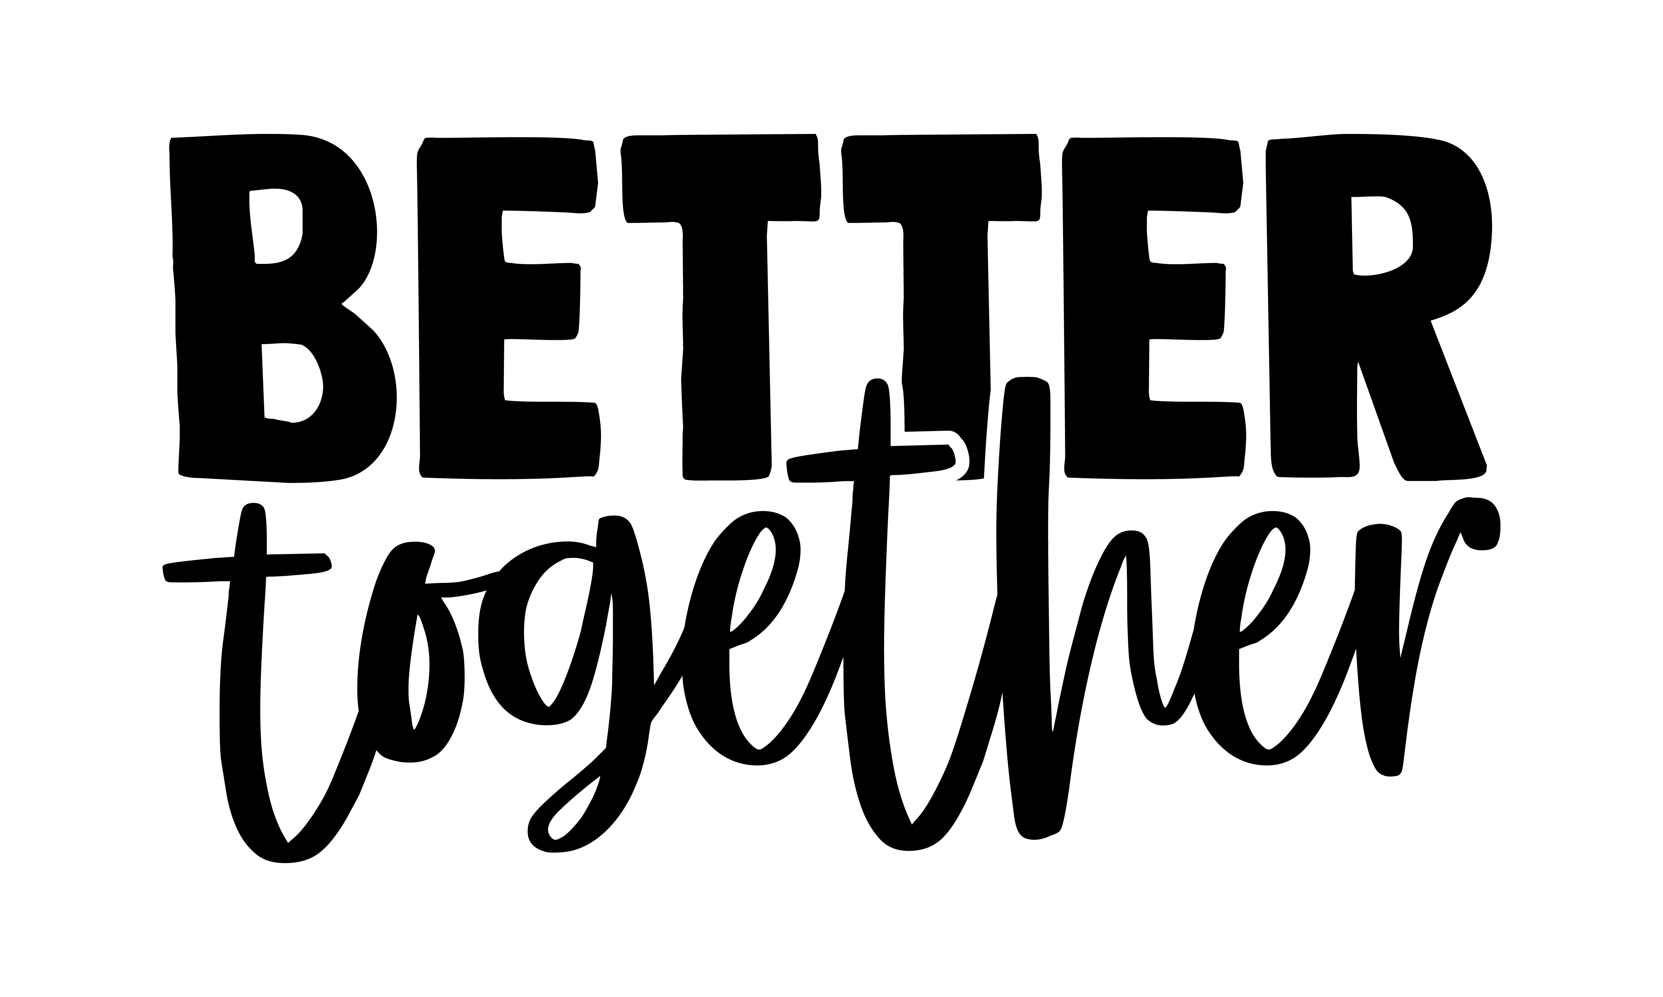
Better together

Slide 34
Some interesting reading
Towards a fully inclusive environment in STEMM for disabled people: A White Paper from NADSN
Being a first-generation university graduate, the impact on a career in science Chemical Science
Stranger than fiction: That lying conniving, disabled snitch...burn, burn, burn the Witch! Feminist Review
Research culture: Using reflective practice to support doctoral students in the biosciences eLife
Ableism and exclusion: Challenging academic cultural norms in research communication Journal of Research Management and Administration
How to be an effective ally Inclusive Employers
£5bn in cuts proposed to WCA and PIP Disability Rights UK
University of Lancaster report on workplace job insecurity for disabled workers

Slide 35
Thank you
Thank
you

