Slide 1




Adapting the Easy Read Adult Social Care Outcomes Toolkit for older social care users
James Caiels, Ann-Marie Towers, Stacey Rand, Rasa Mikelyte, Elizabeth Field and Lucy Webster

Slide 2
Study Overview: Aims and Methods

Slide 3
The ASCOT designed to measure social care-related quality of life (SCRQoL).
Eight domains of SCRQoL.
Structured questionnaire, quantitative analysis.
Developed and tested with older social care users
Could self-report (home care users)
Able to take part in user experience surveys and interviews
View the tools here: https://www.pssru.ac.uk/ascot/tools/

Slide 4
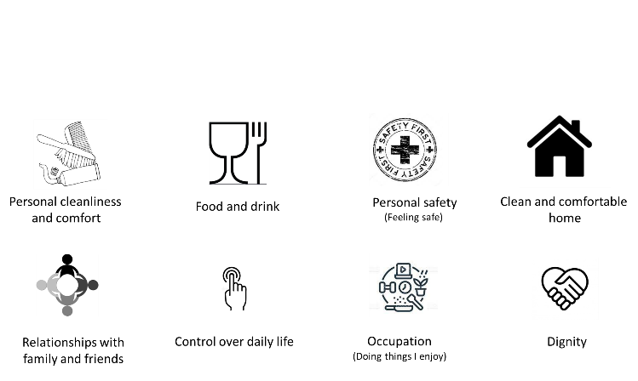

Slide 5
Comprehension: understanding the questions and response options.
Manageability: too long, too structured, difficulty choosing a response option.
Physical and sensory barriers: need someone to read the questions, be their scribe, alternate formats needed (braille).
Recent report found that the following groups faced particular barriers to participation in surveys:
Older social care users
Those with cognitive decline
(Aznar et al, 2021. Representativeness of Adult Social Care Surveys: Main Report)
Barriers to self-report in older adults

Slide 6
ASCOT-ER
Uses simplified wording and pictures to aid understanding and support participation for longer.
Developed and tested with adults with learning disabilities and autism.
Many requests to use this tool with older people living in their own homes and receiving social care.

Slide 7
Study aims
Adapt
Adapt the ASCOT-ER for and with older social care users.
Test
Test whether our changes help people understand and give their views.
Explore
Explore whether people need additional support and what types of support are needed

Slide 8
Methods (24 month study)
Co-production working group 6-8 people living with dementia and their supporters
Meetings 1-3: review the ASCOT-ER, adapt, review again until ready for cognitive testing.
7-10 cognitive interviews
Co-production WG meeting to review and refine.
7-10 cognitive interviews
Co-production WG to review and refine.
7-10 cognitive interviews.
Final version agreed with WG .
Notes:
Participatory, qualitative design.

Slide 9
Study Findings and Changes

Slide 10
Co-production working group
Comprises nine people who have mild to moderate dementia, or are caring for someone who does
Integral part of iterative development
Members suggest, discuss, and reach consensus on the tool
Contribution of the group is highly valued
Changes to the ASCOT-ER have included:
New (more relatable) illustrations
Re-ordering of, or additional (more relevant) prompts for questions
Changes to the wording of response options
Excluding qualifiers in response options (“It is ok.”)

Slide 11
Co-production working group (ASCOT-ER illustrations)
Disliked illustrations
Not relevant or relatable
Could alienate responders
Reinforcing stereotypes (that older people need help)
Food and drink unclear
“Is it about health, or a balanced diet?”
“Too busy, not big enough”
Too much detail
Disliked style
‘Emoji style’ happy/sad faces for response options were thought to be helpful

Slide 12
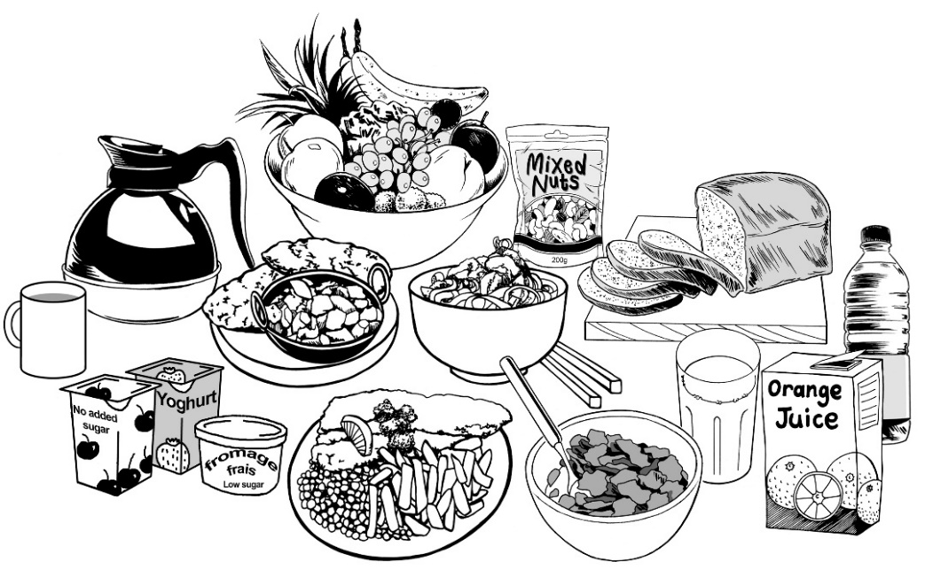


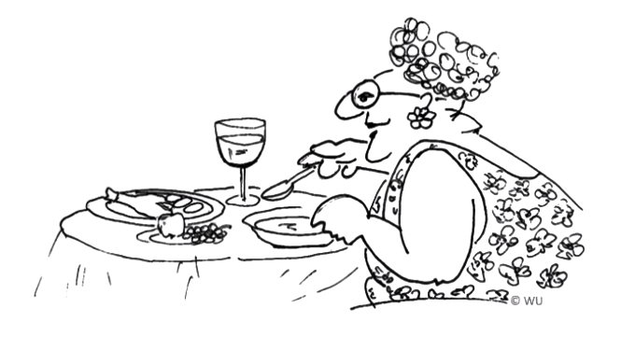
Illustration change – example
ASCOT-ER for people with ID and autism
Original
ASCOT-ER for older social care users

Slide 13
Co-production working group (ASCOT-ER wording)
Less need for lengthy or ‘wordy’ questions and response options.
Move back towards standard ASCOT questions.
Some words changed / added due to risk of misinterpretation or relevance.
Some word ordering changed to reflect the concerns of older people.

Slide 14
Cognitive testing round 1
Conducted six interviews
Areas covered included: Kent (3), Hampshire (1), Sussex (1) and London (1)
Higher end of cognitive impairment (as measured by mini cog)
Scores ranged from 0-3 (out of 5)
Of the six people interviewed:
6 white British,
4 female, 2 male
Aged 72-89
Social care use:
5 using home care, 2 using community activities, 3 using equipment (e.g. walking aids), 3 home adaptions, 2 other support (dementia support group)
5 pay for their own social care, 1 pays a contribution

Slide 15
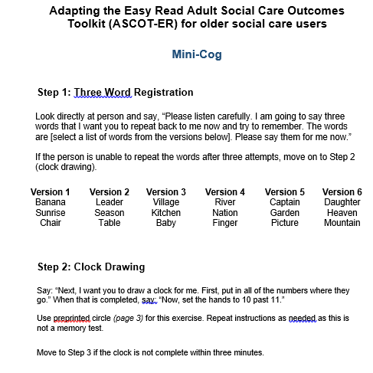
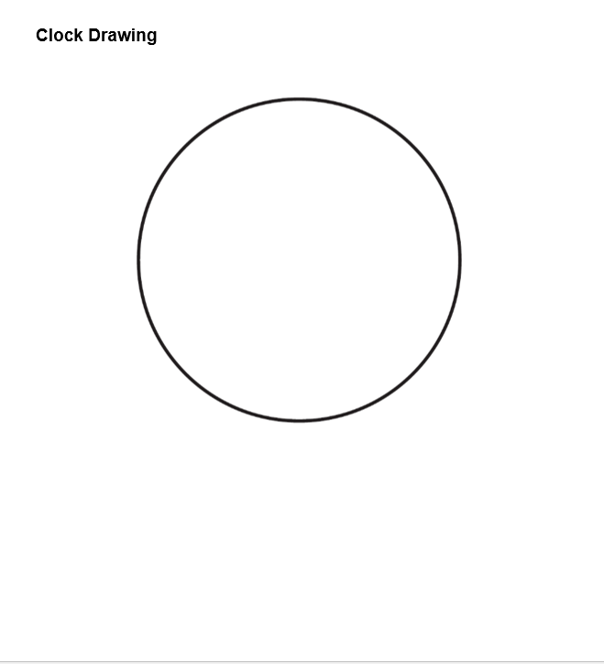
Mini-cog tool

Slide 16
Cognitive testing round 1 – question ordering
Control over daily life
Personal cleanliness
Food and drink
Accommodation
Safety inside the home
Safety outside the home
Social Participation (life)
Occupation (how you spend your time)
Dignity
Control over daily life
Personal cleanliness
Food and drink
Accommodation
Social Participation (life)
Safety inside the home
Safety outside the home
Occupation (how you spend your time)
Dignity

Slide 17
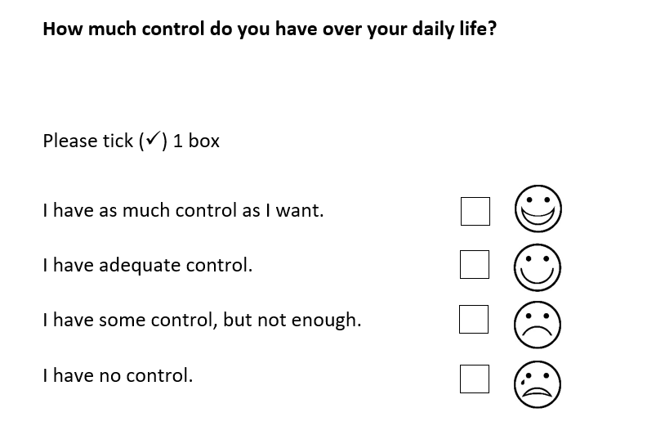
Cognitive testing round 1 – tick boxes and response prompts

Slide 18
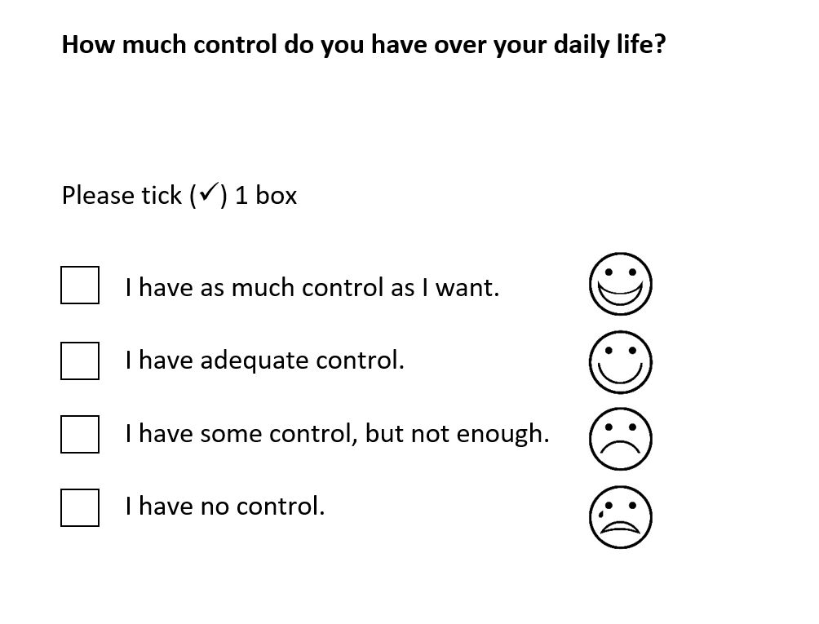
Cognitive testing round 1 – tick boxes and response prompts

Slide 19
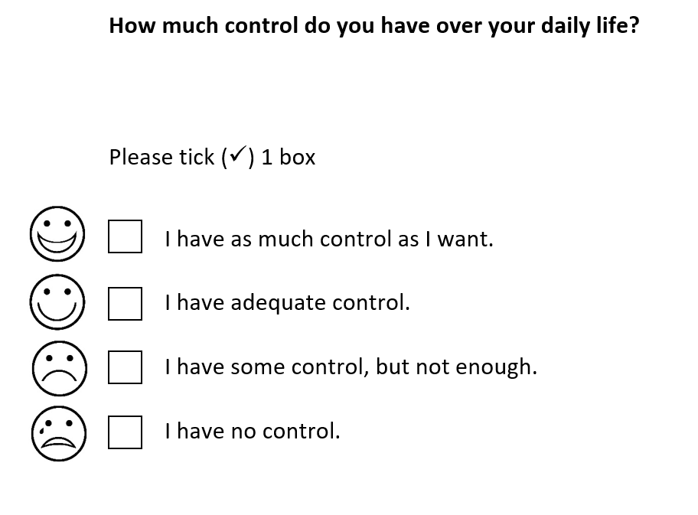
Cognitive testing round 1 – tick boxes and response prompts

Slide 20
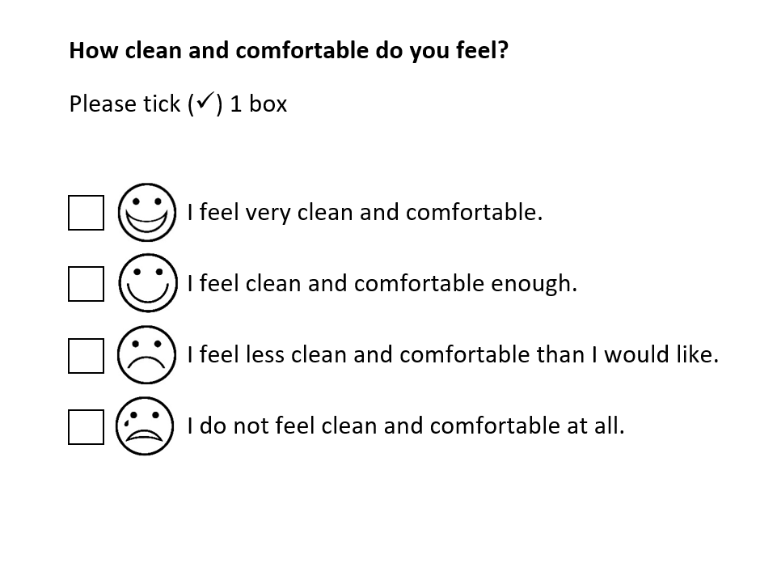
Cognitive testing round 1 – tick boxes and response prompts

Slide 21
Cognitive testing round 2
Conducted seven interviews
Areas covered included: Kent (3), Surrey (1), Sussex (1) and London (2)
More medium end of cognitive impairment (as measured by mini cog)
Scores ranged from 1-5 (out of 5)
One unable due to visual impairment
Of the 7 people interviewed:
6 white British (or English), 1 white German
4 female, 3 male
Aged 75 (3) - 88
Social care use:
3 using home care, 2 using community activities, 4 using equipment (e.g. walking aids), 4 home adaptions, 3 other support (Age UK advisor, singing for dementia)
4 pay for their social care, 3 non-charging support

Slide 22
Cognitive testing round 2 – potential changes taken to working group
Universal changes
Removing all illustrations
Removing response option illustrations (faces)
Safety outside question
Clarify: the places you usually go and who you go with
Occupation question
Emphasise potential activities such as hobbies and leisure activities (including passive- watching TV; reading)
Dignity question
Clarify who we mean by paid support (By paid support we mean anyone that is paid by you, or anyone else, including the council, to support you.)

Slide 23
Disclaimer
This study is funded by the NIHR Research for Social Care (NIHR23334).
The views expressed are those of the author(s) and not necessarily those of the NIHR or the Department of Health and Social Care.

Slide 24
Thank you for listening
Contact
J.Caiels@kent.ac.uk
Twitter: @ascot_pssru @pssru_Kent @CHSS_Kent
Website: www.pssru.ac.uk/ascot

