Slide 1
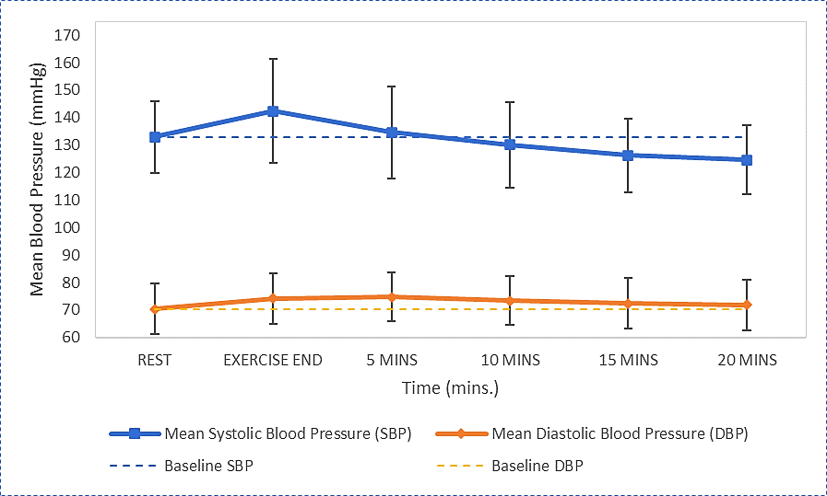
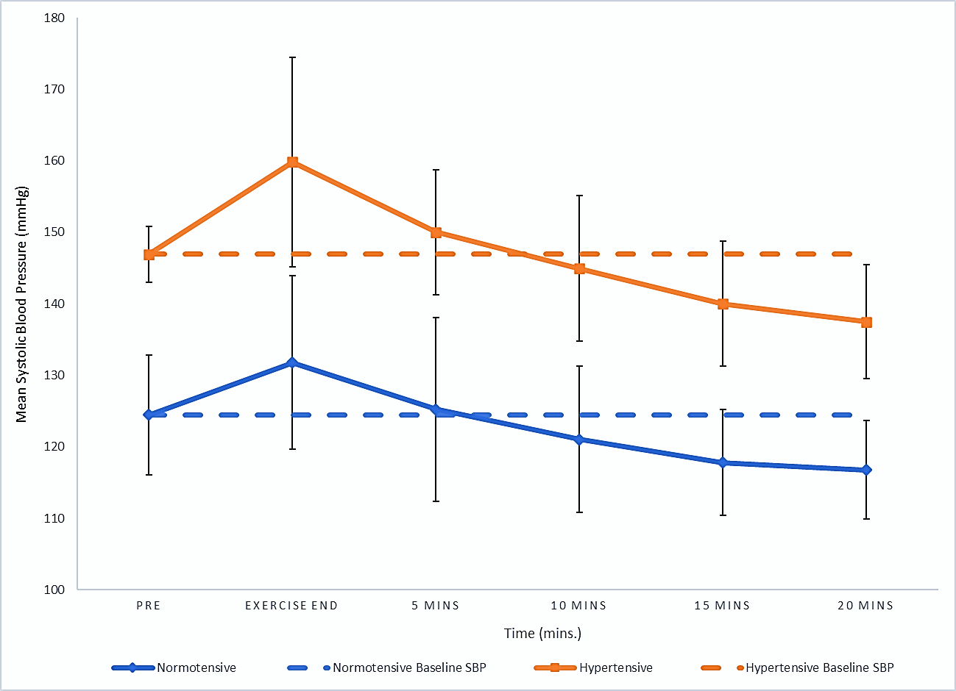
School of Sport & Exercise Sciences
The Effect of the 6-Minute Walk Test on Post-Exercise Blood Pressure in Phase IV Cardiac Rehabilitation Participants
Steve Meadows & Ella Saxby
Select the section of text you want to update and type/insert your poster copy.
If cutting and pasting from another file, click on the mini clipboard icon after pasting and select “Keep Text Only” to preserve the font style in this template.
Do’s
Only use the approved fonts, Overpass or Verdana
Only use one highlight colour per poster (except in charts)
Keep your copy short and concise
Only use good quality images
Make sure your image is correctly proportioned, check – Picture format > Size > Scale – the height and width % should be the same
Make sure your have copyright permission to use the image
Printing
When you are happy with the content of the poster save it as a PDF. The file is set up at A1, once saved as a PDF it can be scaled when printing to A0 or A2.
Send the PDF to designandprintcentre@kent.ac.uk , confirm the size and quantity required and deadline.
Introduction
Hypertension (HTN) is diagnosed when blood pressure (BP) measurements are consistently high, with systolic blood pressure (SBP) ≥ 140mmHg &/or diastolic blood pressure (DBP) ≥ 90mmHg. Physical activity (PA) is recommended for healthy BP management & a post-exercise hypotension (PEH) response has been reported as an acute effect following PA.
Purpose
Would 6-minutes of walking (6-minute walking test – 6MWT) reduce SBP below resting baseline values (PEH response) in a Phase IV cardiac rehabilitation population.
Methods
29 participants (20 male; 9 female; see Table 1.) participating in Phase IV cardiac rehabilitation exercise performed the 6MWT, with seated BP measurements recorded pre (baseline) & 20-minutes post-6MWT at 5-minute intervals. Repeated ANOVA used to check statistical significance (p<0.05).
Results
Baseline resting values for SBP achieved within 10-minutes post-6MWT in all participants (see Figure 1.). Mean SBP significantly reduced below baseline value within 20-minutes post-6MWT (mean 8.36mmHg, p=<0.001). 86.2% of participants experienced PEH in SBP in the 20-minutes post-6MWT recovery period. A greater average total reduction in SBP (9.50 mmHg vs 7.30 mmHg) was observed in those with HTN at baseline (mean SBP 146.9 ±3.94 mmHg, n=11), compared to those who were normotensive (mean SBP 124.4±8.33 mmHg, n=18) – see Figure 2. DBP increased from rest to post-exercise, remaining elevated above baseline values after 20 minutes of recovery (1.38mmHg, p=<0.001) – see Figure 1.
Discussion
The rate of SBP recovery post-exercise has been used as a prognostic tool; findings suggest delayed reduction of SBP increases risk of developing HTN (Singh et al., 1999). The normotensive group recovered back to baseline SBP faster than the HTN group (5 mins. vs 10 mins.). This could be explained by vascular changes that occur with HTN, e.g. arterial remodelling & increased vascular contraction associated with abnormal vascular reactivity (Touyz et al., 2018). This suggests a higher degree of vascular responsiveness amongst normotensive individuals could be responsible for the faster SBP recovery post-exercise.
Discussion (cont’d)
The findings from this study support this; those with HTN took longer to return to baseline SBP (see Figure 2). The HTN individuals also demonstrated a greater SBP increase from rest to the first post-exercise measurement compared to their normotensive counterparts (12.90 vs 7.30 mmHg). This is also supported in previous research, as individuals with HTN have been found to have more significant changes to mean arterial pressure and sympathoexcitation (Sidhu et al., 2019).
Most importantly, the HTN group experienced a greater reduction in SBP (9.50 vs 7.70 mmHg) in the post-exercise period, reducing SBP below 140 mmHg. This suggests the clinical significance of walking in reducing SBP to a normotensive level.
Conclusions
6-minutes of walking at a light-moderate intensity (mean walking speed 2.98 ±0.66 mph; mean METS 3.45 ±0.85) can significantly reduce SBP, with greater PEH effect observed within 20-minutes post-exercise amongst individuals with higher baseline SBP. Short bouts of walking have the potential for BP management, especially in those with SBP in a HTN range.
References
Sidhu, S., Weavil, J., Rossman, M., Jessop, J., Bledsoe, A. & Buys, M. (2019). The exercise pressor reflex contributes to the cardiovascular abnormalities characterizing hypertensive humans during exercise. Hypertension, 74(6), 1468-1475.
Singh, J., Larson, M., Manolio, T., O’Donnell, C., Lauer, M. & Evans, J. (1999). Blood pressure response during treadmill testing as a risk factor for new-onset hypertension. The Framingham Heart Study. Circulation, 99(14), 1831-1836.
Touyz, R., Alves-Lopes, R., Rios, F., Camargo, L., Anagnostopoulou, A., Arner, A. et al. (2018). Vascular smooth muscle contraction in hypertension. Cardiovascular Research, 114(4), 529-539.
Table 1. Demographic data of participants (n=29)
Variable | Mean (±SD) | Minimum | Maximum
Age (years) | 74.65 (±6.40) | 63 | 87
Height (m) | 1.68 (±0.08) | 1.53 | 1.82
Weight (kg) | 76.09 (±13.15) | 54 | 102
BMI (kg.m²) | 26.81 (±3.32) | 19.26 | 32.82
Waist Circumference (cm) Males Females | 102.10 (±9.40) 83.50 (±8.90) | 82.50 71.50 | 115.50 94.50
Resting Heart Rate (bpm⁻¹) | 63.10 (±8.50) | 48 | 85
Resting BP (mmHg) SBP DBP | 132.97 (±13.07) 69.38 (±9.49) | 108 52 | 154 88
Figure 1. Mean (±SD) blood pressure pre- & post-6MWT
Figure 2. Mean (±SD) systolic blood pressure pre- & post-6MWT
School of Sport & Exercise Sciences, University of Kent, Canterbury, Kent. CT2 7NZ.
Correspondence:
s.meadows@kent.ac.uk

