Slide 1
How Bad Can Systemic Cyber Get?

Slide 2
Research Question
What does a comparison of the scale of natural activity data to cyber event data suggest about the risks that cyber could pose to the global insurance market?
The prospective scale of systemic cyber has largely relied on hypotheticals
Many believe that “the big one” has yet to come, albeit without supporting evidence
Natural disaster losses suggest that the potential quantum for systemic cyber may be much lower than many fear, given the wide disparity seen during peak years of cyber risk (1999-2004)
Although there is no direct correlation between natural disaster and cyber economic losses, the sheer magnitude of the former (and attendant insurance market activity) suggests that a smaller and declining magnitude of economic threat in the latter speaks not just to insurability but also remoteness of risk

Slide 3
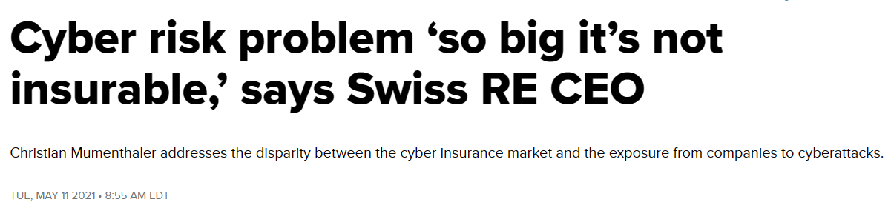

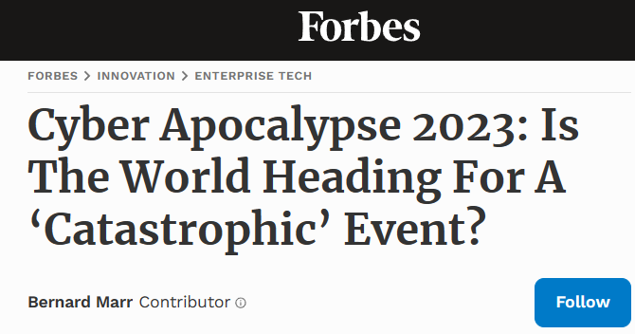
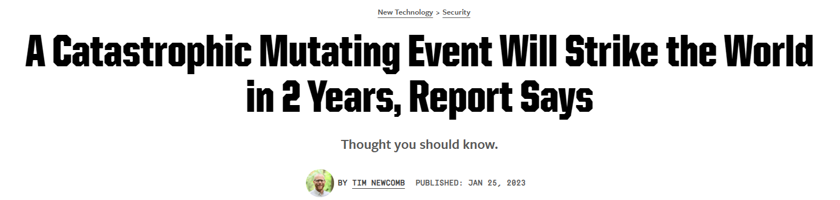
Doomsday Fears

Slide 4
Methodology
Descriptive statistics applied to small data sets – there’s no mathematical wizardry, this is just a simple comparison that nobody has thought to conduct before
Comparison of systemic cyber events and natural disasters on an economic loss basis neutralizes for discussions about extent of insurance penetration, particularly in natural peril-exposed regions
Catastrophe economic loss data sources: EM-DAT, Munich Re NatCatSERVICE, sigma
Cyber catastrophe economic loss data sources: Various disparate sources
  Limitation: No visibility into underlying estimation methodology; estimates have to be taken as is
  Mitigation: The disparity between natural disaster and cyber catastrophe economic quantum is wide enough that even the most realistically egregious errors in estimation would not matter

Slide 5
Key Cyber Data Findings
16 relevant events since 1999
Range (indexed for inflation): $850 million to $65 billion
Average economic loss (indexed for inflation): $16.2 billion
76% of systemic cyber losses for the period came 1999-2004 … 91% 1999-2007
No major systemic cyber losses since 2017

Slide 6
Cyber Losses Provide Context
Worldwide cyber losses approaching $1tn have been easily absorbed by the global economy[1]
Economic losses from systemic cyber since 1999 reach only $260bn[7]
Exorbitant estimates of prospective cyber losses are inherently constrained by the realities of ongoing cyber crime losses
The risk of systemic cyber appears to have declined precipitously, with most major events coming until 2007
Sources: Beattie[2], Cyware Hacker News[3], Gerencer[4], Greenberg[5], Leman[6]

Slide 7
Cyber Losses Provide Context
16 largest natural disaster economic losses since 1999 = $1.4tn … 5.3X major systemic cyber losses during that period
The two largest systemic cyber economic losses would be #9 and #10 among the largest historical natural disasters (behind Hurricane Irma)
Average economic loss (indexed for inflation): $87bn (~30% higher than the largest systemic cyber event)
Economic loss range (indexed for inflation): $31bn - $291bn
The entirety of systemic cyber economic losses would fall between Hurricane Katrina and the Tohoku Earthquake
Sources: Beattie, Cyware Hacker News, EM-DAT[8], Gerencer, Greenberg, Leman, Munich Re NatCatSERVICE[9], sigma[10]

Slide 8
Conclusions
The difference in scale between natural disasters and systemic cyber events is massive, to the point where real comparison is not even possible
  The research above does not even account for all major natural disasters
  It simply compares the largest of cyber to the largest of natural
  The number of natural disasters XS $800mn since 1999 is orders of magnitude greater than for cyber
Systemic cyber has clearly declined since 1999, while natural disaster activity is on the rise – a problem further fueled by climate change
The threat of economic loss posed by natural disasters is well established, climbing, and difficult to mitigate, while the opposite is observably true for systemic cyber
Discussion of doomsday scenarios and hyperbolic potential losses only serves to keep capital away from the cyber re/insurance market, constraining trading activity in a market that would otherwise be advantageous for re/insurers and ILS managers

Slide 9
References
Riley, Tonya. 2020. The Cybersecurity 202: Global losses from cybercrime skyrocketed to nearly $1 trillion in 2020, new report finds. Washington Post. 7 December.
Beattie, A. 2012. The Most Devastating Computer Viruses. Technopedia. 6 March. https://www.techopedia.com/2/26178/security/the-most-devastating-computer-viruses.
Cyware Hacker News. 2016. Most Expensive computer Viruses of All Time. Cyware Social. 30 August. https://cyware.com/news/most-expensive-computer-viruses-of-all-time-de0d5fae.
Gerencer, T. 2020. The Top 10 Worst Computer Viruses in History. HP Tech Takes. 4 November. https://www.hp.com/us-en/shop/tech-takes/top-ten-worst-computer-viruses-in-history.
Greenberg, A. 2018. The Untold Story of NotPetya, the Most Devastating Cyberattack in History. Wired. 22 August. https://www.wired.com/story/notpetya-cyberattack-ukraine-russia-code-crashed-the-world/.
Leman, J. 2019. 11 Malware Attacks That Nearly Wrecked the Internet. Popular Mechanics. 31 October. https://www.popularmechanics.com/technology/security/g29625471/history-of-malware-attacks/.
Inflation calculated using a 3% annual rate for reference. While the use of any rate is debatable, this one has at least been used throughout the analysis for the sake of consistency.
Centre for Research on the Epidemiology of Disasters (CRED). 2022. EM-DAT Public Data. EM-DAT: The International Disaster Database. 1 February. https://public.emdat.be/data.
Munich Re. 2022. Munich Re NatCatSERVICE. https://www.munichre.com/en/solutions/for-industry-clients/natcatservice.html.
Swiss Re Institute. 2022. sigma-explorer. https://www.sigma-explorer.com/index.html.

Slide 10
How to Cite
Johansmeyer, Tom. 2023. How Bad Can Systemic Cyber Get? 7th ASTIN Cyber Workshop – A market set for growth. 30 October. London.

