Slide 1
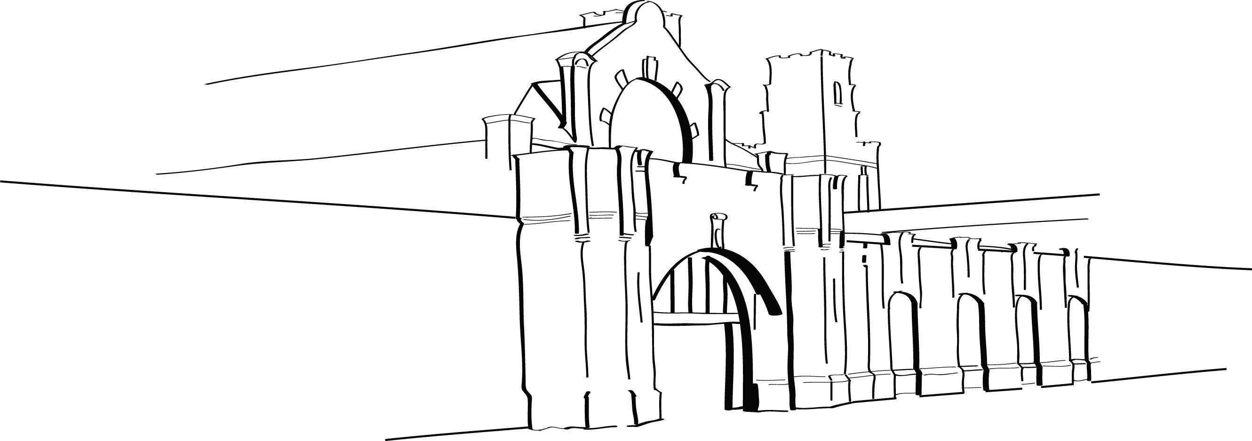
Beyond the reading list: encouraging wider reading
David Bedford, Academic Support Librarian
d.d.bedford@greenwich.ac.uk / @dhldavidb

Slide 2
My brief
2nd year Paramedic Science students.
“explore with them how to get the most out of wider reading … narrow focus when it comes to searching and selecting sources for their assignments … if it doesn’t have paramedic or pre-hospital in the title then they struggle to see the relevance and thus may discard valuable sources.”
Topic : airway management.

Slide 3
Step one : books
Any books which mentioned airway management – surgery, critical care, emergency nursing…
Hunting for gems – is the content applicable to paramedic practice?
Allowed the students to find the info rather than pointing to it.

Slide 4
Step two : Electronic sources
Introduced unfamiliar sources disguised as a “how to search” reminder.
Evidence-based sources from a variety of professions.
Students searched and evaluated the relevance of what they found.

Slide 5
Putting it together
Use of the VLE’s wiki tool to create a collaborative reading list.
In teams researching different elements of airway management – with rules!
Creating an ongoing resource.

Slide 6
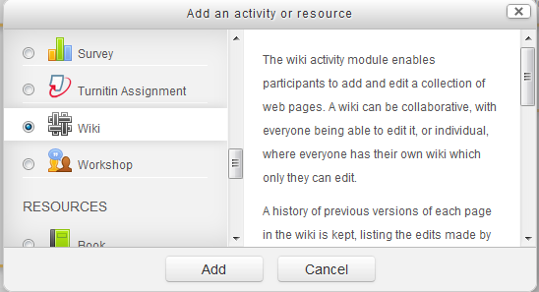
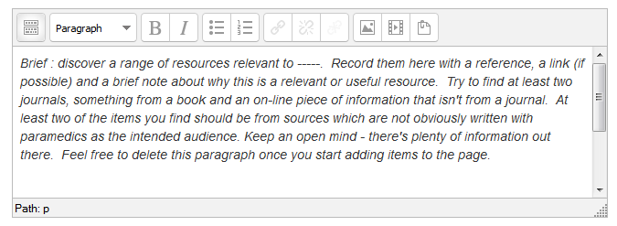
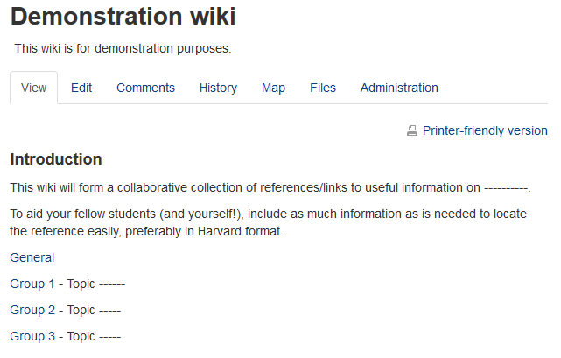
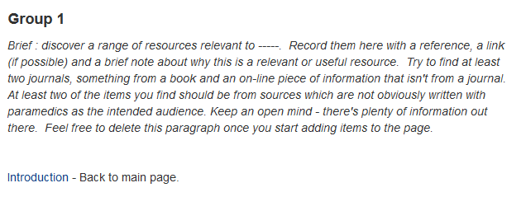

Slide 7
Impact
Immediate : good engagement (at varied levels).
Short-term : useful resource for airway management information ; module review showed increased satisfaction with library.
Medium-term : increased citation of material from relevant professions.
Longer-term : ?????

Slide 8
Thank you
David Bedford, Academic Support Librarian
d.d.bedford@greenwich.ac.uk / @dhldavidb

