Slide 1
Open Access: Denied!
Josie Caplehorne (she/her)
University of Kent, United Kingdom
Twitter: @JosieCaplehorne

Slide 2
Widening access
For readers,
to quality works,
without fees.

Slide 3
Inaccessible by design
Open Access works that are not accessible may as well be behind a paywall for those who rely on alternative formats.
Notes:
The problem with Open Access is that the vast majority of works are not born digitally accessible as standard.

Slide 4
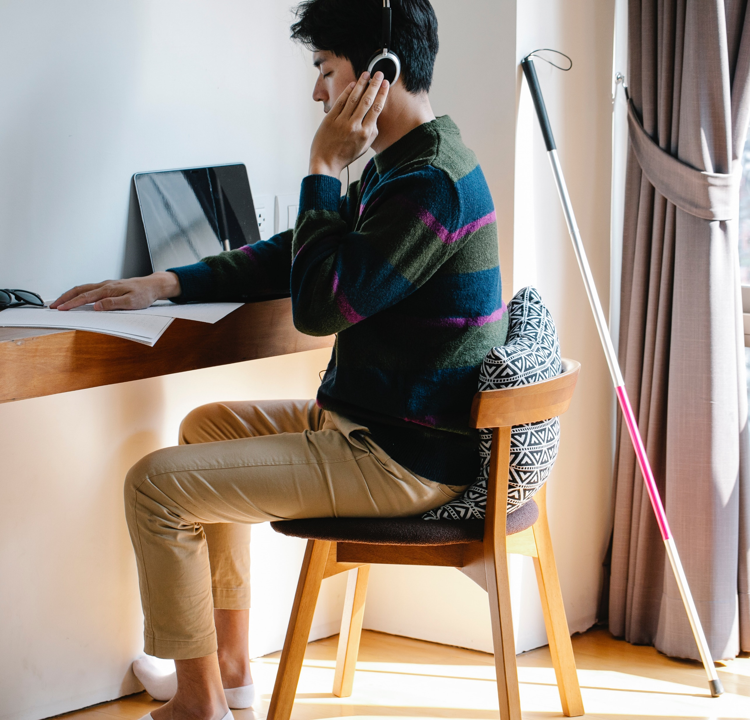
Alternative formats
Accessible digital files can be more easily transformed into meaningful alternative formats.

Slide 5
Defining Accessible
Making something that can be used, not just accessed, by everyone.
Notes:
No alternative provision needs to be made in teaching
Less need for disclosure of a disability, chronic illness and/or neurodivergence
Equitable approach that remove biases in scholarly publishing.

Slide 6
The good news!
Our actions can create Open Access works that can be truly used by everyone.
Notes:
The remaining slides will focus on how to approach improving digital document accessibility.

Slide 7
Design and layout
Layout and design matter because they are the building blocks of an accessible document, presentation, webpage, blog or social media post.
Left align text – do not centre or justify
Use good colour contrast
Avoid using colour only to show meaning
Number the pages in long documents
Avoid using document headers and footers
Don’t use watermarks.

Slide 8
Text formatting
Format your text using in-built functionality to improve navigation, access, and meaning.
Use in-built Heading Styles
Create selectable text (copy and paste)
Use in-built lists
Minimum font size 14
Non-serif fonts (such as Arial or Helvetica)
Avoid underlining text that isn’t a link
Avoid italics and all capital letters
Use bold text as little as possible.

Slide 9
Hyperlinks
Hyperlinks should be meaningful. For example,
Digitally accessible:
University of Kent open access journal platform
Not digitally accessible:
https://journals.kent.ac.uk/
Click here
If using a Q.R. code include text that explains how it can be used

Slide 10
Hashtags
Hashtags should be written in #CamelCase as it makes it more readable
Hashtags that are #notcamelcase are less readable

Slide 11
Image alt text
Alternative text (alt text) is used to describe images. The written description of the image can be communicated according to the alternative format being used.
Use in-built alt text functionality
Visual content that has a purpose beyond decorative should have alt text
Replace automatically generated alt text
Mark decorative text
Don’t embed text in images
The alternative text for this image is:
One-eyed, grey and white Alaskan Malamute dog with an open mouth.

Slide 12
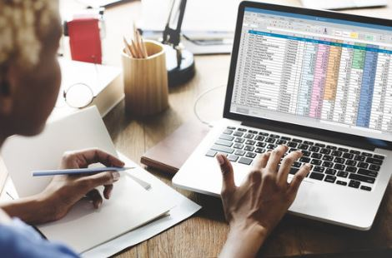
Tables
The structure of a table matters because screen reader software will read a table from top to bottom and left to right. Decide if a table is needed or if there are better ways to share the information.
Add a heading row to the table
Keep the structure simple by not using:
Split cells
Merged cells
Nested tables
Ensure the table content is formatted to be accessible by applying the practices outlined in the previous slides.

Slide 13
Check that its accessible
Checking the accessibility of any digital work, before its shared, will help reduce barriers to Open Access. Use automated and manual testing together to detect and enable better accessibility. The following options can help you to do this.
WCAG Colour Contrast Checker (manual testing)
Testing Portable Document Files (PDFs)
Keyboard navigation
(manual testing)
Testing Microsoft Office files
Screen reader testing
(manual testing)
Testing OpenOffice and LibreOffice

Slide 14
Access this presentation
Access this “Open Access Denied” presentation on the Kent Academic Repository.
https://kar.kent.ac.uk/102775

Slide 15
Thank you

