Slide 1
Introduction to the Participatory Autism Research Collective (P.A.R.C.) and Critical Autism Studies
Dr Damian E.M. Milton

Slide 2
Welcome to P.A.R.C. 2018
Some general guidance for the day:
Sticking to time!
Accessibility issues
‘Flappause’ and general levels of noise
Asking questions of speakers
Respectful debate please!

Slide 3
The Participatory Autism Research Collective
P.A.R.C. was set up to bring autistic people, including scholars and activists, together with early career researchers and practitioners who work with autistic people.
Our aim is to build a community network where those who wish to see more significant involvement of autistic people in autism research can share knowledge and expertise.
Not just for researchers!

Slide 4
Participation and insider knowledge
“...right from the start, from the time someone came up with the word ‘autism’, the condition has been judged from the outside, by its appearances, and not from the inside according to how it is experienced.”
(Williams, 1996: 14).

Slide 5
The autistic voice and the production of knowledge
People on the autism spectrum rarely in the role of researcher, traditionally seen as passive subjects.
The ‘glass sub-heading’ (Milton and Bracher, 2013).
“Of over $314 million in research funding, only 3% went to research into services, supports and education and less than 1% went to research into the needs of adults.” (Ne’eman, 2011).

Slide 6
Participatory research
A range of theoretical and methodological approaches. Yet with the main objective of handing power from the
Researcher to research participants, who are often
Community members or community-based organisations.
In participatory research, participants have control over the research agenda, the process and actions taken.
Most importantly, participants themselves are the ones who analyse and reflect on the information generated, in order to obtain the findings and conclusions of the research process.

Slide 7
Activity of the P.A.R.C. group
The Participatory Autism Research Collective website continues to attract interest.
This has included links to events set up by P.A.R.C. members or other related material.
Critical blog posts regarding research and practice in the field.
Expanding to other regions – events held in London, Birmingham, Sheffield and Nottingham. Discussions held in Edinburgh and Kent.

Slide 8
Conference streams
Damian Milton and Nicola Martin from the P.A.R.C. group will again be chairing a stream at the Learning Disability Today conference.
We have been asked to chair a stream on ‘Neurodiversity’ at the next Centre for Disability Research Conference at Lancaster University in September 2018.

Slide 9
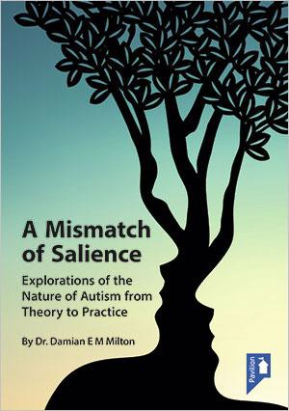
Publications
Special edition of the Scandinavian Journal of Disability Research (S.J.D.R.) regarding a critical dialogue on Neurodiversity.
Special edition of Advances in Autism (A.I.A.), work in the field of education and autism.
Invited to write an article for the Tizard Learning Disability Review.
Partnership with Pavilion Press.

Slide 10
Reinvigorating the ‘Theorising Autism Project’
A series of workshop days
One of these workshop days has already looked at research regarding the ‘double empathy problem’. Another is likely to look at ‘monotropism’ and related theory and research.
Presenting workshop – potential for more events of this kind.
Publishing workshops
‘Hacking the system’ workshop suggested.

Slide 11
Critical Autism Studies (C.A.S.) – the early years
Workshop held in Toronto in 2010 followed by a seminar day in Sheffield in Jan 2011.
Autonomy first edition published in 2012.
Worlds of Autism (Davidson and Orsini, 2013).
Re-thinking Autism (Runswick-Cole et al. 2016).

Slide 12
Differing definitions (1)
“...about critical thinking, new perspectives and a channel for further debate in future.” (Arnold, 2013).
For Davidson and Orsini (2013) C.A.S. is about scrutinising power relationships in autism research and practice; promoting positive accounts of autism that confront prevailing negative views; and the development of theoretical and methodological approaches that are inclusive and valuing.
For Runswick-Cole et al. (2016) C.A.S. is about examining whether a diagnosis of autism is scientifically valid, and whether such a diagnosis is useful in the lives of those so ‘labelled’.

Slide 13
Differing definitions (2)
A broader and more inclusive definition however was provided by Waltz (2014):
“The ‘criticality’ comes from investigating power dynamics that operate in discourses around autism, questioning deficit-based definitions of autism, and being willing to consider the ways in which biology and culture intersect to produce ‘disability’” (Waltz 2014, p 1337).

Slide 14
The citation survey (Milton et al. yet to be published)
Event held at London South Bank University (L.S.B.U) last year, concerns raised regarding power differentials involved.
The motivation for holding a P.A.R.C. conference
on the theme this year.
A citation survey was piloted in 2017 and then was completed in 2018 regarding these core texts and works in the field of C.A.S. within relevant journals.

Slide 15
Cross-citations within key texts
Texts | RT-A | WoA | Autonomy
RT-A | 46 | 33 | 3
WoA | 8 | 49 | 14
Autonomy | 5 | 17 | 21

Slide 16
Most cited authors in Disability and Society
Authors | Text | Citations in D&S CAS articles
Dan Goodley | RT-A | 12
Katherine Runswick-Cole | RT-A | 10
Damian Milton | Autonomy | 8
Rebecca Mallet | RT-A | 6
Charlotte Brownlow | WoA | 5
Jim Sinclair | Autonomy | 5
Larry Arnold | Autonomy | 5

Slide 17
Number of articles published in D&S by author
Name | Number of articles published in D & S
Damian Milton | 6 (1)
Nick Chown | 2 (1)
Charlotte Brownlow | 2
Lindsey O’Dell | 2
Katherine Runswick-Cole | 1
Michael Orsini | 1
Frances Ortega | 1
Hanna Bertilsdotter Rosqvist | 2
Richard Woods | 2 (0)
Mitzi Waltz | 2
Anne Lindblom | 2
Carmel Conn | 2

Slide 18
CrossRef Citations
Author | Article | CrossRef Citations | Text
Milton (2012)* | On the ontological status of autism: the ‘double empathy problem’ | 31 | Automony
Runswick-Cole (2014) | ‘Us’ and ‘them’: the limits and possibilities of a ‘politics of neurodiversity’ in neoliberal times | 14 | RT-A
McWade, Milton and Beresford (2015)* | Mad studies and neurodiversity: a dialogue | 9 | Autonomy
Bertilsdotter Rosqvist, Brownlow & O’Dell (2012) | Mapping the socialgeographies of autism – online and off-line narratives of neuroshared and separate spaces | 8 | WoA
Chown (2014)* | More on the ontological status of autism and the ‘double empathy problem’ | 5 | Autonomy

Slide 19
Cross citations in articles in D&S between the authors of the initial texts
Texts | RT-A authors in D&S | WoA authors in D&S | Autonomy authors in D&S
RT-A authors in D&S (2) | 7 | 6 | 0
WoA authors in D&S (2) | 1 | 6 | 0
Autonomy authors in D&S (8) | 4 | 0 | 17
Highest Altmetric scores were all authored or part-authored by autistic scholars, and four of the five most viewed papers.

Slide 20
Questions to think about and to return to later
The most cited C.A.S. articles are also the least cited by some working within C.A.S! What to do about the subcultures forming within C.A.S?
How to relate such work to traditional research organisations based mainly within a medical model framework – e.g., Autistica and the AIMS-2 project?
How can we increase participation and the autistic voice within autism research – e.g., less represented groups?
What kind of scrutiny might we be able to bring to the field working cooperatively and internationally?

Slide 21
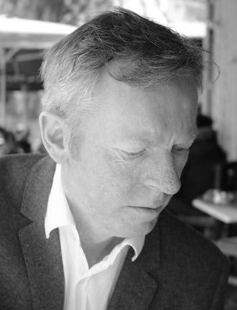
Doctor Michael McCreadie – a tribute
Health Psychologist with over twenty- five years experience in the field
Provided clinical support, advice and consultancy in the UK and beyond
Promoting a focus on well-being and meeting holistic needs in service delivery
Worked with Studio3, Scottish Autism, and most recently was a director of A.T.- autism
Supported P.A.R.C. and contributed to the L.D.Today conference stream and annual last year
Exemplified the concept of the ‘reflective practitioner’ and will be sadly missed.

