Slide 1
Food and drink-related needs/outcomes of older people who use community-based social care
Stacey Rand¹, Lavinia Bertini², Monique Raats³, Alan Dargan¹, Becky Sharp†
Karin Webb, Joy Fletcher & Della Ogunleye§
1 Personal Social Services Research Unit (PSSRU), University of Kent
2 Brighton and Sussex Medical School (BSMS), University of Sussex
3 Food, Consumer Behaviour and Health Research Centre, University of Surrey
† NIHR Applied Research Collaboration, Kent, Surrey and Sussex (ARC KSS)
§ Research Advisors (PPI)

Slide 2
Acknowledgements
This presentation summarises independent research funded by the National Institute for Health and Care Research School for Social Care Research (NIHR SSCR). The views expressed are those of the authors and not necessarily those of the NIHR SSCR, the NIHR or the Department of Health and Social Care.
Images are from the Centre for Better Ageing’s library of age-positive images.
Further information about ASCOT is available here: www.pssru.ac.uk/ascot

Slide 3
Background
An estimated 1.3 million UK older adults, aged 65+, are undernourished
Malnutrition and dehydration are major causes of health deterioration
People using community social care (incl. homecare) are at particular risk
Complex inter-related risk factors:
Health and care-related needs (e.g. limited mobility, cognitive impairment, changes to taste or appetite)
Social isolation and loneliness – including impact of bereavement
Accessibility of local area, including transport to/from shops
Low or reduced household income
Also, how do we understand food and drink-related needs/outcomes…?
Thinking beyond (risk of) dehydration and malnutrition to consider quality of life…
What role do community-based services play in addressing needs/improving outcomes?

Slide 4
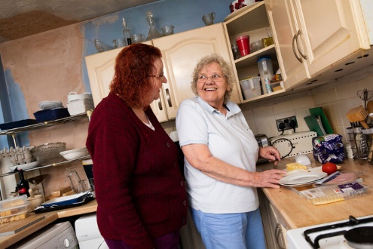
Aims and Objectives
To scope existing evidence on food and drink-related needs/outcomes* of older adults using homecare
To identify unmet need/outcomes related to Food and drink among older adults using publicly-funded services in England
To understand the factors related to unmet need and outcomes
* Defined broadly, as ‘food and drink care-related quality of life’
Notes:
Defined broadly, as ‘food and drink-related quality of life’, i.e. does support with eating & drinking adequately consider personal preferences & psychosocial, cultural, religious/ethical etc. needs – alongside, supporting basic nutrition & hydration.

Slide 5
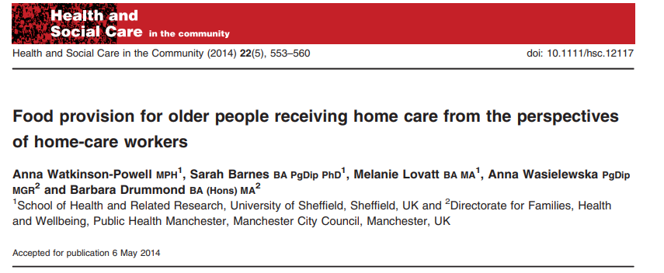
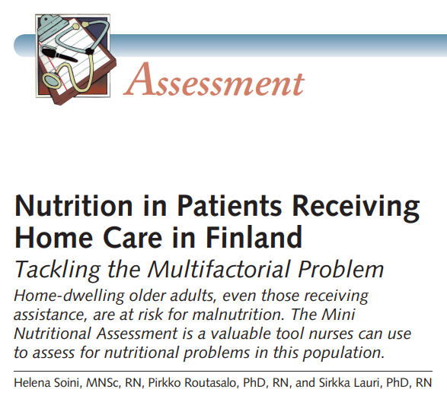
Methods
Scoping literature review
Analysis of the ‘Adult Social Care Survey’ (ASCS) in England data
Developing a guide to findings and recommendations

Slide 6
Work Package (WP) 1 - Scoping Literature Review
Objectives
Conduct a systematic search of published works and grey literature
To gain an overview of the international literature on food and drink-related needs and outcomes of older adults using homecare
Establish the type and range of methods, measures and theoretical frameworks applied
Identify the conceptual understanding(s) of ‘food and drink-related needs/outcomes’
Identify evidence of effectiveness of direct care, service delivery or policy interventions – where are the gaps?
Identify implications for policy and practice

Slide 7
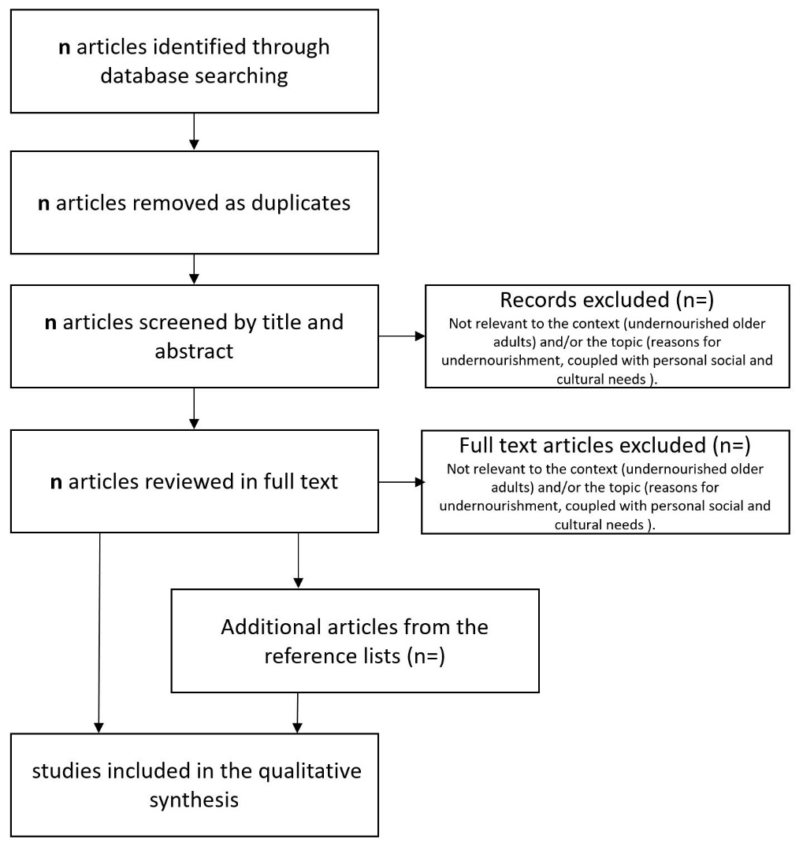
Work Package (WP) 1 - Scoping Literature Review
Eligibility criteria:
Published journal articles or grey literature that report a research study (or studies)
Relates to:
Older adults, aged 65 or over, using homecare
Food and drink-related needs or outcomes, including: nutrition, hydration and/or quality of life
Published in English language, after 2000

Slide 8
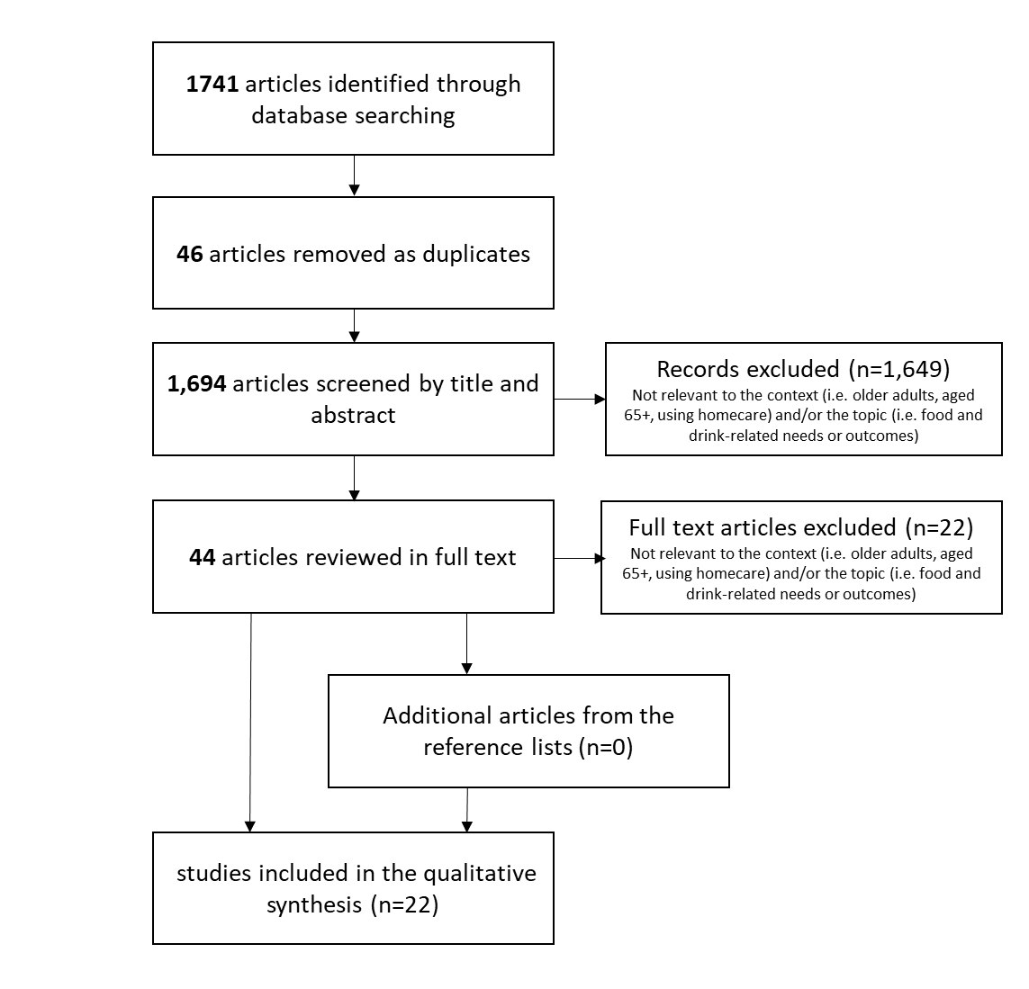
Progress so far:
Database searches (Nov 2022)
Web of Science
Psycinfo
SCIE Online
ProQuest Politics Collection
Screening by title/abstract (Dec 2022 to Feb 2023)
Review of full-text (Feb-Mar 2023)
Summary of each item (‘charting’)
Qualitative analysis (In progress)
Managed in Nvivo
Thematic analysis using framework approach

Slide 9
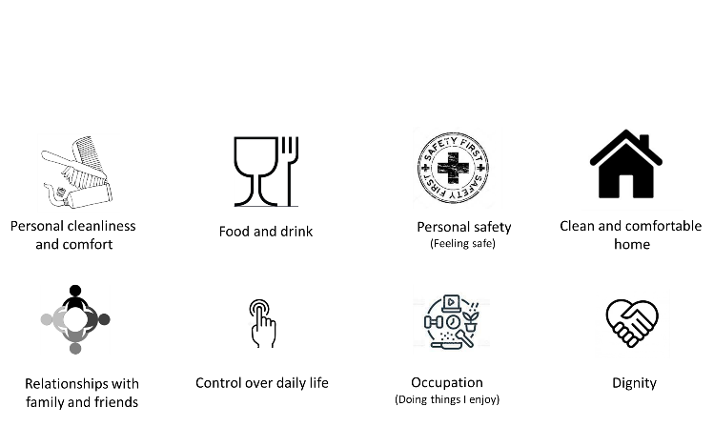
WP2 - Analysis of Adult Social Care Survey Dataset
Annual survey of adults using publicly-funded social care services in England
Adult Social Care Outcomes Toolkit (ASCOT) to collect care-related QoL data

Slide 10
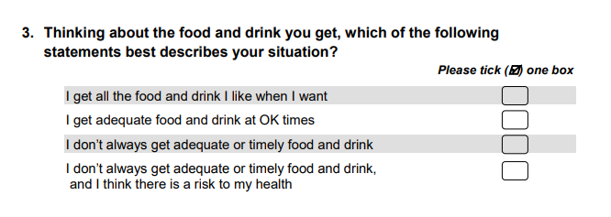
food & drink care-related quality of life
Based on capability approach
(i.e. the ability to do and be, as you wish…)
= Ideal state
= No needs
= Some needs
= High-level needs
Needs met
Unmet
needs

Slide 11
WP2 - Analysis of Adult Social Care Survey Dataset
Preliminary descriptive analysis …
---- % unmet need (with formal help to eat & drink)
___ % overall unmet need
___ % unmet need (no formal help to eat & drink)

Slide 12
WP2 - Analysis of Adult Social Care Survey Dataset
What are the factors* related to unmet need?
Ethnicity
Sex/gender
Health and care needs (difficulty with everyday activities, anxiety & depression)
Informal help from family & friends
Suitability of home design
Financial contribution towards cost of care
By the person, their family or person & family (combined)
Survey year
Type of local authority
*These are limited by data available in the ASCS dataset or linked data.

Slide 13
 | B | SE | OR
Gender: male | -.115*** | .021 | .891
Ethnicity: categories other than white | .148*** | .030 | 1.160
Local authority †
Unitary | -.014 | .026 | .986
Shire county | -.052 | .027 | .949
Inner London | .202*** | .034 | 1.224
Outer London | .082** | .030 | 1.085
I/ADLs with difficulty | .121*** | .005 | 1.128
Eating and drinking with difficulty | .498*** | .025 | 1.646
Suitability of home †
Meets most needs | .657*** | .024 | 1.929
Meets some needs | 1.429*** | .026 | 4.176
Totally inappropriate | 1.842*** | .040 | 6.310
Informal care / Practical help
Outside home | 1.347*** | .027 | 3.845
Inside and outside home † | .286*** | .047 | 1.332
None | 1.665*** | .033 | 5.283
Privately purchased care (‘top up’) †
Yes, family money | -.047 | .038 | .954
Yes, own & family money | .078 | .058 | 1.081
None | -.164*** | .020 | .849
Response by proxy report | .096** | .030 | 1.101
Preliminary analysis ….
Analysis is still ongoing
† Base category
Local authority - metropolitan Suitability of home - meets all needs
Informal care - inside home
Privately purchased care - own money
** p<0.01
*** p<0.001

Slide 14
 | B | SE | OR
Survey year †
2012 | .008 | .047 | 1.008
2013 | .025 | .046 | 1.025
2014 | .036 | .046 | 1.037
2015 | .136** | .044 | 1.146
2016 | .179*** | .044 | 1.196
2017 | .199*** | .044 | 1.221
2018 | .179*** | .046 | 1.196
2019 | .213*** | .045 | 1.238
2020 | .230*** | .046 | 1.259
2021 | .080 | .107 | 1.084
2022 | .449*** | .044 | 1.567
Constant | -5.300*** | .053 | .005
McFadden’s pseudo r ² |  |  | 12.0%
χ² |  |  | 12,366, df = 29, p<.001
† Base category
Survey year (2011)
** p<0.01
*** p<0.001

Slide 15
WP2 - Analysis of Adult Social Care Survey Dataset
Food and drink care-related QoL (‘outcome’) = care intensity + care quality + functional care needs + individual characteristics
ASCS dataset does not include individual-level care intensity
Estimate of average care intensity per older person using services per LA
From 2015 to 2022 only, due to data availability
Results are similar except….
Ethnicity – no longer significant
Privately purchased care - with own and family money – significant (higher likelihood of unmet need)
Survey year, 2021 – significant (lower likelihood of unmet need) *
Survey year, 2022 – significant (higher likelihood of unmet need)
Average care intensity per person, by LA - significant (lower likelihood of unmet need)
* Survey conducted on a voluntary basis vs mandatory, due to the pandemic.

Slide 16
Summary and Conclusions
Estimated 4% to 8% of older adults living at home using community-based social care have unmet food and drink care-related needs
% increased between 2011 and 2022
Factors related to unmet need….
After controlling for other factors (including average care intensity per person per LA), survey year is significant…
Does this reflect wider sector impacts (e.g. workforce shortages, chronic underfunding) or context (e.g. pandemic, cost of living increases)?
Further analysis…
Data linkage – but a challenge with current data collection and reporting
New possibilities based on changes to social care data collection in England…?

Slide 17
WP3 – Brief guide to key findings and Recommendations Development, Dissemination and Implementation
Share preliminary findings from WP1/2 with the ARC KSS Homecare Community of Experience (June 2023) and other networks:
Identify the different audiences and key stakeholders and reason for interest
Explore how the findings could be used to inform, engage, influence
Development of a brief guide - summarising key findings and recommendations, tailored to the different audiences
Consider contextual issues, in relation to implementation
Facilitate discussion and commitment to further research
Blog post(s)
Final guide hosted on PSSRU website
On-line event (spring 2024)
Informed by the Knowledge Exchange, Impact and Engagement (KEIE) Plan

Slide 18
s.e.rand@kent.ac.uk @DrStaceyRand
Any questions?

