Slide 1
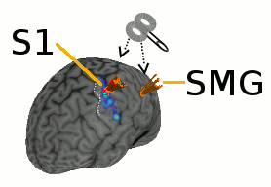
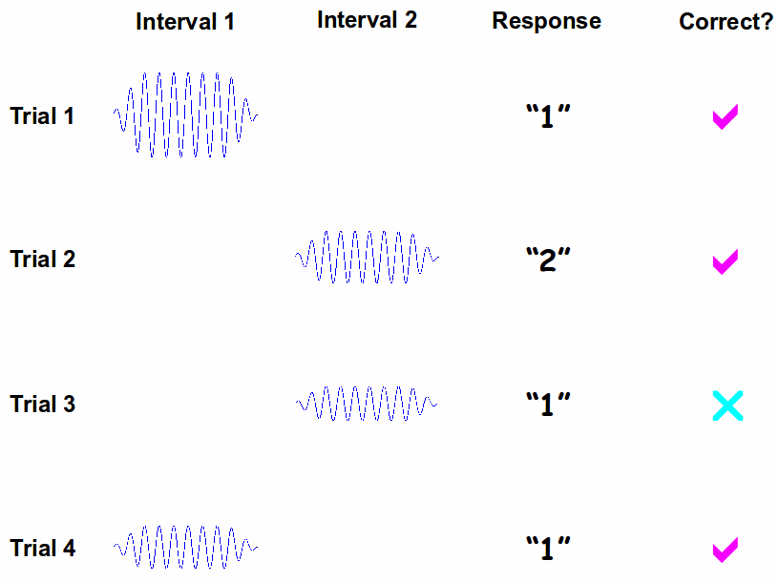
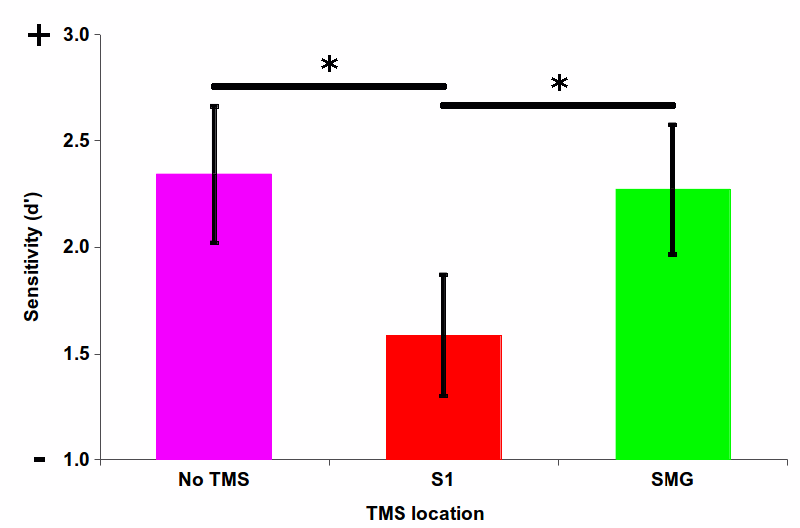
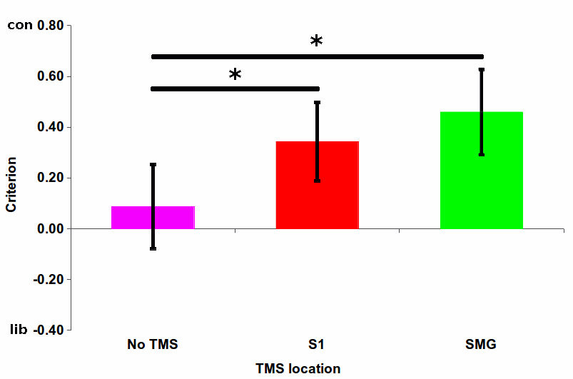
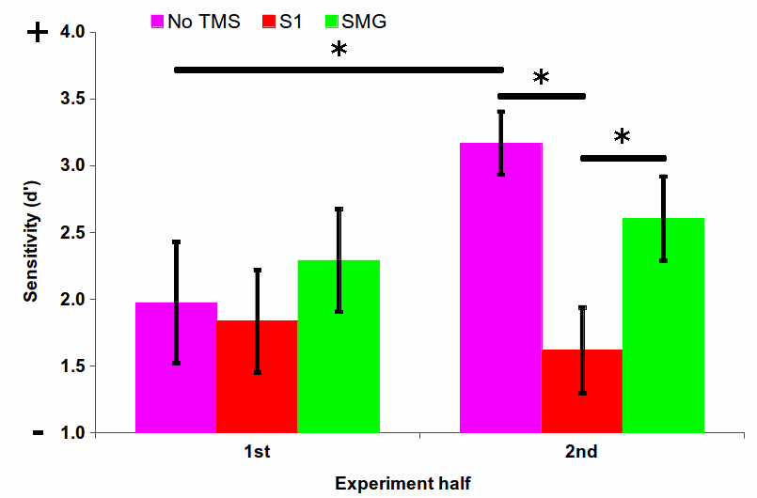
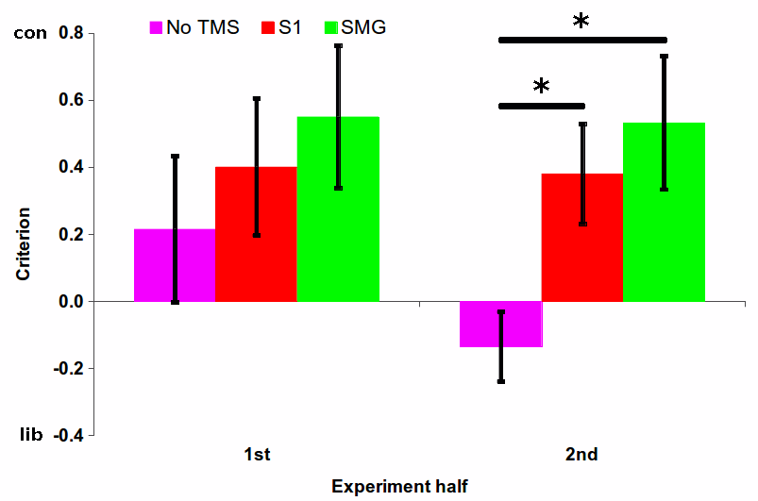
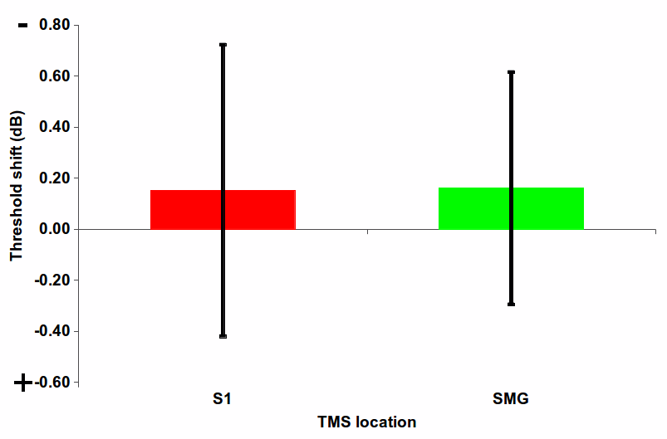
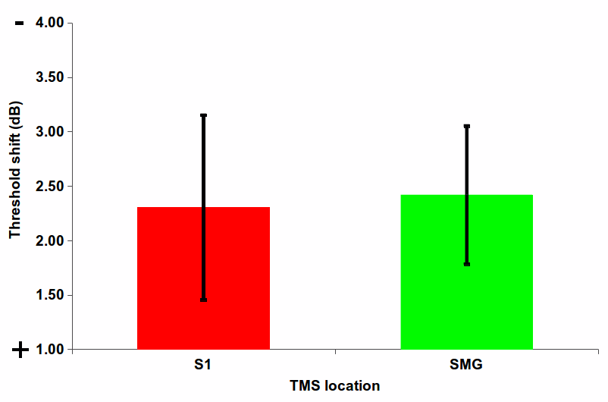
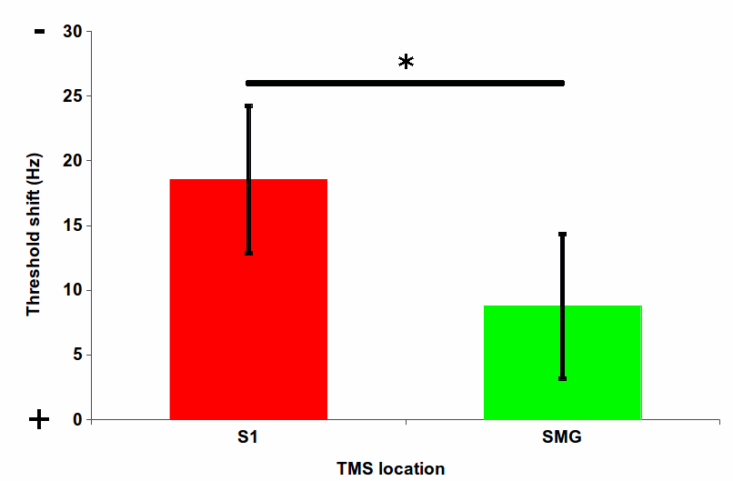
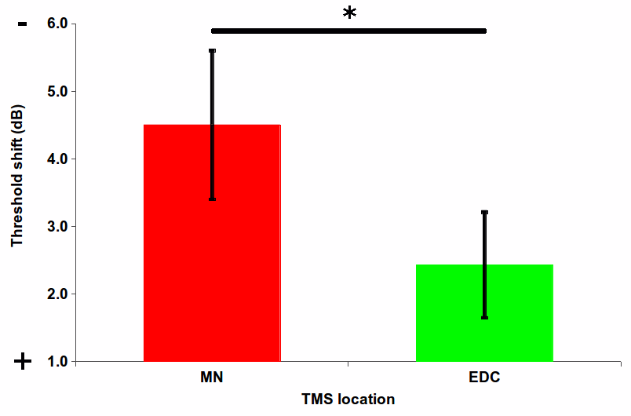
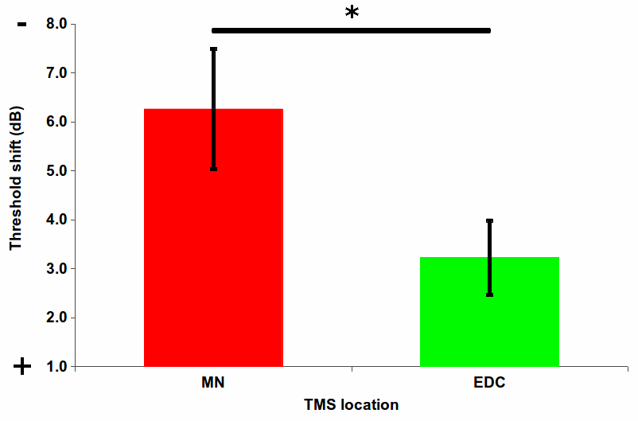
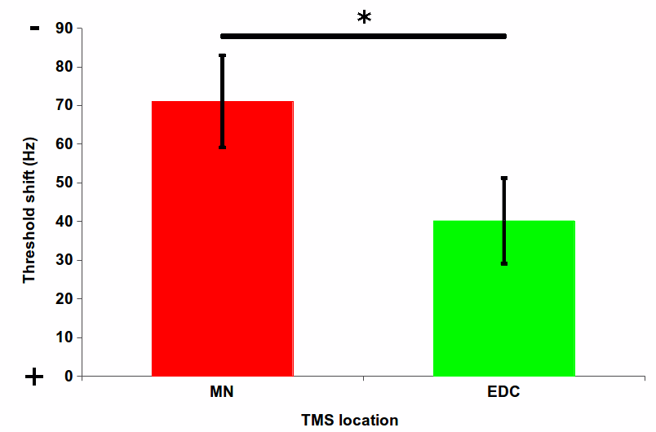
TMS over human primary somatosensory cortex interferes with tactile detection* & discrimination
Luigi Tamè^{a,b} & Nicholas P Holmesª
a) Centre for Integrative Neuroscience & Neurodynamics, University of Reading, UK
b) CIMeC, Center for Mind/Brain Sciences, University of Trento, Italy
The problem
- Monkey studies tell us that primary somatosensory cortex is not required for detection of tactile stimuli¹; tactile detection can be re-learnt following complete parietal lesions¹; and single-unit activity in S1 does not correlate (at all) with perceptual decisions about stimulus presence².
- BUT, human studies using single-pulse TMS over (almost any part of) the sensorimotor & parietal cortex have shown near-complete disruption of tactile detection^{3,4}.
- Are monkeys' brains different from humans? Is TMS more effective than unilateral parietal ablation?
The solution
- Series of TMS-psychophysics experiments; criterion-dependent & criterion-free tasks
- (f)MRI-guided per single-subject; fully counter-balanced; nearby active control site; sham TMS
Methods
Replication...
but...
Single-subject
fMRI-guided TMS
over S1 & SMG
120% RMT
1-interval (yes/no) &
2-interval (bias-free)
forced-choice vibrotactile
detection & discrimination
TMS over S1 but not SMG decreases detection sensitivity
TMS over S1 AND SMG
increases criterion
N=12, mean±SE, *p<.05
Exploration
Bias-free detection tasks
TMS only effective in 2nd half of experiment
(Working) memory? Learning? Maintenance of 'internal standard'?
No effect of single- or double-pulse TMS on bias-free detection
'pure' perception is unaffected by TMS
Bias-free frequency-discrimination
MS over median nerve raises all thresholds
TMS over S1 raises frequency discrimination thresholds. Consistent with monkey neurophysiology
Single-pulse, 2-IFC
detection
Double-pulse, 2IFC
detection
Double-pulse, 2-IFC
discrimination
Conclusion
S1 maintains representation of touch over time
References: 1) Lamotte (1979); 2) Romo et al. (2012); 3) Cohen et al. (1991); 4) Pascual-Leone et al. (1994)
* But only in a criterion-dependent, memory-dependent task

