Slide 1
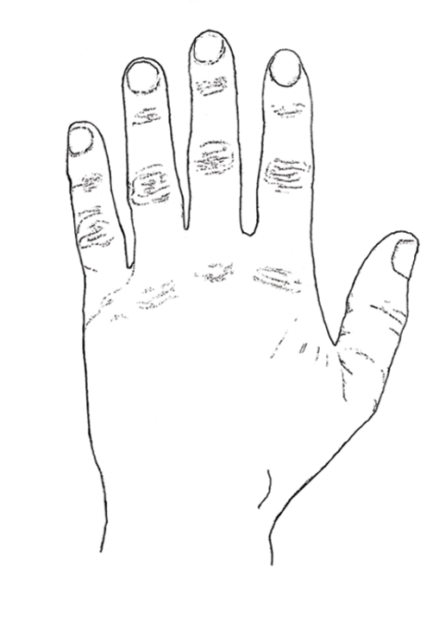
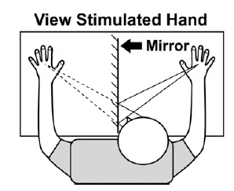
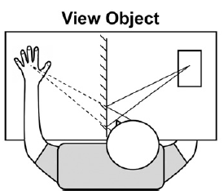
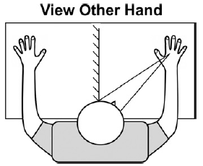
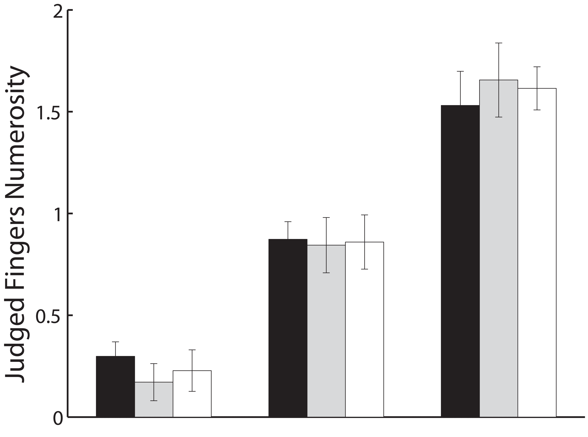
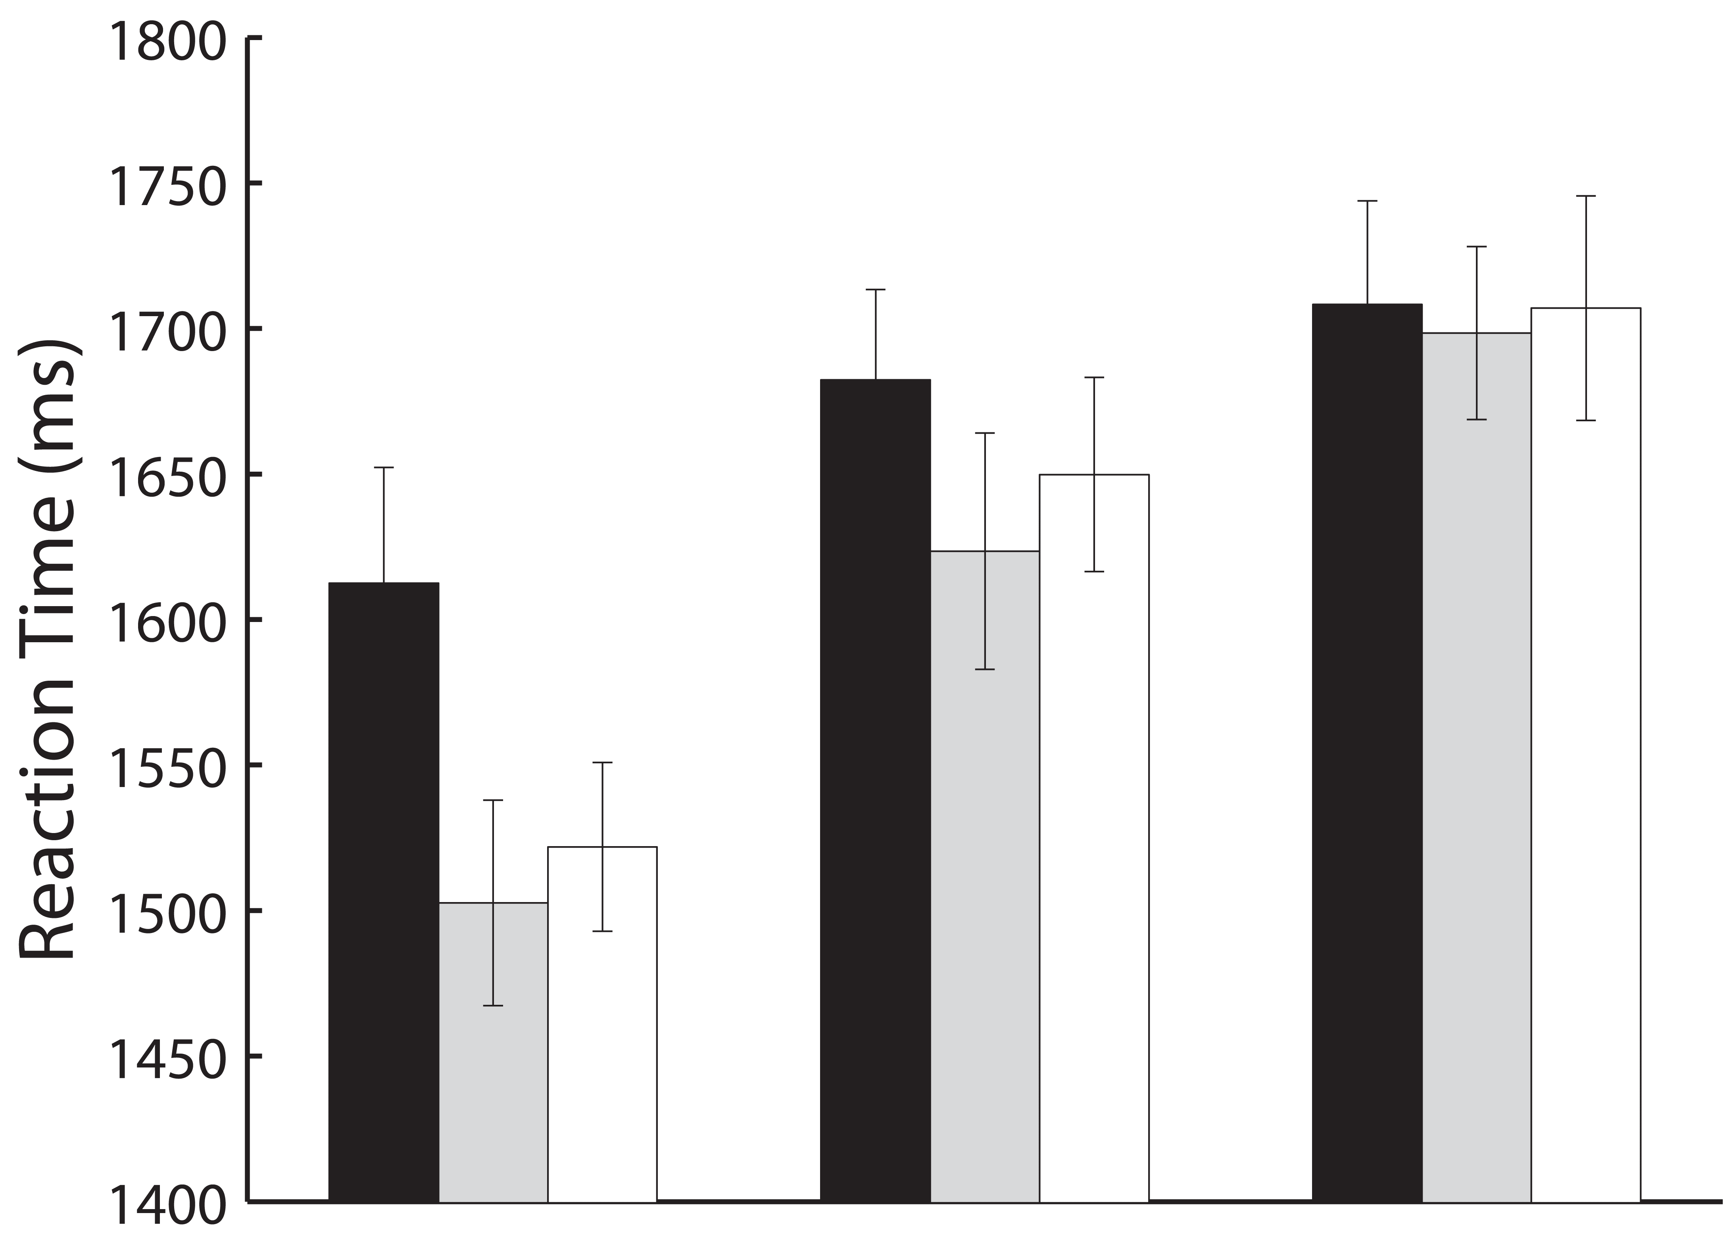
Vision of the Body Alters Perceived Finger Numerosity
Luigi Tamè, Renata Sadibolova, Beata Panek & Matthew R Longo
Department of Psychological Sciences, University of London, London, UK
Patients with lesions of the left posterior parietal cortex commonly fail in identifying their fingers, a condition known as finger agnosia (Kinsbourne & Warrington, 1962; Sirigu et al, 1991), yet are relatively unimpaired in skilled action (Buxbaum & Coslett, 2001). Several studies have shown that non-informative vision of the body enhances performance in numerous tactile tasks (Press et. al., 2004). However, it is unknown whether body structural representations are also affected by vision, given that finger agnosia is typically assessed while patients are blindfolded.
Aim
Number of fingers “in-between”
Is the body structural representation modulated by non-informative vision of the body?
Method
N=30
Tactile stimuli: suprathreshold, 5 ms (solenoid tappers)
72 trials x 6 blocks (ABCCBA)
Different visual condition for each block
Visual Conditions
Results
*
*
*
*
*
*
*
*
Fingers in-between
Fingers in-between
Fingers “in-between” X Vision: F(2,58) = 360.9, p < 0.0001
*Denotes p<0.05. Error bars represent the ±95% Confident Interval of the within participants variability.
Conclusions
Participants numerosity estimates were less accurate when they were seeing the stimulated hand compared to when an object or the unstimulated hand was visible. Our results demonstrate that vision of the body alters body structural representations impairing tactile fingers identification.
Contact: luigi.tame@gmail. com

