Slide 1


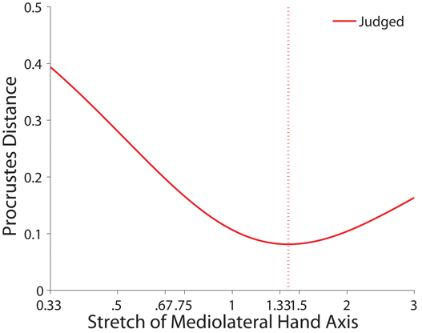
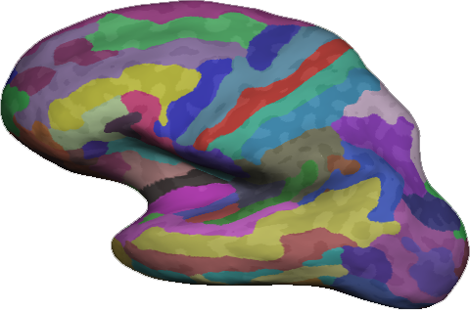
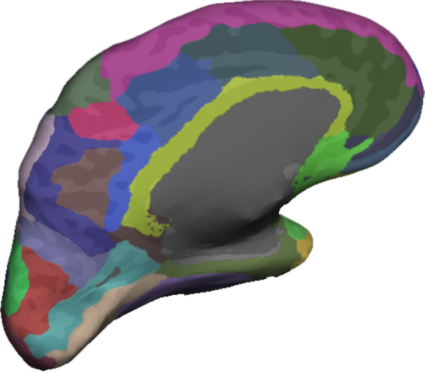
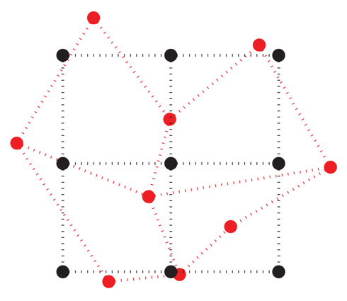
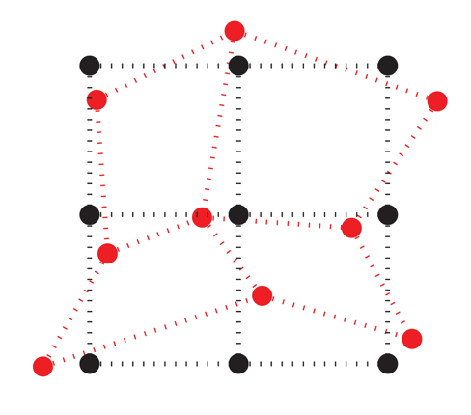
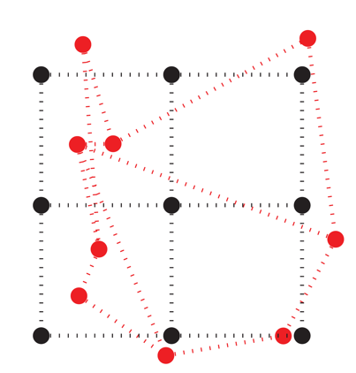
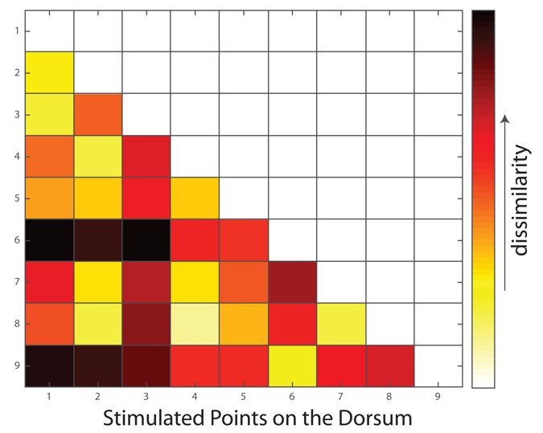

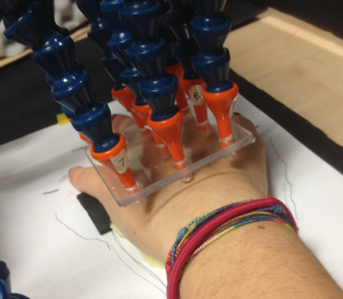
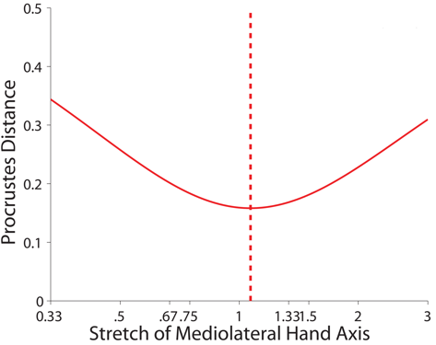
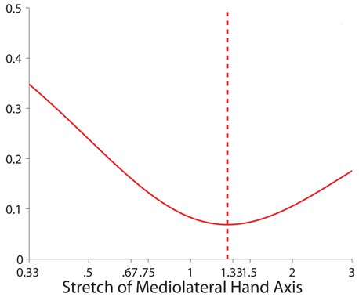
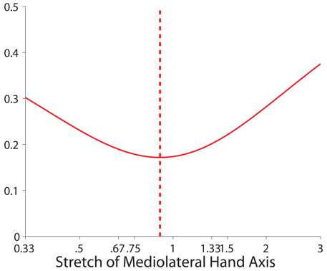
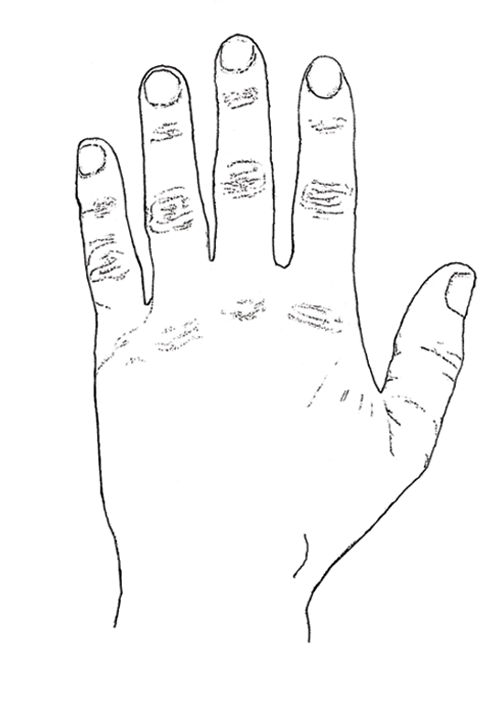
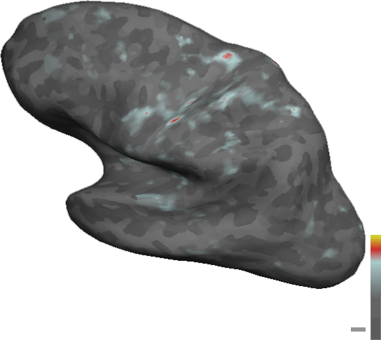
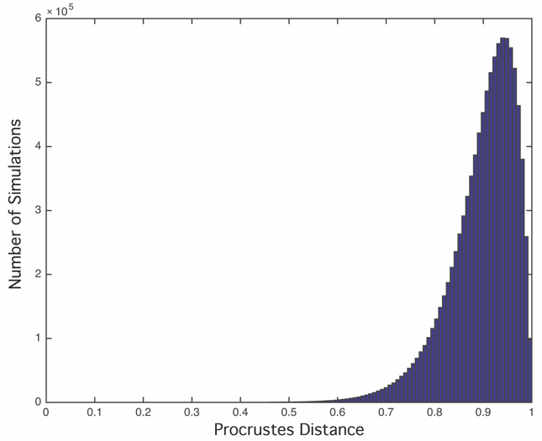
Neural correlates of distorted body representations underlying tactile distance perception
235.13
Luigi Tamè¹, Marty I Sereno^{1,2,3}, Renata Sadibolova¹ & Matthew R Longo¹
(1) Birkbeck, University of London, London, UK (2) University College London, London, UK (3) Department of Psychology, San Diego State University, San Diego, USA
Introduction
Analysis
Results
Tactile distance perception requires that immediate afferent signals be referenced to a stored representation of body size and shape (the body model) (Longo & Haggard, 2010).
Anatomy: For each subject, we used FreeSurfer to reconstruct the cortical surface (Fischl, Sereno & Dale, 1999).
Procrustes alignment superimposes configurations of homologous landmarks by translating, scaling, and rotating them so as to minimize the distance between pairs of landmarks (Rholf & Slice, 1990; Bookstein, 1991).
A series of ROIs were defined a priori using FreeSurfer Parcellation. These Areas were SI, Area 5, SII, VPc, DPc, MPc all involved in the tactile representation processing. In this preliminary study only three areas are considered (see below).
Behavioural (n=12)
Pre Central Gyrus
Post Central Gyrus
Para Central
Generalised Procrustes alignment of the actual configuration of points on the hand (black dots and lines) and perceptual maps (red dots and lines). The light crosses are data from individual participants, while the dark dots represent the average shape.
Stored body representations involved are highly distorted with the hand dorsum represented as wider and squatter than it actually is (Longo & Haggard, 2011; Longo & Morcom, in press).
We measured the response pattern generated by each stimulated point by contrasting each stimulation condition against baseline.
fMRI (n=3)
A searchlight cross-correlation analysis was performed for each subject including only the unique Vertices (searchlight area = 250 mm²) using the coefficient parameters for each stimulated point.
Pre Central Gyrus
Post Central Gyrus
Para Central Gyrus
The aim of this project is to investigate the neural basis of these distortions
Dissimilarity matrix for one Vertex
Multidimensional scaling (MDS)
Design
Scan parameters
Each point stimulated 5 times + 10 times of no-stimulation
Random Block Design (4 Runs)
TR=1s; voxel size=2.3mm³; Volumes=670
4x multiband sequence
Length: 11.7 minutes
Participant task: count how many asynch stimulations?
Eyes closed
Stimulation: airpuff (Huang & Sereno, 2007)
Procrustes Distance (pD) was used to create a map on the surface to highlight the vertices that show different Procrustes distances.
Procrustes Distance simulations (10⁶)
12s
12s
Subject 1
Conclusion
50ms
…
P3
0.3
Based on our preliminary analyses of the brain areas we tested so far (i.e., Precentral, Postcentral and Paracentral Gyrus) a brain region that contributes to generate the distorted body representations we found in the behavioural experiment is the post central gyrus (Primary Somatosensory Cortex).
50ms
…
…
…
P1
P2
0.5
Point 1
Point 3
Point …
Px
pD
1
Sequence: HiResMPRAGE-1.0m
Sequence: AlignMPRAGE 1x1x2
An arbitrary threshold in the Procrustes Distance for each vertex was defined using a simulation of the distribution of random distances. As a result we set a threshold of .5 Procrustes Distance where “0” means identical and “1” completely different shape.
5x5cm grid
References
Longo & Haggard (2010) PNAS, 107, 11727–11732; Longo & Haggard (2011) JEP:HPP, 37, 720–726; Longo & Morcom (in press) FHN; Huang & Sereno (2007) NeuroImage, 34:1060 –1073; Fischl, Sereno & Dale (1999) NeuroImage, 9, 195-207;
Rholf & Slice (1990) Syst. Zool. 39, 40–59 (1990); Bookstein (1991) Morphometric tools for landmark data: Geometry and biology, Cambridge University Press.
Contact: luigi.tame@gmail.com

