Slide 1
Rethinking laboratory-based Assessments in the foundation year program at the University of Kent
School of chemistry and Forensic Science
DR A Berko

Slide 2
Assessment and learning
Introduction
Drivers
Initiative
Results
conclusion

Slide 3
Assessment and learning
Assessments are an important part of teaching and learning in higher education.
It allows institutions to make judgements on learning outcomes and teaching quality (Fletcher et al 2012, Klassen 2006).
They also serve as a means of judging ability and competence of graduates in the selection of candidates in the workplace (Madaus & Kellaghan, 1993).
Assessments shape and influence the behaviour of students to a higher degree than perhaps teaching.
Because of this, assessments should be leveraged and designed to improve teaching and learning at higher education institutions (Gibbs and Simpson 2004).
Notes:
Assessments are an important part of teaching and learning in higher education.
It allows institutions to make judgements on learning outcomes and teaching quality (Klassen 2006).
Since the introduction of quantification of grades in 1792, it has also served as a means of judging ability and competence of graduates in the selection of candidates in the workplace (Madaus & Kellaghan, 1993).

Slide 4
Assessment and learning
Student realities, perceptions and motivations should be considered in effectively designing assessments in the higher education sector to promote learning (Fulmer et al 2015).
It is important to also note that students experience of evaluation and assessment determines the way in which the way they approach (future) learning.
Assessment is therefore logically, and empirically, is one of the key defining forces of students’ approach to learning (Struyven, Dochy and Janssens 2005).
Assessments (more than feedback) should therefore be leveraged in shaping (transforming) student learning.
Notes:
However for the effective design of assessments in the higher education sector, the realities (experienced) and perceptions of students when it comes to assessments have to be considered (Struyven, Dochy and Janssens 2005).
It is important to also note that students experience of evaluation and assessment determines the way in which the way they approach (future) learning. In other words, if they think they are doing just about enough to get by and ignore feedback, they their future learning may not change. If they think they are not doing enough to pass whiles ignoring feedback, then they may do more of the same as opposed to changing how they learn.
Struyven, K., Dochy, F. and Janssens, S., 2005. Students’ perceptions about evaluation and assessment in higher education: A review. Assessment & Evaluation in Higher Education, 30(4), pp.325-341.

Slide 5
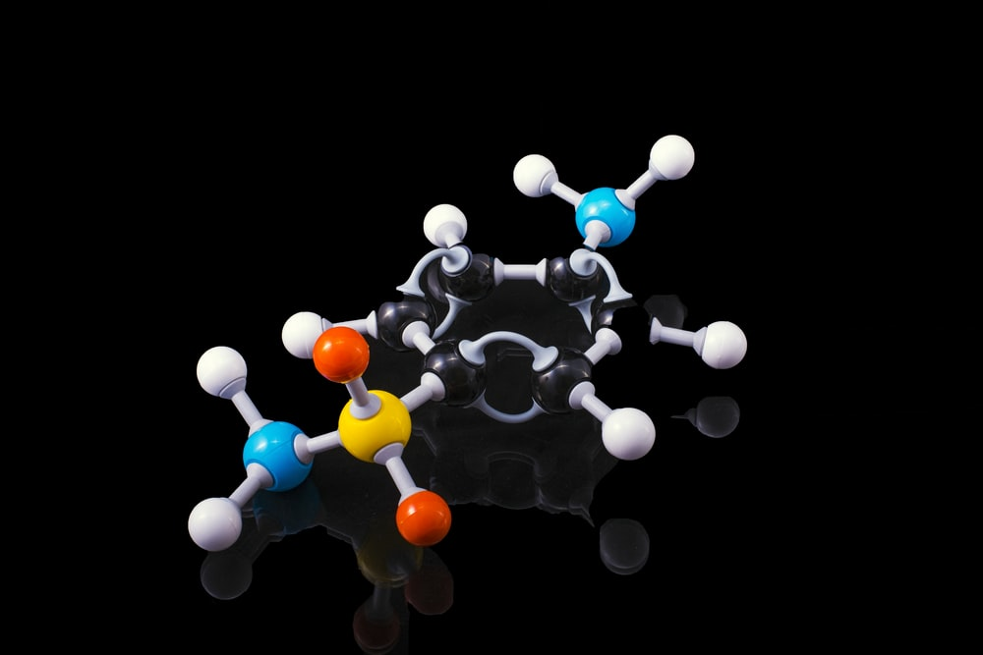
School of Chemistry and Forensic Science
Introduction
Drivers
Initiative
Results
conclusion

Slide 6
School of Chemistry & Forensic Science
The School of Chemistry and Forensic Science has gone through a significant evolution in the last two decades.
This led to the introduction of a forensic science degree stream at the University.
The laboratory-based content and assessment for the foundation year unfortunately had not gone through any modification and improvement until 2016/2017.
Notes:
The School of Chemistry and Forensic Science has gone through a significant evolution in the last two decades.
This has led to the introduction of a forensic science degree stream at the University.
The laboratory-based content and assessment for the foundation year unfortunately had not gone through any modification and improvement until 2016/2017. The course content which was mainly designed for chemistry undergraduates was now serving both forensic and chemistry students in the foundation year.

Slide 7
School of Chemistry & Forensic Science
The course content which was mainly designed for chemistry undergraduates was now serving both forensic and chemistry students in the foundation year.
One of the biggest complaints that students who were registered on the forensic science course had was, the chemistry content was not very applicable to their degree stream.
This is not entirely true - forensic science applications have their foundations in analytical chemistry.
Notes:
The School of Chemistry and Forensic Science has gone through a significant evolution in the last two decades.
This has led to the introduction of a forensic science degree stream at the University.
The laboratory-based content and assessment for the foundation year unfortunately had not gone through any modification and improvement until 2016/2017. The course content which was mainly designed for chemistry undergraduates was now serving both forensic and chemistry students in the foundation year.

Slide 8
School of Chemistry & Forensic Science
Teaching and assessment were not contextual for forensic science or chemistry students.
Traditional assessment methods that tend to decontextualize concepts are unsuitable for evaluating scientific process.
With this knowledge and based on feedback from students, the laboratory-based content of the foundation year went through a series of modifications to contextualise students learning and stimulate engagement.
Notes:
The traditional primary assessment methods that were a result of decomposability, decontextualization, and psychometrics, are unsuitable for evaluating scientific process, does not accurately measure the understanding of concepts by students, is inadequate in determining students’ powers of reasoning and does not allow them to demonstrate how they can use what the know in solving real problems in the workplace or society (Champagne & Newell, 1992; Gardner, 1992,Tamir, 1998, Resnick & Resnick, 1992).

Slide 9
Redesigning experiments and assessments
Introduction
Drivers
Initiative
Results
conclusion

Slide 10
Determination of copper content of brass
This involved the use of volumetric analysis to determine the percentage of copper in a sample of brass.
Simple procedure:
From the supplied solution take 20ml using a volumetric pipette and make up to 250ml in a volumetric flask using deionised water….
Stopper the flask and invert cautiously seven times to mix the solution...
Notes:
This involved the use of volumetric analysis to determine the percentage of copper in a sample of brass. Skills picked up in this experiment are essential in subsequent stages and in the workplace.
Simple procedure:
From the supplied solution (note the identity code in your workbook) take 20ml using a volumetric pipette and make up to 250ml in a volumetric flask using deionised water….
Stopper the flask and invert cautiously seven times to mix the solution. Use a 25ml volumetric pipette to transfer an aliquot to a 250ml conical flask for titration.

Slide 11
Determination of copper content of brass
Procedure didn’t change but we introduced an introduction to contextualise their learning
Brass is an alloy of copper and zinc but can be made up in different ratios. The ratio of zinc to copper is decided according to the required properties.
In this analysis we are looking at brass supplied from a naval restoration project to determine their use based on the copper content…
Notes:
Procedure didn’t change but we introduced an introduction to contextualise their learning
Brass is an alloy of copper and zinc but can be made up in different ratios. The ratio of zinc to copper is decided according to the required properties, which may include machinability, corrosion resistance, mechanical strength, and according to cost of copper (being a more costly raw material than zinc).
In this analysis we are looking at brass supplied from a naval restoration project to determine their use based on the copper content…

Slide 12
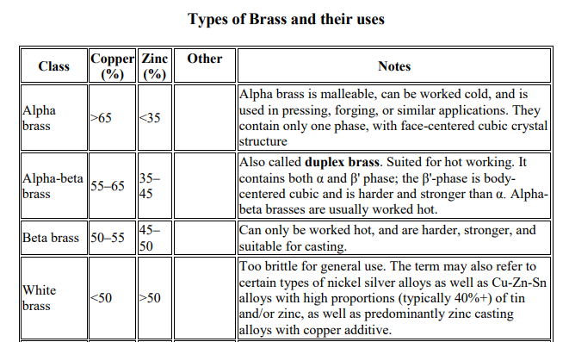
Determination of copper content of brass

Slide 13
Determination of copper content of brass
Previously they had to calculate the copper content of brass only, now they must go a bit further and determine the type of brass and what it could have been used for.
This stretches their research and investigative skills – something needed in the field or study at post-graduate level

Slide 14
Synthesis of indigo [dye]
Replacement of synthesis of acetanilide – a weak analgesic.
This synthesis uses aniline and acetic anhydride covered the practical skills of fume cupboard work, handling hazardous chemicals, measuring liquids and recrystallization.
In terms of assessment, we would only ask simple questions related to the process, observations, and yield.
This was a short experiment using an hour of the three-hour slot and did not give much inspiration for discussion.

Slide 15
Synthesis of indigo [dye]
the acetanilide synthesis was replaced with the synthesis of indigo [dye].
This new experiment requires the students to synthesize the blue jeans dye indigo through a bench safe reaction of acetone, o-nitrobenzaldehyde and NaOH.
This initial reaction process is visually impressive and robust. They can isolate the indigo dye, and then use their own product to dye some cotton through a redox vat dye process.
Using rubber bands, you can create a tie-dye patterning.
Notes:
the acetanilide synthesis was replaced with the synthesis of indigo [dye].
This new experiment requires the students to synthesize the blue jeans dye indigo through a bench safe reaction of acetone, o-nitrobenzaldehyde and NaOH.
This initial reaction process is visually impressive and robust. They can isolate the indigo dye, and then use their own product to dye some cotton through a redox vat dye process. The insoluble indigo dye is, reduced to the colorless, soluble leuco-indigo form, at which point the cotton is added. The cotton is removed from the vat, and on oxidation through exposure to oxygen, the indigo reforms, and fixes into the cotton. Removal of rubber bands or wires leads to tie-dye patterning

Slide 16
Synthesis of indigo [dye]
Assessment of this experiment is more diverse in its possibilities.
We can ask about the yield of the dye formed, and the equivalencies of the reagents, but further to this we are able to discuss oxidation and reduction in organic complexes in a relatable and contextualized way.
All students can take away samples of dyed cotton which is a rarity and appreciated addition to the course.
Notes:
the acetanilide synthesis was replaced with the synthesis of indigo [dye].
This new experiment requires the students to synthesize the blue jeans dye indigo through a bench safe reaction of acetone, o-nitrobenzaldehyde and NaOH.
This initial reaction process is visually impressive and robust. They can isolate the indigo dye, and then use their own product to dye some cotton through a redox vat dye process. The insoluble indigo dye is, reduced to the colorless, soluble leuco-indigo form, at which point the cotton is added. The cotton is removed from the vat, and on oxidation through exposure to oxygen, the indigo reforms, and fixes into the cotton. Removal of rubber bands or wires leads to tie-dye patterning

Slide 17
Impact on student engagement and learning
Introduction
Drivers
Initiative
Results
conclusion

Slide 18
Impact on student engagement and learning
Engagement in lab classes went up - On all three of our groups of 15 students this year, a handful of students from each have stayed until after the allocated slot, simply tie-dyeing cotton sheets to take away.
Attendance was consistently above 70% through out the lockdown compared to below 40% for other in person events
Feedback from module evaluation consistently mention the contextual nature of teaching and assessment – this contextual approach has been extended to assessments in lectures as well.
Foundation year students have been among the top 10% of graduating students in the last 5 years.

Slide 19
Impact on student engagement and learning
Some feedback from students in module evaluation
“Relating the module and work to everyday life gave students a better understanding and a wider perspective of chemistry in general”.
“Labs completed were of excellent quality, methods were given for easy understanding and Lab reports after a lab session allowed for a quick review and refresh, the labs also correlated with the unit being taught that given week in Molecules and Analysis”.
“An example of excellent teaching was the use of examples and exam questions to practice and further understand the concept”.

Slide 20
Conclusion
Properly leveraging assessments can impact student learning/engagement
Small meaningful changes can have a big impact on student learning
More work including data collection and analysis is required to quantify, if possible, the real impact of contextualising teaching and assessment.

Slide 21
acknowledgments
I would like to acknowledge Dr Alex Wright, Dr Hazel Harris and Dr David Colclough – Technicians in the teaching lab

Slide 22
Thank you for listening
Questions

