Slide 1
LEVERAGING ASSESSMENTS TO MOTIVATE STUDENT LEARNING AND ENGAGEMENT
School of chemistry and Forensic Science
DR A Berko

Slide 2
Impact of Assessment on learning

Slide 3
Nothing causes a student to hit the books more that an upcoming assessment deadline or exam
Assessment and learning

Slide 4
Impact of Assessment on learning
Assessments are an important part of teaching and learning in higher education.
It allows institutions to make judgements on learning outcomes and teaching quality (Fletcher et al 2012, Klassen 2006).
They also serve as a means of judging ability and competence of graduates in the selection of candidates for employment (Madaus & Kellaghan, 1993).
Assessments shape and influence the behaviour of students to a higher degree than perhaps teaching.
Because of this, assessments should be leveraged and designed to improve teaching and learning at higher education institutions (Gibbs and Simpson 2004).
Notes:
Assessments are an important part of teaching and learning in higher education.
It allows institutions to make judgements on learning outcomes and teaching quality (Klassen 2006).
Since the introduction of quantification of grades in 1792, it has also served as a means of judging ability and competence of graduates in the selection of candidates in the workplace (Madaus & Kellaghan, 1993).

Slide 5
Use of assessments
Question is, how can we use assessments to motivate student learning?
How do we help them connect with what is being taught?
How do we use Formative and summative assessments effectively

Slide 6
Redesigning assessments – the dilemma
Formative assessments help students gauge their learning and identify gaps in knowledge
Trouble is not many engage with them
Summative assessments get higher engagement from students – do they study to pass exams or to understand concepts in order to apply them to real life problems?

Slide 7
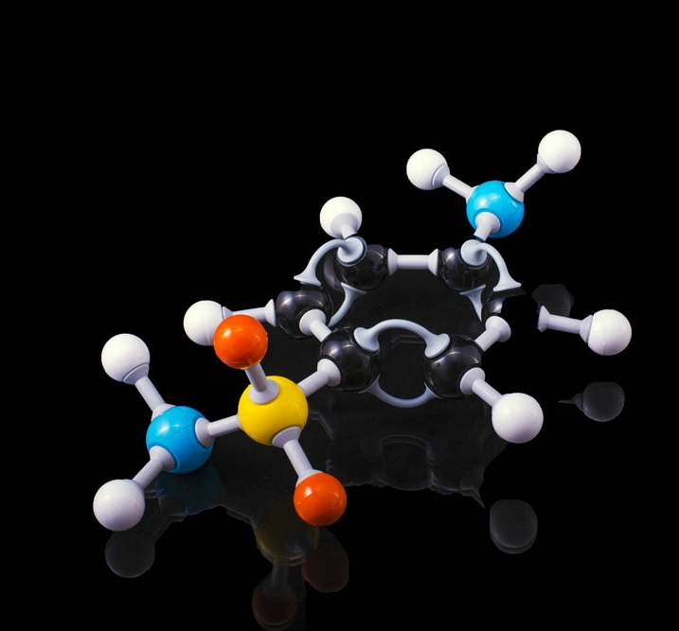
Strategies employed
To get more out of formative assessments, use a variety of them in informal ways
Entry and Exit Quizzes – online via QR codes
Q & A during Lectures
Use past paper questions as examples during lectures– incentivises students
Contextualise assessments – develops problem solving abilities and help students connect with concepts
All of this promotes a growth mindset

Slide 8
Example
A wooden bowl was found during an archaeological dig in Canterbury. A history PhD student from the University of Kent said it was Roman. This would date the bowl around 400AD making it about 1600 years old. Analysis of 1 g of the spear showed radioactivity of 30 counts per hour. 1 g of modern wood gave a count of 80 counts per hour. If the half –life of carbon 14 is 6000 years and levels of carbon 14 in the atmosphere is constant, calculate the age of the spear and determine whether the history student was right.
[Radioactive decay law: N_{t} = N₀e^{-λt} , t_{1/2} = 0.693/λ]

Slide 9
Impact on student engagement and learning

Slide 10
Impact on student engagement and learning
Engagement in lectures has improved
Attendance was around 60% even for online lectures (was higher pre-lockdown)
Feedback from module evaluation consistently mention the contextual nature of teaching and assessment.
Resits in the foundation chemistry modules have been low for a number of years.

Slide 11
Impact on student engagement and learning
Some feedback from students in recent module evaluations
“Relating the module and work to everyday life gave students a better understanding and a wider perspective of chemistry in general”.
“Lectures tie in real world applications which make them interesting”
“An example of excellent teaching was the use of examples and exam questions to practice and further understand the concept”.

Slide 12
Conclusion
Properly leveraging assessments can impact student learning/engagement
Small meaningful changes can have a big impact on student learning
More work including data collection and analysis is required to quantify, if possible, the real impact contextualising teaching and assessment has on student learning.

Slide 13
Thank you for listening
Questions

