Slide 1

Ableism and Exclusion
Challenging Academic Cultural Norms in Research and Innovation Communication to Effect Changes in Practice

Slide 2
About us
Josie Caplehorne
Research and Scholarly Communication Team
Twitter: @JosieCaplehorne
Email: j.caplehorne@kent.ac.uk
Dr Jennifer Leigh
Centre for the Study of Higher Education
Twitter: @DrSchniff
Email: j.s.leigh@kent.ac.uk

Slide 3
Equality and inclusion landscape in Higher Education
Increased awareness of exclusionary practices due to Athena Swan, Race Equality Charter and #BlackLivesMatter
Statistics on disability highlight serious issues around disclosure rates for staff:
16% of working age public disclose a disability, neurodivergence or chronic illness
Less than 4% of academics working in HE (Brown and Leigh, 2018)
We know staff report being stigmatised, challenged and questioned.
Some have been told not to pursue a career in academia as they would fail anyway. In this environment.

Slide 4
Damning data

Slide 5

Personal factors that affect disclosure

Slide 6

Measuring language

Slide 7

Political factors that affect disclosure

Slide 8
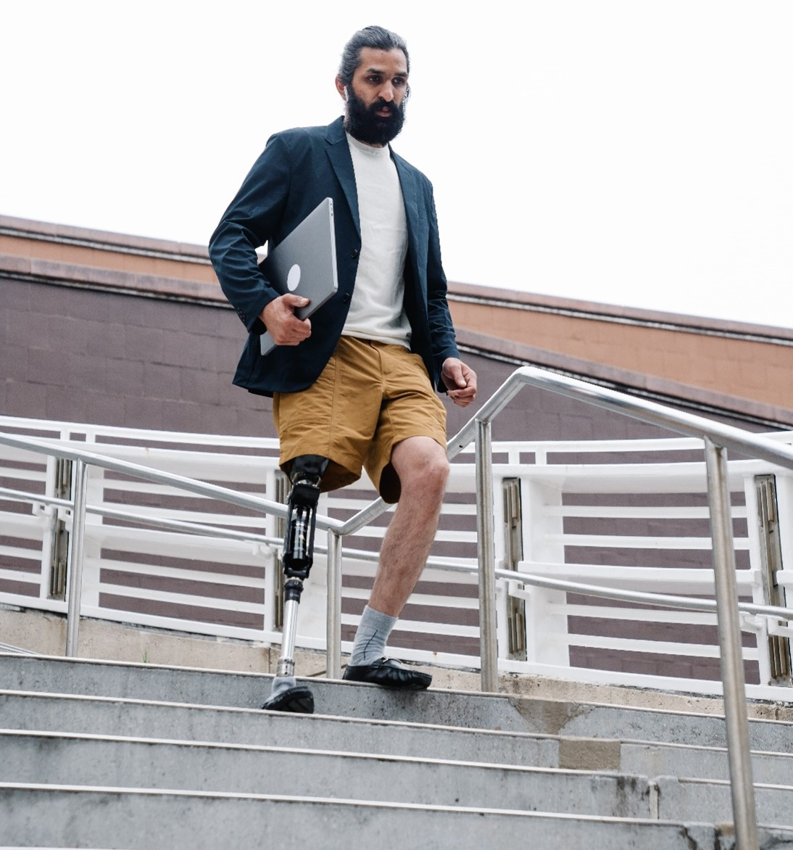
From the top down: towards an accessible and inclusive research support culture
San Francisco Declaration of Research Assessment (DORA)
Leiden Manifesto
Public Sector Bodies (Websites and Mobile Applications) Accessibility Regulations (2018)

Slide 9

Challenges for professional services
“As professional research support managers and administrators, recognising the need for systemic change and being able to make the change are worlds apart.”

Slide 10

Discussion
In this environment how can research managers and administrators be agents of change, raise awareness, and empower academics to ask for and gain adjustments to support their work?

Slide 11

From the ground up: towards an accessible and inclusive research support culture at Kent
Scholarly Communication Conference (2019)
Research and Innovation Support Network Conference (2022)
Challenging publication methods
Open Journals at Kent
Accessibility request process
Digitised c600 thesis (Optical Character Recognition)
Accessibility statements
Blackboard Ally modules
Responsible metrics training

Slide 12

Networks and communities
Sharing expertise…and challenges (conferences, blogs, mailing lists)
Cross-institutional support (internal and external)
Professional networks (e.g. Publishers Association Accessibility Action Group).

Slide 13

Future aims and ambitions
Equality Impact Analysis
Thesis accessibility project
Bookshare with the Royal National Institute for the Blind
Staff training - Accessibility requests, blogs and social media
Engagement with networks

Slide 14
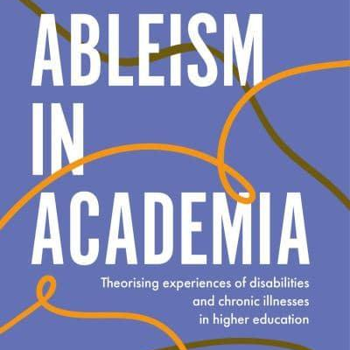

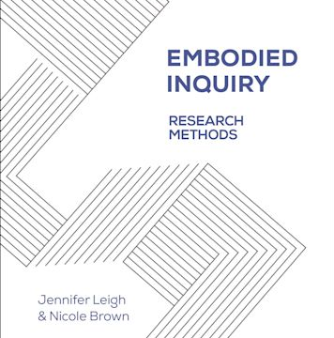
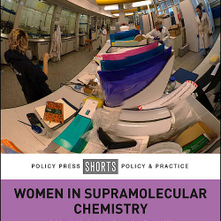

Research, innovate and share
Ableism in Academia (Open Access)
Lived experiences of Ableism in Academia
Embodied Enquiry: Research Methods
Women in supramolecular chemistry (Open Access)
The future of laboratory chemistry learning & teaching must be accessible (Open Access)

Slide 15
Resources and further reading
Academic Career Map / University of Kent
Accessibility and Inclusion News Blog / Office for Scholarly Communication Research Support Team
Ableism in Academia / Jennifer Leigh and Nicole Brown
Embodied Inquiry: Research Methods / Jennifer Leigh and Nicole Brown
Engaging practice researchers in open repositories / Helen Cooper and Josie Caplehorne
Lived experiences of ableism in academia / Nicole Brown
“One of the most welcoming, sustainable, collaborative and inclusive conferences….”/ Office for Scholarly Communication
Open Accessibility / Ben Watson and Josie Caplehorne
Open or ajar? And how we can blow the b****y doors off! / Ben Watson and Josie Caplehorne
Publications by Jennifer Leigh / Kent Academic Repository
Responsible metrics at the University of Kent / Office for Scholarly Communication
Staff Disability Network Blog / University of Kent
The Future of Laboratory Chemistry Learning and Teaching Must be Accessible / Jennifer Leigh and others
Women in supramolecular chemistry / Jennifer Leigh and others

Slide 16

Forthcoming publications
Ableism and Exclusion: Challenging academic cultural norms in research communication / Slowe, Leigh, Caplehorne
Embedding accessibility in research support and scholarly communication systems and processes: a reflective case study / Caplehorne, Bass, Cooper, Duffy, Green-Hughes

Slide 17

With thanks to…
Nicole Brown and Paul Thompson, University College London, for ‘Making events accessible’.
Fen Slattery for ‘An organizer’s guide to pronoun buttons’.
Eddy Ng, PhD, Professor and F.C. Manning Chair in Economics and Business, Dalhousie University.
Jennifer Leigh, Lecturer in Higher Education and Academic Practice, Academic Practice Team Ableism in Academia.
Duke Report, Dyslexia International
Stickman Communications

Slide 18
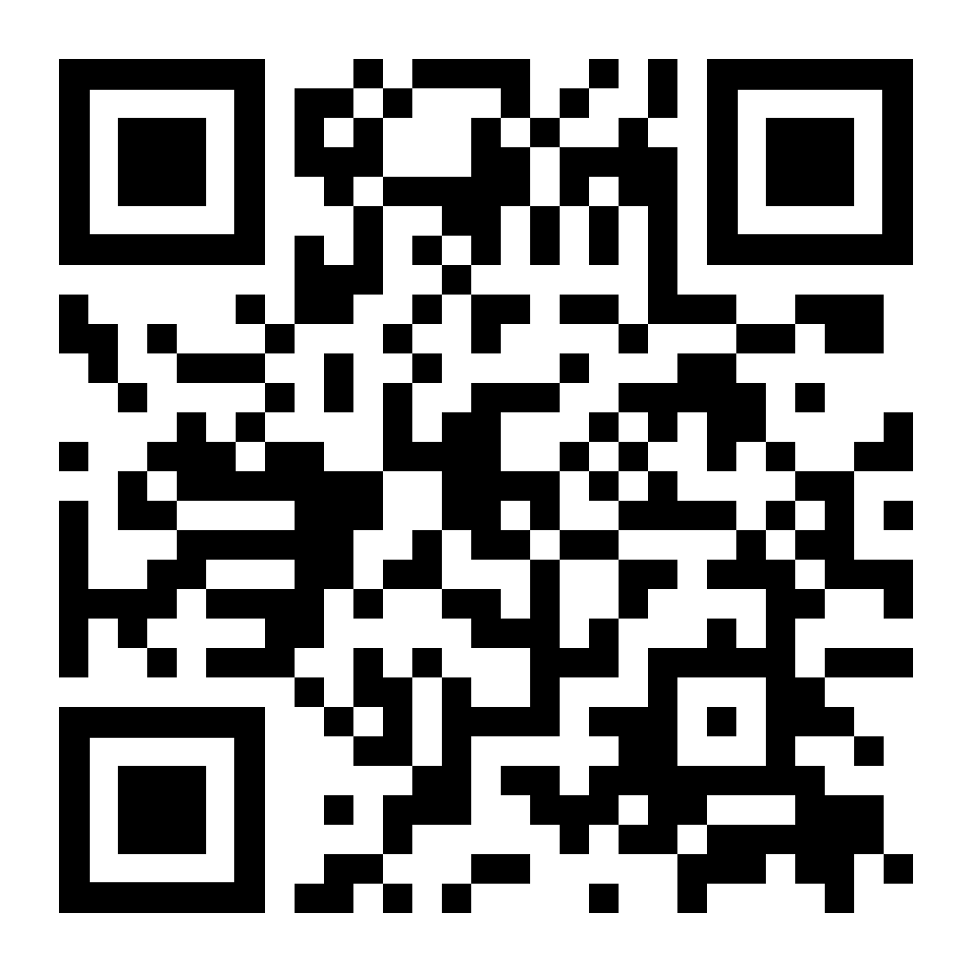
Access this presentation
Turn on the camera on your mobile device
Hold the camera over the code on the right
A link will appear on the screen of your mobile device
Click the link to access this presentation
Alternatively, find the slides via this address: https://kar.kent.ac.uk/97961/
The presentation is fully accessible. However, if you experience any access barriers, please contact us.

Slide 19
Thank
you

