Slide 1
PhD and Postdoc Careers talk at Cambridge MRC Epidemiology Unit 22/04/2021
Dr Barbora Šilarová (she/her)
the Personal Social Services Research Unit (PSSRU)
University of Kent, Canterbury
b.silarova@kent.ac.uk
Notes:
Good afternoon to Everyone! Firstly, thank you very much for inviting me to speak at this seminar. I felt very humbled by the invitation. I would like to thank to Rebecca for organising the seminar and to everyone who has decided to join the talk today.
As you heard I work at the moment at PSSRU at University of Kent in Canterbury and here at this blurred picture you can see the Canterbury Cathedral and it is a view that you can see from the University campus.

Slide 2
Agenda
About me
PSSRU
Project 2
Career
Social care
Project 3
My current role
Project 1
Skills needed
Notes:
Rebecca asked me to speak about my present role, what skills are needed and how my time at MRC Epidemiology Unit send how my time at the Unit lead to my current role. So in the upcoming 20 minutes I will tell you little bit about me as a person and give you an overview of my career to provide a context to my current role. The I will speak about my current role, the Unit I work at especially highlighting some aspects that I think are quit interesting when comparing PSSRU with MRC Epidemiology Unit. As you heard I now work in social care and I thought for those not familiar with social care I would explain that little bit. I will then describe three different projects I am involved in to give you an idea what my current job is about and then summarise the skills I think are needed for my current role.

Slide 3
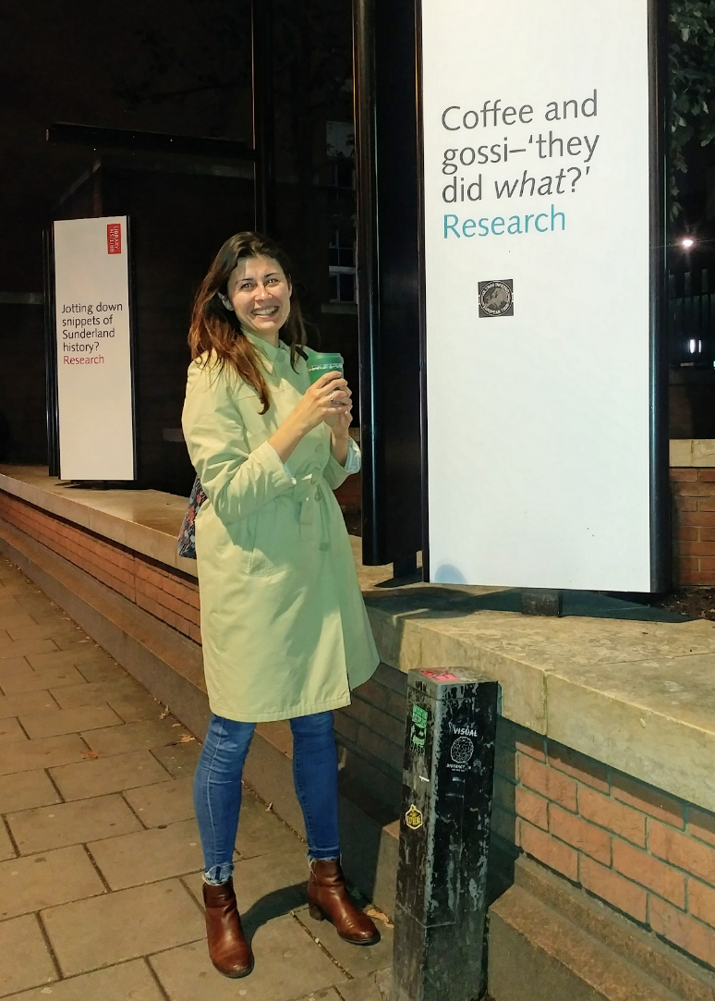
About me
Origin
1985, Slovakia
Little joys
Life abroad
Coffee, Brunch
Carrot cake
Art
Walks, Exercise
2011-2014, The Netherlands
2014-2016, England
2017, the USA
2017-present, England
Professional life
Private life
Clinical and health psychologist
Researcher at University
Volunteer
Daughter, sister, aunt
Friend
Girlfriend
No pets
No children

Slide 4
Career
2009 - 2014
2004-2009
2011 - 2013
2014-2016
2017
2017-2019
2019-present
MSc. Psychology
University of Trnava, Slovakia
Career Development Fellow
MRC Epidemiology Unit
Research Fellow
Department of Psychology
University of Exeter
MSc. (Res.) Clinical and Health Psychology
Leiden University, The Netherlands
PhD. in Medical Sciences
University of Groningen, The Netherlands
Postdoctoral Fellow
Institute for Health & Aging
University California San Francisco, USA
Research Associate
PSSRU

Slide 5
Joined PSSRU in September 2019
Research Associate
Change of research context
In March 2020, the WHO declared the COVID-19 pandemic
My current role

Slide 6
Established at the University of Kent at Canterbury in 1974
Based in the School of Social Policy, Sociology and Social Research (SSPSSR)
Social care research group of 27 people
Needs, resources and outcomes in social and health care, with particular emphasis on community care, residential and nursing home provision, social care markets and commissioning, long-term care finance

Slide 7
In 2018 the NIHR launched a new set of 13 Policy Research Units
PSSRU was successful in securing three of these Units
The units work closely with the Department of Health and Social Care to provide evidence directly to the Secretary of State for Health, government departments as well as NHS England and Public Health England

Slide 8
What is adult social care?
Social work, personal care and practical support for adults with a physical disability, a learning disability, or physical or mental illness, as well as support for their carers.
Adults with care needs cannot perform some activities of daily living such as washing, dressing, cooking, and shopping without support.
Supported in two main ways: either formally through services they or their local authority pay for; or informally by family, friends, or neighbours.

Slide 9
Experience - Projects
Project 1
Measuring the Social Care Outcomes of People with Dementia and their Carers
September 2019-Ongoing
Funded by NIHR Research for Patient Benefit
Project 2
Developing a scale of work-related quality of life for adult social care staff
September 2019- March 2021
Funded by NIHR Research for Patient Benefit
Project 3
The Impact of Social Care for Older Carers and the People they support
September 2020- Ongoing
NIHR School for Social Care Research

Slide 10
Project 1 - MOPED
tested two new questionnaires that are part of the Adult Social Care Outcomes Toolkit (ASCOT)
The ASCOT questionnaires are used to collect information on the quality of life of people who use social care services and their carers
observational cross-sectional study
self-administered questionnaire
307 unpaid carers who live in England between January 2020 and March 2021
NHS, the Join Dementia Research, local authorities, carer’s organisations
Notes:
People with dementia are often excluded from research if they are not able to respond to standard questionnaires. Although they represent a large number of users of social care services, their voices are seldom-heard in national or local evaluations, surveys or social care research. The inclusion of their experiences in social care research requires robust but adapted data collection methods.
The Adult Social Care Outcomes Toolkit (ASCOT) measures social care-related quality of life. It is a tool that is applicable across a wide range of user groups, and care and support settings. ASCOT is used in the Adult Social Care Survey (ASCS), an annual survey of adults who receive services funded by local authority Social Services in England. ASCOT is also used by a number of local authorities and service providers in their internal evaluations and research, as well as in assessments and reviews.
The study will test a new proxy-report version of ASCOT, the ASCOT-Proxy. This is designed to be completed by a family/friend carer on behalf of the person with dementia, when the person is unable to answer on their own behalf.

Slide 11
Project 2 –ASCOT-Staff
To begin development of a work-related quality of life (WRQoL) measure among care staff working in adult social care
The first stage in measure development, and the focus of this project, is to determine the key components of WRQoL that are relevant to care staff
Scoping review of international literature
Individual interviews with stakeholders (12)
Focus groups with managers and frontline staff (16 people)
Consensus survey
Notes:
1.52 million people worked in adult social care in England with a vacancy rate of 7.3% and turnover rate of 30.4% for the 12 month period (Skills for Care, 2020). Given the projections that increasing numbers of people will require some form of social care support over the next decades (Bottery et al., 2018), it is essential to understand how to ensure that the adult social care sector can become an attractive and rewarding sector to work in.

Slide 12
Project 3 –DYADS
How do services improve the QoL of older carers (individually) and with the people they support (as a ‘dyad’)?
How social care professionals understand their role in supporting older carers? And/or the people they care for?
Co-resident carers aged 65, or over, and the people they support/care for
Scoping review
Individual interviews with professionals (20)
Individual interviews with carers and the people they support (24)
Notes:
The number of carers aged over 65 years is growing
At least 20% of carers in the UK
Specific needs of older carers
More likely to be caring for someone co-resident with them (e.g. spouse/partner)
Less likely to recognize themselves as carers or seek support
Own health problems and/or social care needs
‘Co-caring’ is common (approx. 15% of caring relationships)
The impact of community-based social care services
Aim to improve quality of life (QoL) and wellbeing
But how do services affect carers’ QoL, individually or applying a ‘dyadic’ lens (i.e. carer and the person they support together)

Slide 13
Skills, knowledge, experience
Ethics and Research governance
Design study materials
Liaising with CRN, local authorities and social care organisations
Recruitment of participants
Data collection: survey, interviews and focus groups
Data management
Data analysis : qualitative and quantitative
Conduct of evidence synthesis
Dissemination of results
Knowledge of social care and/or health care systems
Knowledge of outcomes measurement in health and social care

Slide 14
Thanks for your attention!
Contact: b.silarova@kent.ac.uk
@BarboraSilarova

