Slide 1

Ableism and Exclusion: Challenging Academic Cultural Norms in Research Communication to Effect Changes in Practice
Josie Caplehorne, Office for Scholarly Communication
Dr Jennifer Leigh, Centre for the Study of Higher Education

Slide 2

Equality and Inclusion landscape in Higher Education
Increased awareness of exclusionary practices due to Athena Swan, Race Equality Charter and #BlackLivesMatter
Statistics on disability highlight serious issues around disclosure rates for staff:
16% of working age public disclose a disability, neurodivergence or chronic illness
Less than 4% of academics working in HE (Brown and Leigh, 2018)
We know staff report being stigmatised, challenged and questioned.
Some have been told not to pursue a career in academia as they would fail anyway. In this environment.

Slide 3
Damning data

Slide 4

Personal factors that affect disclosure

Slide 5

Institutional factors that affect disclosure

Slide 6

Political factors that affect disclosure

Slide 7

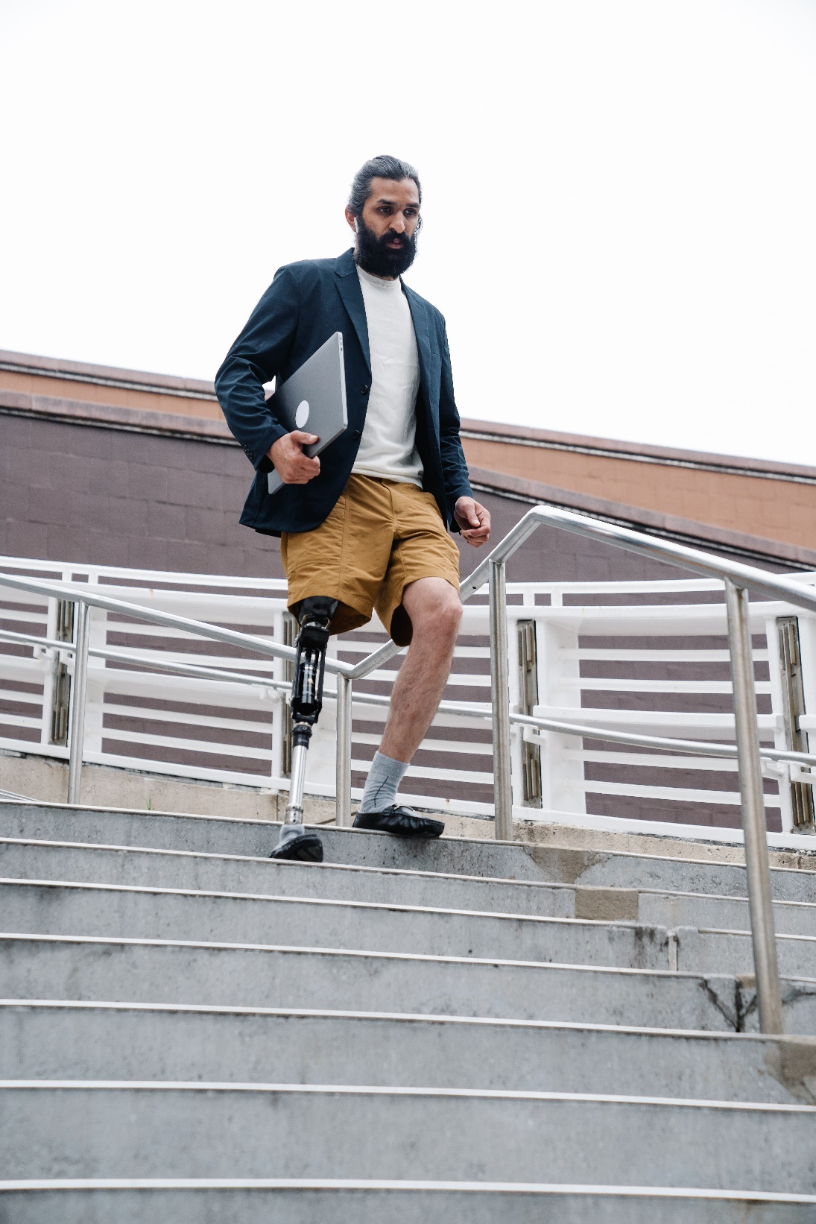
From the top down: towards an accessible and inclusive research support culture
San Francisco Declaration of Research Assessment (DORA)
Leiden Manifesto
Public Sector Bodies (Websites and Mobile Applications) Accessibility Regulations (2018)

Slide 8

Challenges for professional services
“As professional research support managers and administrators, recognising the need for systemic change and being able to make the change are worlds apart.”
Notes:
We can be portrayed as powerless in a world driven by researchers, managers and external agencies and policy drivers.”

Slide 9
In this environment how can research managers and administrators be agents of change, raise awareness, and empower academics to ask for and gain adjustments to support their work?

Slide 10

Discussion

Slide 11


Finding solutions

Slide 12

From the ground up: towards an accessible and inclusive research support culture at Kent
Scholarly Communication Conference
Responsible metrics and the Academic Career Map
Challenging publication bias
Accessibility request process
Thesis accessibility project
Helsinki Initiative on Multilingualism in Scholarly Communication

Slide 13

Research, innovate and share
Ableism in Academia (Open Access)
Lived experiences of Ableism in Academia
Embodied Inquiry: Research Methods

Slide 14

Network and communities
Sharing expertise…and challenges (conferences, blogs, mailing lists)
Cross-institutional support (internal and external)
Professional networks (e.g. Publishers Association Accessibility Action Group).

Slide 15

Inclusive Culture

Slide 16
Resources and further reading
Academic Career Map / University of Kent
Accessibility and Inclusion News Blog / Office for Scholarly Communication Research Support Team
Ableism in Academia / Jennifer Leigh and Nicole Brown
Embodied Inquiry: Research Methods / Jennifer Leigh and Nicole Brown
Engaging practice researchers in open repositories / Helen Cooper and Josie Caplehorne
Helsinki Initiative on Multilingualism in Scholarly Communication / Helsinki Initiative
Lived experiences of ableism in academia / Nicole Brown
“One of the most welcoming, sustainable, collaborative and inclusive conferences….”/ Office for Scholarly Communication
Open Accessibility / Ben Watson and Josie Caplehorne
Open or ajar? And how we can blow the b****y doors off! / Ben Watson and Josie Caplehorne
Publications by Jennifer Leigh / Kent Academic Repository
Responsible metrics at the University of Kent / Office for Scholarly Communication

Slide 17

Forthcoming publications
Ableism and Exclusion: Challenging academic cultural norms in research communication / Slowe, Leigh, Caplehorne
Embedding accessibility in research support and scholarly communication systems and processes: a reflective case study / Caplehorne, Bass, Cooper, Duffy, Green-Hughes

Slide 18


With thanks to…
Nicole Brown and Paul Thompson, University College London, for ‘Making events accessible’.
Fen Slattery for ‘An organizer’s guide to pronoun buttons’.
Eddy Ng, PhD, Professor and F.C. Manning Chair in Economics and Business, Dalhousie University.
Jennifer Leigh, Lecturer in Higher Education and Academic Practice, Academic Practice Team Ableism in Academia.
Duke Report, Dyslexia International
Stickman Communications

Slide 19

The UK’s European University
Josie Caplehorne, j.caplehrone@kent.ac.uk, @JosieCaplehorne
Dr Jennifer Leigh, j.s.leigh@kent.ac.uk, @DrSchniff

