Slide 1
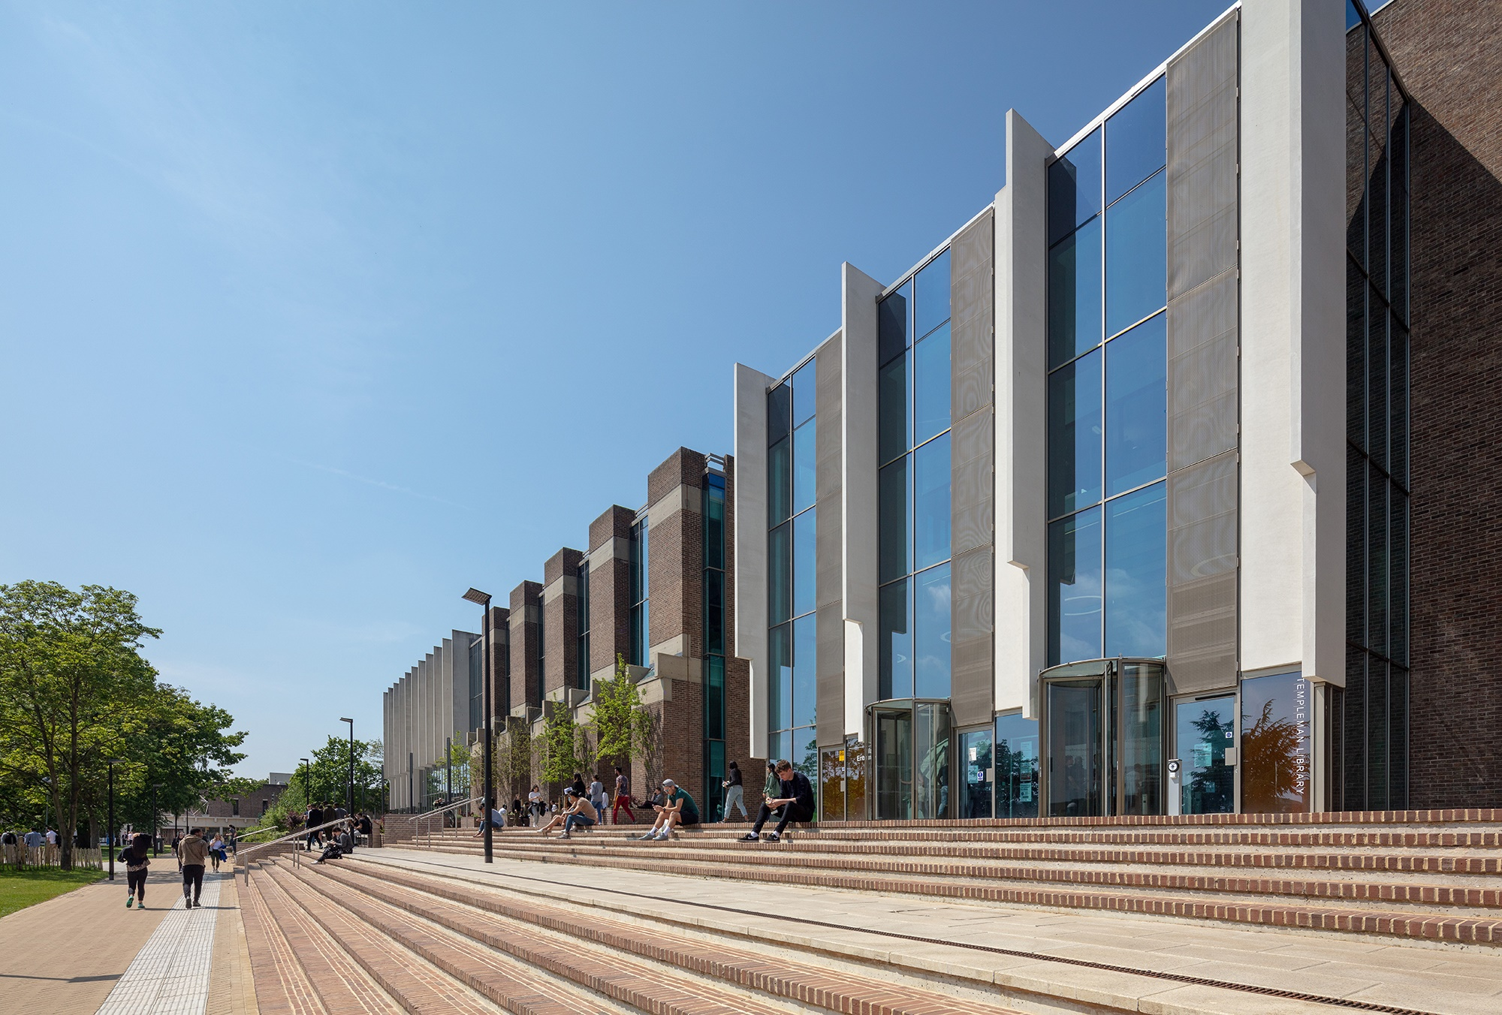
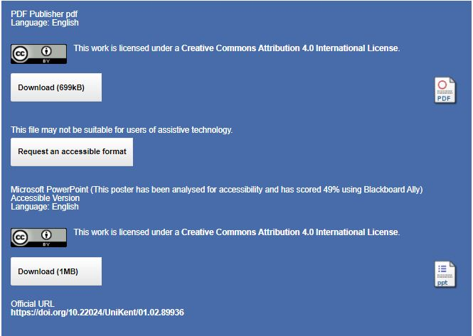
Select the section of text you want to update and type/insert your poster copy.
If cutting and pasting from another file, click on the mini clipboard icon after pasting, select “Keep Text Only” to preserve the font style in this template.
Do’s
Only use the approved fonts, Century Schoolbook and Arial
Keep your copy short and concise
Only use good quality images
See the guidelines for images at www.kent.ac.uk/brand/visual/images.html
View a gallery of images at www.flickr.com/photos/universityofkentidentity/sets/
Make sure your image is correctly proportioned, check – Picture format > Size > Scale – the height and width % should be the same
Make sure your have copyright permission to use the image
Delete the picture box if it’s not required
Do not’s
Add more colours
Move the picture box above sub-heading, the bottom of the picture must align with the bottom of the logo
Use images that appear out of focus or pixelated
Printing
When you are happy with the content of the poster save it as a PDF. The file is set up at A1, once saved as a PDF it can be scaled when printing to A0 if required.
Send your PDF to designandprintcentre@kent.ac.uk ,
confirm the size required, make sure you supply a cost code, delivery/collection deadline. A minimum of 24 hours for printing is requested.
IS – Research and Scholarly Communication Support Team
Embedding accessibility in repository and open journal services
Helen Cooper (H.Cooper@kent.ac.uk) Josie Caplehorne (J.Caplehorne@kent.ac.uk) @UniKentResSupp
New service for Accessibility requests
A new button on open access documents in KAR, so people who need a more accessible version can request it.
Lessons learned
We need to work with multiple internal and external partners. This complicated workflows and timescales.
Automated tools can’t tell us everything – they provide a guide but a fully accessible and meaningful format needs us to check every work.
We rely on our external hosts to deliver our accessible services, therefore, accessibility must be included in procurement decisions.
We can’t control the format of published works. Even as version of record open access increases, we must keep Word versions of AAMs
We have much to do to create a fully inclusive process, but everything we can do now helps. We can’t get there in one giant leap.
Retrospective conversion to accessible documents is time consuming
The user clicks to request a document in an accessible format…
…and fills out and submits a short request form…
… which generates a ticket in the helpdesk and an acknowledging email.
We convert the KAR document to MSWord
The future
Training, guides and advocacy to build accessibility into content at the point of creation. Starting with PgRs, ECRs and OJS journal editors
Embedding cultural change in all our services, so accessibility is as natural to all staff and students as correct spelling and grammar.
Working with suppliers and colleagues and putting pressure on publishers to create born accessible platforms and content.
The Templeman Library, University of Kent, Showing the front steps.
…and check it for accessibility using Blackboard Ally
Context
We are a library based team responsible for the support of research at the University of Kent, we manage 3 systems:
KAR – a publications repository on an Eprints platform
KDR – a data repository on an Eprints platform
Kent Open Access Journals on the Open Journal System (OJS)
Each system consists of a platform and content. The platforms are based on freeware, supported by external agents.
The content is created by staff, students and publishers.
We’re committed to embedding inclusive practices across our service and we knew these systems were not meeting this ideal.
Following the tips from Blackboard Ally we address any issues we can.
If the issues are too great or too complex, we send it to OPERA to help
The click-button on KAR to request an accessible copy and the accessible version
…if the issues affect the content, we ask the author to make the changes.
We recheck on Blackboard Ally aiming for 90%.
We stay in touch with the requestor at each stage to check if the work is accessible for them
Solutions
The platforms: we’ve some freedom to improve the accessibility of the Eprints platforms. We used tools to identify accessibility issues and test fixes:
Lighthouse identified navigation issues – fixed using Andi Bookmarklet
Wave revealed low colour contrast – fixed with Colour Contrast Analyser
The content in all systems is created by academics and publishers:
We link to SensusAccess from every page in the repositories
We developed a new service to address individual requests using Blackboard Ally
We keep Word versions of documents wherever we can for
We add the accessible document to the KAR record with its score.
KDR
We used the same tests and solutions for the platform. Because of the specialist content we’ll deal with accessibility requests on a case-by-case basis. We also found a conflict with some of the FAIR principles e.g. txt. file formats for text documents.
Links
Our Accessibility blogs
Watson, Ben, Caplehorne, Josie (2020) Open or ajar? And how we can blow the b****y doors off! In: Open and Engaged, 19 Oct 2020, Online. (Unpublished) (doi:10.23636/1232).
Caplehorne, J, Bass, R, Cooper, H, Duffy, S, Green-Hughes, L (2021) Embedding accessibility in research support and scholarly communication systems and processes: a reflective case study. Advanced Journal of Professional Practice, . ISSN 2059-3198. (Submitted)
OJS
We’re working with hosts -- PKP, journal editors and Mantra to ensure the platform and the content are accessible. We are developing accessible templates for articles.
https://www.kent.ac.uk/library-it/supporting-your-research Information Services, University of Kent, Canterbury, Kent CT2 7NU, UK.
Http://doi.org/10.22024/UniKent/01.02.89936

