Slide 1



Understanding and Measuring Safety in Older Adult Care Homes A Scoping Review of International Literature
Stacey Rand¹, Nick Smith¹, Karen Jones¹, Alan Dargan¹ & Helen Hogan²
¹ Personal Social Services Research Unit (PSSRU), University of Kent
² London School of Hygiene and Tropical Medicine

Slide 2
Disclaimer
This research is funded by the National Institute for Health Research (NIHR) Policy Research Programme, conducted through the Quality, Safety and Outcomes Policy Research Unit, PR-PRU-1217-20702.
The views expressed are those of the author(s) and not necessarily those of the NIHR or the Department of Health and Social Care.

Slide 3
Background
16,000 registered care homes in the UK (residential and/or nursing care), with capacity of up to 450,000 beds
70% older adult
Safety is the absence of preventable harm and minimization of unnecessary risk of harm to residents
Physical harm
Psychological harm
Improving and maintaining safety
Important role of leadership, organizational culture and process
How to measure and apply safety indicators in practice, to drive safety improvements?
Differences in context compared to healthcare settings
Needs to be reflected in the measurement and application of indicators.

Slide 4
Aims and Objectives
To identify safety indicators used (internationally) to inform quality or safety improvement and decision-making.
Do these measures map to theoretical models of safety monitoring and measurement, developed in healthcare contexts?
Are there any gaps?

Slide 5
Methods
Five stage framework for scoping reviews (Arksey & O’Malley, 2005)
Stage 1. Develop research question
Stage 2. Systematic searches
Inclusion criteria: English language, 1970 to 2019, no restriction to country, peer-reviewed articles
Databases: Web of Science, Scopus, PubMed
Search: “safety” AND “care home” OR “nursing home” OR “residential home” refined by “indicator”
Stage 3. Screening of title and abstract
Relevant to care context (care homes for older adults) and topic (safety monitoring or measurement, concepts of safety)
Stage 4. Extract key information (charting)
Stage 5. Organize identified safety measures/themes
Used the Safety Measurement and Monitoring Framework (SMMF) (Vincent et al, 2014)

Slide 6
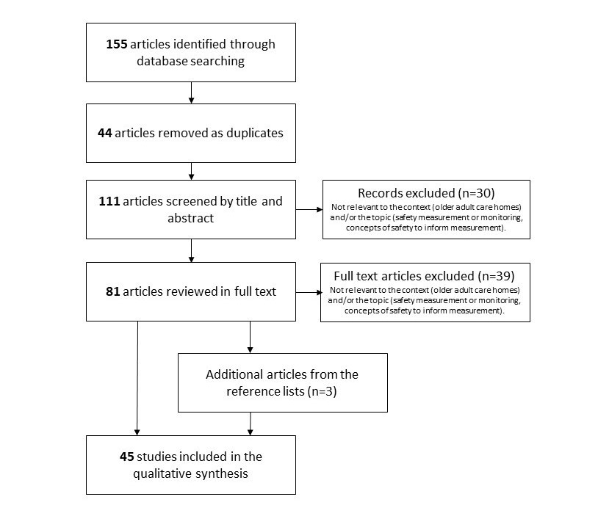
Findings

Slide 7
Dimension | Indicators of Safety
Harm Has care been safe in the past? | Physical harm pressure ulcers, falls, diarrheal disease or scabies, malnutrition, dehydration, incontinence, catheterisation, unplanned weight change, urinary tract infections, decline in activities of daily living, pain, and mortality Psychological harm Measures of an individual’s sense of self, belonging, comfort, security, emotional distress, privacy, respect, autonomy, and dignity
Reliability Are systems, processes and behaviour reliable? | Omission of safety critical care activities, e.g. ambulation, turning Medication-related measures Physical environment of the care home, e.g. lighting & ventilation Social use of the care home environment, e.g. lack of privacy, intrusive noise How care is delivered in the space Care record keeping

Slide 8
Dimension | Indicators of Safety
Sensitivity to operations Is care safe today? | Resident-report of feeling safe Other safety-related aspects of user experience
Anticipation and preparedness Will care be safe in the future? | Staffing levels, skill or training Patient safety culture
Integration and learning Are we responding and improving? | Use of national/regional datasets, e.g. Resident Assessment Instrument Minimum Data Set 2.0 (RAI-MDS 2.0).

Slide 9
Discussion
A wide range of available safety indicators
Focus tends to be on clinical measures, physical harm vs psychological harm
How to better reflect person-centred care?
How does care respect a person’s dignity and sense of self?
… independence, choice and control?
… ability to live in an environment that is safe, clean and ‘homely’?
… ability to socialize, as they wish (with family, friends, staff, other residents)? Etc.
and collect these data in care home context?
Gap in measures of incidence of abusive or neglectful care practice
Limited evidence of learning from safety data within staff team, within the care home, between care homes, or at systems-level
Influences at multiple levels, from individual staff (e.g. training) to systems level (e.g. funding, policy, inter-organizational relationships)

Slide 10
Next steps
Ongoing QSO-PRU qualitative study of safety in care homes in England.
What are key issues related to safety, in practice?
Within team, within care home, between homes, inter-organizational, systems-level
What safety indicators are already collected? How are they used?
What are the opportunities, challenges and barriers to the systematic collection and use of safety data for quality and safety improvement?
Analysis of Safeguarding Adults Reviews
Qualitative interviews (to be presented by colleague, Nick Smith)
Professional stakeholders (local authorities, CQC, DHSC, provider associations)
With a second phase of interviews with care home managers, staff, residents and family.

Slide 11


Any questions?
s.e.rand@kent.ac.uk
@StaceyERand
Reference
Rand S, Smith N, Jones K, et al. Measuring safety in older adult care homes: A scoping review of the international literature. BMJ Open 2021;11:e043206. doi: 10.1136/bmjopen-2020-043206

