Slide 1
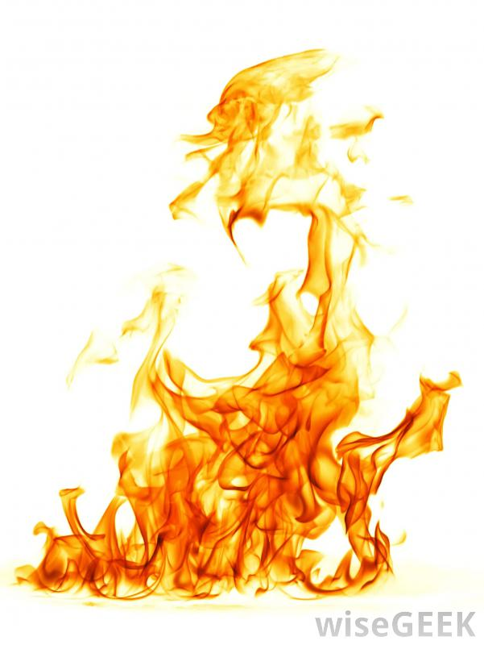
DELIBERATE FIRESETTING
Katie Sambrooks
Research Associate | PhD Researcher | Associate Lecturer
CORE-FP, School of Psychology, University of Kent;
Kent and Medway NHS and Social Care Partnership Trust.
Notes:
V1.0
To change the footer on every slide:
1. On the menu go to Insert > Header and Footer…
2. Select the Footer checkbox and enter the footer text in the accompanying text box
3. Click “Apply to All”

Slide 2
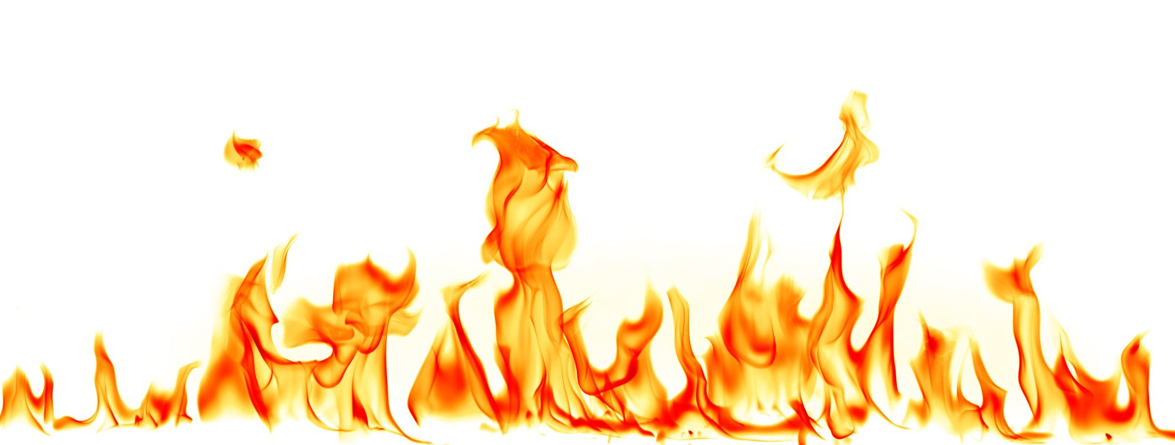
Scale of the problem
83,236 deliberate fires in England in 2018/19
(Home Office, 2019)
Notes:
Persistent increase since 2012

Slide 3
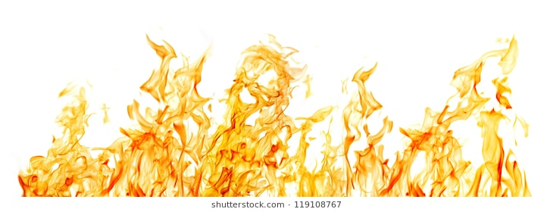
Scale of the problem
In one year period:
England: 1,014 injuries and 51 fatalities
US: 1,310 injuries and 440 fatalities
(Campbell, 2017; Home Office, 2019)
Notes:
This is all of importance because deliberate firesetting presents a critical issue worldwide in terms of cost to the economy, property damage, and human injury and fatality.

Slide 4
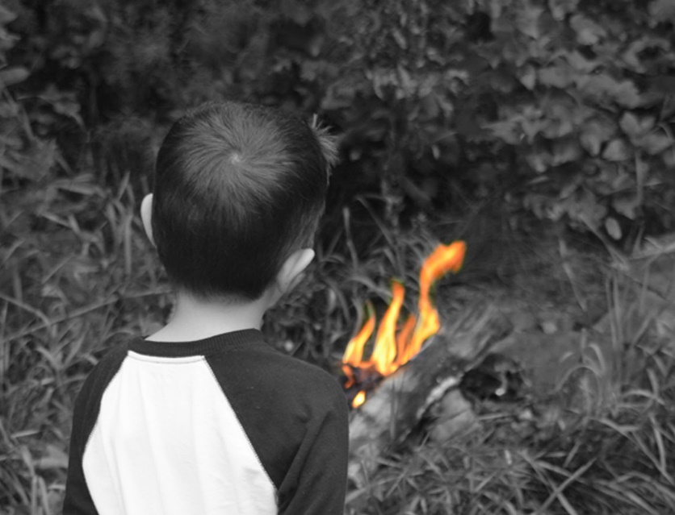
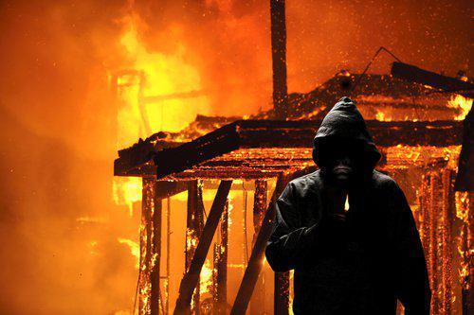
Who deliberately sets fires?
Research largely focused on juveniles (Gannon & Pina, 2010)
Only responsible for 40% of deliberate fires (Kennedy et al., 2006)
Adult perpetrated deliberate firesetting = critical issue

Slide 5
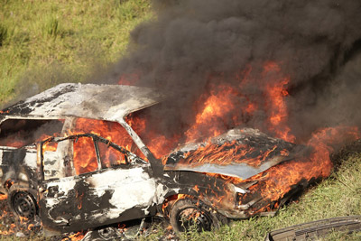
Why do adults deliberately set fires?
Revenge
Enhance heroic status
Profit
Cry for help
Crime concealment
Vandalism
Icove & Estepp, (1987); Inciardi (1970); Koson & Dvoskin (1982); Lewis & Yarnell (1951); Prins (1994); Rix (1994).

Slide 6
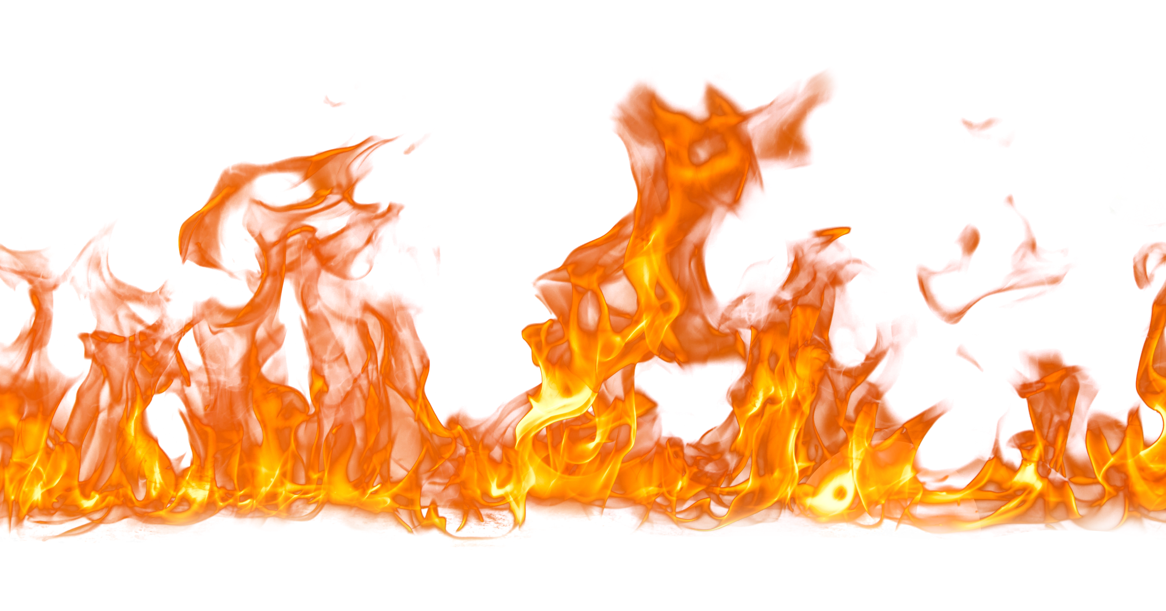
How do we tackle this behaviour? What treatments or interventions are available?

Slide 7
Treatments for deliberate firesetting
Majority of fire and rescue services were working with juvenile firesetters
Interventions for adult arsonists sparse
“Few attempts have been made to develop and evaluate specialist treatment programmes for arson internationally.” (Tyler, Gannon & Sambrooks, 2019)

Slide 8
Treatments for deliberate firesetting
28-week semi-structured programmes
Led by psychologist or psychiatrist
In hospitals
In prisons

Slide 9
FIPP and FIP-MO
Content covered
Understanding offending
Contextual, behavioural, cognitive and affective factors associated with their firesetting
Understanding of mental health and how it is likely to impact on risk factors

Slide 10
FIPP and FIP-MO
Content covered
Understanding offending
Fire interest and fire safety
Explore thoughts and feelings relating to fire
Consider why they chose to use fire as a tool
Basic fire safety awareness

Slide 11
FIPP and FIP-MO
Content covered
Understanding offending
Fire interest and fire safety
Mood and coping
Increasing awareness of appropriate and inappropriate coping strategies
How to express emotions appropriately

Slide 12
FIPP and FIP-MO
Content covered
Understanding offending
Fire interest and fire safety
Mood and coping
Communication and relationships
Increase knowledge of appropriate communication skills and healthy relationships

Slide 13
FIPP and FIP-MO
Content covered
Understanding offending
Fire interest and fire safety
Mood and coping
Communication and relationships
Offense supportive thinking
Challenge beliefs constructively
Learn techniques to recognise when such beliefs are operating

Slide 14
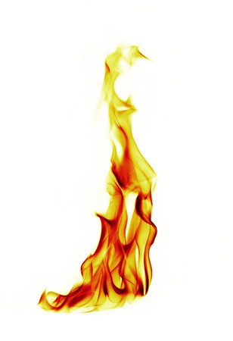
FIPP and FIP-MO
Content covered
Understanding offending
Fire interest and fire safety
Mood and coping
Communication and relationships
Offense supportive thinking
Collaborative, multi-agency approach

Slide 15
Fire safety awareness work
Partnership working:
Meet with psychologists beforehand
Ensure materials are appropriate
Tailored to client’s needs
Fire safety work:
Fire triangle
Fire spread
Unintended effects of firesetting
Ripple effect

Slide 16
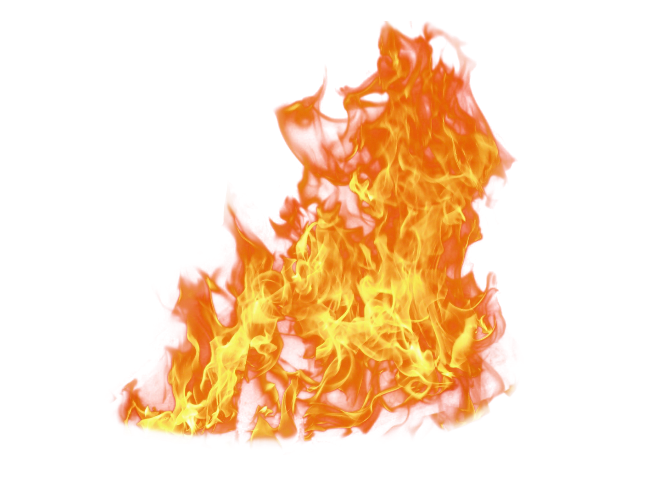
Do the treatments work?
Key improvements in the following areas:
Fire-related factors
Serious Fire Interest
Identification with Fire
Fire Safety Awareness
Coping and emotional issues
Offense supportive attitudes
Violent Attitudes
Antisocial Attitudes
(Gannon et al., 2015; Tyler et al., 2017)

Slide 17
What do clients think?
“One of the best things about the group was learning about the dangers of fire.”
“I thought that the group was good. I particularly liked the fire safety officer sessions. They were really meaningful and will help me in the future.”
“I got a better understanding about myself than I did before and also it made me think twice about fires. Made me realise they were more dangerous than I thought.”
“Understanding my own experience with fire. How dangerous it could have been.”

Slide 18
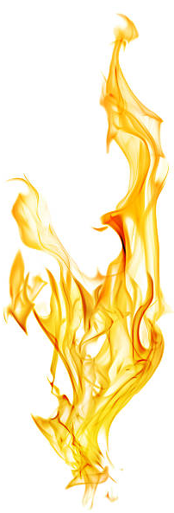
Do the treatments work? New research
Longitudinal studies
7 or 10 year follow up
Impact on behaviour
reduction in firesetting incidents or criminal behaviour in general?
Difference between 1:1 or group treatment?
What if people drop out of the treatment?

Slide 19
Summary
Adult firesetting = under-recognised area
FIPP and FIP-MO = specialist treatment programmes
Importance of multi-agency approach
Key reductions in risk factors after treatment
Impact on firesetting incidents?

Slide 20
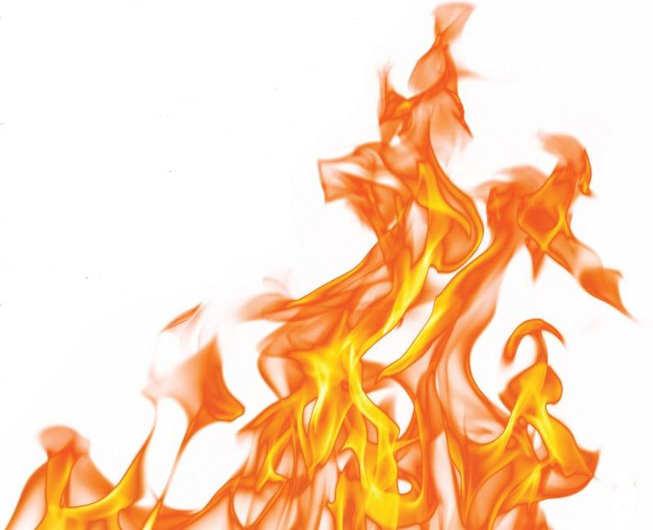
ANY QUESTIONS?
k.l.sambrooks@kent.ac.uk
@KatieSambrooks

