Slide 1
FIRESETTING RECIDIVISM/ A META-ANALYSIS
Katie Sambrooks
CORE-FP, School of Psychology, University of Kent;
Kent and Medway NHS and Social Care Partnership Trust.
CO-AUTHORS:
Professor Theresa Gannon (University of Kent; KMPT)
Dr Mark Olver (University of Saskatchewan)
Dr Tom Page (University of Derby)
Notes:
V1.0
To change the footer on every slide:
1. On the menu go to Insert > Header and Footer…
2. Select the Footer checkbox and enter the footer text in the accompanying text box
3. Click “Apply to All”

Slide 2
Deliberate Firesetting
83,221 deliberate fires
1,014 injuries
50 fatalities
(2018/19 figures; Home Office, 2019)

Slide 3
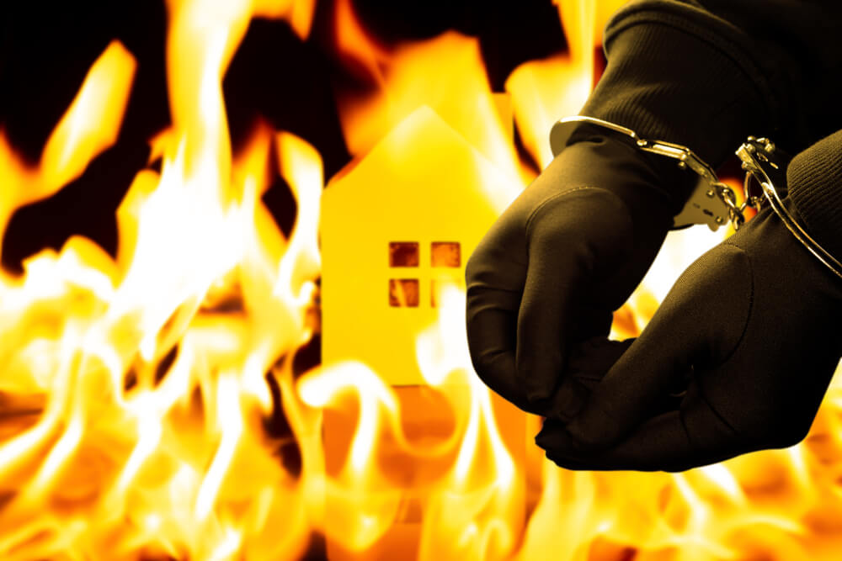
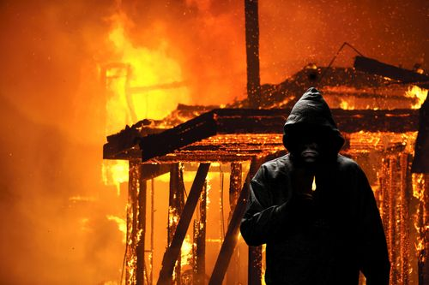
Recidivism
Under-researched area
Early literature → arsonists = dangerous (Brett, 2004)
But evidence to support?

Slide 4
Existing Reviews

Slide 5
Existing Reviews
Large variability in rates of recidivism
Differences in recidivism definition, sample used, and if prospective: length of follow-up
Difficulties in risk assessment without base rate

Slide 6
New research: Meta-Analysis
Comprehensive review of prospective follow-up studies
Juveniles and adults
Firesetting & any recidivism
Aim:
Establish base rate of recidivism amongst untreated firesetters
Notes:
Study inclusion criteria
Include sample of firesetters that have not undergone fire-specific treatment.
Include a follow-up period.
Report either firesetting recidivism or any recidivism
Evaluations of treatment programmes without an untreated control group are excluded.
Retrospective studies comparing offenders with or without prior offences are excluded.

Slide 7
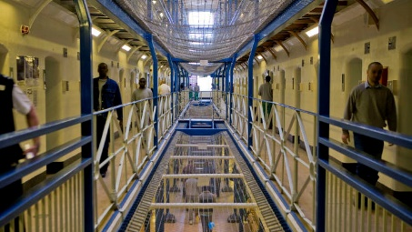
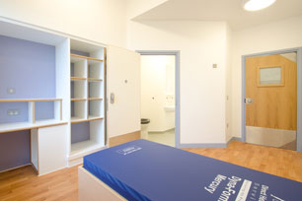
Samples included
25 samples → 12,294 participants
From UK, mainland Europe, North American, Australia and New Zealand
Variety of settings:
Pre-trial assessments
Psychiatric facility
Prison
Court records

Slide 8
Definitions of Recidivism
From variety of sources:
Convictions
Arrests/charges
Police contact
Institutional records
Parent/self-report
Arson
Firesetting
General Recidivism
More informal sources tended to generate higher estimates

Slide 9
Definitions of Recidivism
From variety of sources:
Convictions
Arrests/charges
Police contact
Institutional records
Parent/self-report
Arson
Firesetting
General Recidivism
“Recidivism was operationally defined as having any subsequent charge for arson or arson-related offences” (Ducat, McEwan, & Ogloff, 2014)

Slide 10
Definitions of Recidivism
From variety of sources:
Convictions
Arrests/charges
Police contact
Institutional records
Parent/self-report
Arson
Firesetting
General Recidivism
“Firesetting was defined as an event in which any type of property, however small, was consumed by fire as a result of action by the child”
(Strachan, 1981)

Slide 11
Definitions of Recidivism
From variety of sources:
Convictions
Arrests/charges
Police contact
Institutional records
Parent/self-report
Arson
Firesetting
General Recidivism
“Recidivism was defined as a conviction or detainment for any offence that occurred during the 10-year follow-up period”
(Edwards & Grace, 2013)

Slide 12
Base rate of recidivism
Using random effects models…
8% were reported to have committed arson
20% engaged in the more broadly defined firesetting recidivism
57% engaged in general recidivism

Slide 13
Age
Juvenile samples were observed to have the highest rates of firesetting recidivism
Younger samples had higher rates of general recidivism.
Gender
Only 7.3% of firesetters were female.
Samples with fewer females had higher rates of general recidivism

Slide 14
Compared to other offenders?
Firesetters
Firesetters had a 5-6 times greater odds of firesetting recidivism
Non-Firesetting Offenders
vs.
35.5%
9.7%
engaged in firesetting recidivism or recidivistic arson
Notes:
Again – this is hugely important since lots of people are still arguing that you don’t need to treat firesetters with specialized treatment!

Slide 15
Implications
Criminally versatile
Deliberate firesetting = persistent problem
Need for prevention and intervention work
Collaborative multi-agency approach
Notes:
To successfully reduce the recurrence and widespread effects of deliberate fire-setting, a new two-pronged approach that effectively targets adults and young people is needed. First, given what we know about unidentified fire-setters, prevention efforts should be aimed at adolescents and young adults.

Slide 16
Collaborative approach
Specialist psychological treatment programmes for adult firesetting
Fire safety awareness = key element
Collaboration with Fire and Rescue Service crucial

Slide 17
FIRESETTING RECIDIVISM/ A META-ANALYSIS
First meta-analysis examining recidivism of individuals with history of firesetting
Substantial number go on to reoffend
Base rate will assist with defensible risk assessment
Need to be the focus of both research and clinical work

Slide 18
ANY QUESTIONS?
k.l.sambrooks@kent.ac.uk

