Slide 1
Whittington Health Service Training 26th January 2018 ‘Rosie 2’: Assessing risks to children and making informed decisions Professor Jane Reeves Vanisha Jassal Centre for Child Protection

Slide 2
Aims of the day JR
Demonstrating the versatility of ‘Rosie 2’ in providing a platform to reflect and learn about key child assessment and protection issues and practice Morning:
Introduction to ‘Rosie 2’ and the value of simulative learning for child protection professionals – we are going to model some of the approaches you can use in staff training with the simulation
Recent research into child neglect
Learn about the concept of ‘mentalisation’ to develop child-centred practice and a deeper understanding of infant-caregiver interactions;
Afternoon:
Understanding the wishes and feelings of children and young people and mentalisation
Examine the relevance of reflective supervision
Analyse how concerns and assessments lead to making a final decision.
Encourage you to think about how you are going to use the resource

Slide 3
Activity: Character journey and experiences JR
During the scenes throughout the day, consider the journey and experiences of the family member which you have been given. We will come together as a group in the afternoon to discuss this.
Thank you.

Slide 4
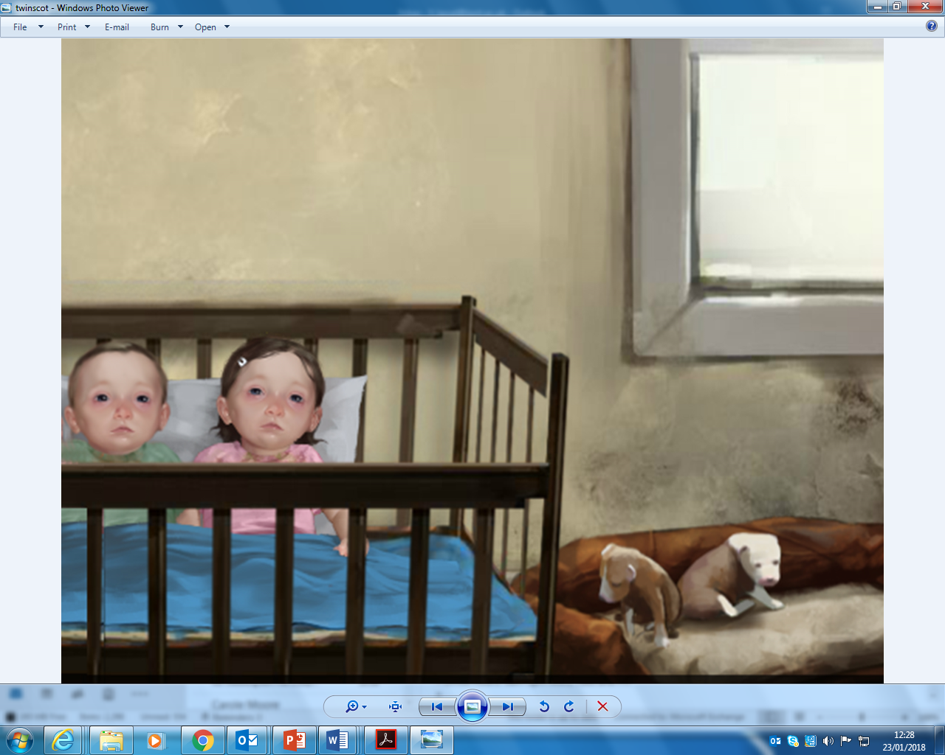
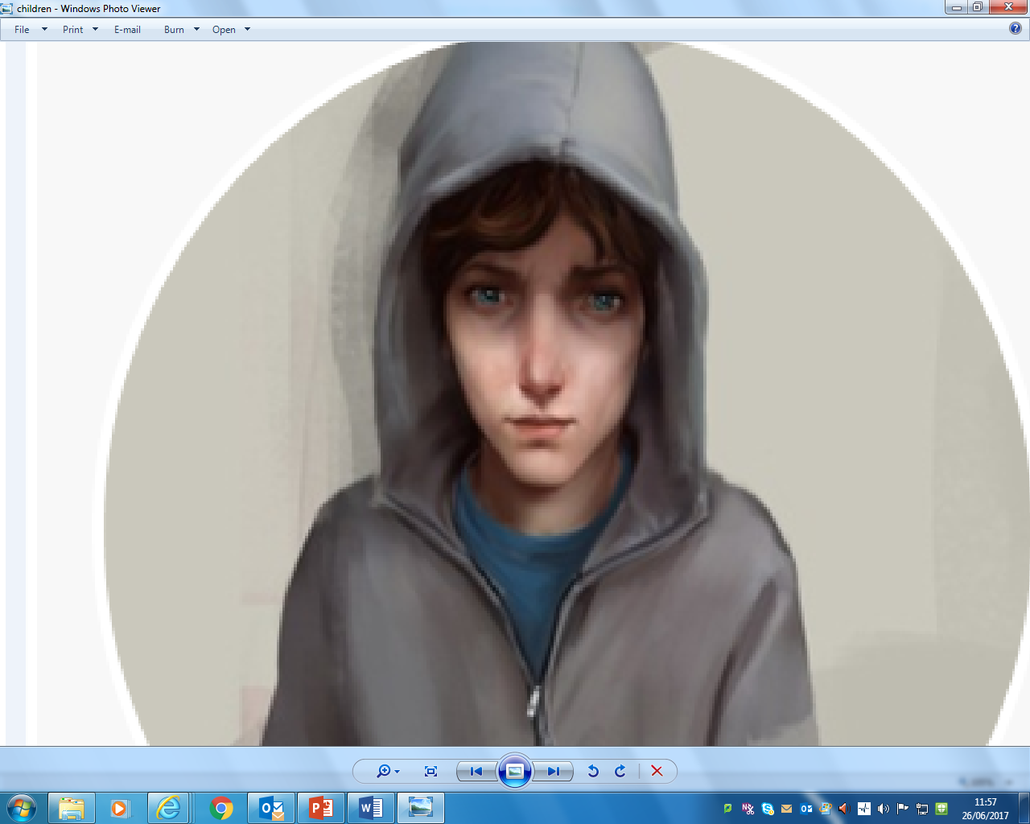
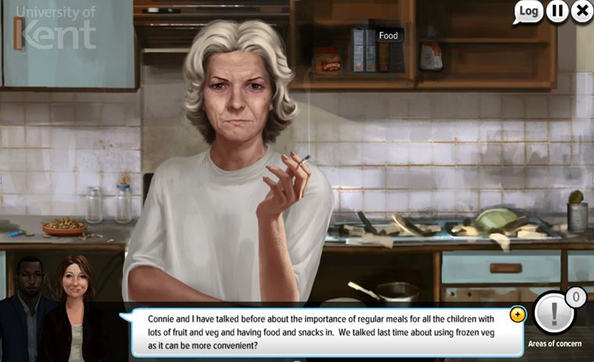
Character life journeys JR
Jade and Charlie: 10 month twins
Mum Connie
Trevor: aged 14
Nan Tiffany
Rosie: aged 9

Slide 5
Let’s meet Rosie and her family JR
Scene 3: In the Garden

Slide 6
BARRY
Social Grandfather
TIFFANY
Grandmother
NAME UNKNOWN
DEL
Current Partner
CONNIE
Mother
BRUCE
DANNY
UNBORN
JADE
10 months
CHARLIE
10 months
ROSIE
9 Years
TREVOR
12 Years

Slide 7
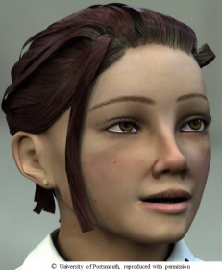
“Innovation is taking two things that already exist and putting them together in a new way” (Tom Freston).

Slide 8
Child abuse is evolving, pervasive and complex… JR
We had a vision for a Centre which captured the best of contemporary technology and gaming techniques to help professionals & children learn in a modern way to help them to protect children and ultimately help children to protect themselves
Put simply…it is a dangerous world on and off line….

Slide 9
What is our approach?
World class international distance learning MA in Advanced Child Protection for all professionals to safeguard children – high quality resources from international experts in child protection
Innovative training simulations with versions for professionals & young people
Working with strategic stakeholders (Home Office and DfE) to build simulations to take directly to young people to help them protect themselves
Research based, branded robust products
Inter-professional
UK and International reach with training run at the University and outreach delivering directly to organisations
Part of a Erasmus+ project; social work training across Europe
Tackling hard hitting topics – sexual abuse, neglect, grooming, CSE, radicalisation

Slide 10
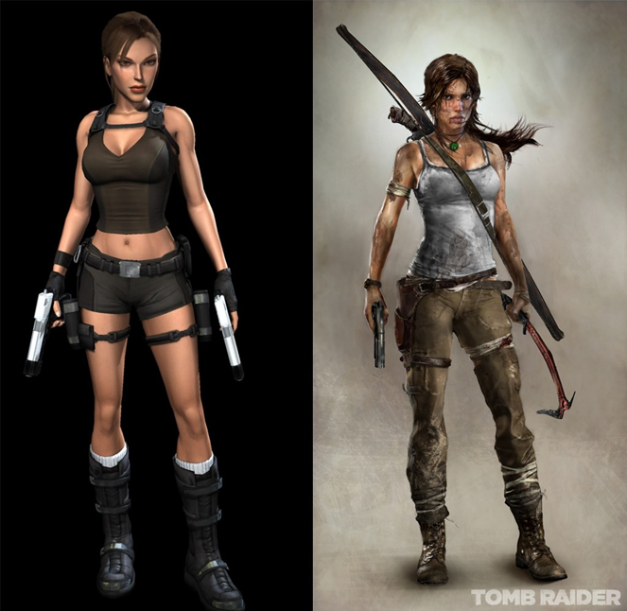
The use of simulations for training professionals and protecting children – why?

Slide 11
How do people learn best?
90% of what they learn when they teach someone else/use i90% of what they learn when they teach someone else/use immediately.
75% of what they learn when they practice what they learned.
50% of what they learn when engaged in a group discussion.
30% of what they learn when they see a demonstration.
20% of what they learn from audio-visual.
10% of what they learn when they’ve learned from reading.
5% of what they learn when they’ve learned from lecture.
http://www.ndt-ed.org/TeachingResources/ClassroomTips/Constructivist%20_Learning.htm
mmediately.
75% of what they learn when they practice what they learned.
50% of what they learn when engaged in a group discussion.
30% of what they learn when they see a demonstration.
20% of what they learn from audio-visual.
10% of what they learn when they’ve learned from reading.
5% of what they learn when they’ve learned from lecture.
http://www.ndt-ed.org/TeachingResources/ClassroomTips/Constructivist%20_Learning.htm
90% of what they learn when they teach someone else/use immediately.
75% of what they learn when they practice what they learned (kinesthetic learning)
50% of what they learn when engaged in a group discussion (auditory learning)
30% of what they learn when they see a demonstration (visual learning)
20% of what they learn from audio-visual.
10% of what they learn when they’ve learned from reading.
5% of what they learn when they’ve learned from even the best lecture.
http://www.ndted.org/TeachingResources/ClassroomTips/Constructivist%20_Learning.htm

Slide 12
Uses and benefits of the virtual
environment for training
Engaging (Hearrington 2010)
Formation of online communities & discussion groups
High course/CPD performance and discussion (Hornik & Thornburg 2010)
Immersion and interaction in a ‘safe’ space (DeNoyelles et al 2014)
Offers experiential learning (Kolb 1984) which many people thrive on (Bolan 2003)
Learner centred rather than teacher led – the ‘teacher’ becomes the facilitator rather than disseminator (Carver et al 2007)
Enables ‘mentoring’ across practice experience
Enables us to evaluate practice in different ways (Reeves et al 2015)

Slide 13
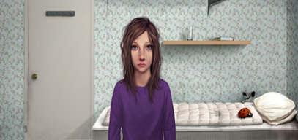
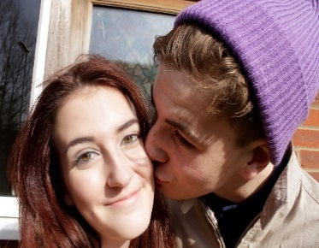
Our simulations
‘Rosie 1’ on sexual abuse (2011)
‘Rosie 2’ on complexity and neglect (2012)
‘myCourtroom; Rosie’s family go to court’ on court work (2017)
‘Zak’ on radicalisation (2014)
‘Looking out for Lottie’ on CSE (2015)
‘Maryam and Joe; behind closed doors’ on radicalisation (2017)
‘Visiting Elliot’ on managing a sex offender in the community (2014)

Slide 14
Prevalence of neglect
Neglect is the main concern in 43% of CPP in England (DfE 2015)
Following assessment neglect is identified in 16.5% of all family assessments (DfE 2015)
It is a background feature in many SCR (Brandon et al 2012/3)
The combination of neglect factors in some families make in utero, babies, young children and teenagers particularly vulnerable to neglect including families with 4 or more children, a mother with low self esteem, invisibility of some men in some families (Brandon et al 2010; Davies 2011)
Neglect was evidence in the majority (60%) of SCR between 2009-11 (Brandon et al 2012)

Slide 15
What are the key issues in child neglect? (what does the child need me to do?)
The impact of unmet needs on children and the severity of this
Developmental & well being effects on children
Parental omissions or deficits & if they will accept help and make changes ‘complex inter-play of factors for parents’ (Brandon 2008)
Do professionals recognise it and then respond? How do they respond?
This is often linked to the debate and anxiety about thresholds – are they neglected enough?
What does intervention look like?
Lack of consistency across UK
(Daniel 2015: ‘Why have we made neglect so complicated?)

Slide 16
Alcohol or drug misuse
Domestic violence
Maternal depression
Number of children 4+
Missing appointments

Slide 17
How to work more effectively
More rigorous approach to charting children’s development and progress and using this in court
More overt use of contracts with parents
Key yet specific problems need to be directly addressed
Therapeutic help needs to be targeted to children
Cases need follow through & consistency
Not awaiting a ‘trigger event’ before intervening
To be aware of start again syndrome and giving too many chances
Assessing for real parental engagement
Clear case recording for court
Be mindful of inappropriate case closure
Joint visits with a fresh pair of eyes
(Farmer & Lutman 2015)

Slide 18
Pre-visit feelings and thoughts (what do we sometimes feel at this stage?)
Scene 1:
In Andrew’s Office
Scene 2: Outside the property

Slide 19
Emotions in the workplace VJ
Ingram, R. (2016). ‘Emotions, social work practice and supervision: an uneasy alliance?’. Journal of Social Work Practice, 27 (1), pp5-19.
‘The relationship between rational thought and emotions is often depicted as an uneasy alliance’ (page 8) but it is argued that there is compatibility and intrinsic linking of the two (page 9);
‘if one does separate off one’s emotions from practice, then one is essentially separating the relationship with the service user’ (page 5);
‘social workers must be engaged in deep analysis of their practice and be clear about their own perceptions and those of others’ (page 13);
SWs had an underdeveloped ‘language’ when it came to describing feelings;

Slide 20
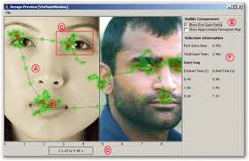
Eye-tracker research JR
Using simulations means you can evaluate in different ways – using eye tracker and facial recognition software. See Reeves et al 2015

Slide 22
Assessing the parenting capacity of Connie A mentalization-based approach

Slide 23
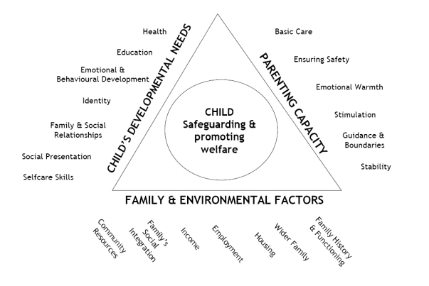
Assessment Framework
DoH. (2001). Assessing Children in Need and their Families: Practice Guidance. The Stationery Office, Norwich.

Slide 24
Mentalisation
Parental Reflective Functioning (PRF)
“One of the capacities that define the human mind is the ability to take account of one’s own and others’ mental states and, thus, to understand why people behave in specific ways” (Fonagy et.al., 1991, p.203).
PRF is an overt manifestation of an individual’s mentalising capacity….it is a parent’s capacity to hold the child’s mental states in mind. (Slade, 2005)

Slide 25
In everyday language……..
It’s when you are aware that what others may be thinking and feeling may be different to what you are thinking and feeling;
Facilitates our ‘curiosity’ to understand our own mental states and that of others;
It is the capacity to understand how one’s own and other people’s mental states affect behaviour;
Much of this ‘activity’ takes part in the unconscious part of the brain;
Babies can interpret the mental state of the mother from a few months old.

Slide 26
Why do we need to understand these concepts in child protection work?
“risk of children being harmed by their parents can be heightened when the psychological distance between the worker and parent…widens” (Howe, 2010; p.332)
“The majority of parents who maltreat their children have problems mentalising their children’s psychological condition. Their own histories tend to be ones of rejection, abuse, neglect, trauma and loss. Never having been recognised as an independent, complex psychological being themselves, they have problems relating to their children as complex, separate psychological beings” (Howe, 2010; 336).

Slide 27
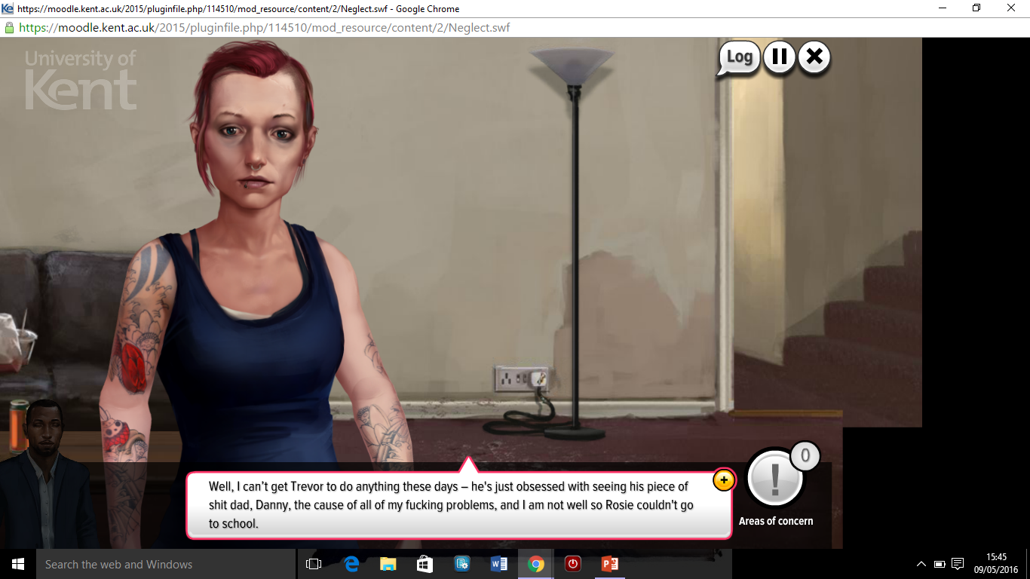
Scene 5: Andrew and Connie, in the living room Complete Mentalisation Worksheet

Slide 28
Mentalization-based assessment in practice
‘So tell me what it’s like being a mum’
‘So what’s your child feeling here?’
‘What do you think that cry means?’
If your child could speak, what do you think she’d be saying/have said?
What do you do to show them that you love them?
One mother began to tease her child when he cried after catching his finger in the door: “You’re a faker”, mocking him. Health Visitor: “Ooh, that hurt. You’re kinda scared and want Mommy to make it feel better” (Presentations by Arietta Slade and Peter Fonagy)

Slide 30
Physical signs of neglect JR
Scene 6: In Kitchen
What is causing you concern here?
How should the food for the children be addressed considering it has been discussed many times before?

Slide 31
Mentalising children and young people
There is “evidence that practitioners can become desensitised to evidence of neglect or so overwhelmed by parents difficulties that they are unable to see the situation clearly and the child’s unmet needs” (Davies and Ward 2010; p.9).

Slide 32
The importance of a strong knowledge and skills base for undertaking Direct Work
“Participation can be empowering if undertaken well. However, practitioners may feel ill-equipped to communicate with children and involve them at every stage of the child protection process….the core skills required for effective communication with children….include listening, being able to convey genuine interest, empathic concern, understanding, emotional warmth, respect for the child, and the capacity to reflect and to manage emotions (Munro, 2011; page 25). Munro, E. (2011). The Munro Review of child protection: a child-centred system. (London: Department for Education).

Slide 33
The policy framework: a reminder
UN Convention on the Rights of the Child (UNCRC): ‘…….the right to express their views, feelings and wishes in all matters effecting them, and to have their views considered and taken seriously (article 12).
1989 Children Act: local authorities must‘…..ascertain the wishes and feelings of children’.
Working Together (2015): ‘anyone working with children should see and speak to the child; listen to what they say; take their views seriously and work with them collaboratively when deciding how to support their needs’ .

Slide 34
“The review has …shown…that despite the significant history known to various agencies, no single practitioner or service knew what life was like for Child T [Poppy] or the extent to which she was exposed to risk and harm on a daily basis’ (pages 14-15).
North East Lincolnshire Local Safeguarding Children Board. Serious Case Review Report Child T (Poppy Widdison).

Slide 35
What’s it like to be in this family? JR
In small groups discuss what it feels like to be the character on your card.

Slide 36
Scene 9:
In the Bedroom Complete Direct Work Worksheet

Slide 37
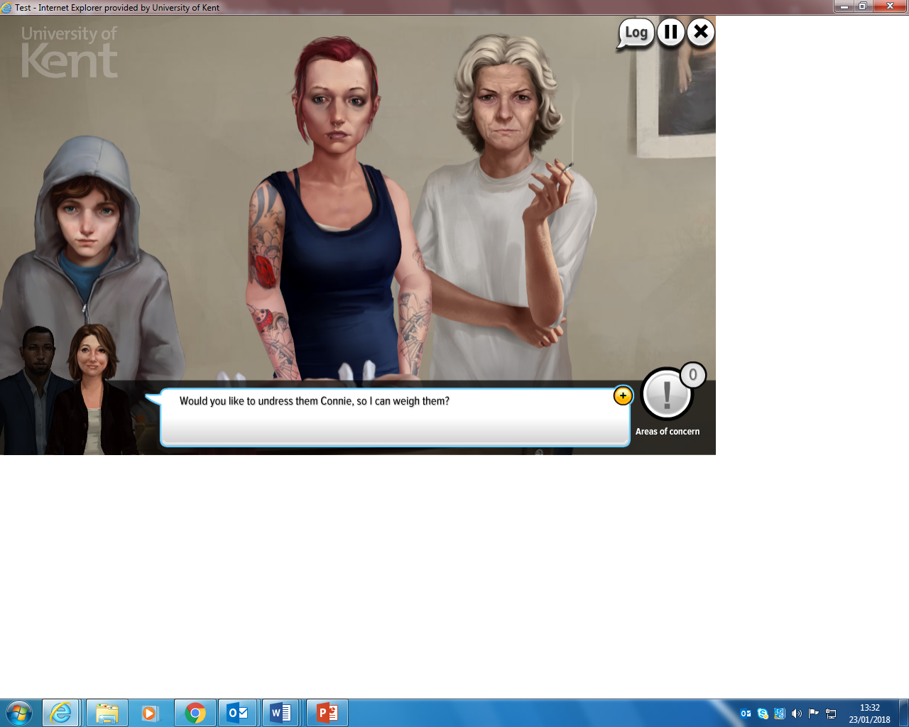
Scene 10:
Downstairs in the Living Room Complete Direct Work Worksheet

Slide 39
Highlighting the need for practitioners to work through their emotions: a case for “emotionally inclusive supervision”

Slide 40
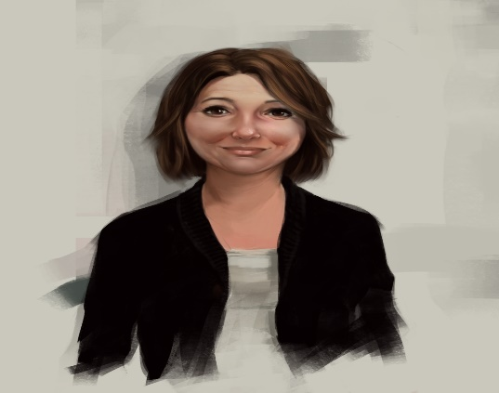
Being Beth
Having watched some of the relevant scenes, what anxieties do you have ?
What would you want to say to Connie during this visit?
What points would you make about the joint visit with Andrew?
How are you left feeling after all this?
What would you expect from your next supervision of this case?

Slide 42
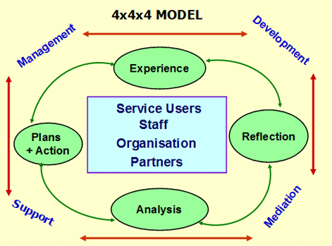
The 4x4x4 Integrated Model of Supervision (Tony Morrison)
Morrison T. and Wonnacott, J. (2010). ‘Supervision: Now or never. Reclaiming Reflective Supervision in Social Work’. Available from: http://www.in-trac.co.uk/supervision-now-or-never/
Notes:
Supervision is a complex activity and there is a need for an integrated model. Traditionally supervision policies refer to a three or four function model of supervision including management, professional development, emotional support and (sometimes) mediation. This task-focused approach fails to take account of the interaction between these functions, or identify the role of the supervisor in facilitating critical analysis of practice. It also frequently fails to situate the dynamics of the supervisory process within the wider organisational or inter-agency context.
The integrated 4x4x4 model ⁽¹⁴⁾ provides a coherent, practical, and well-tested framework to integrate these different but connected elements of supervision. It is comprises:
This model integrates the four functions of supervision, with the reflective supervision cycle and focuses on the needs and priorities of the four stakeholders. At the heart of this model is the principle, demonstrated by the Supervision-Outcome chain (Fig 1) that supervision is part of the intervention with service users. Management
Focusing on the interests
of people who use services
and quality of practice Support
Focusing on the emotional
impact of the work and any
resulting stress or support
Needs Mediation
Ensuring role clarity and
effective multi-agency
Working Development
Self-evaluation and
building professional
capability

Slide 43
Research on supervision in social care
Despite the many of models of supervision, few, if any, are based on empirical research
In 1996 the Association of Directors of Social Services identified supervision as one of the five elements of good practice (Morrison and Wonnacott, 2010);
“There is concern that the tradition of deliberate, reflective social work practice is being put in danger because of an overemphasis on process and targets, resulting in a loss of confidence amongst social workers. Regular, high quality, organised supervision is critical (Laming, 2009; page 32).
Serious Case Reviews are often highlighting the fundamental importance of supervision to critical thinking around practice.

Slide 44
Decision-making
What would you consider before making a decision about the twins (and Rosie and Trevor )?
Would your next steps be to remove the children or leave them in the home ?;
Write a one page report on your action points and recommendations for this case – what is your evidence and justification for your decision?

Slide 45
Some core theories for ‘Rosie’
Psychoanalytic theory: Sigmund Freud “the mind of the client and its workings had to be understood if real change and permanent improvement was to be achieved” (Howe, 2009; p.29);
Attachment theory: John Bowlby Emphasis upon infant – carer relationship and identification of attachment styles;
Systems theory: Urie Bronfenbrenner The individual is affected by an interaction between the micro and macro factors surrounding him/her: from the intimate, close family relationships to the broader economic, political and cultural factors.
We need to encourage our professionals to engage in relevant theories to better understand the behaviour of children and families.

Slide 46
How are you going to use Rosie in your organisation?
Consider your teams, the individuals you want to target
Timings
Theme by theme
Drop it into an existing CPD structure

Slide 47
References
Cuthbert et al (2011). ‘All Babies Count: Prevention and Protection for Vulnerable Babies’. London: NSPCC.
Department for Education (2010). ‘Building on the learning from Serious Case Reviews: A Two Year analysis of Child Protection Database Notifications 2007-2009. DFE-RR040.
Department for Education (2011). ‘Safeguarding Children Across Services: Messages from Research on Identifying and Responding to Child Maltreatment. DFE-RBX-10-09.
Department for Education (2011). ‘The Munro Review of Child Protection: Final Report’. The Stationery Office Limited.
Ferguson, H. (2014). ‘What Social Workers do in Performing Child Protection Work: Evidence from Research into Face-to-Face Practice’. Child and Family Social Work, doi:10.1111/cfs.12142.
Ferguson, H. (2010). ‘Therapeutic journeys: the car as a vehicle for working with children and families and theorising practice’. Journal of Social Work Practice, V.24(2), pp 121-138.
Fonagy, P., Gergely, G., Jurist, E.L. and Target (2002). ‘Affect Regulation, Mentalization, and the Development of the Self’. (Karnac Books Ltd, London).
Fonagy, P. (2002). ‘The Internal Working Model or the Interpersonal Interpretative Function’. Journal of Infant, Child, and Adolescent Psychotherapy. V.2(4), pp27-38.
Fonagy, P., Steele, M., Steele, H., Moran, G.S. and Higgitt, A.C. (1991). ‘The Capacity for Understanding Mental States: the Reflective Self in Parent and Child its significance for Security of Attachment’. Infant Mental Health. V.12(3), pp201-218.
Fraiberg, S.A. (1975). ‘Ghosts in the nursery. A psychoanalytic approach to the problems of impaired Infant-Mother Relationships’. Journal of the American Academy of Child Psychiatry. V.14(3), pp387-421.
Handley, G. and Doyle, C. (2014). Ascertaining the wishes and feelings of young children. Child and Family Social Work, V.19, pp 443-454.
Healy, K. (2014). ‘Social Work theories in context: Creating frameworks for practice’. (Basingstoke: Palgrave Macmillan).
Howe, D. (2010). ‘The Safety of Children and the Parent-Worker Relationship in Cases of Child Abuse and Neglect’. Child Abuse Review. V.19, pp330-341.
Howe , D. (2009). ‘A brief introduction to social work theory’. (Basingstoke: Palgrave Macmillan).

Slide 48
References
HM Government (2015). ‘Working Together to Safeguard Children. A guide to inter-agency working to safeguard and promote the welfare of children’.
Ingram, R. (2012). ‘Emotions, social work practice and supervision: an uneasy alliance?’. Journal of Social Work Practice, V.27(1), pp 5-19.
Laming, L. (2009). ‘The Victoria Climbié Inquiry’. (The Stationery Office).
Moran, P. (2011). ‘Neglect: Research Evidence to Inform Practice’. Action for Children.
Mor Barak, M.E. et al. (2009) ‘The impact of supervision on worker outcomes: a metaanalysis’. Social Service Review, Vol.83(1), pp. 3−32.
Morrison, T. and Wonnacott, J. (2010). ‘Supervision: Now or never. Reclaiming Reflective Supervision in Social Work’. Available from: http://www.in-trac.co.uk/supervision-now-or-never/. [Accessed 19 July 2016].
Munro, E. (2011). ‘The Munro Review of child protection: a child-centred system. (London: Department for Education).
North, J. (2014). ‘Mindful therapeutic care for children’. (Jessica Kingsley Publishers).
Richards, S., Ruch, G. and Trevithick, P. (2005). Communication skills training for practice: the ethical dilemma for social work education. Social Work Education, V.24 (4), pp.409–422.
Shemmings, D. and Shemmings, Y. (2011). ‘Understanding Disorganised Attachment’. (Jessica Kingsley, London).
Slade, A. (2005). ‘Parental Reflective Functioning: An Introduction’. Attachment & Human Development. V.7(3), pp269-281.
Winnicott, C. and Kanter, J. (1997). ‘Communicating with Children’. Smith College Studies in Social Work. V.67)2), pp115-178.

Slide 49
Scene 13:
Interviewing Rosie
What do we know about the trauma of child sexual abuse?
How can we ensure that Rosie’s voice is heard?

