Slide 1


Direct Work with Children and Young People: a new perspective
London Borough of Bromley
Vanisha Jassal and Laura Hanbury

Slide 2
Icebreaker
Welcome and Introductions
The Centre for Child Protection
Group discussion: what we all understand by the term ‘Direct Work’
Today’s Agenda

Slide 3
What do we mean by direct work?
It’s more than just talking and listening and goes beyond ascertaining wishes and feelings;
It is about understanding the inner world of the child;
Purpose should always be to help the child/yp communicate with us;
So that we can truly SEE and HEAR what they are expressing to us, verbally or through their behaviour;
It should entail a specific piece of work through employing certain tools/techniques;
Always ask permission from the child/young person before starting the direct work with him/her.

Slide 4
When direct work may be carried out
Helping traumatised children and young people
Gaining an understanding of children’s wishes and feelings
Gaining an understanding of children and young people’s perceptions of his/her life and experiences
Reintegration of early life events
Explaining plans for the future
Addressing current areas of concerns
Helping children to ‘keep safe’
Facilitating identity formation and increasing children and young people’s knowledge of self
Helping children gain and sustain friendships
Helping children and young people within their family relationships

Slide 5
Reviewing our direct work
As in all aspects of practice, we need to reflect upon whether the direct work we are carrying out is progressing well. It is important to consider:
What sense is the child making of the work with you?
Are the methods effective or do they need to be altered?
Whether someone else may be able to connect more with the child.

Slide 6
Research and policy frameworks
There has been a significant amount of research about direct work – see handout;
1989, 2004 Acts; UN Convention on the Rights of the Child; 2011 Munro Review:
‘Participation can be empowering if undertaken well. However, many practitioners feel ill-equipped to communicate with children and involve them at every stage of the child protection process…the core skills required for effective communication with children ….include listening, being able to convey genuine interest, empathic concern, understanding, emotional warmth, respect for the child, and the capacity to reflect and to manage emotions’ (Munro, 2011; page 25).

Slide 7
Today’s Aim
To increase practitioner confidence in undertaking effective direct work practice through providing a reflective space in which we can appreciate the relationship between:
hearing/observing children and young people, mentalisation
and
our own feelings.

Slide 8
Learning Outcomes for today
Morning:
Remind ourselves of the importance of effective direct work skills.
Utilise a technique which may support children in care.
Develop our definition of ‘direct work’ through the concept of ‘mentalisation’: “Just because you don’t show emotion, doesn’t mean you don’t feel emotion”.
Examine some of the barriers to effective direct work including how it makes us feel.
Participate in specific direct work activities.
Afternoon:
Getting us to think outside of the box and develop our communication skills in a creative and innovative way.
Continue active participation in direct work activities.
Expanding our knowledge about using technology in direct work interactions.
Bringing direct work to a close and how we need to be supported.

Slide 9



Ground rules
Listen, Think and Reflect throughout the day;
During the 6 direct work activities, do not talk but stick to the activity in hand and see the activities as real direct work interactions;
Complete the activities as YOU but during the day, keep the children/young people you typically work with in your mind;
Be sensitive to your own feelings and the feelings of others;
Switch your phone on silence and try to only check it during tea/lunch breaks.
Not a rule but please feel free to speak to the facilitators if you feel uncomfortable or concerned about anything.

Slide 10
Direct Work Activity 1:
Mapping the Life of a Looked After Child
Watch the ‘ReMoved’ film:
https://www.youtube.com/watch?v=lOeQUwdAjE0
How did the film make you feel?
Does the film resonate with any of the (looked after) children you may be working work?
Have a Scribble – Get Creative and warm up for the River/Road Activity.
Complete the Activity and Feedback
The Michaelamovement blog: https://michaelamovement.blog/2017/11/10/safeguarding-in-practice/

Slide 11
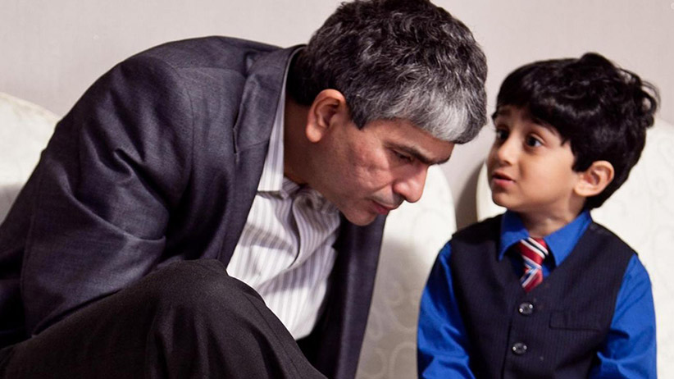

Slide 12


Slide 13

An attempt to portray a child’s perspective (by Radio 4)
http://bobnational.net/record/204596

Slide 14


Slide 15

Mentalisation
“One of the capacities that define the human mind is the ability to take account of one’s own and others’ mental states and, thus, to understand why people behave in specific ways”
(Fonagy et.al., 1991, p.203).

Slide 16
In everyday language……..
It’s when you are aware of what is going on in your head and in the heads of other people;
It’s when you are aware that what others may be thinking and feeling may be different to what you are thinking and feeling;
It facilitates our ‘curiosity’ to understand our own mental states and that of others;
It is the capacity to understand how one’s own and other people’s mental states affect behaviour;
Much of this ‘activity’ takes part in the unconscious part of the brain;
Babies can interpret the mental state of the mother from a few months old.

Slide 17
BARRY
Social Grandfather
TIFFANY
Grandmother
NAME UNKNOWN
DEL
Current Partner
CONNIE
Mother
BRUCE
DANNY
UNBORN
JADE
10 months
CHARLIE
10 months
ROSIE
9 Years
TREVOR
12 Years

Slide 18
Direct Work Activity 2:
‘Rosie 2’: Mentalising Rosie or Trevor
Read the Biography and Genogram
Scene 3 in the Garden
As two groups discuss what we think Rosie or Trevor may be feeling about their life and that this is the fifth SW coming into their home , and what we would do to try and work with Rosie/Trevor.

Slide 19
Direct Work Activity 3: The Feelings Cards
Scene 13: Direct Work with Rosie;
As two groups discuss what this scene tells us about Rosie’s inner world and how effective is Andrew in his DW approach (note his tone, pauses, questions and tools);
Group feedback on the two activities.

Slide 20
Having a go at the Feelings Cards
Each of you have been given a feelings card;
Working in pairs, tell each other your emotion and elaborate upon what the person in the picture is feeling;
Taking turns, tell the other person when you have recently felt this emotion and then answer questions posed noting how this is making you feel; whether you are being asked the questions you want/do not want asked? whether it is feeling intrusive? whether you are reluctant to share some things?
As the person asking the questions, note whether the person is able to speak about the emotion quite easily or whether you are having to work quite hard in getting them to relate it to themselves; what did you observe from their body language; did you want to ask something else but felt that you couldn’t?
Only share what you are comfortable sharing; please remain sensitive to each other; Stop if you wish to.
Group Feedback.

Slide 21


Slide 22
Direct Work Activity 4:
Creating Your World through Sand Play
This is an intimate DW technique so remember to ask permission;
Confidentiality boundaries need to be set very clearly, making it clear to the child that information they share will be kept between the two of you unless there is a reason to share with other people/agencies;
You as a practitioner would decide on its appropriateness, according to the age and cognitive capacity of the child;
You would also decide the timing of when this intervention is introduced;
The purpose is to facilitate communication between the child and yourself in a detached and safe way;
How the information gathered is taken forward is to be discussed within the supervision/organisation context.

Slide 23
Group feedback on the sand tray technique
Only share what you wish to share;
How did the process make you feel?
What conscious or unconscious feelings arose?
Could you see yourself using it with a child/young person?
https://www.youtube.com/watch?v=bt0gF7hAqxw

Slide 24
What facilitates effective direct work?
Confidence of the practitioner;
Techniques and tools at his/her disposal;
Calm and stable environment for child e.g. foster care placement, good relations with parents;
Child development – child’s capacity to engage; cognitive ability; verbal and language skills;
Dependent upon what time in the child’s life you are placed with him/her;
Organisational support;
Introspection.

Slide 25
Supporting you the practitioner
Practitioners need to feel supported in supervision/through their organisation when carrying out direct work in terms of its emotional impact.
Ingram (2016):
‘The relationship between rational thought and emotions is often depicted as an uneasy alliance’ (page 8);
‘if one does separate off one’s emotions from practice, then one is essentially separating the relationship with the service user’ (page 5);
PRACTITIONER EMOTIONS ARE IMPORTANT TO CP PRACTICE BUT IF THEY ARE NOT PROCESSED THE IMPACT CAN BE VERY DAMAGING

Slide 26
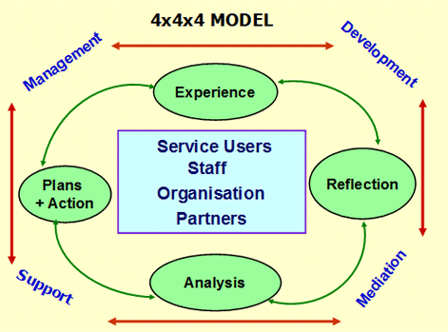
The 4x4x4 Integrated Model of Supervision (Tony Morrison)
Morrison T. and Wonnacott, J. (2010). ‘Supervision: Now or never. Reclaiming Reflective Supervision in Social Work’. Available from: http://www.in-trac.co.uk/supervision-now-or-never/

Slide 28
Direct Work Activity 5:
Keeping children safe from online grooming
‘Looking out for Lottie’: spotting the signs of CSE.
Scene 4.
Worksheets.

Slide 29
Direct Activity 6 – Further tools for Direct Work
The Shield; Three Houses; Three Islands;
Take one tool and fill it in alone as you, using pictures only;
Take it in turns to ask the other about aspects of the drawing;
The person giving the answers ought to try and give as little information as possible;
Reflect upon the process of being asked and in asking the questions.

Slide 30
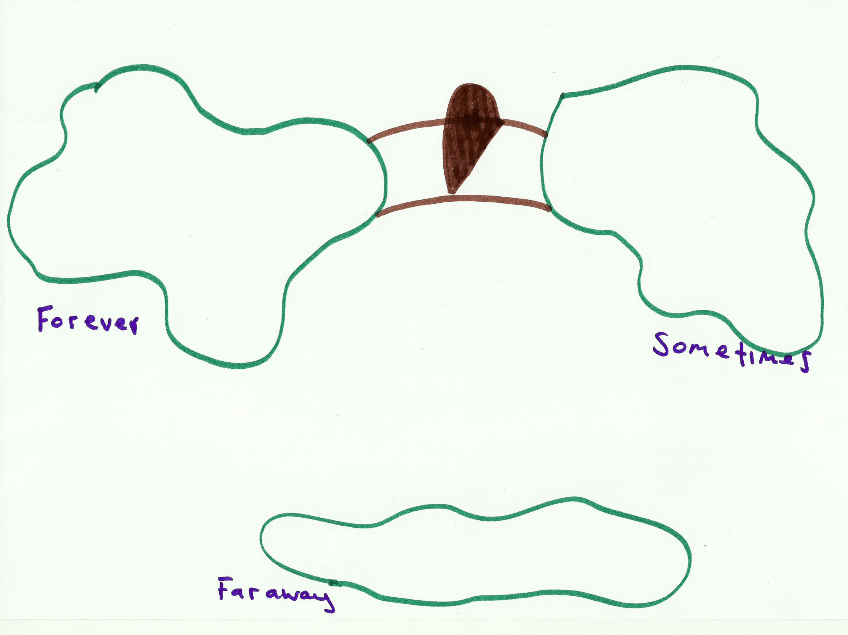

Slide 31
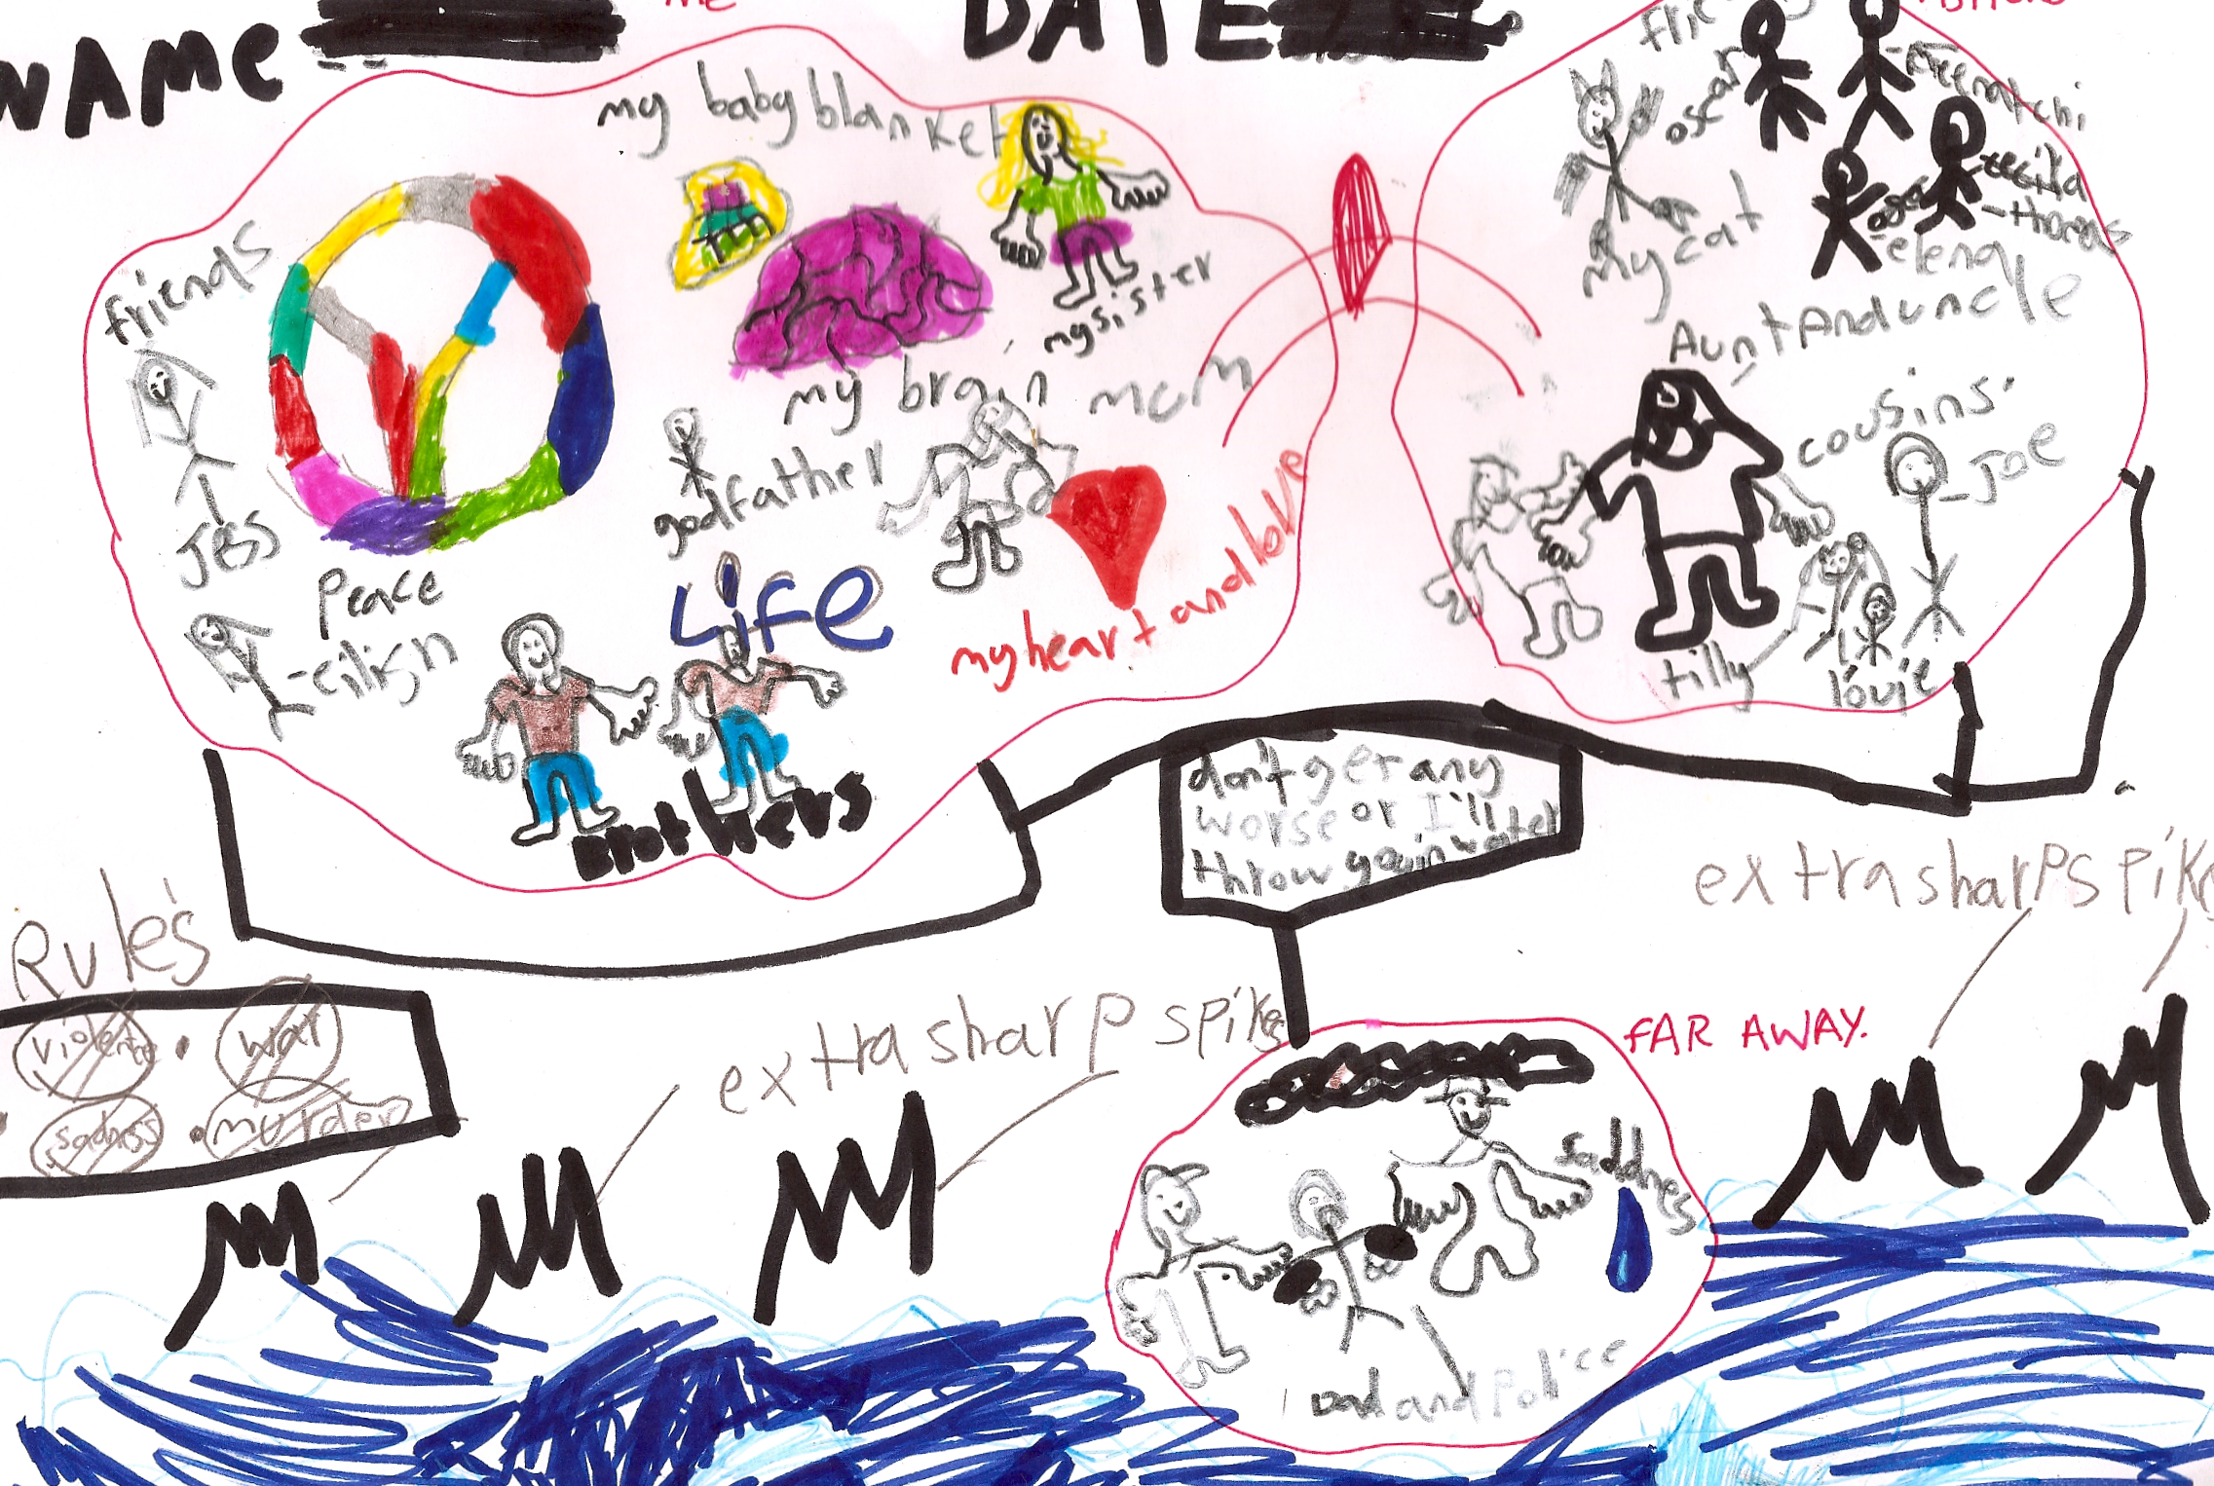

Slide 32
Technologies and Direct Work
– see handout
“computers can be beneﬁcial as an aid to assessment and therapy, as they are an effective help for children enabling them to better express their emotions, feelings and describe experiences….The medium itself is appealing to children, and the sense of familiarity with the tool, as well as the feeling of being better than adults at using it, can be empowering for the child. Furthermore, the use of a computer to mediate sensitive discussions can release some pressure from the traditional one-to-one interview, by providing an external focus to the conversation” (Grasso et al., 2013, p.318).

Slide 33
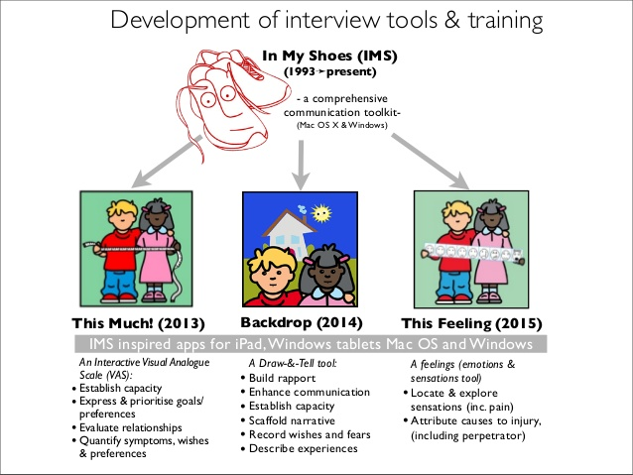
In My Shoes by
Child and Family Training
Computer assisted
Develops conversations around pictures
Advantages of not being face to face
Active participation
Everything is recorded
Lawyers have asked for IMS interviews.
‘Emotions and Scenes’ section
Can give you a completely different dimension from the child’s case file.
http://www.childandfamilytraining.org.uk/28/In-My-Shoes

Slide 34
Bringing direct work to a close
Consider:
Whether you have achieved your shared aims?
How the relationship with the child will finish or alter?
How you will mark the end or changing nature of your work with the child?
Whether the child has someone else to confide in.
Whether the child will be able to get in touch with you or another social worker if needed.
Whether the child will have the confidence or ability to seek help, or can someone act on his/her behalf?
How the process(es) made us feel.

Slide 35
Closing Reflections
Final thoughts;
What may you do differently in the future?
What can your supervisor, team, organisation do to support you?

Slide 36
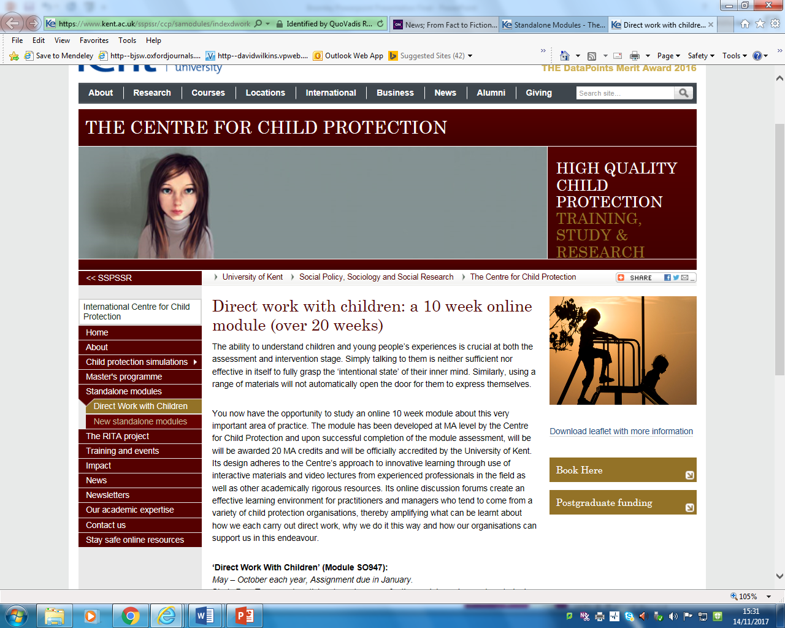
Direct Work with Children online, distance learning MA module
(Centre for Child Protection)

Slide 37
Useful further reading
Butler, I. and Drakeford, M. (2011). ‘Social Work on Trial’. (Bristol: The Policy Press).
Clark, A. and Moss, P. (2011). Listening to Young Children: The Mosaic Approach, 2nd edn. (London: National Children’s Bureau Enterprises).
Fonagy, P., Steele, M., Steele, H., Moran, G.S. and Higgitt, A.C. (1991). ‘The Capacity for Understanding Mental States: the Reflective Self in Parent and Child its significance for Security of Attachment’. Infant Mental Health. V.12(3), pp201-218.
Grasso, F., Atkinson, K. and Jimmieson, P. (2103). ‘In My Shoes’ – A computer assisted interview for communicating with children about emotions. (Humaine Association Conference on Affective Computing and Intelligent Interaction).
Ingram, R. (2012). ‘Emotions, social work practice and supervision: an uneasy alliance?’. Journal of Social Work Practice, V.27(1), pp 5-19.
Laming, W.H. (2003). ‘The Victoria Climbié Inquiry’. (TSO).
Leeson, C. (2010). The emotional labour of caring about looked after children. Child and Family Social Work, V.15, pp.483–491.
Handley, G. and Doyle, C. (2014). Ascertaining the wishes and feelings of young children. Child and Family Social Work, V.19, pp 443-454.
Lefevre, M., Tanner, K. and Luckock, B. (2008). Developing social work students’ communication skills with children and young people: a model for the qualifying level curriculum. Child and Family Social Work, V.13, pp.166–176.
Munro, E. (2011). ‘The Munro Review of Child Protection: a child-centred system’. (London: Department for Education).
North East Lincolnshire Local Safeguarding Children Board. Serious Case Review Report Child T (2017).
O’Neill, T. (2010). ‘Someone to Love Us’. (London: Harper Collins Publishers).
Richards, S., Ruch, G. and Trevithick, P. (2005). Communication skills training for practice: the ethical dilemma for social work education. Social Work Education, V.24 (4), pp.409–422.
Shemmings, D. and Shemmings, Y. (2011). ‘Understanding Disorganised Attachment’. (Jessica Kingsley, London).
Winnicott, C. and Kanter, J. (1997). ‘Communicating with Children’. Smith College Studies in Social Work. V.67)2), pp115-178.
Winter, K. (2010). The perspectives of young children in care about their circumstances and implications for social work practice. Child & Family Social Work, V.15, pp.186–195.

