Slide 1
Hampshire Health Trust Annual conference
Understanding Different Cultures and Barriers to Support and Services:
Intra-familial Child Sexual Abuse OF FEMALES within England’s South Asian Communities
VANISHA JASSAL
LECTURER AND PHD STUDENT
CENTRE FOR CHILD PROTECTION, UNIVERSITY OF KENT
19/10/2018

Slide 2
Aims of the study
To examine the concepts of ‘shame’/’sharam’ and ‘honour’/’izzat’ and how these may be influencing the disclosure and management of intra-familial child sexual abuse (CSA) within South Asian communities living in England.
To examine the extent to which being a female may prohibit the disclosure of CSA and its reporting by families.
To facilitate greater knowledge and understanding of these deeply embedded cultural concepts amongst professionals and volunteers working in child protection.
To argue for more culturally sensitive approaches, interventions and services for these communities, ensuring that victims receive the appropriate therapeutic support and measures to help them move beyond the trauma.

Slide 3
common findings across communities
Prevalence is likely to be higher than that reflected in official statistics (Office of the Children’s Commissioner, 2015; Horvath et al 2014);
Predominantly male perpetrators and female victims;
Limited disclosures due to shame, guilt, fear, concerns about breaking family relationships (Dubowitz, 2017; Lemaigre et al., 2017; Horvath et al., 2014; Herman, 1981);
Tend to disclose to mothers, followed by a friend/trusted adult;
Criminality of CSA makes interventions (understandably) heavily statutory led and punitive but does this make disclosure by families less likely?

Slide 4

THE SOUTH ASIAN story
We know that we don’t know enough (Barnardos, 2016; Office of the Children’s Commissioner, 2015; Horvath et al, 2014);
Inadequate national datasets on ethnicity (Department for Education, 2013-15);
Under-representation of Asian children registered because of ‘sexual abuse’ and those receiving relevant interventions (Gilligan and Akhtar, 2006; Moghal et al, 1995).
“In all communities, it remains difficult, and frequently traumatic, to disclose sexual abuse. In many Asian communities, some cultural imperatives appear to make it even more difficult” (Gilligan and Akhtar, 2006; page 1374).
Frontline professionals need to better understand these cultural factors (Gohir, 2013).
What are these cultural factors?
Do we really understand them?

Slide 5
SHAME (Sharam) anything that is shameful is to be avoided because it can bring dishonour upon the family – i.e. Izzat will be lost
Sexual abuse and sex per se is viewed largely as shameful
(Cowburn and Gill, 2014).
HONOUR (Izzat)
an untarnished family standing;
respect;
dignity;
reputation;
virtue.
“not only a person’s estimation of his or her own worth, but also the acknowledgement of that claim by his or her community (Gill and Brah, 2014; page 73-74).
“Mud sticks, and stays!”
We need to better understand the extent to which Sharam and Izzat enable a perpetrator to be ‘protected’ or left unexposed. Twinned with dominant patriarchal models of family life, the perpetrators are often in a very powerful position.
How significant are these concepts for CSA?

Slide 6
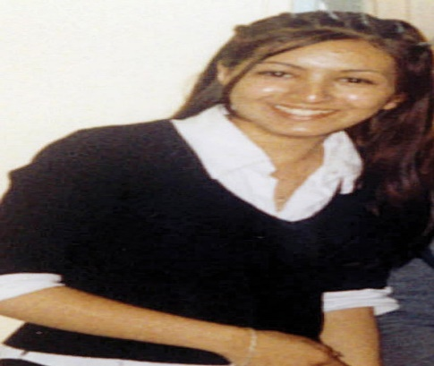
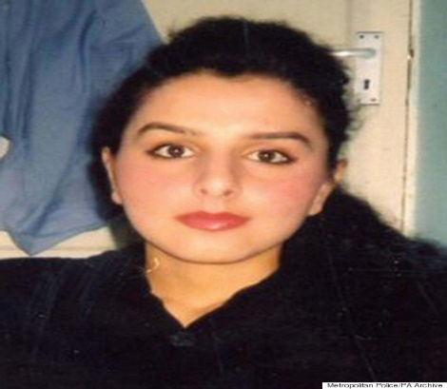
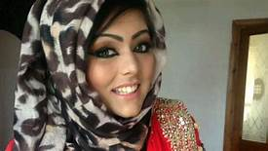
What do we know about shame and honour?
Gilligan and Akhtar (2006): Study of 12 discussion groups totalling 130 women - children from these families may not disclose due to shame and honour;
House of Commons Home Affairs Committee (2013): Investigating CSE - victims from these communities are unlikely to come forward from fear of being ostracised by their families and community;
‘Honour Killings’ - Shafileah Ahmed (2003), Banaz Mahmood (2006) Samia Shahid (2016);
closer examination of violence and murder against women in the name of protecting family/community shame and honour (Gill and Brah, 2014; Aplin, 2017, Idriss, 2017).

Slide 7
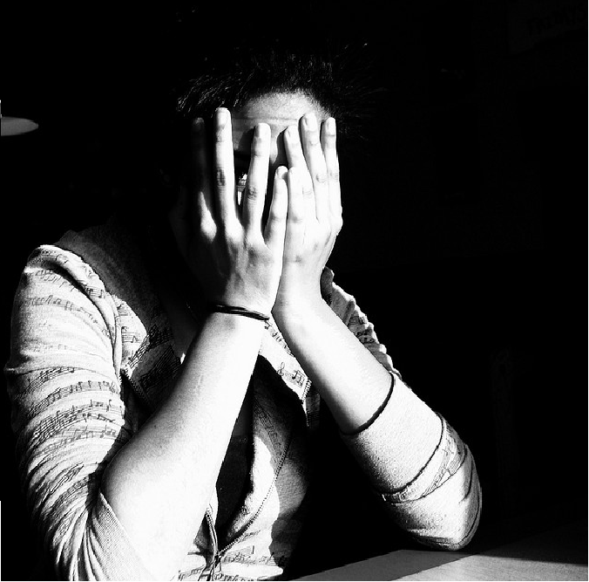
THE LAST TABOO: File on four (Radio 4)
http://www.bbc.co.uk/programmes/b04mctw3
(Radio 4, 2014).

Slide 8

Ruswana Bashir
Thank you to all survivors
Born in Skipton in North Yorkshire in 1983
Pakistani ethnic origin
British entrepreneur
Founder and CEO of Peek.com, a travel company based in San Francisco
Attended the University of Oxford where she later became President of the Oxford Union
Obtained her MBA from Harvard Business School
Sexually abused from the age of 10
Disclosed in her 20s
https://www.youtube.com/watch?v=qHQUk_CshmA

Slide 9
References
Aplin, R. (2017). ‘Exploring the role of mothers in ‘honour’ based abuse perpetration and the impact on the policing response’. Women’s Studies International Forum, V.60, pp1-10.
Barnardos (2016). ‘It’s not on the radar. The hidden diversity of children and young people at risk of sexual exploitation in England’.
Cowburn, M., Gill, A. and Harrison, K. (2014). ‘Speaking about sexual abuse in British South Asian communities: offenders, victims and the challenges of shame and reintegration’. Journal of Sexual Aggression: An International, inter-disciplinary forum for research, theory and practice, DOI: 10.1080/13552600.2014.929188.
Department of Education (2013-2015). Children in Need Census.
Doyle, K. and Magor-Blatch, L.E. (2017). “Even Adults Need to Play”: Sandplay Therapy With an Adult Survivor of Childhood Abuse. International Journal of Play Therapy, 26 (1), pp. 12-22.
Dubowitz, H. (2017). ‘Child Sexual Abuse and Exploitation – A Global Glimpse’. Child Abuse & Neglect, V.66, pp 2-8.
Gill, A. and Brah, A. (2014). ‘Interrogating cultural narratives about ‘honour’- based violence’. European Journal of Women’s Studies, V.21 (1), pp72-86.
Gilligan, P. and Akhtar, S. (2006). ‘Cultural barriers to the Disclosure of Child Sexual Abuse in Asian Communities: Listening to What Women Say’. British Journal of Social Work, V.36, pp1361-1377.
Gohir, S. (2013). ‘Unheard Voices. The Sexual Exploitation of Asian Girls and Young Women’. (Muslim Women’s Network, UK).
Grubbs, G.A. (1995). ‘A Comparative Analysis of the Sandplay Process of Sexually Abused and Nonclinical Children’. The Arts in Psychotherapy, 22 (5), pp. 429-446.
Herman, J.L. (1981). ‘Father-Daughter Incest’. (Harvard University Press: Cambridge).

Slide 10
Horvath, M.A.H., Davidson, J.C., Grove-Hills, J., Gekoski, A. and Choak, C. (2014). “It’s a lonely journey” A Rapid Evidence Assessment on intrafamilial child sexual abuse. (London: Office of the Children’s Commissioner).
House of Commons Home Affairs Committee (2013). ‘Child sexual exploitation and the response to localized grooming’ (London: The Stationery Office).
Idriss, M.M. (2017). ‘Not Domestic Violence or Cultural Tradition: is Honour-Based Violence Distinct from Domestic Violence?’. Journal of Social Welfare and Family Law , V. 39 (1), pp 3-21.
Kalff, D.M. (2003). ‘A Psychotherapeutic Approach to the Psyche’. (Temenos Press).
Lemaigre, C., Taylor, E.P. and Gittoes, C. (2017). ‘Barriers and Facilitators to Disclosing Sexual Abuse in Childhood and Adolescence: A Systematic Review’. Child Abuse & Neglect, V.70, pp
39-52.
Moghal, N.E., Nota, I.K. and Hobbs, C.J. (1995). ‘A Study of Sexual Abuse in an Asian Community’. Archives of Diseases in Childhood, V72, pp346-347.
Office of the Children’s Commissioner (2015). ‘Protecting children from harm: A critical assessment of child sexual abuse in the family network in England and priorities for action’ (London).
Radio 4 (2014). ‘The last Taboo. File on 4 ’. Accessed: http://www.bbc.co.uk/programmes/b04mctw3

Slide 11

please DO GET IN TOUCH IF YOU ARE INTERESTED IN THIS RESEARCH.
Vanisha Jassal
v.jassal@kent.ac.uk
01227 823737
@vanishajassal
If you would like to participate in my research as a survivor, please email me at sacsauk@gmail.com

