Slide 1

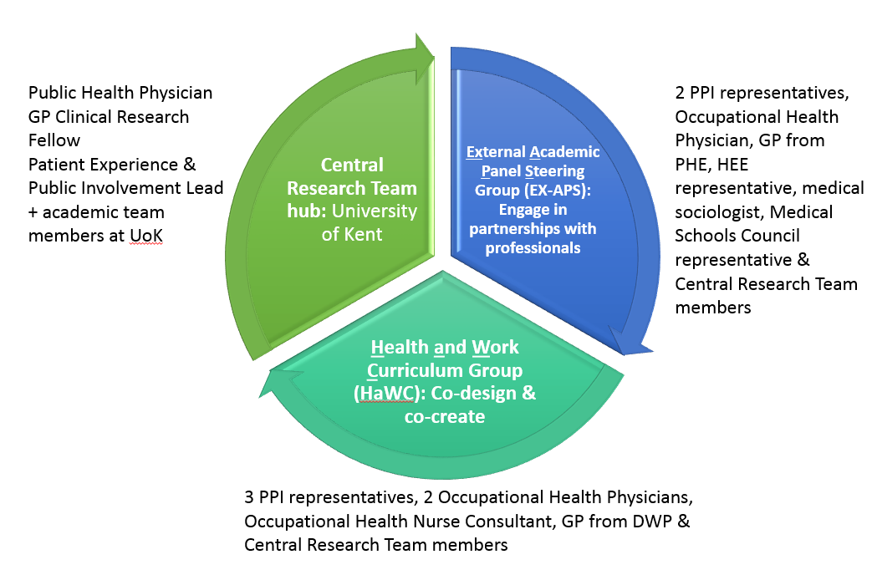

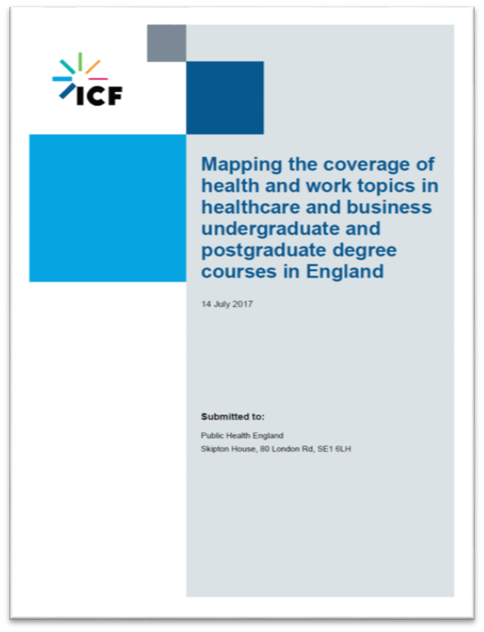
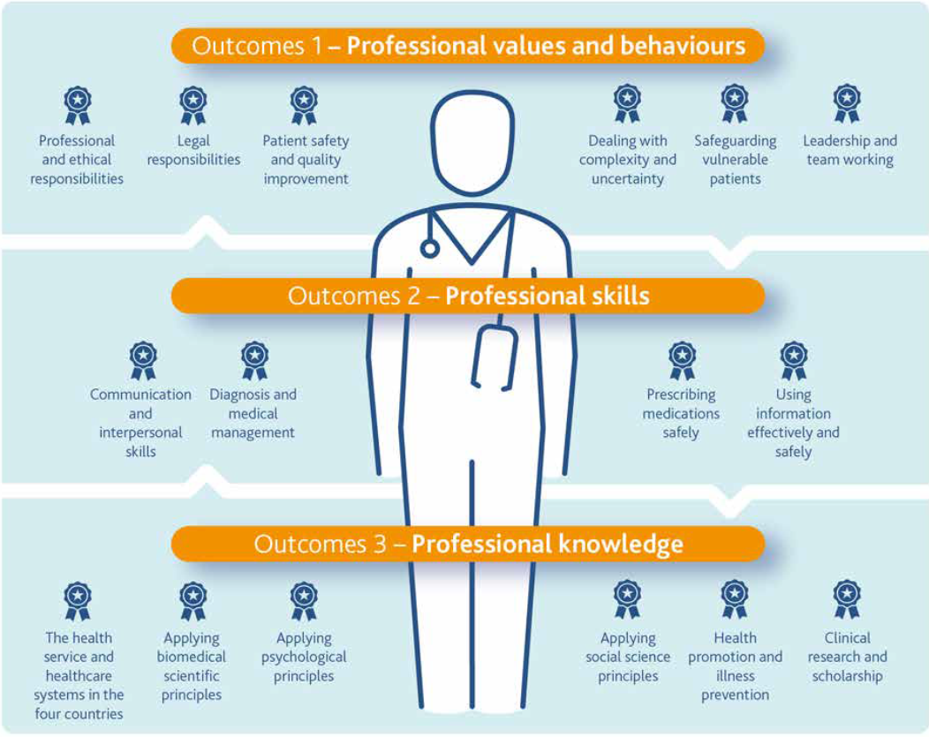
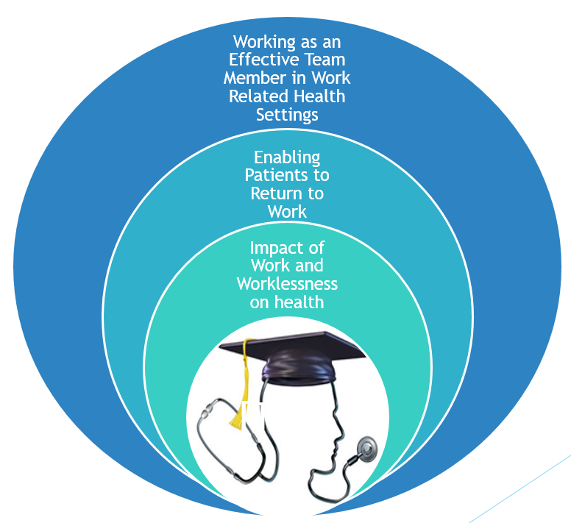

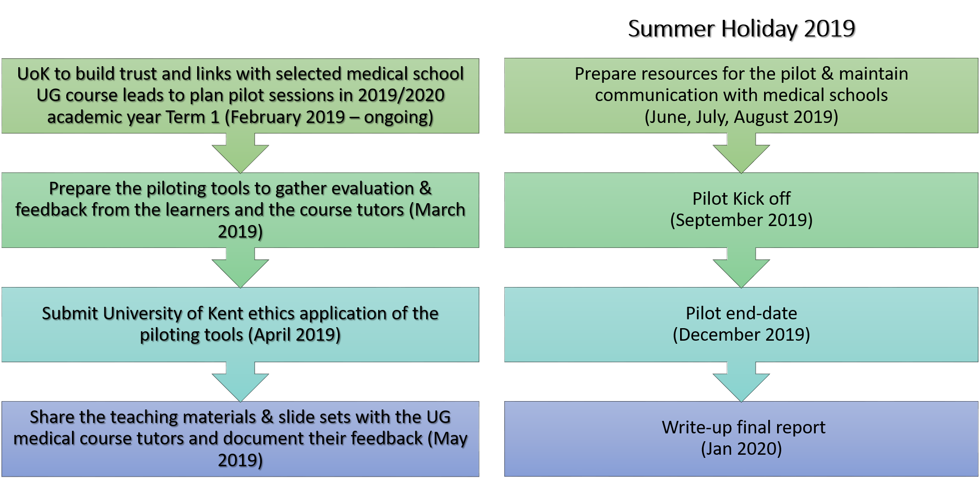
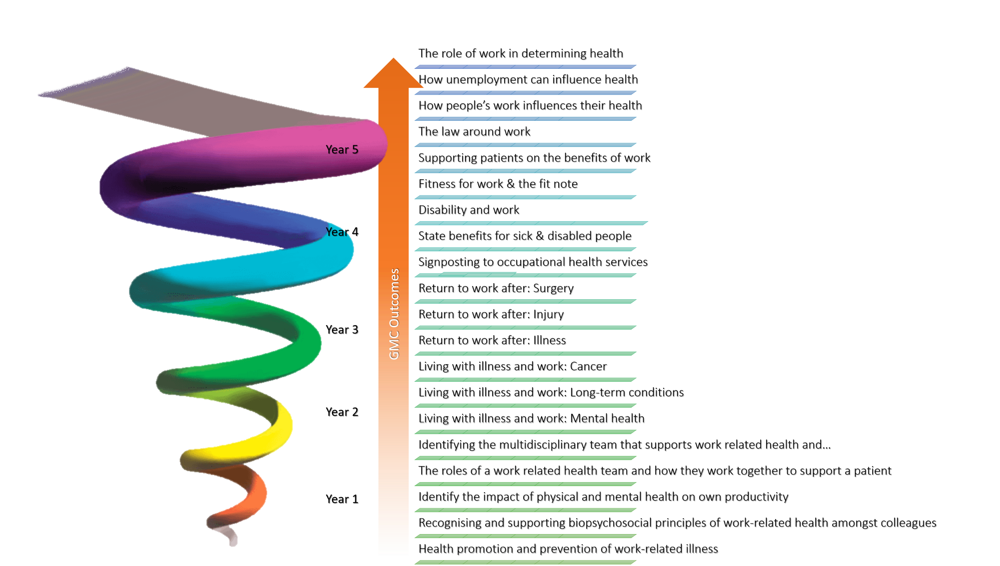


Developing Undergraduate Curriculum Resources on Health and Work in Medical Education
Dr. Ferhana Hashem, Dr. Catherine Marchand and Sabrena Jaswal
Centre for Health Services Studies, University of Kent
Project Background
Aims and Objectives
Commissioned by Public Health England (PHE) & joint Work & Health Unit (WHU), includes Department for Work & Pensions (DWP) & Department of Health & Social Care
Start: September 2018; Ends: January 2020
- Outputs: comprehensive set of teaching resources on health & work including:
  slide-sets of core topics
  session outline for lecturers
  online resources collection
- Using a co-productive approach involving stakeholders & Patient and Public Involvement
To design an integrated curriculum for future doctors that addresses how to communicate with service users/patients about staying in and returning to work.
To increase future doctors’ confidence in discussing health and work with patients, having acquired the skills, knowledge, tools and techniques to undertake this activity
To increase the uptake of future doctors broaching the issue of Health & Work in their patient consultations, including giving professionals the capability and confidence to use the fit note as a system for practical advice as well as a process for sickness certification
To increase patients’ experience of feeling more supported by future doctors in the long term
To increase the number of patients understanding the value of work to their own health and well-being, including their expectations of the fit note, by receiving advice from doctors
Why is this important?
Co-Production Approach
Improving Lives. The Work, Health and Disability Green Paper (2017) one of the key aims is to “ensure people are able to access the right employment and health services, at the right time and in a way which is personalised to their circumstances and integrated around their needs”
The report underlines the vicious circle between work and health and the importance of having a unified vision of the relationship between health and work
It highlights the importance to improve work conditions for workers with disabilities and chronic diseases
PHE commissioned an audit report from ICF Consulting Services Ltd with the intention of broadly identifying Health and Work core topics for the current undergraduate medical curriculum
Learning Framework
Project Milestones
Learning Framework and topics development based on the General Medical Council’s Outcomes for Graduates (2018)
List of topics in no particular order developed following the GMC (2018)
Curriculum mapping of all 41 medical schools in the UK (inc 5 which will be starting in 2019 and/or 2020). This included identifying the school’s:
  Teaching approach
  Type of curriculum (full spiral, partial spiral, none)
  Core syllabus topics
  Identify where Health and Work topics can be incorporated
  Assessment methods
  Recent / proposed changes to the curriculum
Creation of slide sets with topics linked to the General Medical Council’s Outcomes for Graduates (2018)
Piloting
  5 sites across England

Slide 2
GMC Outcomes
The role of work in determining health
How unemployment can influence health
How people’s work influences their health
The law around work
Supporting patients on the benefits of work
Fitness for work & the fit note
Disability and work
State benefits for sick & disabled people
Signposting to occupational health services
Return to work after: Surgery
Return to work after: Injury
Return to work after: Illness
Living with illness and work: Cancer
Living with illness and work: Long-term conditions
Living with illness and work: Mental health
Identifying the multidisciplinary team that supports work related health and…
The roles of a work related health team and how they work together to support a patient
Identify the impact of physical and mental health on own productivity
Recognising and supporting biopsychosocial principles of work-related health amongst colleagues
Health promotion and prevention of work-related illness
Year 5
Year 4
Year 3
Year 2
Year 1

