Slide 1

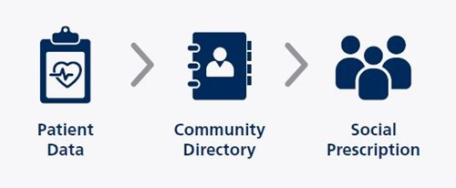
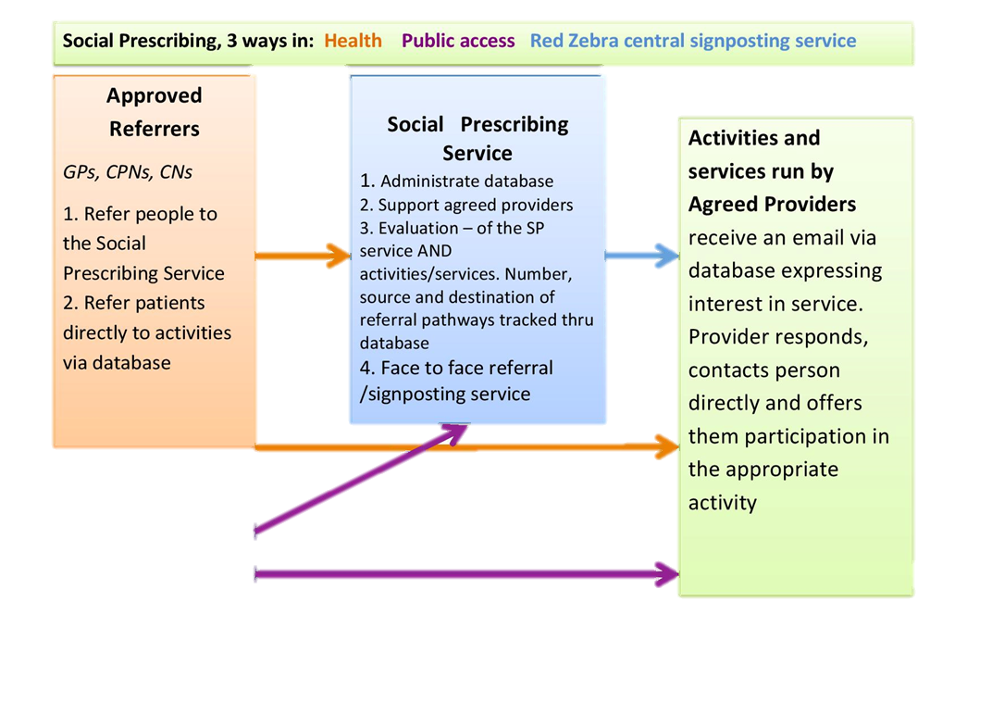
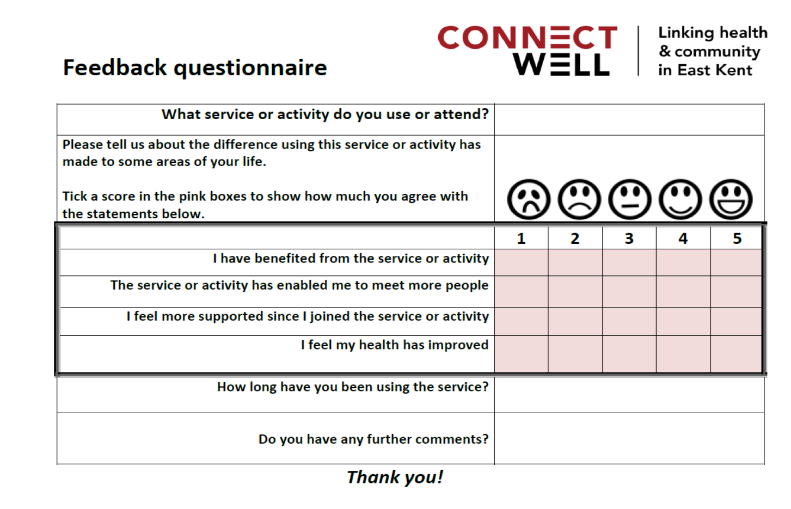


Social Prescribing and Integrated Care: An Evaluability Assessment
Sabrena Jaswal & Dr. Kate Hamilton-West
  The Centre for Health Services Studies (CHSS), University of Kent, Canterbury Kent, CT2 7NF, UK
  Email: S.K.Jaswal@Kent.ac.uk Telephone: +44 1227 823 680
Background
Programme Theory
The Encompass multispecialty community provider (MCP) is one of 14 ‘vanguards’ established across the UK in response to improving the integration of health and social care. This necessity to pursue a more inclusive and sustainable approach to health has allowed concepts such as social prescribing (SP) to rise to prominence.
An evaluability assessment; a systematic approach or determining the feasibility of an evaluation was undertaken on a local social prescribing service known as Red Zebra Community Solutions in relation to this MCP. Red Zebra has been tailored to the needs of this MCP by referring and/or signposting patients to non-medical services within the community.
This social prescribing programme is based on the theory that:
Practices are facing pressures due to an ageing population and complex needs
of people with long term conditions
These pressures may be reduced by linking patients with support in the community.
The service has also been developed according to the following assumptions:
  Patients will voluntarily engage with such services
  GPs will refer patients
  The service itself will raise awareness of community services among GPs and patients
Methodology
It was agreed that the key criteria to consider for this evaluability assessment were:
The quality of the project purpose
The quality of expected outputs
The availability of baseline monitoring data
The feasibility of attribution
Data Collection
Members of the Encompass MCP and Red Zebra provided the
researchers with information on the service that included:
  A logic model developed by Encompass
  A history of Red Zebra and list of services it provides
  A template of the Red Zebra customer feedback form (below)
In-person interviews were undertaken with social prescribing managers, case officers and commissioners engaged with the Encompass MCP process. The research team also collated and analysed information related to Red Zebra’s narrative, copies of client feedback forms and the social prescribing platform Connect Well (CW).The CW database documents online referrals and whether the activity provider has responded to the referral. Self-referrals are recorded independently by Red Zebra. As this system is not compliant with NHS information governance. NHS patient numbers are not recorded and therefore cannot be linked to other patient activity.
Source: Red Zebra Short Form Contract
Conclusion
The overall programme theory is consistent with previous research on outcomes of social prescribing and supported by service data indicating that service users are predominantly older people with long-term conditions requiring support for social isolation.
At the time of this assessment, impact of the service were not possible to evaluate, since there was not a formal assessment of either patient reported outcomes or change in health service use (e.g. GP visits, or emergency admissions). While satisfaction with onward referral providers is assessed via feedback forms, these do not include questions on users’ experience of the social prescribing service itself.
Whilst very promising, the outcome data collected by Red Zebra at the time of this evaluability assessment needed to include a formal assessment of client perceived benefits and anticipated outcomes of the service itself to be considered for a full evaluation.

