Slide 1
CENTRE FOR CHILD PROTECTION
FACILITATING INTER-PROFESSIONAL BEST PRACTICE IN CHILD PROTECTION THROUGH ASYNCHRONOUS ONLINE FORUMS ALT CONFERENCE SEPT. 2015 VANISHA JASSAL & ISOBEL DREW
@UniKentCCP #ccponlineforums
Notes:
V1.0
To change the footer on every slide:
1. On the menu go to Insert > Header and Footer…
2. Select the Footer checkbox and enter the footer text in the accompanying text box
3. Click “Apply to All”

Slide 2
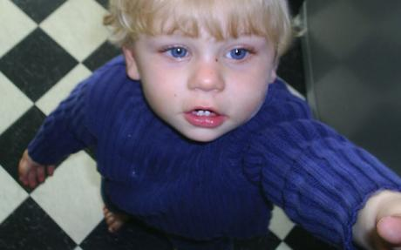
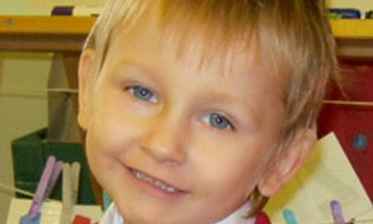
Inter-professional CP practice: the failings

Slide 3
(Munro Review of Child Protection, 2011)
“A major challenge in building a more responsive child protection system is helping a wide range of professionals to work together well in order to build an accurate understanding of what is happening in a child or young person’s life, so the right help can be provided”

Slide 4
Why is this not happening?
Limited time spent together as an inter-agency group (Watkins et al, 2009)
The lack of opportunity to come together reflect upon practice
Positive developments with multi-agency safeguarding hubs etc.
The role of teaching and learning:
“The connection between inter-agency child protection training and effective working relationships in practice were given relatively scant attention by central government ….prior to the late 1980s” (Glennie, 2007);

Slide 5
MA Advanced Child Protection (V)
12 distance learning online students
experienced practitioners/managers
12 agencies
4 sectors
2 years of conversation about how best to keep children safe and support good practice
Page 5

Slide 6
MA participants: agencies representation (V)

Slide 7
Discussing how professionals can better assess ‘at risk’ children (V)

Slide 8
The move to more innovative approaches: online forums (V)
Advantages of asynchronous online discussions over face-to-face (Wang and Woo, 2007; Mazzolini and Maddison, 2005; Guiller and Ross, 2008);
Adult learners – wanting to share their experience and discuss and reflect (Chen, 2014);
The need to belong and interdependence (Maslow) and benefits of collaborative learning;
Encouraging agencies “to see different perspectives and to learn to work with people different from themselves” – ‘heterogenous grouping’ (Jacobs and Seow, 2015);
“There appears to be a consistent view that an asynchronistic method enabled the students to think about their response before posting’ (Cooner and Hickman, 2008);
Facilitating ‘higher-order thinking’ which is particularly critical to inter-professional CP practice, and constructing knowledge (Bellefeuille et al, 2008);
Importance of forum question (Wang and Woo, 2007).

Slide 9
The CCP MA research project (I)
Analysis of over 50 student posts over a 10 week period from 1 MA module
A start of a long journey
Emergence of an interaction pattern which is ‘synergistic’ (Schrire, 2006) consisting of significant student-student collaboration and an appropriate balance of tutor interaction (Mazzolini and Maddison, 2005).

Slide 10
Theme 1: Challenged existing paradigms of practice (I)
Reinforcing importance of child-centred practice and moving focus away from the parent;
Attributing far more attention to the role of supervision and managing worker emotions;
Developing mentalization skills.

Slide 11
Theme 2: Changing perceptions of practice (I)
The need to examine why a parent/carer is parenting negatively – their own emotional ‘baggage’;
The importance of what this analysis means for improved outcomes for children;
The importance of developing parental knowledge in understanding the psychology of their child.

Slide 12
Theme 3: Ability to conceptualise and critique multiagency practice (I)
Effective and wholesome collaboration needs to take place at an early stage of a child’s life;
The need for agencies other than just social services to have knowledge about ‘attachment’ theory and child development;
To best support a family and child requires a collaborative approach

Slide 13
Theme 4: Ability to integrate theory into practice (I)
Psychodynamic theories proved very useful in helping make sense of organisational dynamics and pressures;
The need to know more about theories such as attachment (e.g. disorganised attachment) so that it can be integrated into practice assessments.

Slide 14
Theme 5: Application of forum learning to practice (V)
Increased awareness of how to assess when parents are being manipulative (disguised compliance);
Realisation that existing agency assessment forms sometimes have no pace to add anything about the parent-child relationship…..or attachment relations!
A review of training to incorporate working with parents more effectively.

Slide 15
Theme 6: Peer to peer learning (V)
Valuing how different practitioners may view the same situation differently;
A whole discussion about what we should wear when meeting parents especially when imparting bad news;
Practitioners need to feel confident in using the tools shared in the MA (guided parenting task/Adult Attachment Interview);
Masses of shared student resources.

Slide 16
Findings and thoughts (V)
‘Transformational learning’ amongst the self-directed adult learners;
Forums as an appropriate tool to facilitate the much needed critical analysis of CP issues;
Permanent hard data challenging existing ideologies and professional practices and biases;
Potential for so much more learning for practitioners in the future.
Page 16

Slide 17
Traditional v blended: the debate within child protection (I)
‘Concerns about the appropriateness and effectiveness of using technology based education for preparing students for a person-centred discipline have likely stood in the way of our profession fully embracing online learning.’(Ayala, 2009)
Question: How might more traditional teaching methods facilitate the interprofessional child protection learning? Is this reticence valid/ understandable?
But who are our students?
‘Students in professional education are likely to be both goal orientated and self directed, and distance education, especially web-based, suits the learning needs and temperaments of these students.’ (Moore, 2005)

Slide 18
Communities of Practice (CoP)
‘The concept of CoP is neither old nor new. It has both the eye opening character of novelty and the forgotten familiarity of obviousness.’ (Wenger, 1999)

Slide 19
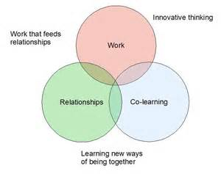
Relevance of CoP to child protection and forums
Their work transcends the classroom context’ (Moore, 2005).
‘Members develop tacit or implicit knowledge that cannot necessarily be catalogued, bulleted, or identified in procedure manuals. This kind of learning or knowledge gives members an understanding of practice’ (Moore, 2008).
Consider this in relation to professional child protection practice and the facilitation of learning through asynchronistic forums.
CoP helps connect the classroom with the practice setting.

Slide 20
Quick tips for not seeing forums as a chore (V)

Slide 21
Hear it from the students themselves…… (I)

Slide 22
References
Appleton, J. V., & Stanley, N. (2009). Learning and training in safeguarding work. Child Abuse Review, 18(3), 147-150.
Ayala, J. S. (2009). Blended learning as a new approach to social work education. Journal of Social Work Education, 45(2), 277-288.
Bajinsky, W. (2013). ‘Rosie 2’: a serious training game. Child Abuse Review 22: 224–226.
Bellefeuille, G., McGrath, J., & Jamieson, D. (2008). A pedagogical response to a changing world: Towards a globally-informed pedagogy for child and youth care education and practice. Children and Youth Services Review, 30(7), 717-726.
Chen, J.C. (2014). “Teaching nontraditional adult students: adult learning theories in practice” Teaching in Higher Education 19 (4): 406-418.
Cooner, T. S., & Hickman, G. (2008). Child protection teaching: students' experiences of a blended learning design. Social Work Education, 27(6), 647-657.
Glennie, S. (2007). Developing interprofessional relationships: Tapping the potential of inter‐agency training. Child Abuse Review, 16(3), 171-183.
Guiller,J., Durndell, A. and Ross, A. (2008). “Peer interaction and critical thnking: Face-to-face or online discussion?” Learning and Instruction 18: 187-200.
Jacobs, G. and Seow, P. (2015). Cooperation Learning Principles Enhance Online Interaction. Journal of International and Comparative Education, 4 (1), 28-38.
Mazzolini, M. and Maddison, S. (2005) “When to jump in: The role of the instructor in online discussion forums” Computers & Education doi:10.1016/j.compedu.2005.06.011
Moore, B. (2005). Key issues in web-based education in the human services: A review of the literature. Journal of technology in human services, 23(1-2), 11-28.

Slide 23
References
Moore, B. (2008). Using technology to promote communities of practice (CoP) in social work education. Social Work Education, 27(6), 592-600.
Munro, E. (2011). The Munro review of child protection: final report, a child-centred system (Vol. 8062). The Stationery Office.
Nimmagadda, J., & Murphy, J. I. (2014). Using Simulations to Enhance Interprofessional Competencies for Social Work and Nursing Students. Social Work Education, 33(4), 539-548.
Schrire, S. (2006). “Knowledge-building in asynchronous discussion groups: Going beyond quantitative analysis” Computers & Education 46: 49-70.
Wang, Q. and Woo, H.L. (2007) “Comparing asynchronous online discussions and face-to-face discussions in a classroom setting” British Journal of Educational Technology 38 (2): 272-286.
Watkin, A., Lindqvist, S., Black, J., & Watts, F. (2009). Report on the implementation and evaluation of an interprofessional learning programme for inter‐agency child protection teams. Child abuse review, 18(3), 151-167.
Wenger, E. (1999). Communities of practice: Learning, meaning, and identity. Cambridge University Press.

Slide 25
Inter-professional CP practice through simulations: “Rosie 2” (I)
“ [“Rosie 2”] is designed to suit the differing learning needs of professionals with varying experience and importantly emphasises it is not intended to be a ‘model of best practice’, but instead aims to inspire discussion as the game progresses” (Baginsky, 2013).
Simulation is a pedagogy using a real world problem in a realistic environment to promote critical thinking , problem solving and learning. “ (Nimmagadda and Murphy, 2014)
“Rosie 2” – Bedroom scene

