Slide 1

Open Accessibility
Ben Watson, Accessible Information Adviser
Josie Caplehorne, Scholarly Communication Coordinator

Slide 2

Our students
19,860 students
15,190 undergraduate
2,2670 postgraduates
2,000 part time students
159 nationalities

Slide 3
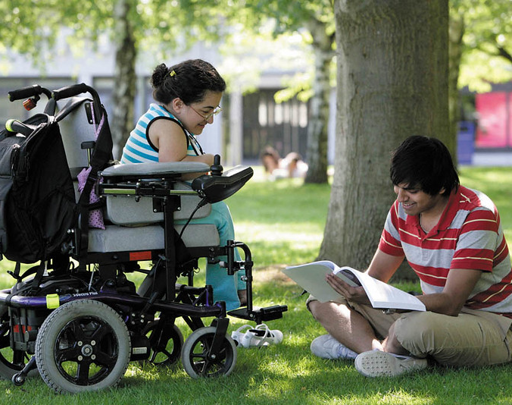
Disclosed disabilities
22 blind or partially-sighted
31 deaf or hearing-impairment
82 mobility difficulties
1286 mental health difficulties
262 unseen disabilities
290 multiple disabilities
164 Autistic Spectrum Disorders
810 Specific Learning Difficulties
260 with disability not listed above

Slide 4
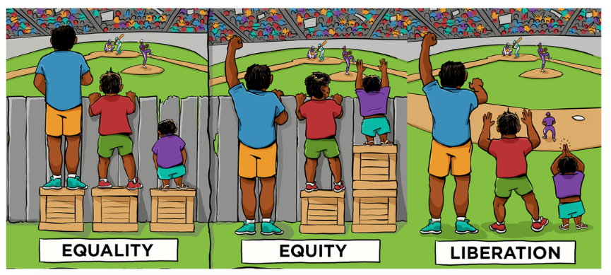
Why accessible? It’s the right thing to do
Accessible services are better services. The changes you make to support people who face barriers will benefit everyone.
The law tells you to:
Equality Act, 2010.
Public Sector Equality Duty (PSED).
Public Sector Web Accessibility Regulation (2018/852).

Slide 5
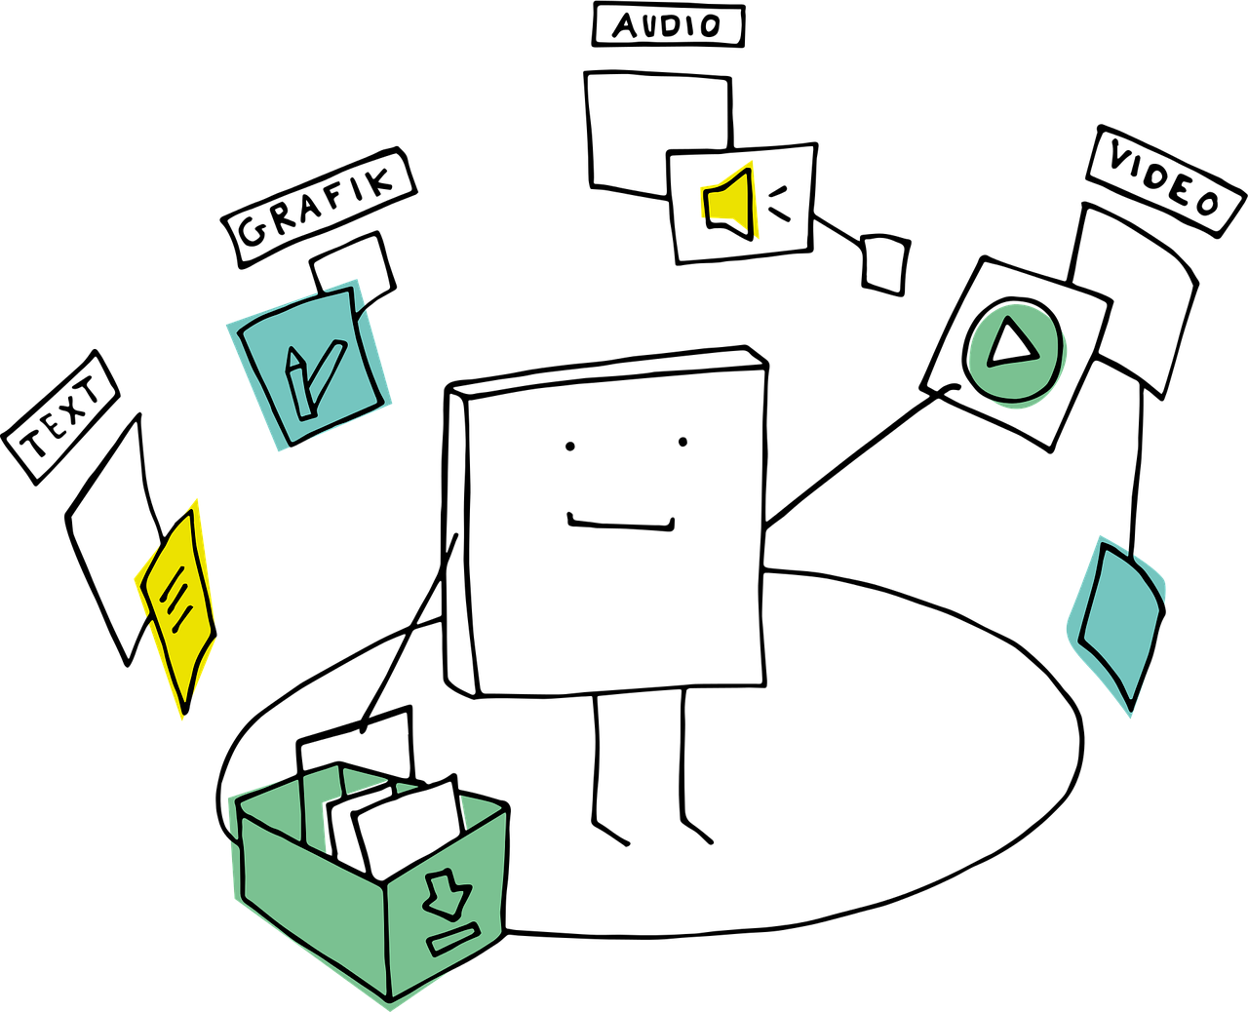
How we are applying this concept to what we all do
Accessible resources: documents, presentations and spreadsheets

Slide 6
Kent Inclusive Practices (KIPs) data
Kent Individual adjustment | Number of Inclusive Learning Plans (ILPs) featuring adjustment | Percentage of ILPs
Permitting lecture recording for personal use | 972 | 62.2%
Providing lecture outlines before class | 945 | 60.5%
Prioritised reading lists | 757 | 48.4%
Total | 2674
Notes:
In a Kent context (mapping the Edinburgh adjustments to Kent ILP terminology) this would account for 2674 separate ILP entries for the above commonly recommended ILP adjustments.

Slide 7

Kent Inclusive Practices
Maximise electronic resources
Make documents easy to navigate and understand
Make presentations meaningful
Provide alternative media but make it accessible
Make assessments accessible
Promote productivity tools
Equity of access for all
Notes:
Kent Inclusive Practices (KIPs) offer guidance on simple but powerful mainstream adjustments to learning and teaching delivery at Kent and are informed by analysis of our most frequently requested Inclusive Learning Plan (ILP) adjustments.
Why you should use KIPs
to improve the learning environment for all students
to reduce the need for retrospective adjustments
to lessen the reliance upon Inclusive Learning Plans (ILPs)
KIPs reinforce the measures for inclusive module design in the Code of Practice for Quality Assurance: ANNEX B: Approval and Withdrawal of Modules (Appendix A)
KIPs reinforce the measures for inclusive module design in the Code of Practice for Quality Assurance: ANNEX B: Approval and Withdrawal of Modules (Appendix A)
Give preference to electronic (‘born-digital’) resources that meet minimal accessibility standards and support the use of productivity tools (assistive technologies).
Make module outlines accessible electronically (e.g. via Moodle) at least 4 weeks before the module starts:
Reading list – core texts – periodicals, web links etc. could be added dynamically where they are available electronically.
Learning outcomes and assessment methods.
Make lecture/seminar slides accessible electronically (e.g. via Moodle) at least 24 hours before the session to enable all students to prepare (particularly students with notetaking difficulties).
Make prioritised reading lists available at least 4 weeks in advance to accommodate the provision of alternative formats and support those with slow reading speed.
Use lecture capture to assist notetaking, ideally for everyone, but at least for students with relevant Inclusive Learning Plans (ILPs).
2: Make documents easy to navigate and understand.
Accessible Word documents (essentials).
3: Make presentations meaningful.
Accessible PowerPoint (essentials).
4: Provide alternative media but make it accessible.
Give text alternatives for the key teaching points in images, tables, graphics, videos and audio.
Creating accessible resources.
5: Make assessments accessible.
Vary assessment methods and make them appropriate to learning outcomes. When you assess a disabled student, make sure you're assessing their knowledge, skill and understanding, not their disability.
Consider if assessment methods are varied and appropriate to learning outcomes.
6. Promote productivity tools (assistive technologies) to everyone.

Slide 8

Beyond Open Access
University of Kent as Open Access publisher
Open Journal System platform (OJS)
Directory of Open Access Journals (DOAJ)
“Publishing your open access journal with the University of Kent”
“Application to publish”

Slide 9
Our commitment to Open Accessibility
“Accessibility involves formatting documents to optimise access. Accessible and inclusive content can be used by all intended audiences, taking into account their differing capabilities.
Tell us how you will provide accessible content and how you will communicate this with editors and contributors. For more information the university’s Student Support and Wellbeing team have produced guidance on how to make your publication accessible.
Let us know if you would like a Blackboard Ally module set up for the journal. Ally can be used to check that article content can be accessed in alternative formats, such as HTML, audio, ePub, electronic Braille and tagged PDF. Using Ally to check that article content is accessible can increase the reach and impact of the work.”

Slide 10

Join the conversation
Social Media Exercise
#AccessibleDesignIsGoodDesign
#OpenEngaged19
Put paper to pen, exercise
Idea or observation?
Post-It!
We’ll blog about the outcomes

Slide 11

Tools, resources and guidance
There are a variety of tools that can help all your readers improve the value of information experiences.
These work best when the underlying information has been created to meet basic accessibility standards.
Microsoft Word Accessibility Checker
Lexdis Digital Accessibility Toolkit
Productivity Tools
SensusAccess
Blackboard Ally

Slide 12

Further reading
Kent Digital Accessibility Working Group
“One of the most welcome, sustainable, collaborative and inclusive conferences…”
“Maximising your audience”
“Why Plain English?”
Responsible metrics

Slide 13
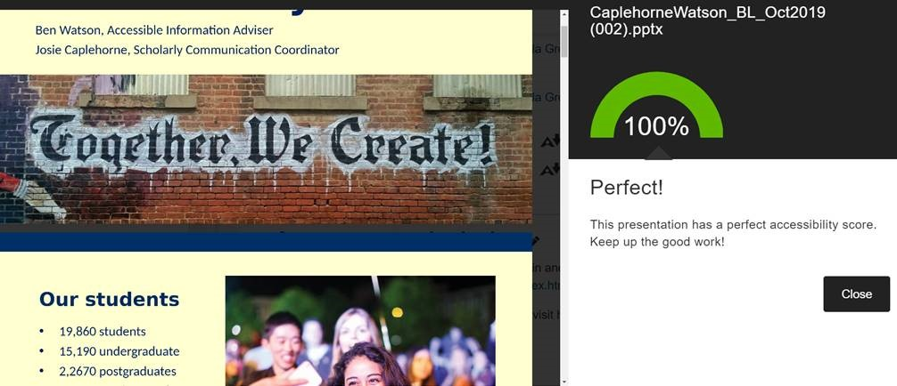
Practising what we preach

Slide 14

Contact us
Ben Watson
Accessible Information Adviser
Email: b.watson@kent.ac.uk
Telephone: +44 (0)1227 816338
Josie Caplehorne
Scholarly Communication Coordinator
Email: j.caplehorne@kent.ac.uk
Telephone: +44 (0)1227 816525
[Link to presentation]

