Slide 1




Measuring Outcomes in Care Homes: methodological developments
Ann-Marie Towers
NIHR SSCR Annual Conference, 12th April 2016, London.

Slide 2
Aims
Overview of ASCOT and the care homes toolkit
How and why the approach works for older adults living with dementia
Methodological developments being piloted in new NIHR SSCR study
Outcomes-focused care planning: working with providers to maximise impact.

Slide 3
The current team
Nick Smith
Sinead Palmer
Grace Collins
Julien Forder

Slide 4
Adult Social Care Outcomes Toolkit (ASCOT)
A set of tools for measuring the quality of life of those who use social care:
  Interview version: INT4
  Self-completion version: SCT4
  Care homes version: CH3
New tools:
  Proxy
  Easy Read
  Carers

Slide 5
Domains of SCRQoL
Social care related quality of life (SCRQoL)
  Personal cleanliness and comfort
  Food and drink
  Personal safety
  Accommodation cleanliness and comfort
  Control over daily life
  Social participation and involvement
  Occupation
  Dignity

Slide 6
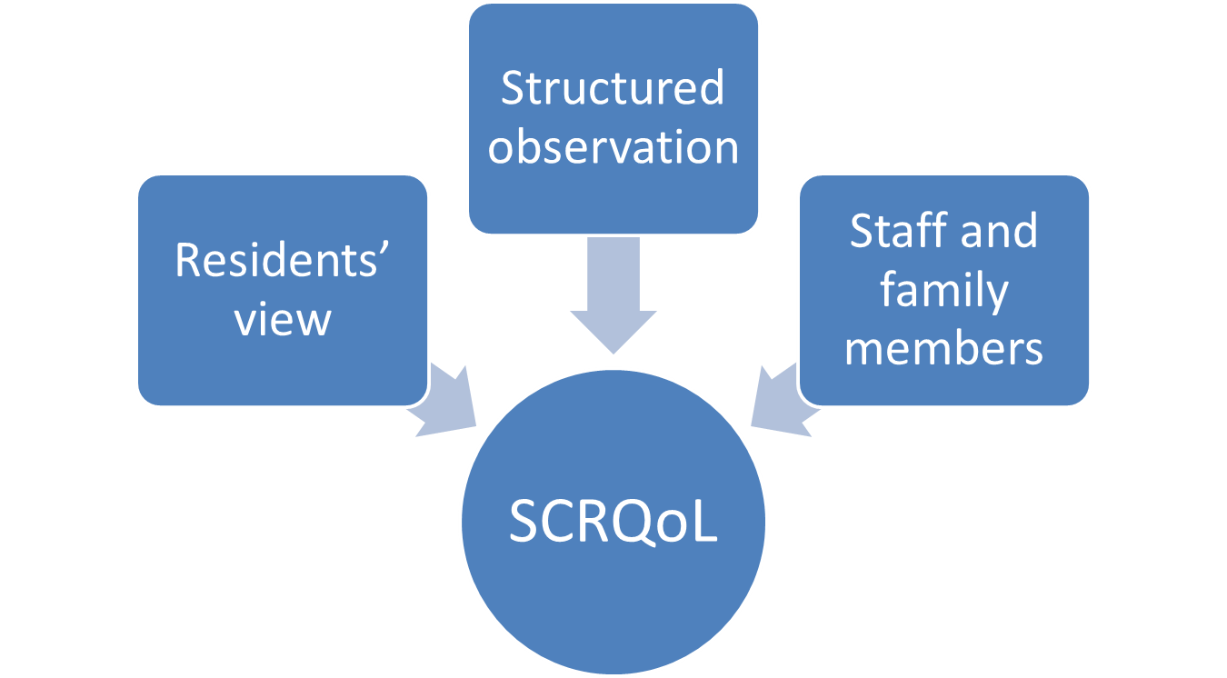
CH3 – mixed methods toolkit
Good IRR is possible (.77 using CH3 team)
Requires training

Slide 7
Why use CH3?
Usual PROM format not ‘dementia friendly’
A methodology for engaging directly with the person with dementia – giving them a voice.
Provides more than just scores: observations provide context and this can be helpful for providers…

Slide 8
ASCOT feedback
I think this was an excellent piece of work. It’s very clear, it’s very straightforward... I was very pleased with the overall outcomes, as were the staff. And we used this as sort of to incorporate with our CQC inspection. I don’t know if you were aware, but on the last one that we had done in February we were found in certain areas not to be reaching our standard in terms of dignity and respect. So once this was actually done and came out, and we had a chance to sit and look at it, I could actually use this and implement that to recreate and involve our residents more in terms of their dignity and respect. So on our last inspection… we are now fully compliant in all areas. So this has actually played a large part in the home becoming compliant.
Care home manager (Towers et al (submitted))

Slide 9
New study: MOOCH
NIHR SSCR funded study examining relationship between residents’ outcomes and regulator ratings.
30 care homes for older adults: range of provider/size/type of home
Aiming for 10 residents per home, including those lacking capacity.
Resident data: health, needs, characteristics, fees, outcomes.
Other data: staff characteristics and motivations, CQC ratings.

Slide 10
Methodological development 1
Extend CH3 to CH4
  Better read across between tools and settings
  Ideal state is aspirational in terms of QoL
  Links with personal outcomes and person-centred care
Challenge:
  Rating whether needs are being met in a way that suits preferences

Slide 11
CH3 to CH4
Staff and family member views
Observing preferences/ideal state?
  Looking for people’s emotional responses to events/situations (laughter, smiling, distress, challenging behaviour
  Personalisation – rooms, dress, appearance
  Diversity (not all wearing red nail polish)
  Choice and variety in meals, drinks, how people spend their time.
Ideally we would have the resident’s voice too

Slide 12
Methodological development 2
Helping people living with dementia tell us about their quality of life using ASCOT
Talking Mats
  Developed by a team at Stirling University
  Communication tool using symbols
  Working with Stirling to develop ASCOT symbol set
Pilot with up to 30 people living with dementia.

Slide 13
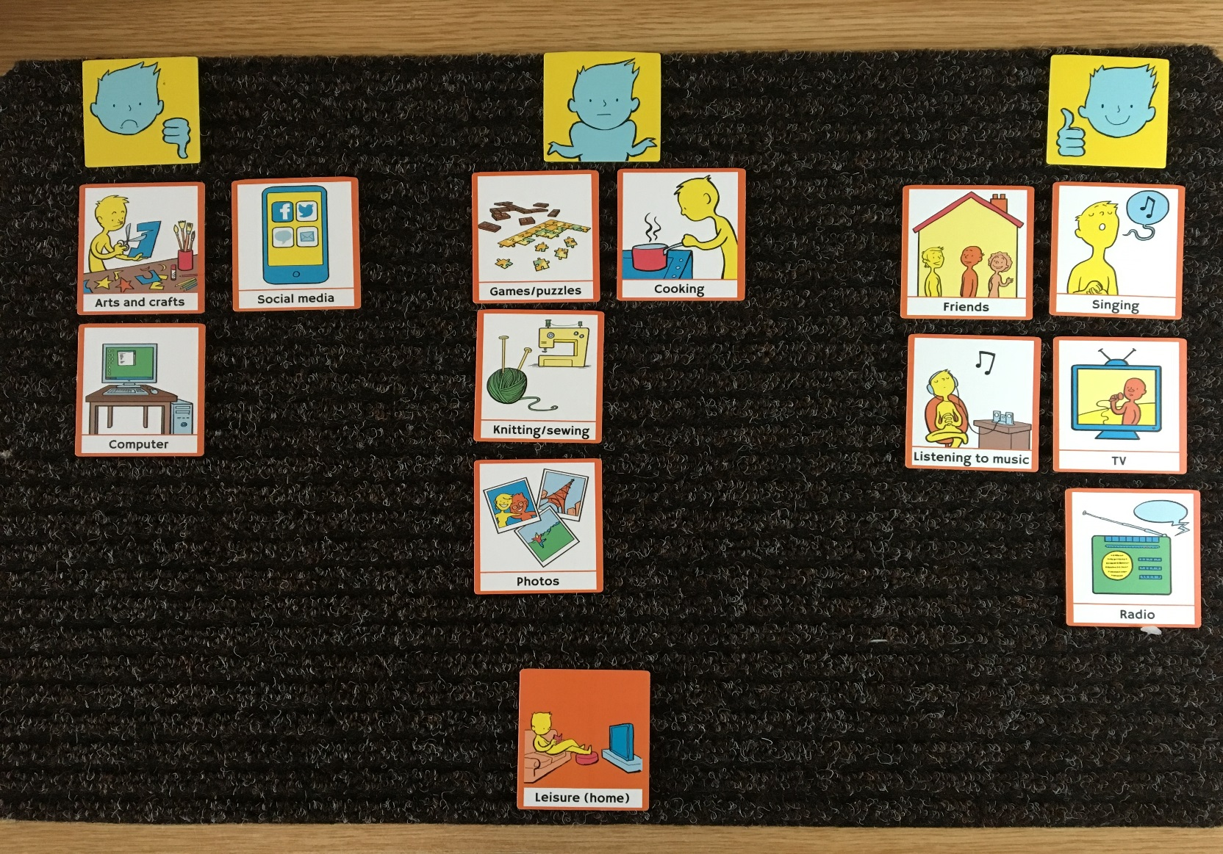
An example mat

Slide 14
Use by providers
Previous research suggests providers find the ASCOT data helpful
But to improve residents’ outcomes, needs to directly influence care (feedback?).
Working with 2 providers (UK and Australia) to pilot integrating ASCOT into care planning.
Method?
  Review outcomes using a circle of care/support
  Where needs identified, these inform care plan
  Review 6 months later
  Build up the data over time, continuous improvement

Slide 15
Summary
Methodologically challenging to measure outcomes in care homes
Residents are physically frail with high levels of cognitive impairment
Methods need to be flexible and draw on various sources to get a full picture
New developments to address some of these challenges in MOOCH project
Working with providers for greater impact.

Slide 16
NIHR School for Social Care
This presentation reports on independent research funded by the NIHR School for Social Care Research. The views expressed in this presentation are those of the authors and not necessarily those of the NIHR School for Social Care Research or the Department of Health/NIHR.

