Slide 1

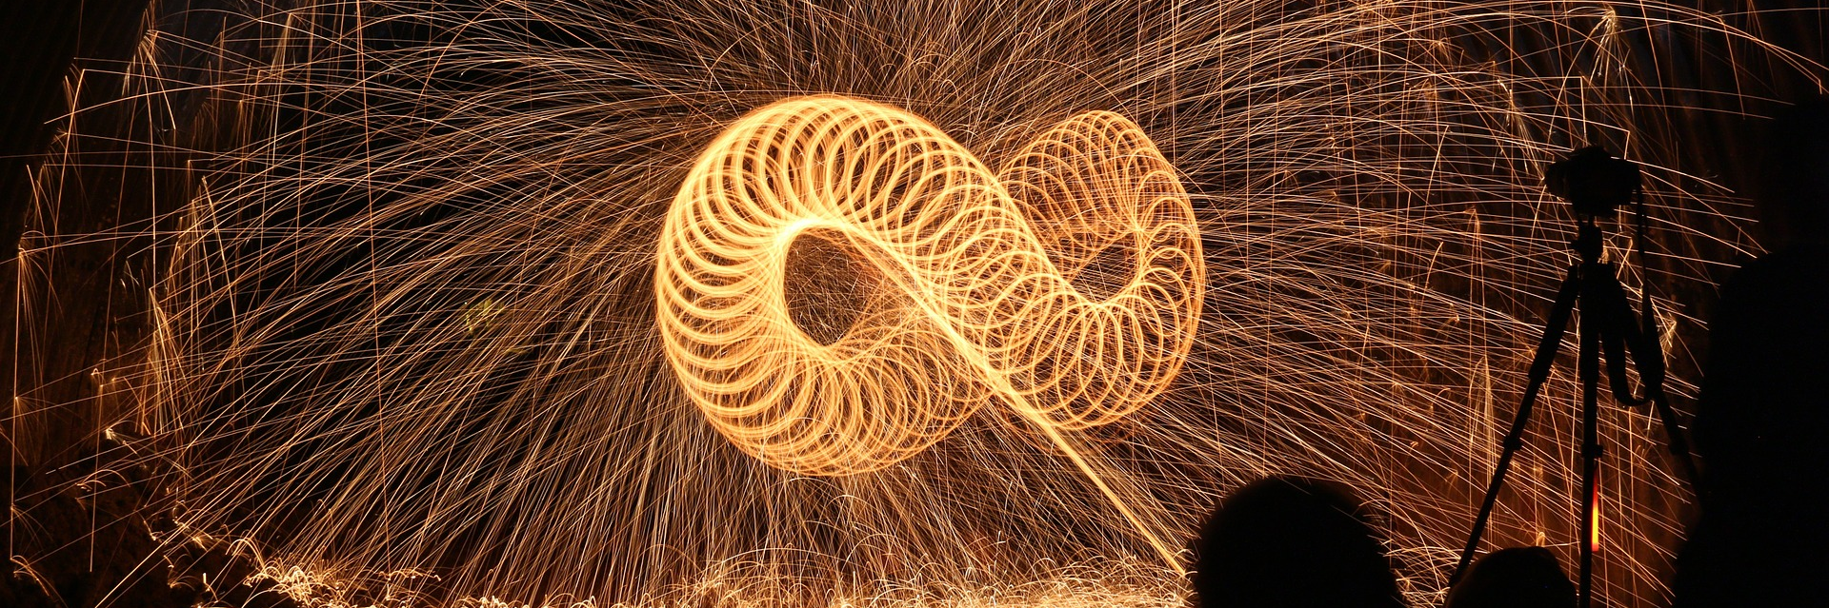
The UK’s European university
Engaging practice researchers in open repositories: Beyond A. B. C.
Helen Cooper, Research Support Librarian
@UniKentResSupp
Josie Caplehorne, Scholarly Communication Coordinator
@JosieCaplehorne

Slide 2
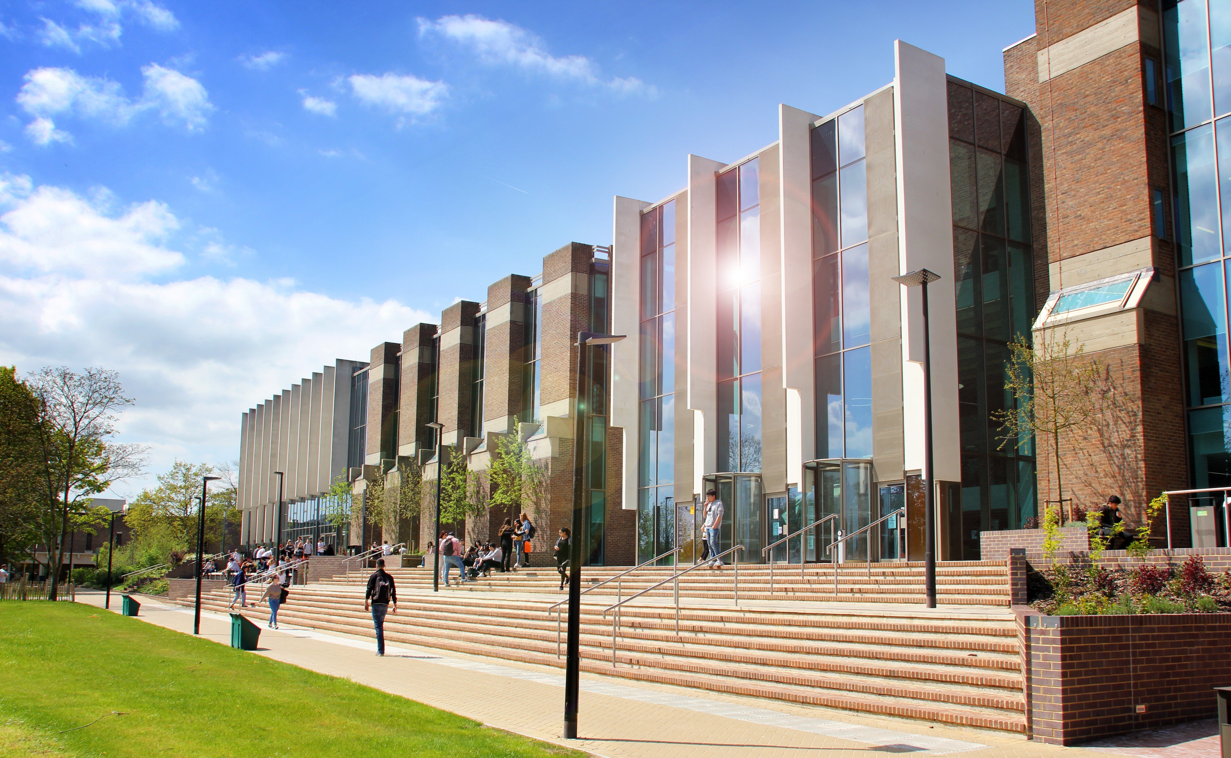

“Where people of various disciplines mix up” Geoffrey Templeman, University of Kent’s first Vice-Chancellor, 1963-1980
Granted Royal Charter and founded in 1965 – first 500 students
Geoffrey Templeman, first Vice-Chancellor
Interdisciplinary: Humanities, Sciences and Social Sciences
Over 15,000 undergraduates and over 4,500 postgraduates across 22 schools
Templeman Library, Canterbury: Athens, Brussels, Paris, Rome
Kent Academic Repository (KAR)
Standard Eprints set-up
Dublin Core and DataCite compliant metadata
Research Excellence Framework Compliance Checker and 2021 plugins
Supports staff profiles on web pages and promotion reports
Formal reporting contexts
@UniKentResSupp
@JosieCaplehorne
@

Slide 3
“True creativity needs remarkably flexible administration”
Professor Mark Connelly, University of Kent
What our researchers said
“our current research systems are acting as barriers rather than facilitators … systems that support open access also foster interdisciplinary collaboration in individualistic cultures”
Dr. Benjamin Vis, Classical and Archaeological Studies
What this means
Academics do not feel represented by the repository
Gives impression that their research is not of interest or important to institution
View shared by researchers from across Arts and Humanities, Sciences and Social Sciences
@UniKentResSupp
@JosieCaplehorne
@

Slide 4
“Supporting non-textual and non-digital research outputs”
Project Objectives
Investigate how well we are supporting all our researchers at Kent and what other Higher Education Institutions are doing
Define specific changes in policies and practice to better support practice-based research (PbR) and creative research
Project Drivers
Maximise dissemination/preservation opportunities for all researchers
Nurturing and inclusive research environment
Research Excellence Framework 2021 guidelines*
Leiden Manifesto and San Francisco Declaration on Research Assessment (DORA)
* “All types of research and all forms of research output across all disciplines shall be assessed on a fair and equal basis … while attaching no greater weight to one form over another” https://www.ref.ac.uk/publications/guidance-on-submissions-201901/
@UniKentResSupp
@JosieCaplehorne
@

Slide 5
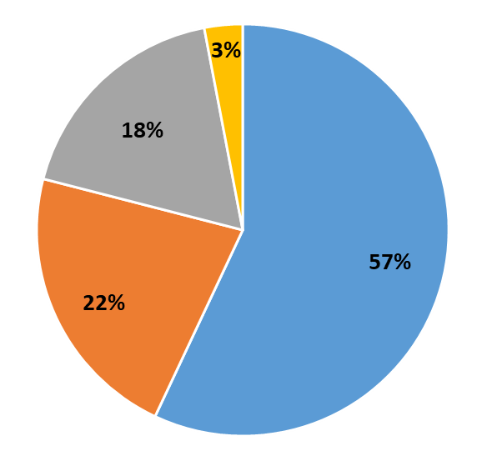
The numbers tell the story
Proportion of all item types
Articles: 57%
Books and monographs: 22%
Conferences: 18%
Other: 3%
@UniKentResSupp
@JosieCaplehorne
@

Slide 6

We Are Not Alone!
Research is “the creation of new knowledge and/or the use of existing knowledge in a new and creative way, so as to generate new concepts methodologies, and understandings in the relevant discipline areas” (https://sydney.edu.au/research_support/performance/documents/ntro-guidelines-sydney.pdf)
Art is Research …
“deeply-embedded prejudice against any form of creative arts research that does not conform to the humanities and Social Science research models and methodologies.” (Woodrow, 2019)
… but not as we know it
“Practice-based Research has particular characteristics that do not conform to traditional norms about research, new knowledge and how it is generated” (Rikou and Yolari, 2018)
‘Open Science’
Terminology shapes the approach and image of open repositories
@UniKentResSupp
@JosieCaplehorne
@

Slide 7
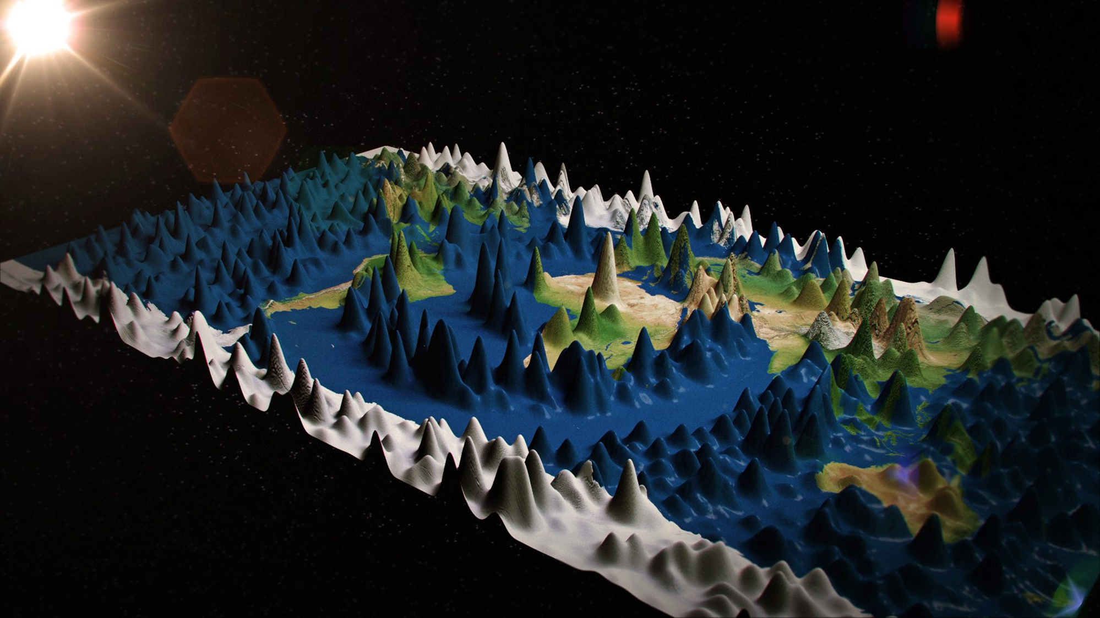
KULTUR and KAPTUR Eprint developments 2009 and 2013
Solutions
“a transferable and sustainable IR model for research output in the arts”
Metadata and workflow adaptations
Changes to the end user experience
Vocabulary
Research
assessment since 2014:
Australia ERA – NTROs
UK REF 2021 guidance
@UniKentResSupp
@JosieCaplehorne
@

Slide 8
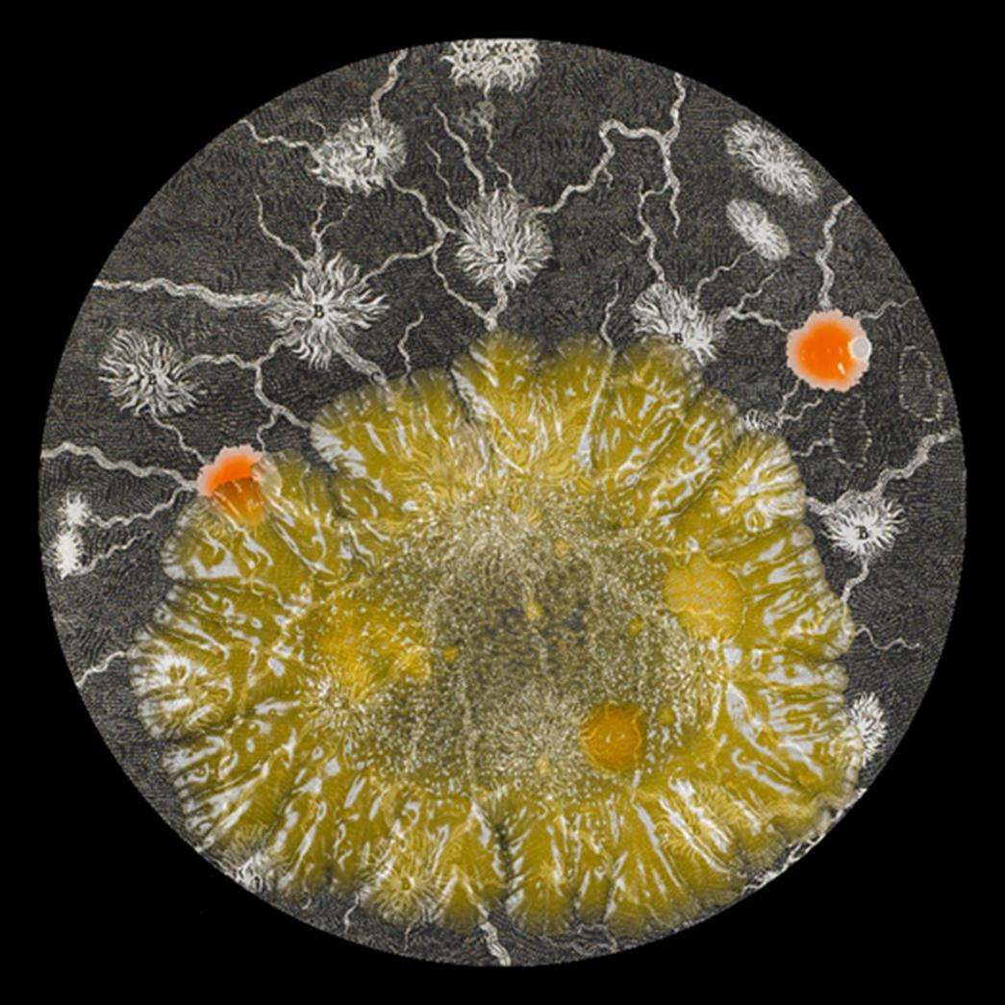
What we did
Asked academics to tell us about their research
Informal conversations introduced by mutual friends
Talked to other LIS professionals at creative Universities
KULTUR/KAPTUR – where are they now?
Other Creative/Arts specialist HEIs
Desk research – UK and international approaches
Excellence in Research Australia (ERA) experience
Wider research context
Scope
Policies
Repository systems
Guidance
Language
https://blogs.kent.ac.uk/templeman-exhibitions/tag/sarah-craske/
@UniKentResSupp
@JosieCaplehorne
@

Slide 9
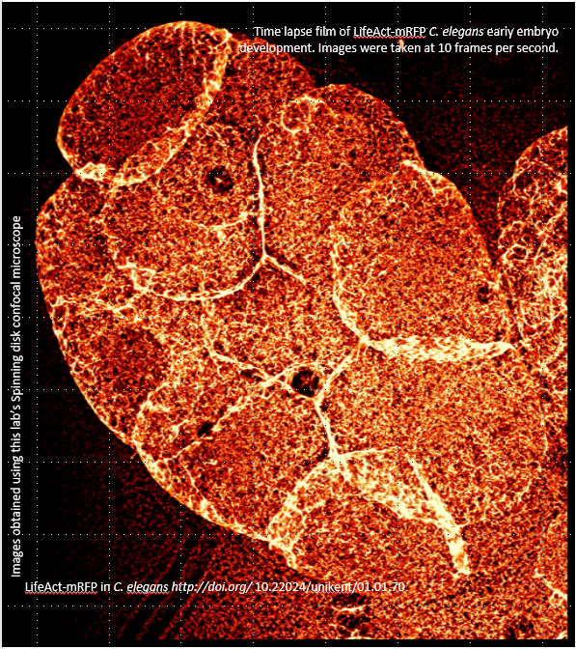
Time lapse film of LifeAct-mRFP C. elegans early embryo development. Images were taken at 10 frames per second.
Still from
Decisions at Kent
https://data.kent.ac.uk/70/
Not just Art
Under represented research came from all faculties
Interdisciplinarity is key to shaping the solution
Not so much Kultur-ization as Un-publication-ization
Mind the gap – defining the absent
“Defiant objects”? Non-traditional research works?
Practice-based Research (PbR) works?
Epistemic Objects – ‘knowledge’ objects?
Plain English across all systems for a level playing-field
Images obtained using this lab’s Spinning disk confocal microscope
How to record the unrecorded
Digital surrogates?
Accompanying text?
Portfolios?
Flexibility within a framework for interoperability
LifeAct-mRFP in C. elegans http://doi.org/ 10.22024/unikent/01.01.70
@UniKentResSupp
@JosieCaplehorne
@

Slide 10
Project timeline: 2018
Academic Liaison interviews
Gap analysis
Digitisation service review
Agree offering/draft statement
Communications strategy
Repository review
Metadata
Language
April
May
June
July
August
September
Liaison – external to Kent
KULTUR partners and other HEIs
Desk research/literature review
Glossary of terms
Data Management Planning
Web guidance
Conferences and events
Best practice report
@UniKentResSupp
@JosieCaplehorne
@

Slide 11
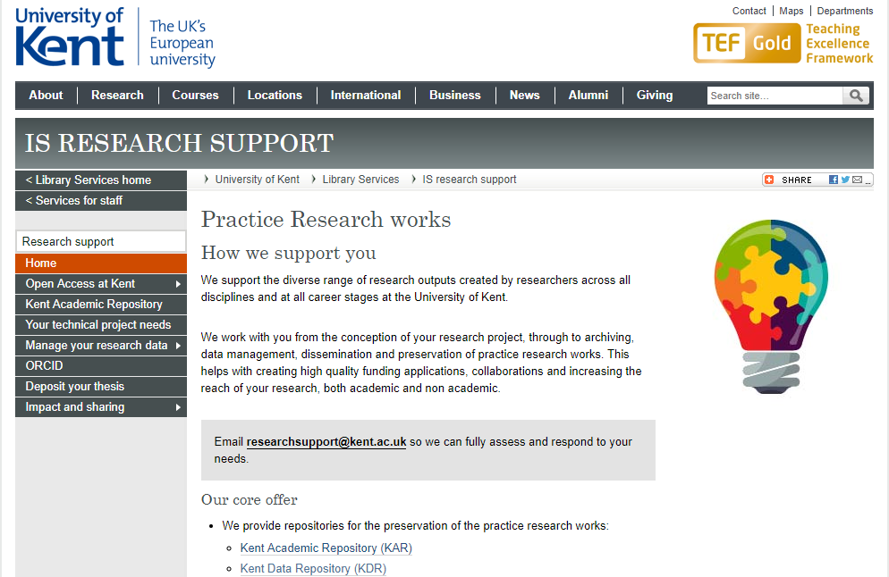
https://www.kent.ac.uk/library/research/practice-research/
@UniKentResSupp
@JosieCaplehorne
@

Slide 12
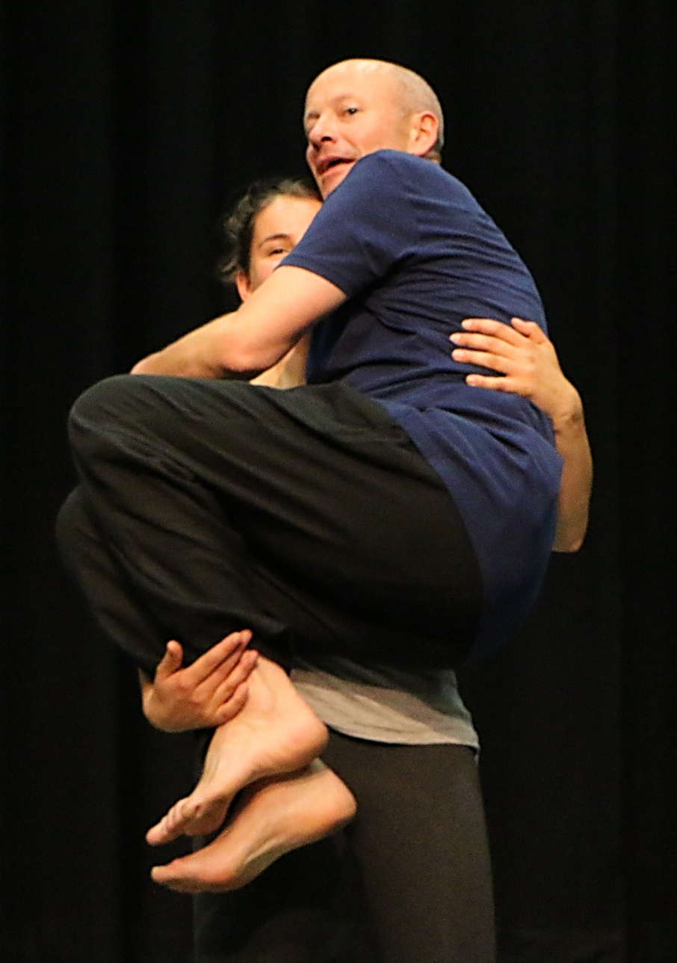
Supporting our Researchers
User focused – future focussed
Inclusive language – Plain English
Inclusive practices and services
Lines are blurred between data and output
…old binaries between inside-outside, and academia and the world, become inter-permeable” (Mani, 2019)
We can contribute
- “Interdisciplinary cross-fertilisation”
– by recording the unrecorded
– by providing an appropriate framework
– by providing a persistent platform
@UniKentResSupp
@JosieCaplehorne
@

Slide 13

What’s next? Beyond A. B. C.
Implement repository changes within project framework:
Reconfigure ‘item types’: Crosswalk with CDWA
Freestanding item type for portfolios
Rename ‘Upload document’
Image based look and feel (Kultur influenced)
Metadata: Dates, status, CRediT framework and creative researcher taxonomies (Kultur influenced)
Digital Object Identifiers (DOIs)
Digitization service including 3D
Include PbR sensitivity in research and repository policies
Include accessibility and inclusivity in procurement
Open accessibility
Research led teaching vertical project
Non-publication options in academic promotion reports
How are we doing? Sense check with academics
@UniKentResSupp
@JosieCaplehorne
@

Slide 14
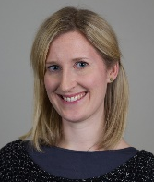
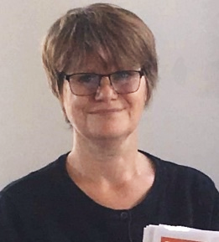
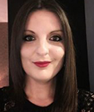
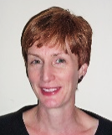
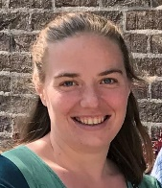

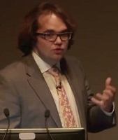
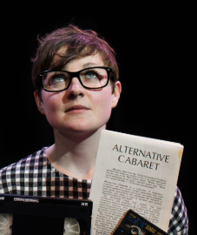
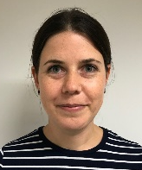
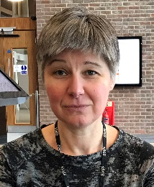
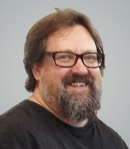
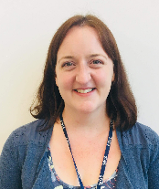
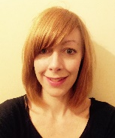
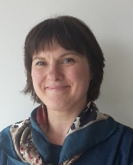

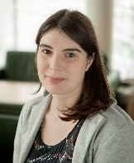
Contact us
Helen Cooper
Research Support Librarian
@UniKentResSupp
Josie Caplehorne
Scholarly Communications Coordinator
@JosieCaplehorne
Email us:
researchsupport@kent.ac.uk
Katie
Arts
Librarian
Helen
Research Librarian
Josie
Scholarly
Comms.
Rosalyn
Faculty Librarian
Sarah
Scholarly
Comms.
Johnathan
Curation Manager
Elspeth
Digital Archivist
Clair
Digital Curation
Angela
UX & Digital Content
Andy
Social Sciences Librarian
Theresa
Faculty Librarian
Emma
Humanities Librarian
Sarah
Sciences Librarian
Karen
Faculty Librarian
Abigail
Social Sciences Librarian
@

Slide 15


