Slide 1

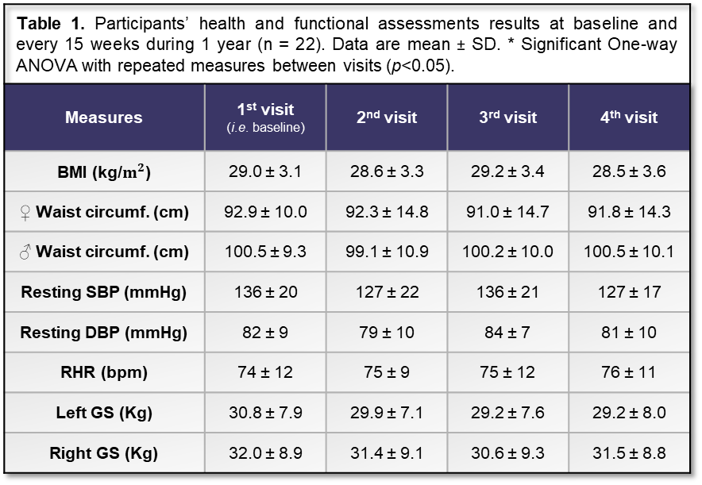
Can exercise preserve motor and non-motor function in Parkinson’s?
School of Sport & Exercise Sciences, University of Kent
Arthur Waters, Steve Meadows, Glen Davison, Anna Ferrusola-Pastrana, Chris Fullerton
A.Ferrusola-Pastrana@kent.ac.uk
Introduction
Parkinson’s is a chronic neurodegenerative disease, which usually leads to disability and disengagement with active lifestyles. There is good evidence that exercise is effective at improving and sustaining cognitive and physical function in people with Parkinson’s (PwP) (Campos et al., 2016; Crizzle & Newhouse, 2006). Few studies have assessed long-term effects of exercise and it remains unclear the optimal dose for PwP. In October 2016, a collaboration with Parkinson’s Equip and Medway Working Age Group (MWAG), a University of Kent Research Team started a community-based exercise programme for PwP. Using data collected over one-year, we evaluate the effects of multi-modal exercise on physical function, cognition, and wellbeing outcomes in PwP. In addition to the mostly studied single type exercises, a combined exercise session also involves cognitive aspects and may be more beneficial (Vaughan et al., 2014). We are also planning a process evaluation of the venture to examine its feasibility.
Table 1. Participants’ health and functional assessments results at baseline and every 15 weeks during 1 year (n = 22). Data are mean ± SD. * Significant One-way ANOVA with repeated measures between visits (p<0.05).
Measures | 1st visit (i.e. baseline) | 2nd visit | 3rd visit | 4th visit
BMI (kg/$m^{2}$) | 29.0 ± 3.1 | 28.6 ± 3.3 | 29.2 ± 3.4 | 28.5 ± 3.6
♀ Waist circumf. (cm) | 92.9 ± 10.0 | 92.3 ± 14.8 | 91.0 ± 14.7 | 91.8 ± 14.3
♂ Waist circumf. (cm) | 100.5 ± 9.3 | 99.1 ± 10.9 | 100.2 ± 10.0 | 100.5 ± 10.1
Resting SBP (mmHg) | 136 ± 20 | 127 ± 22 | 136 ± 21 | 127 ± 17
Resting DBP (mmHg) | 82 ± 9 | 79 ± 10 | 84 ± 7 | 81 ± 10
RHR (bpm) | 74 ± 12 | 75 ± 9 | 75 ± 12 | 76 ± 11
Left GS (Kg) | 30.8 ± 7.9 | 29.9 ± 7.1 | 29.2 ± 7.6 | 29.2 ± 8.0
Right GS (Kg) | 32.0 ± 8.9 | 31.4 ± 9.1 | 30.6 ± 9.3 | 31.5 ± 8.8
Methods
22 participants (18 male, 4 female; age 65 ± 8 years; all had Hohen and Yahr scores of between I and III, indicating mild to moderate PD) attended a once-a-week multi-modal group exercise session (1h) that consisted of a cardiovascular warm-up, a main circuit-based session consisting of various multi-directional mobility movements and a cool down. With emphasis on both cognitive and physical demands, this session intended to improve muscular strength and endurance. Mean attendance was 75.1 ± 20.2 %.
At the start (i.e. baseline) and every 15 weeks for one year participants completed the following health, functional (related to the ability to perform activities of daily living) and cognitive assessments: body mass index (BMI), waist circumference, resting systolic (SBP) and diastolic (DBP) blood pressure, resting heart rate (RHR), six-minute walking test (6MWT) distance, timed up and go (TUG), 1-minute sit-to-stands (STS), bilateral grip strength (GS), Clock Drawing Test (CDT), Mini-Mental Parkinson’s (MMP), the Trail Making Test A (TMT-A) and B (TMT-B); plus quality of life with the brief Older People’s Quality of Life Questionnaire (OPQOL-Brief). As part of an ongoing process evaluation, focus group interviews were conducted with 7 PwP and 4 spouses.
Table 2. Participants’ cognitive assessments results (n = 16). Data are mean ± SD. * Significant One-way ANOVA with repeated measures between visits (p<0.05).
Measures | 1st visit (i.e. baseline) | 2nd visit | 3rd visit | 4th visit
CDT (max. score of 4) | 3.9 ± 0.3 | 3.9 ± 0.3 | 3.6 ± 1.0 | 3.8 ± 0.4
TMT-A (seconds) | 46.63 ± 14.75 | 38.19 ± 10.47 | 44.63 ± 25.44 | 43.56 ± 20.00
TMT-B (seconds) | 115.06 ± 44.06 | 106.63 ± 87.19 | 96.81 ± 55.49 | 122.19 ± 68.95
OPQoL-Brief (max. score of 65) | 54.6 ± 7.7 | 54.1± 7.7 | 54.3 ± 6.8 | 54.3 ± 8.6
MMP (max. score of 32) | 26.0 ± 3.4 | 29.3 ± 1.9 | 29.1 ± 2.2 * | 29.4 ± 2.5 *
Results
Scores for 6MWT, TUG, bilateral GS, CDT, TMT-A, TMT-B and OPQOL-Brief did not significantly change across assessments. STS increased during one year, specifically between baseline and the first 15 weeks (P = 0.012). MMP increased between baseline and the last two assessments (P = 0.002). Themes identified from the focus group were: belief that exercise is beneficial, support for exercise as therapy among health care professionals, and opportunity to make friends.
*
Figure 1. Functional capacity measurements; 6MWT (distance), 1-STS (sit-to-stand repetitions in 1 minute) and TUG (time to stand, walk 3m, walk back and sit down). Data are mean ± SD. * Significant One-way ANOVA with repeated measures between visits (p<0.05).
Discussion and conclusion
A once-a-week multi-modal group exercise programme for PwP showed an improvement in STS and MMP scores (notably, MMP scores significantly increased from 26.0 to 29.4). No other significant changes (i.e. no decline) were observed in health and physical function over one year. That functional and cognitive performance were increased or maintained is a positive outcome given the progressive nature of PD. Outcomes from qualitative data capture the psychosocial factors that support engagement with the programme, how exercise helps PwP and evidence about ‘real-world’ feasibility. This project is ongoing (now running for 2–years), which is a testament to its sustainability as a collaboration between a support group for PwP and a higher education institute. Moreover, we are currently measuring the levels of neurotrophic factors (e.g. BDNF); biological substances produced within the brain and also in skeletal muscle during exercise, important for brain neuroplasticity, survival and neuronal growth. This will allow us to study the underlying biological mechanisms of the observed beneficial effects of exercise.
References
Campos, C., et al., (2016). Expert review of neurotherapeutics, 16, 723-734.
Crizzle, A. M., & Newhouse, I. J. (2006). Clinical Journal of Sport Medicine, 16, 422-425.
Vaughan, S., Wallis, M., Polit, D., Steele, M., Shum, D., & Morris, N. (2014). Age and ageing, 43, 623-629.

