Slide 1
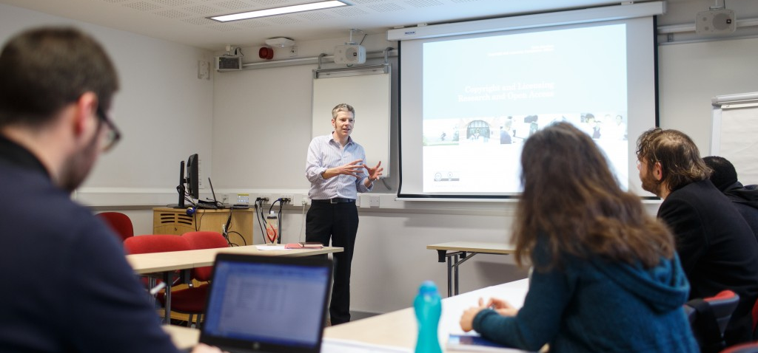
Inserting a picture on the title page
A selection of images is available at
www.flickr.com/photos/universityofkentidentity/albums
Choose an image that reflects the content of your presentation.
Click on the download arrow in the bottom right corner, select ‘Original’ from the menu, the image will download to your computer.
Click on the picture icon in the centre of the slide, locate and insert the image you just downloaded from Flickr.
To change the footer on every slide
On the menu go to Insert > Header and Footer…
Select the Footer checkbox and enter the footer text in the accompanying text box
Click “Apply to All”
COPYRIGHT AND LICENSING/ WHY IT IS IMPORTANT
Chris Morrison, Copyright, Licensing and Policy Manager, University of Kent

Slide 2

What is copyright?
A type of “Intellectual Property”
covering creative works
Others include:
Moral rights
Performance rights
Database rights
Design rights
Trade Marks
Patents
Trade secrets (confidentiality)
Image: Alan Cleaver www.flickr.com/photos/alancleaver/4105747756/

Slide 3
Copyright and research
Intellectual property rights in other people’s work you use in your research
Your intellectual property rights and choices when communicating your own research
Notes:
We are going to use this concept for the structure of the workshop. Chris and Roz are sharing the session and will dip in and out for different sections

Slide 4




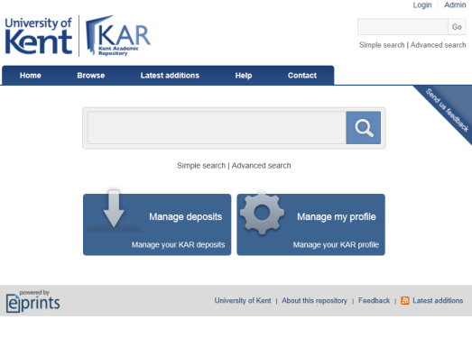

Research and Intellectual Property Rights
Rights In
Rights Out
Data

Slide 5


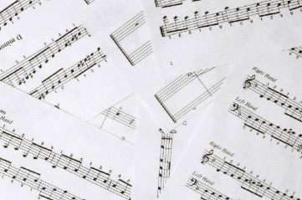


Copyright and Related Rights

Slide 6
So when can you use copyright material?
If copyright has expired
If you, or your organisation hold the rights
If you have permission from the rights holder
If you are relying on a legal defence

Slide 7
So when can you use copyright material?
If copyright has expired
If you, or your organisation hold the rights
If you have permission from the rights holder
If you are relying on a legal defence

Slide 8


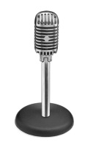
Copyright Duration
Many different durations but the most relevant are:
Published literary, artistic, musical or dramatic works – 70 years following death of the author
Typographical copyright – 25 years from publication
Unpublished literary, artistic, musical or dramatic works – either 70 years following death of the author or until 31 December 2039 (whichever is later)
Crown copyright (UK Government) – usually 50 years after creation or publication
Sound recordings/film –70 years after date of creation/release or death of director/writer/producer

Slide 9
So when can you use copyright material?
If copyright has expired
If you, or your organisation hold the rights
If you have permission from the rights holder
If you are relying on a legal defence

Slide 10

Who owns the rights?
Institution
Staff/Student
Work produced by staff ‘in the course of employment
  Emails, papers, photographs
  Databases
  Film/sound recordings
  Software, etc.
Teaching material
Work not related to role
‘Scholarly’ works
  Lecture notes
  Books, articles
  Theses, essays
  Exam papers/responses

Slide 11
So when can you use copyright material?
If copyright has expired
If you, or your organisation hold the rights
If you have permission from the rights holder
If you are relying on a legal defence

Slide 12
Copyright as Property
Has an “owner”
May be “bought”, “sold” or “rented”

Slide 13




Creative Commons and Open Licensing
Icon | Right | Description
 | Attribution (BY) | Licensees may copy, distribute, display and perform the work and make derivative works based on it only if they give the author or licensor the credits in the manner specified by these.
 | Share-alike (SA) | Licensees may distribute derivative works only under a license identical to the license that governs the original work. (See also copyleft.)
 | Non-commercial (NC) | Licensees may copy, distribute, display, and perform the work and make derivative works based on it only for noncommercial purposes.
 | No Derivative Works (ND) | Licensees may copy, distribute, display and perform only verbatim copies of the work, not derivative works based on it.
http://creativecommons.org

Slide 14
Creative Commons and Open Licensing
Icon | Description | Acronym
 | Attribution alone | BY
 | Attribution + NoDerivatives | BY-ND
 | Attribution + ShareAlike | BY-SA
 | Attribution + Noncommercial | BY-NC
 | Attribution + Noncommercial + NoDerivatives | BY-NC-ND
 | Attribution + Noncommercial + ShareAlike | BY-NC-SA
http://creativecommons.org
http://en.wikipedia.org/wiki/Creative_Commons_license

Slide 15
So when can you use copyright material?
If copyright has expired
If you, or your organisation hold the rights
If you have permission from the rights holder
If you are relying on a legal defence

Slide 16


Fair dealing
Determines whether usage is lawful or infringing based on how a ‘fair minded and honest person’ would deal with the work.
Does using the work affect the market for the original work? Does it affect or substitute the normal exploitation of the work.
Is the amount of the work taken reasonable and appropriate? Was it necessary to use the amount?

Slide 17




Key Research Exceptions to Copyright
S29 – Research or private study
S29a – Text and data mining
S30 - Quotation (criticism and review)
S32 – Illustration for instruction

Slide 18


Summary of the theory
Copyright – covers all ‘fixed’, original creative works
Related rights – moral, performers, database
Some instances where you can do some things
Restrictions on what you can do without permission
All of which has become really important in a digital context

Slide 19
Thesis submission
Do you need to redact parts of your thesis?
Do you want to apply an embargo (restrict access for a period of time)
Do you want to apply a Creative Commons licence?

Slide 20
Notes:
This

