Slide 1
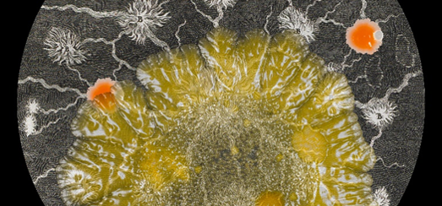
Research Data Management
Helen Cooper
IS Research Support
Sarah Slowe
Helen Cooper
June 2018
https://blogs.kent.ac.uk/templeman-exhibitions/tag/sarah-craske/

Slide 2
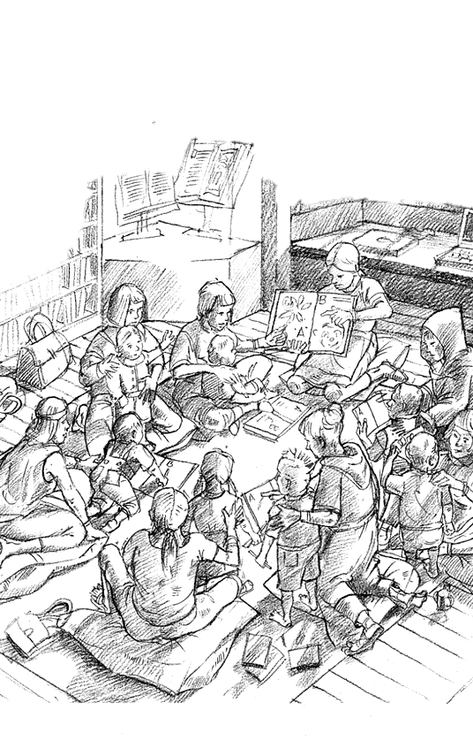
What are data?
Any information that has been collected, observed, generated or created to validate original research findings. Although usually digital, research data also includes non-digital formats such as laboratory notebooks and diaries.
Interviews – recordings and transcripts
Questionnaires and responses
Materials created in workshops
Observations - notes and logs
Correspondence – letters and emails
Statistics -

Slide 3

What are Research Data management plans?
Type of data created or used in your research
Any issues related to ethics or GDPR and how you are addressing them
Any resourcing questions
How you will care for your data before and after the project ends
How you will ensure your data can be shared

Slide 4
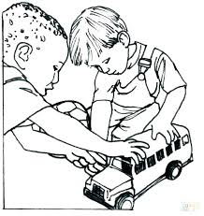
Why do we need them?
Plan for resources
Plan for ethical and legal issues
Plan for preservation
Plan for sharing
Aide memoire
Demonstrate competence
http://nextbook.co/editor/?

Slide 5

Who are they for?
Your Funder
Your university
Your colleagues and collaborators
Your publisher and your readers
You …
R
D
M
P

Slide 6
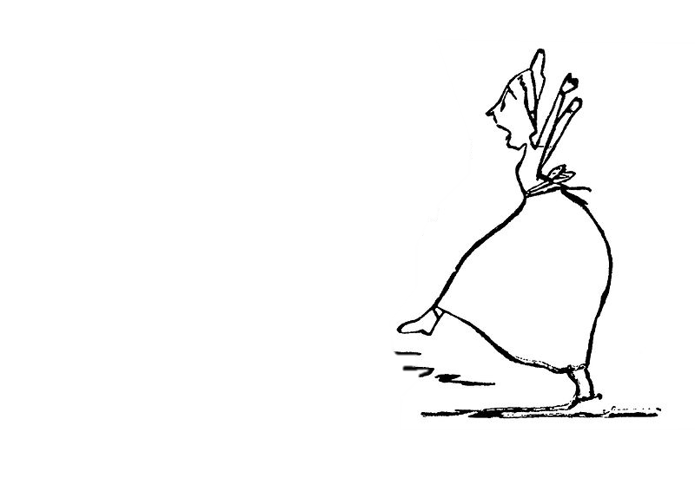
When should I write them?
Now!
…and now ….and now …and now

Slide 7
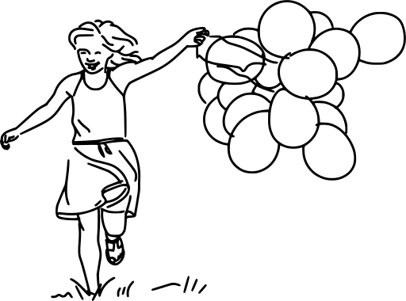

How do I know what to write?
Funder templates and guidance
Publisher guidance
Institutional support
https://dmponline.dcc.ac.uk/
https://www.ukdataservice.ac.uk/

Slide 8
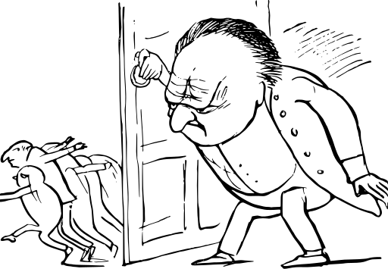
Is it F.A.I.R.?
“As open as possible as restricted as necessary”

Slide 9
FAIR
F – findable – have formatted information (metadata and DOI)
A – accessible - archived in a stable data repository
I – interoperable – are in standard/open file formats
R – reusable – are ethical and legal

Slide 10
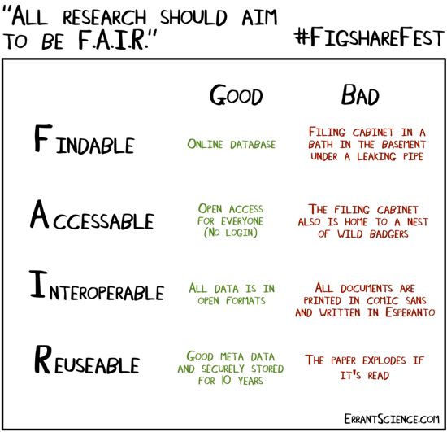
Its not FAIR!

Slide 11
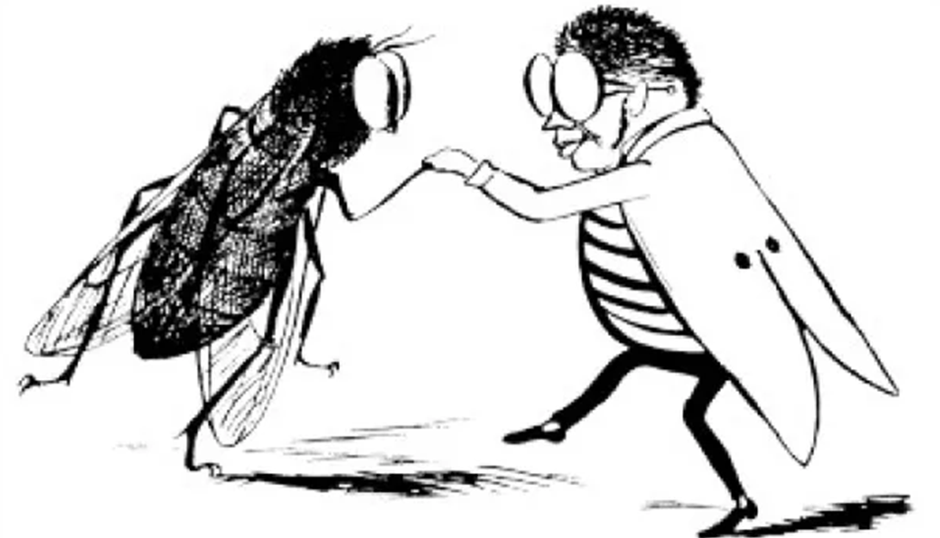
Can I find other peoples data that I can use?
http://reshare.ukdataservice.ac.uk/
https://zenodo.org/
https://www.re3data.org/

Slide 12
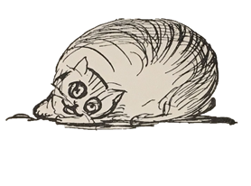
https://www.kent.ac.uk/library/research/data-management/
https://blogs.kent.ac.uk/isnews/category/library-news/research-support/
@UniKentResSupp
All images in this presentation are CC0 – thanks go to to Mr E Lear and friends
Notes:
This

