Slide 1

RESEARCH IMPACT/AN OVERVIEW
Maddy Bell
Impact & Engagement Officer

Slide 2

What do we mean by ‘impact’?
What others do as a result of research
Influence
Change
Measured in terms of:
Reach
Significance
UKRI:
‘the demonstrable contribution that excellent research makes to society and the economy’
Local, regional, national, international

Slide 3
Reach & Significance
Reach: the extent and/or diversity of the beneficiaries of the impact, as relevant to the nature of the impact.
Significance: the degree to which the impact has enabled, enriched, influenced, informed or changed the performance, policies, practices, products, services, understanding, awareness or well-being of the beneficiaries.

Slide 4
Examples: impacts on…
Health, wellbeing and animal welfare
Creativity, culture and society
Social welfare
Commerce and the economy
Public policy, law and services
Production
Practitioners and professional services
The environment
Understanding, learning and participation
p94 REF Draft Panel Criteria & working methods: http://www.ref.ac.uk/media/ref,2021/downloads/Consultation%20on%20the%20draft%20panel%20criteria%20and%20working%20methods%20REF%202018_02.pdf

Slide 5
Why is impact important?
UK:
Demonstrates value of government investment in research
Contributes to culture of engagement
Institutions:
REF & allocation of government funding
Marketing: attracts students and staff
Demonstrates contribution to wider world
Individual
Increases relevance of research to real world problems
Funding applications
Drives research quality through focus on user involvement

Slide 6
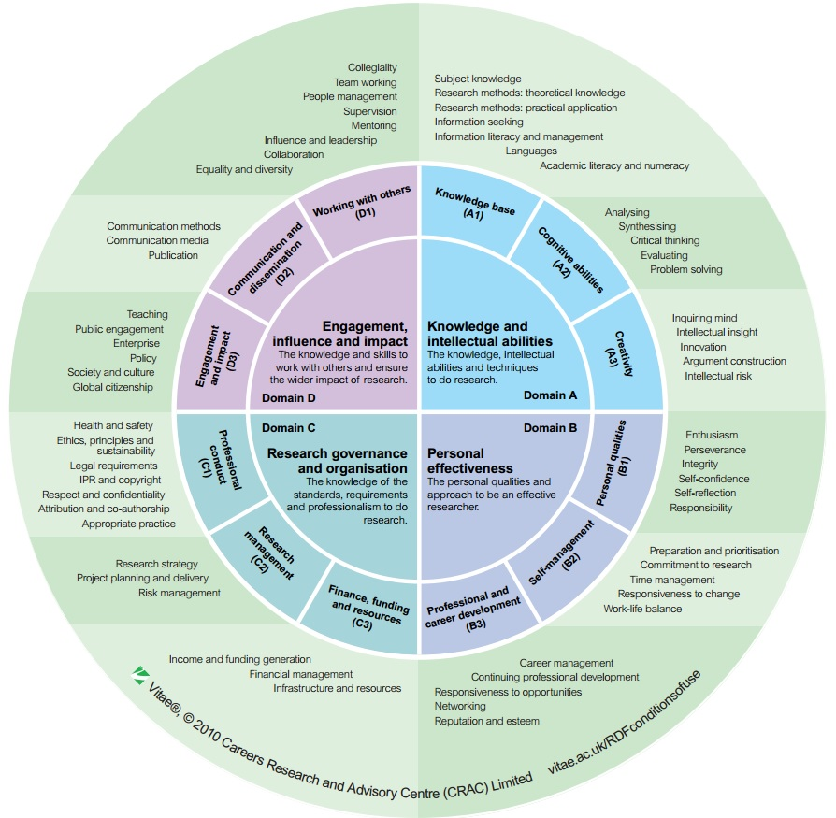
Impact at Kent
Research & Innovation strategy
Researcher Development Framework
Demonstrating value of our work
REF
Notes:
Developed by VITAE, RDF describes the attributes, qualities and knowledges of researchers and underpins the Grad School’s programme of RD training
See how prominent the skills of impact and engagement are

Slide 7
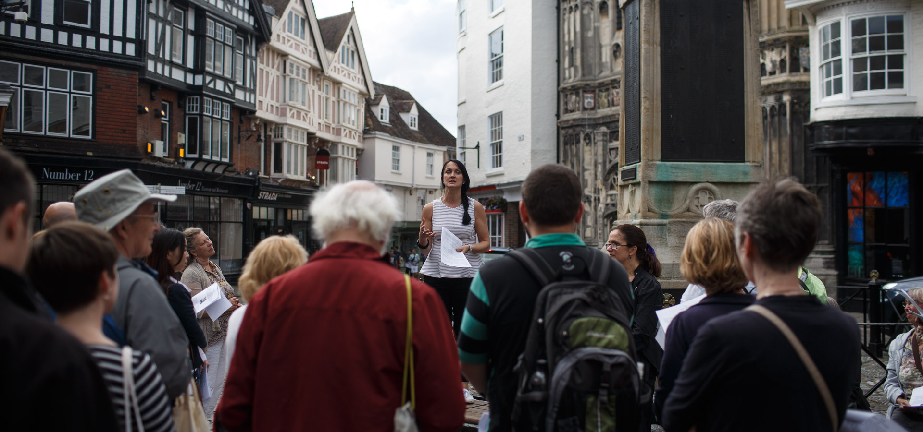
How does public engagement with research link to impact?

Slide 8

How does impact happen?
Pro-activity, planning and strategy
Involving users from start to finish
Focusing on relationships
Aligning research with real world needs
Networks with potential users
Publications strategy
Notes:
Impact doesn’t just ‘happen’

Slide 9

Measuring impact: Evidencing influence
Evidence type dependent on the impact being claimed
Common:
Testimonials
Policy documentation
Independent reports
Media coverage (context)
Notes:
Importance of the context
Evidence that the research/er played I significant role in generating the impact

Slide 10
Pathways to impact should...
be project-specific
be flexible, focus on potential outcomes
identify & proactively engage research users throughout the project
show an understanding of the context and needs of users
plan the activities to engage with stakeholders
include evidence of any existing collaboration with stakeholders

Slide 11
Preparing pathways....
Use the impact summary to design the project
“Pathways” is crucial
Public engagement is two way...

Slide 12
Questions and reflections?

