Slide 1
Working differently for improved primary care for young people in a difficult financial climate
Workshop for the EFPC Conference, September 2018

Slide 2
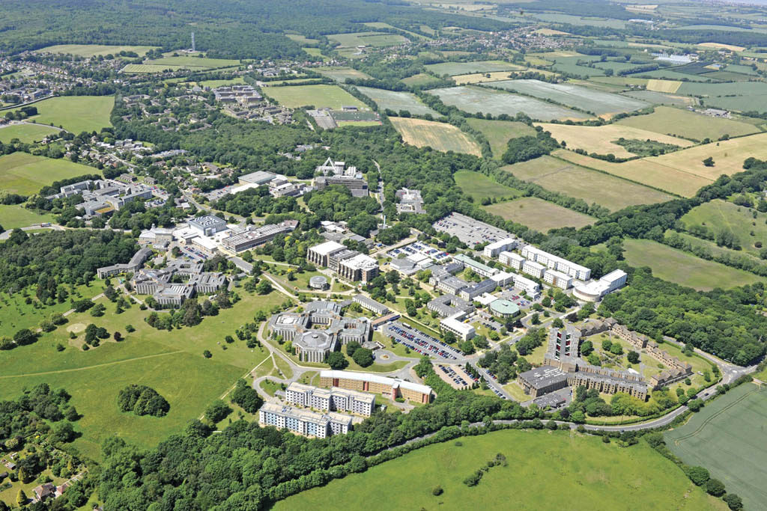
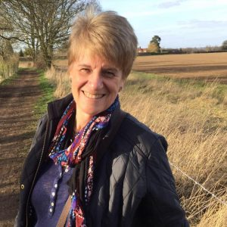
About CHSS https://www.kent.ac.uk/chss/index.html
Primary and community care
Public health
Public policy
Prof. Sally Kendall, MBE
Health psychology
Palliative care
Integrated health and social care
Public engagement
Notes:
CHSS is one of three research centres within the School of Social Policy, Sociology and Social Research at the University of Kent.
We carry out high quality health services research with local, national and international professional partners, with the aim of improving the links between research, policy and practice.
Led by Stephen Peckham, we carry out research in a diverse range of areas including public health, public policy, health psychology, integrated care, palliative care and primary and community care.

Slide 3
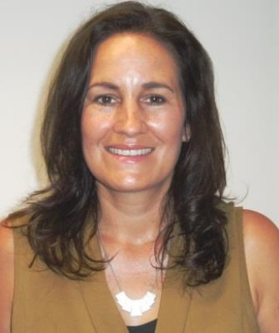
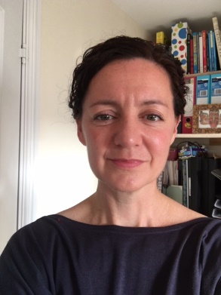
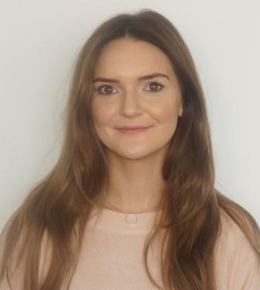
The team here today
Olena Nizalova
Erica Gadsby
Nadine Hendrie
Tamsyn Eida
Rosa Vass
Catherine Marchand

Slide 4
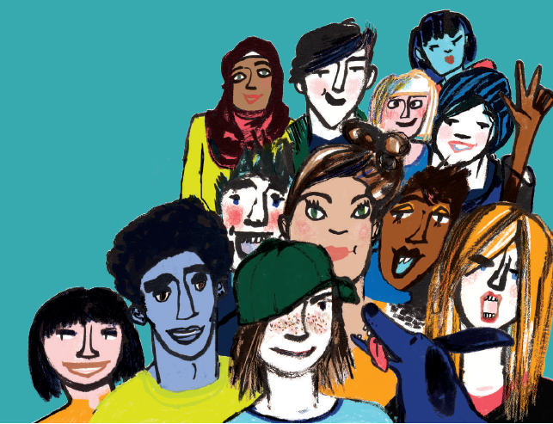
This workshop
Introduction
The nature of the situation
3 different projects – learning and challenges
Ideas about working in different ways
Image from WHO HBSC 2016 study report

Slide 5
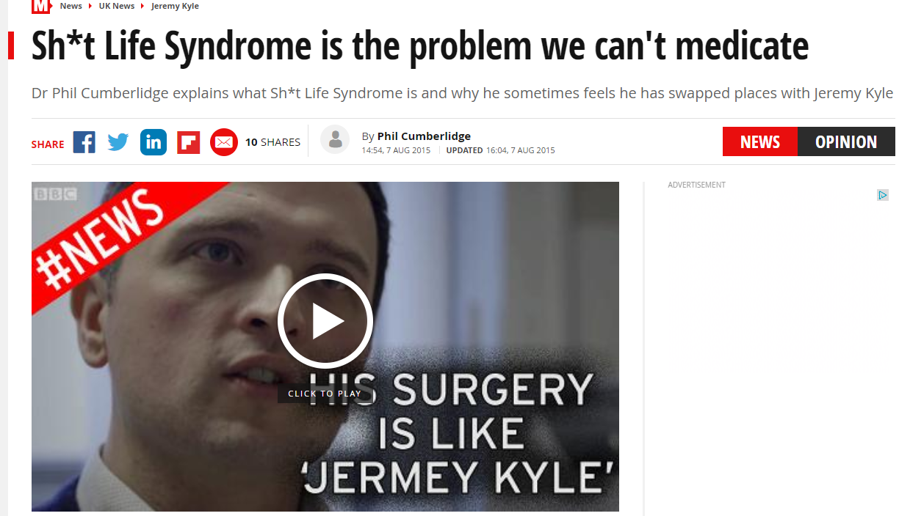
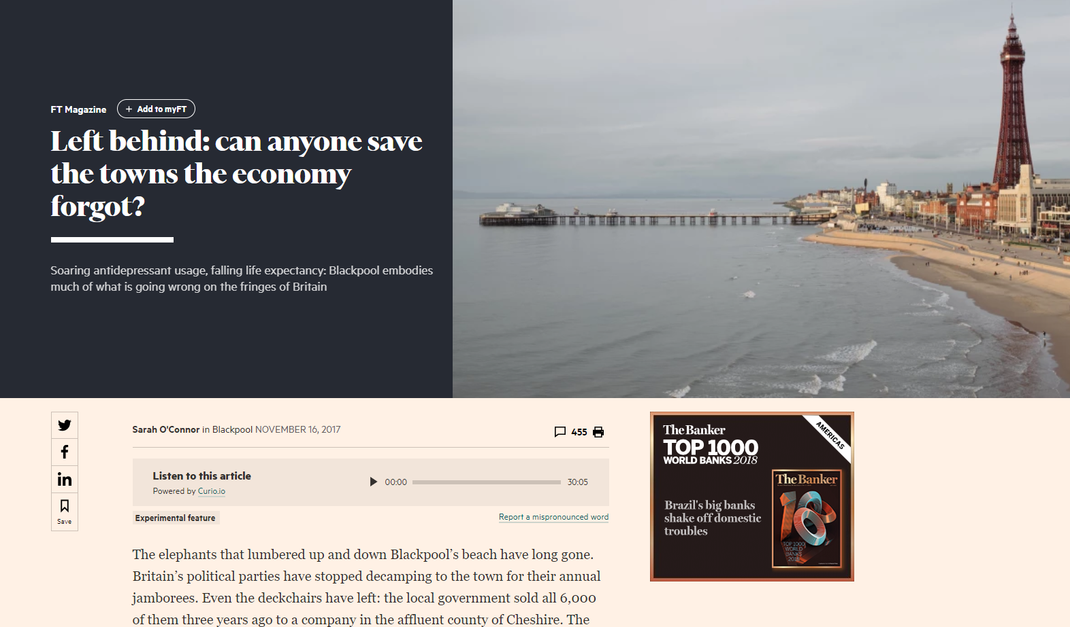
Notes:
Introduce the concept shit life syndrome
GPs are often faced with patients who present with ‘low mood’ caused by adverse life circumstances. Many GPs have dubbed this ‘Shit-Life Syndrome’.

Slide 6
The context
Cuts to social security
Growing relative poverty; rising inequality
Increase in in-work poverty
“Shit-Life Syndrome”
(SLS)
Cuts to education, training, careers services, and YP’s services
High housing and other living costs
Notes:
Lack of earnings growth, lack of pay progression, particularly for those in part-time work.
Much low-skilled work is part-time, paying minimum (not living) wage, with minimal or no job security.
Today’s young adults are significantly less likely to own a home at a given age than those born only 5 or 10 years earlier.

Slide 7
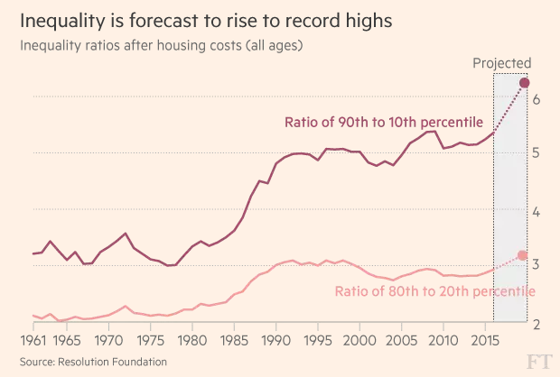
Rising inequality
From: https://www.ft.com/content/fc4a3980-e86f-11e6-967b-c88452263daf, article in FT by Gavin Jackson, 01/02/2017

Slide 8
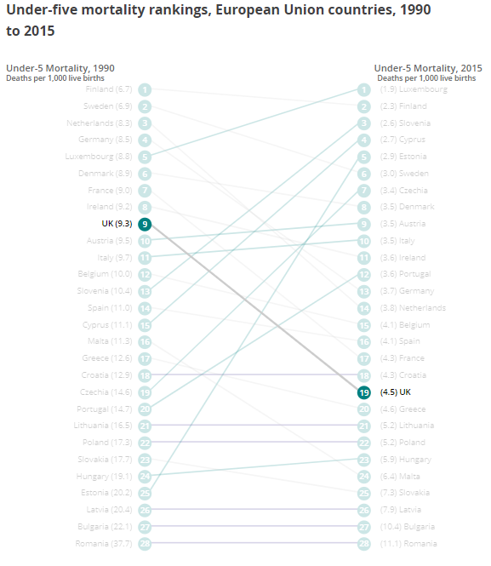
Child mortality
www.euro.who.int/cah 08/2018
Notes:
If we take a look at some of the outcome measures for children and young people. Let’s start with the ultimate indicator – child mortality. The good news is that mortality rates across the European region are going down. But there are stark inequities across the region, varying from a rate of 2 deaths per 1000 live births in the best region to 51 deaths per 1000 in the worst region. And just look at the situation for under 5 mortality in the UK, which has seen a marked fall in the rankings of EU countries from 1990 to 2015, plummeting from 9th place to 19th place in the rankings. Note that the rate has improved in this time, but it has improved much less quickly than in other EU countries.

Slide 9
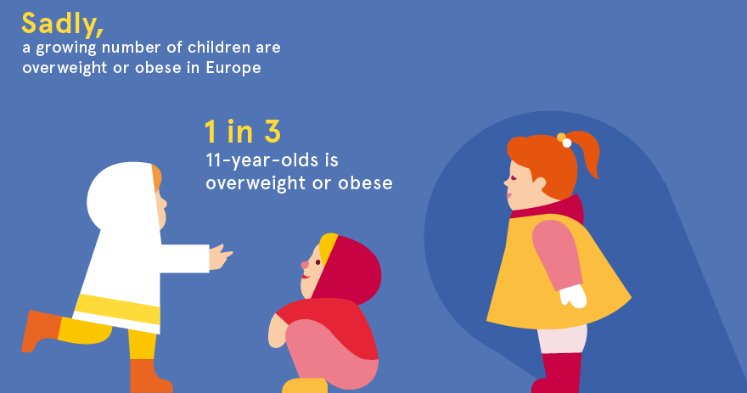
Childhood obesity
EUFIC 2018 Childhood obesity infographic
Notes:
There are lots of potential health indicators we could look at here, but I’m just going to pick out childhood obesity as one that has particular relevance to one of our projects. Obese children are more likely to become obese adults. In the short term, child obesity is linked with problems with bone health, breathing difficulties, and a range of psychological and social issues. In the longer term, we know of course that obesity is linked with cancer, heart disease and type 2 diabetes
Might also include a slide on food insecurity – depending on time/availability of good data.

Slide 10
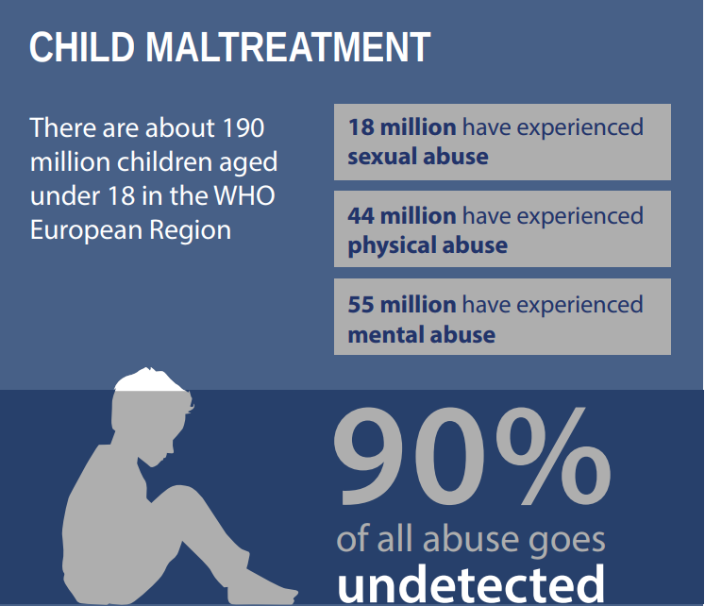
Maltreatment of children
www.euro.who.int/child-maltreatment-report WHO 09/2014
Notes:
Lets look more broadly at children and young people’s wellbeing. Again, there are lots of potential indicators we could look at here, but I’m just going to point out a couple. First, an issue that we might expect to be influenced strongly by societal factors – child maltreatment.

Slide 11
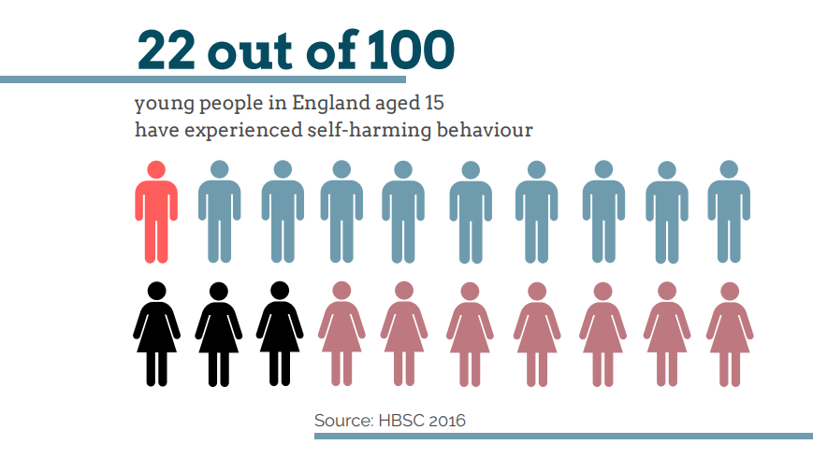
Self-harm in adolescence
11%
32%
Notes:
And an issue that has hit the headlines in the UK recently – self-harm in adolescence. These statistics came from an analysis of the WHO collaborative multi-country study on the health and behaviour of school aged children.
Rates have been increasing over the past decade.
Most of those young people who were self-harming reported engaging in self-harm once a month or more.
This behaviour is more often seen among young people living in one parent households, and is more common in young people from lower family affluence.
Young people receiving free school meals were more likely to report self-harming behaviour.
Young people reporting self-harming behaviour are at risk of developing mental illness in later life. They are at higher risk of engaging in risky behaviours.
The school environment is strongly associated with adolescent health and emotional wellbeing – YP who self-harm were less likely to trust their teachers, feel safe, and feel like they belong in their school.
YP with a positive perception of their neighbourhood were less likely to report having self-harmed.

Slide 12
Discussion – in small groups / pairs
In one sentence, describe ‘the problem’ from the point of view of:
The ‘victim(s)’ (the person or people affected)
The ‘villain(s)’ (the person or people responsible)
The ‘hero(es)’ (the person or people from whom help is sought)
The ‘bystander(s)’ (the person or people who is/are witness to the situation
Notes:
Nadine will take a lead on this discussion – linking it to one of the tools used in RISKIT

Slide 13
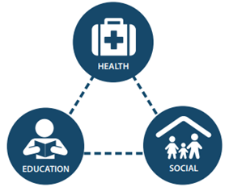
Complexity
All these issues are interconnected in complex and dynamic ways
Yet, it’s too easy to be reductionist in our approach to dealing with the situation
“I can offer you some anti-depressants?’
“How about this weight management class?’
Notes:
That’s just the way it is
I can refer you to so and so
This is all I can do
Not a lot I can do …

Slide 14
Three different CHSS projects:
‘RISKIT-CJS’ – a ‘multi-component’ approach to addressing alcohol and substance use and risk-taking behaviour among young offenders
‘Go Golborne’ – a ‘place-based’ approach to improving child health by reducing child obesity
‘EXCEPT’ – policy initiatives to help young people in Europe to overcome labour market insecurities and related risks

Slide 15
RISKIT-CJS : A pragmatic randomised control trial.
YP
Notes:
Hello,
We are now going to present briefly RISKIT-CJS.
You will see a star with YP written, this is our Young person and you will see them on all the slides varying in size and importance.

Slide 16
RISKIT-CJS in a nutshell
Mixed method two-arm randomized controlled trial to evaluate the effectiveness and cost-effectiveness of the RISKIT-CJS intervention in reducing substance use in young people in criminal justice settings (CJS)
YP
Start date: 01/09/2016
Duration: 36 Months
Funder: NIHR Public Health Research
Funding:
Nearly £1million
Notes:
It is NIHR Public health research started in September 2016 and with a duration of 36 months.
First project of its kind (the population) to receive NIHR funding

Slide 17
The problematic situation: Young Offenders
Average risk score of substance use has risen
45% entered custody with concern about substance use.
66% receive some form of intervention and there is little evidence of their effectiveness
Increased risk of health and social problems making them one of the most vulnerable and often ‘hard to reach’ populations in the UK
Reduced employment chances
Economic Hardship
Drug and alcohol dependence
Poorer physical health
Early pregnancy in females
Higher rates of tobacco use
SLS
YP
Notes:
In a nutshell – what do we know and why is this a concern? (remember this is a primary care conference)
Details on slide – pc concern is health inequalities later in life
What is the specific context for this programme/intervention/project?
Youth Offending linked to an increase in health and social problems making them a vulnerable and hard to reach population.
I have just added the relevant stats nut we need to arrange this with the YP as a star to show how small they are in the system ********
Research has shown that young people who offend are more likely to experience a range of inequalities in later life

Slide 18
The Big wishes
Macro level OR the Big Wish of Funders/collaborative partners:
Delivering substance treatment that works
Evidence based research that informs treatment policy and provide substance treatment interventions that are guided by research
Micro level: the humanitarian wish for the young person
To reduce both their substance use and risk taking behaviour.
Skills to navigate SLS
SLS
Knowledge
Coping strategies
Develop self efficacy

Slide 19
The Strategy: The RISKIT-CJS Intervention Model
Knowledge & education
Step 1
Individual 1 to 1 session using motivational interviewing approaches
Researchers
University of Kent
Cognitive & learning skills
Step 2
Peer group facilitated session focusing on psycho-education and skills development
YP
RISKIT-CJS
Multi-component Intervention
Self-efficacy
Step 3
Peer group facilitated session focusing on social skills development
Practitioners:
Addaction
Motivation
Step 4
Individual 1 to 1 session
Notes:
How did the programme/intervention/project go about improving the situation? Describe it very briefly, but comprehensively, perhaps using the TIDIER framework to ensure you’ve included all relevant information?
RISKIT-CJS is based upon the theoretical underpinning of the social development model and participatory collaboration with young people and a drug treatment provider. It’s based upon a multi component approaches and the intervention has 4 main component X, Y, Z, W.
WHY: SDT MI CBT
WHAT: 1:1 MI Interviewing approach
Group: Peer group facilitated : Psycho education & Social Skills development
WHO: 13 -17 ys CJS substance use – South east North East London
WHERE : YOT’s /PRUS AP
MODIFICATIONS: Adapted to EH/PRU’s due to change in YP’s in the CJS landscape
Too early for rest …..
HOW MUCH:
TAYLORING:
HOW WELL:

Slide 20
Lessons Learnt
YP
Assumption 1.
That Young People in the Criminal Justice System are ‘hard to reach’ populations
Lesson learnt: difficulty accessing them in the system because of the low engagement levels the young person already has with the system.
Assumption 2.
That the Criminal Justice System would facilitate RISKIT-CJS
Lesson learnt: the Criminal Justice System is fragmented and chaotic.
Assumption 3.
Early Help = Low Risk offending behaviour!
Lesson learnt: Young People in Early Help are not always low risk , but more likely moderate to high risk of offending, which included serious crimes.
Our pragmatic solution is to access the young people in alternative settings (i.e. Education)
Researchers see the young people in a more holistic way, acknowledging their vulnerabilities and responding with compassion.
Notes:
What were the key lessons learned in the implementation of this approach?
Solutions not problems !!!
Assumption 3 …explain the knowledge of YOT referrals are high risk and often we knew the offense . EH we do not always have prior knowledge of criminality …..therefore we see the YP before knowing the risk level … the RH process has provided us the opportunity to see the YP before the criminal thus a ‘lens to view the vulnerability of the YP ‘
This solution provided us an opportunity to see the YP in a more holistic way, aside from their criminal behaviour which allowed us to see the wider vulnerabilities and appreciate their SLS.

Slide 21
Key Challenges: Implementation of the Intervention
Locate YP
Chaotic Environment: YP & CJS
Engagement of YP
Engagement of CJS
Wider collaboration
Delivery
YP
Notes:
Environment
Delivering the intervention
Locate the targeted population
Engage the young person with the intervention
From M1 to M2, passing by group 1 and 2
Environment: Fragmented and chaotic system, overworked, low staff engagement
Target population: multiple vulnerabilities, chaotic lives, potential impact on ability to engage with interventions

Slide 22
Go Golborne
A place-based approach to halt and reverse childhood obesity

Slide 23
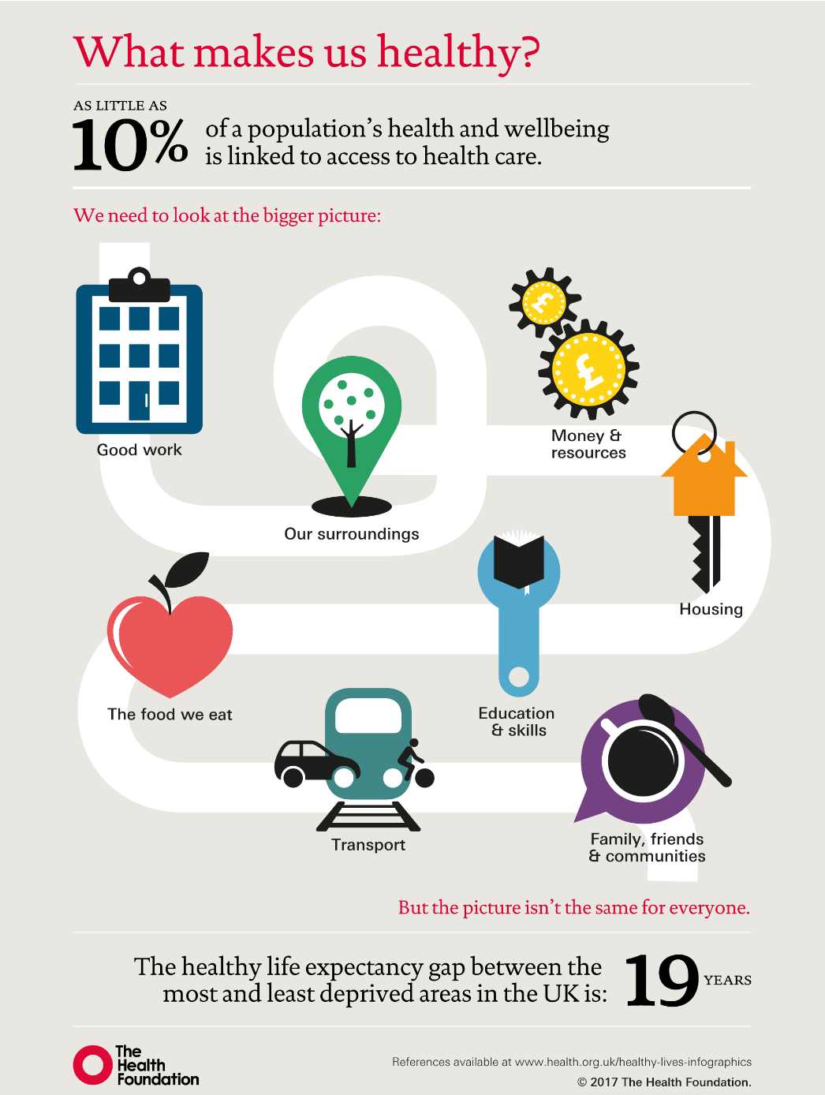
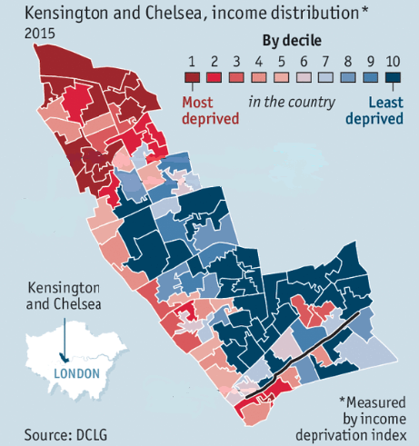
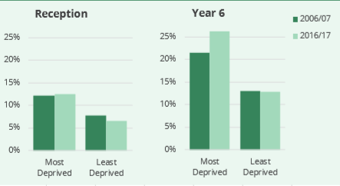
The problematic situation:
Childhood obesity prevalence more than doubles…
over the primary school years
in the most compared to least deprived areas
(NHS Digital: 2016-2017)

Slide 24
The big wish
The Bi-Borough Public Health team wanted to:
halt and reverse childhood obesity trends in a complex, deprived and diverse area
localise national campaigns to suit the people and place
create healthier local environments
deliver services to support healthy lifestyles

Slide 25
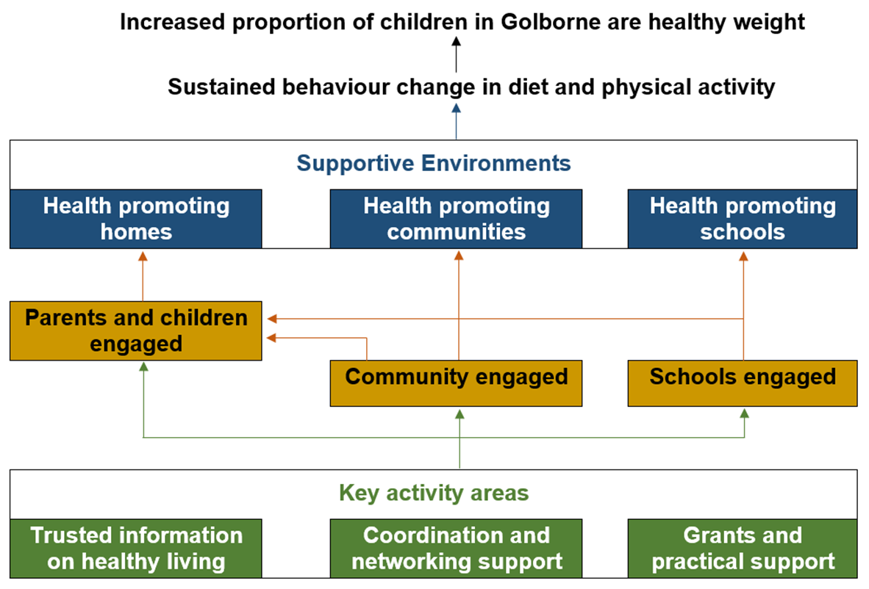
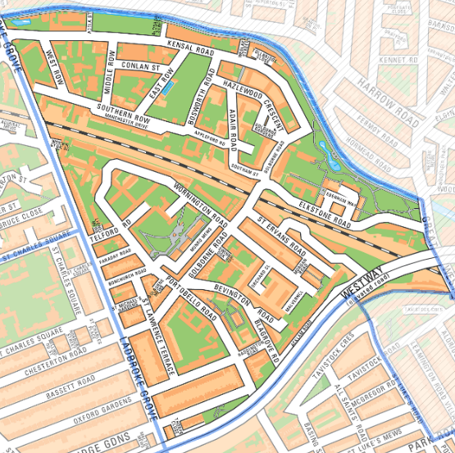
The strategy
2015-2018 pilot: strong engagement through a multi-stakeholder network
intensive tailoring
5 consecutive campaigns developed using social marketing principles: multiple levels
aim: supportive environments foster and support behaviour change

Slide 26
Lessons learned
Assumption 1: The programme will generate evidence and learning on key influencing factors
pragmatic programme design – with an engaged network – enables rich innovation, creativity and trust to try out ideas
complexity requires multiple contributions; each action generates learning
Assumption 2: Engaging statutory partners will be key to programme success
local and high level programme reputation, exploring common outcomes and momentum contribute to engagement
flexible involvement menu enables partners to engage in ways which suit – this needs to be managed

Slide 27
Key challenges
Achieving developments across the ‘whole system’
Generating system change at council level
Addressing the deprivation drivers
Including NHS partners in a systematic way
Notes:
Question:
Primary care practitioners say that they struggle to communicate with parents about their children’s weight and lifestyle factors – and that parents normalise their children’s weight.
How can place-based community projects like Go Golborne systematically contribute to primary care confidence and resources in their healthy weight conversations with families?

Slide 28
This project has received funding from the European Union’s Horizon 2020 research and innovation programme under grant agreement No 649496

Slide 29
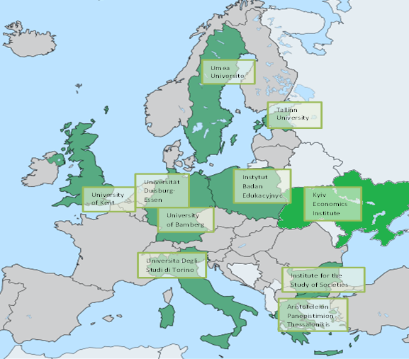
Except: short overview
SOCIAL EXCLUSION OF YOUTH IN EUROPE: Cumulative Disadvantage, Coping Strategies, Effective Policies and Transfer (EXCEPT)
Focus on the effect of youth unemployment on health, wellbeing, autonomy and poverty
Multi-method approach:
Policy expert interviews and policy evaluation analyses;
Multi-level models using EU comparative micro-data;
Qualitative in-depth semi-structured interviews in selected countries;
Longitudinal analyses of national panel data

Slide 30
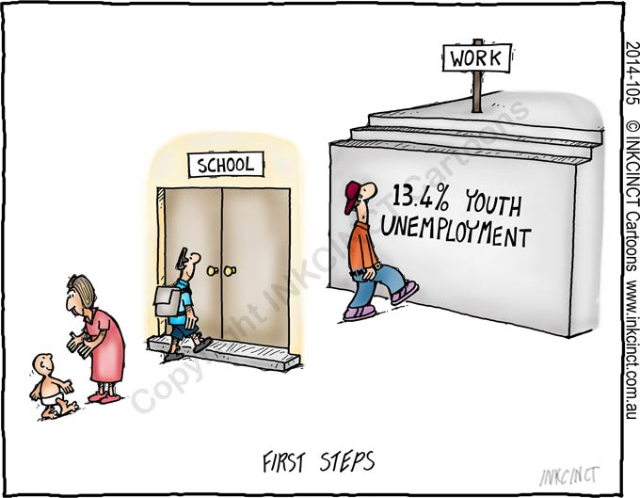
The problematic situation
Youth Unemployment – Corrosive Legacy of the Great Recession:
Youth disproportionately affected (Bell & Blanchflower 2011)
Increased risk of becoming ‘‘lost generation‘‘ (Scarpettaet al. 2010)
Vulnerability of young people to negative effects of unemployment (Bell & Blanchflower 2011, Strandh et al. 2014):
Early career represents a sensitive period in life course
Young people lack experience and resources to cope with and overcome unemployment.

Slide 31
Contribution of EXCEPT project - Findings
Having a job really matters for the health and wellbeing of young people in Europe, irrespective whether the job is permanent or temporary.
Unemployment strongly deteriorates wellbeing and to a lesser extent health.
Unemployment has a negative spillover effect on partners.
There are long-term scarring effects of unemployment with respect to wellbeing and health.
(Ukraine): negative effect on health for men can be attributed to increased tobacco and alcohol consumption.
(Ukraine): past unemployment explains 8% of the “transition happiness gap”.

Slide 32
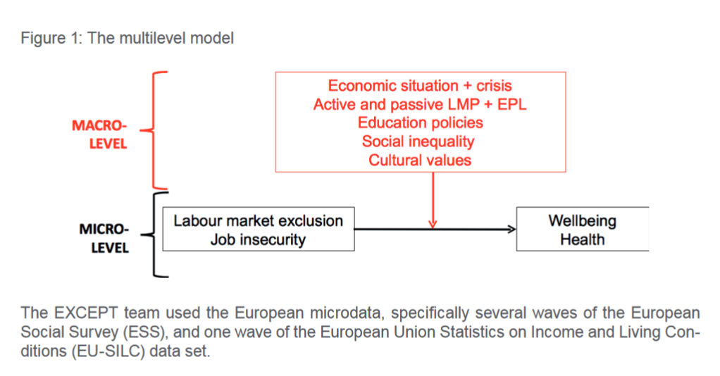
The strategy
Policy recommendations from the project are focusing on:
changes to the secondary and higher education sector to improve employability
better targeting and improvements in the employment services to shorten the duration of unemployment

Slide 33
Lessons learned / key challenges
The long-lasting health implications of youth unemployment are not well recognised
More research is needed on which characteristics of healthcare systems are more effective at mitigating the long-run effects of youth unemployment on health and wellbeing.
Given the interconnectedness between unemployment and health, a key challenge is to look outside the labour market and engage other partners (including health) in this problematic situation
To recognise (and take action to mitigate) the potential long-lasting health implications of periods of youth unemployment.

Slide 34
Bringing it all together – our challenge
To perceive this as a problem for us, in primary care
To reimagine ourselves as ‘heroes’ rather than bystanders
To challenge our perception of our power to act (or of our skill to influence)

Slide 35
Questions for discussion
Thinking about your consultations with adults, can you identify opportunities when primary care could have intervened earlier to mitigate elements of SLS?
Primary care practitioners say they struggle to communicate with parents about their children’s weight and lifestyle factors. How can place-based community projects like Go Golborne help to address this?
What is the potential for the primary care sector to address long-lasting health effects of youth unemployment?

Slide 36
Thank you!
www.kent.ac.uk/chss
@CHSS_Kent
www.kent.ac.uk/chss

